Slide 1

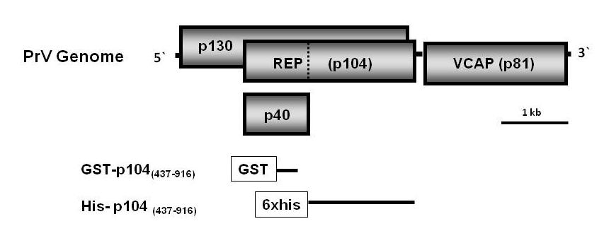
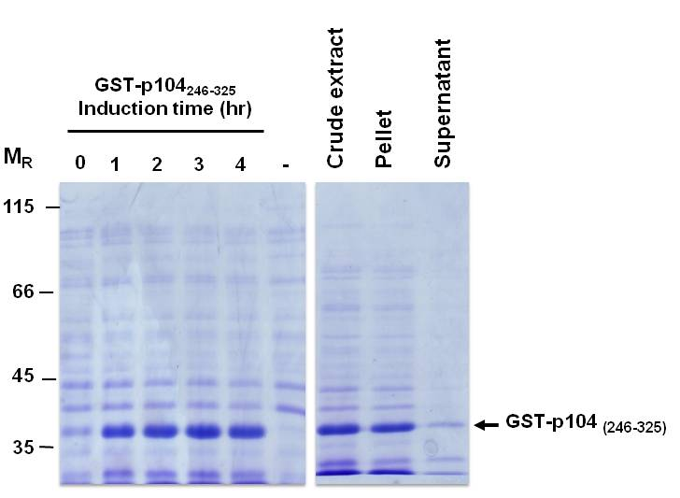
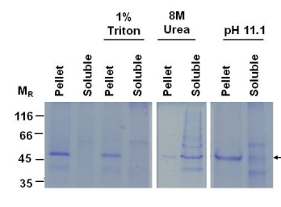
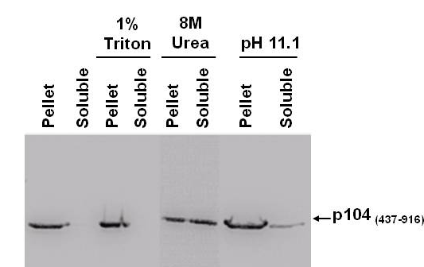
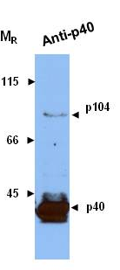
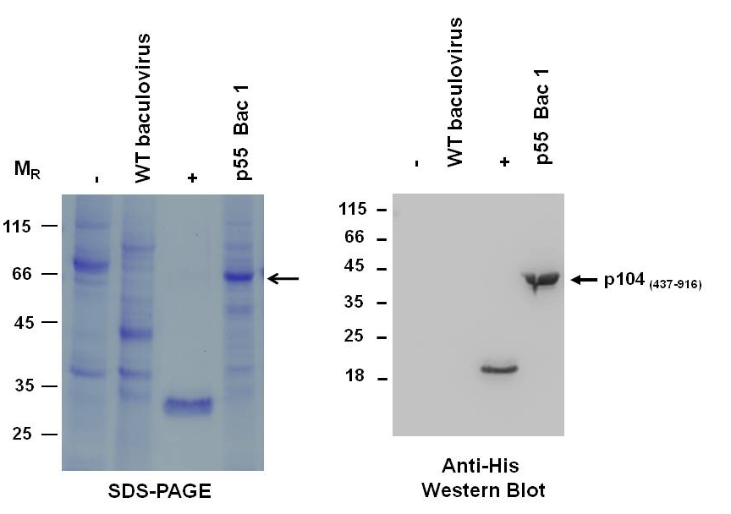
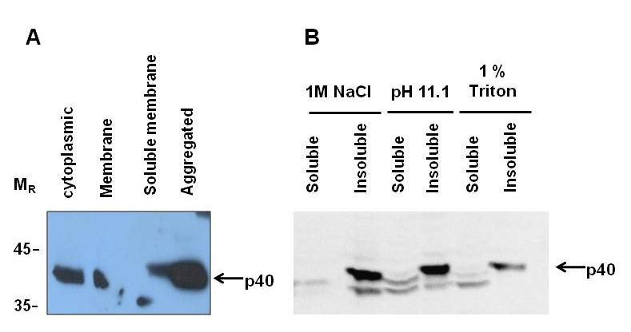
Subcellular localisation of Providence virus replication proteins in insect cell lines
Ritah Nakayinga, James Short, Cheryl Walterª, Rosemary A. Dorrington
Dept of Biochemistry, Microbiology and Biotechnology, Rhodes University, Grahamstown, 6140, South Africa
ª Institute for Molecular and Cellular Biology, University of Leeds, LS2 9JT, United Kingdom
INTRODUCTION
Providence Virus (PrV) belongs to the Tetraviridae, a family of small insect RNA viruses that exclusively infect insect species within the order Lepidoptera, many of which are important agricultural pests. The tetraviruses have a non-enveloped capsid with T = 4 icosahedral symmetry encapsidating a positive sense, single stranded RNA genome that is either monopartite or bipartite. PrV, which was isolated as a persistent infection in a Helicoverpa zea midgut cell line, is unique in that it is the only tetravirus able to replicate in tissue culture. PrV is thus a good model for studying tetravirus replication. Our focus has been on elucidating the function of non-structural proteins and characterizing host-viral protein interactions that occur during tetravirus replication. PrV encodes two non-structural proteins, the viral replicase (p104) and p130, a protein of unknown function (Figure 1). The PrV p104, comprising 91 has a read-through stop codon resulting in over-expression of a shorter translation product (p40) and approximately 10-fold less of the read-through translation product, p104. The C- terminal region of p104 contains signature motifs that are conserved in all viral RNA-dependent RNA polymerases. The aim of this study was to characterise the expression of viral replicase (p104) and localise the site of replication.
Figure 1: Genome organisation of Providence Virus showing the position of the three ORFS: p130, the viral replicase (REP), which is translated into 40 and p104 through the action of a read-through stop codon (indicated by dashed line) and the capsid protein precursor (VCAP). comprises 916 amino acids and encodes a read-through stop codon, the activity of which results in translation of p40 (indicated by the dashed line). T
RESULTS
Production of anti-p104/p40 antibodies
A peptide corresponding to the C-terminal region of p40 (aa 246-325) was expressed in E. coli as a GST fusion (Figure 2,A) purified by native affinity chromatography and used to raise rabbit polyclonal antibodies. These antibodies were able to detect p104 and p40 in PrV-infected cells (Figure 2B)
Solubility of ₄₃₇₋₉₁₆ in expressed in insect cells
A
B
A
B
SDS-PAGE
Western Blot
Figure 3 Solubility of 6xhis-p104 ₄₃₇₋₉₁₆ expressed in S. frugiperda Sf9 cells. (A) SDS-PAGE analysis of crude protein extract treated with either 1% Triton-X100, 8M urea or at pH 11.1. (B) Western blot analysis of protein extracts from S. frugiperda cells expressing 6xhis-p104 ₄₃₇₋₉₁₆ probed with anti-6xhis antibodies.
Figure 2: Production of –anti p104/p40 antibodies. (A) SDS-PAGE analysis of expression of a GST-p104 ₂₄₆₋₃₂₅ fusion in E. coli over 4 hours and solubility of recombinant protein. (B) Western blot analysis of PrV-infected H.zea MG8 tissue culture cells using anti- GST-p104 ₂₄₆₋₃₂₅ antibodies.
Subcellular fractionation and solubilisation of p40 in PrV-infected cells.
Baculoviral expression of p104 ₄₃₇₋₉₁₆ in insect cells
A recombinant baculovirus was used to express a p104 peptide coresponding to the C-terminal of the protein (p104 ₄₃₇₋₉₁₆ ) in Spodoptera frugiperda Sf9 cells. The peptide was fusedat its N terminus to a 6xhis tag to facilitate detection with anti-his antibodies (Figure 3 B) and subsequent purification by ni-affinity chromatography.
A
B
Figure 3 Solubility of 6xhis-p104 ₄₃₇₋₉₁₆ expressed in S. frugiperda Sf9 cells. (A) SDS-PAGE analysis of crude protein extract treated with either 1% Triton-X100, 8M urea or at pH 11.1. (B) Western blot analysis of protein extracts from S. frugiperda cells expressing 6xhis-p104 ₄₃₇₋₉₁₆ probed with anti-6xhis antibodies.
CONCLUSIONS
Figure 3 Expression of 6xhis-p104 ₄₃₇₋₉₁₆ in S. frugiperda Sf9 cells. (A) SDS-PAGE analysis of expression of 6xhis-p104 ₄₃₇₋₉₁₆. (B) Western blot analysis of crude protein extracts from S. frugiperda cells expressing 6xhis-p104 ₄₃₇₋₉₁₆ probed with anti-6xhis antibodies. (-) uninfected cells; (WT) wild-type baculovirus; (+) 6x-his-tagged control (p5s Bac1) recombinant baculovirus expressing 6xhis-p104 ₄₃₇₋₉₁₆

