Slide 1

Assessing the Status of Urban Forests in Benin Metropolis, Nigeria
Arabomen, O.
Departmental Seminar
Forest Economics and Extension Department
Forestry Research Institute of Nigeria
Ibadan, Nigeria
April 2020

Slide 2
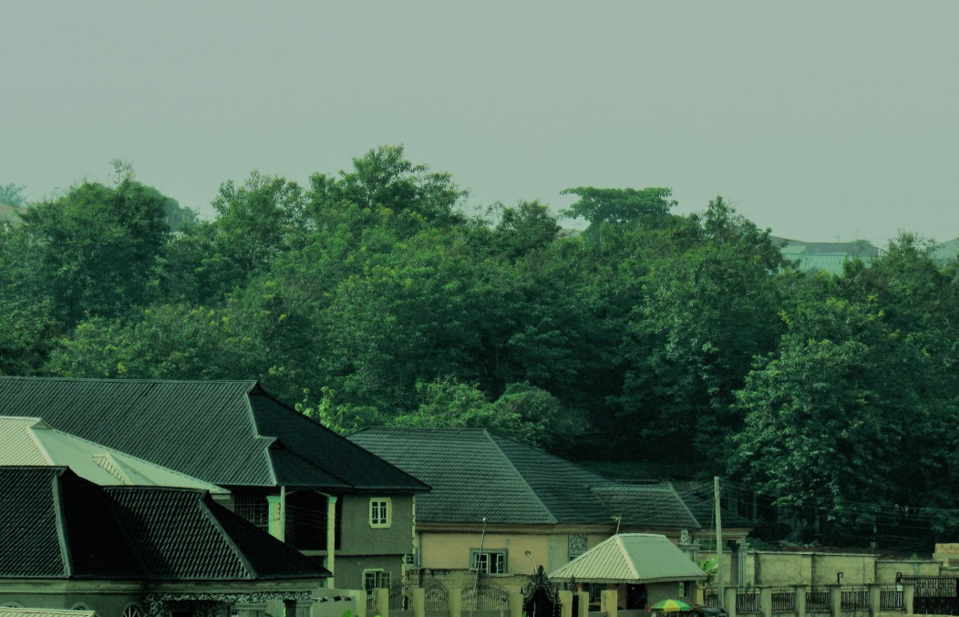
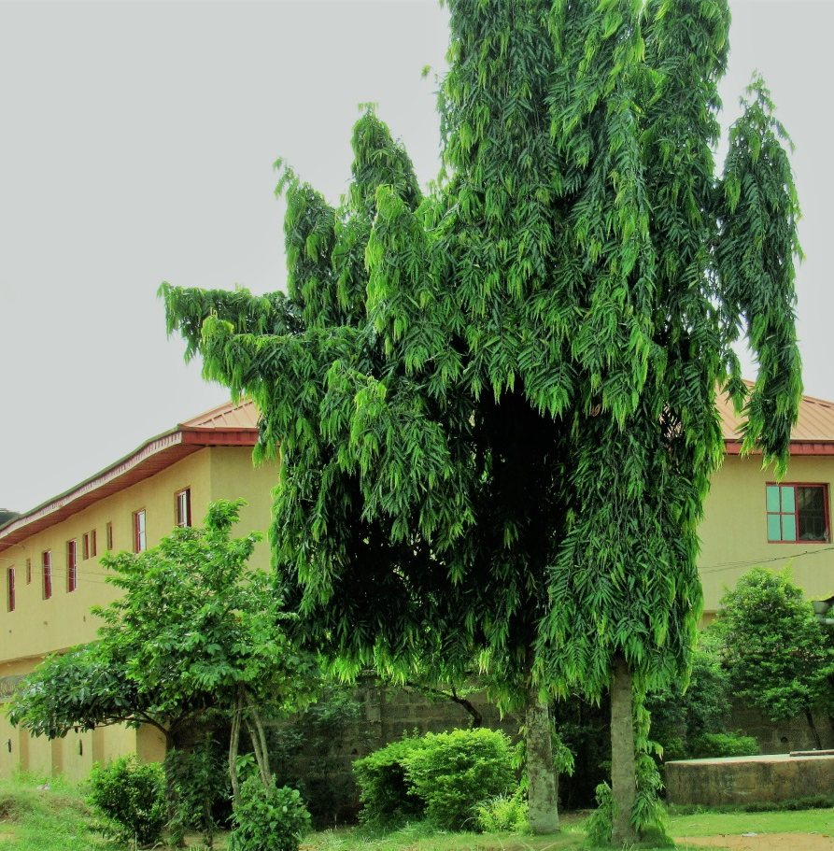
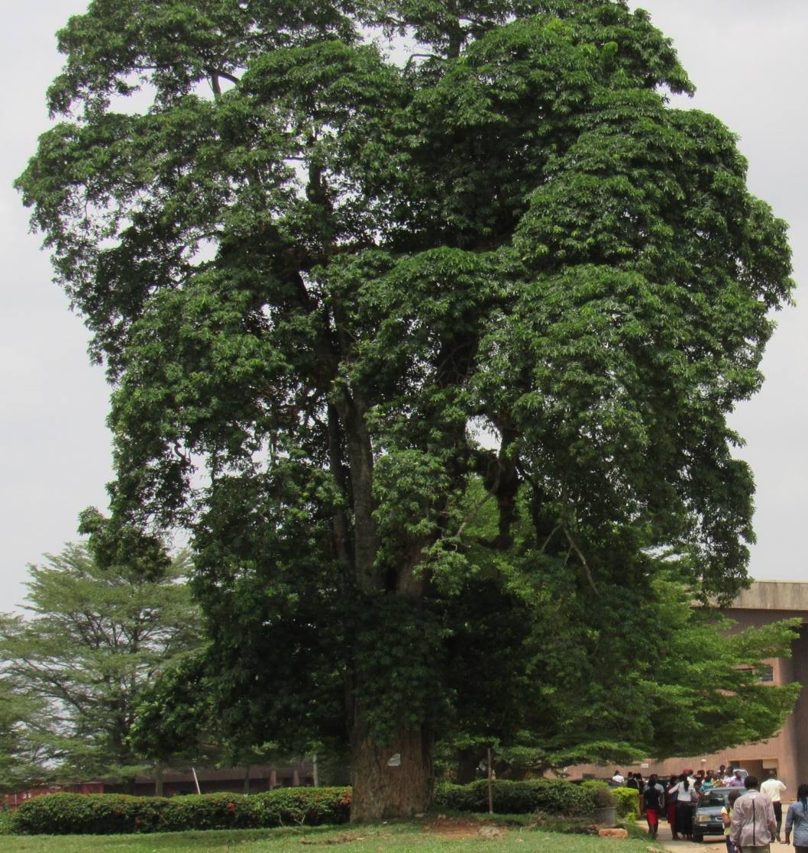
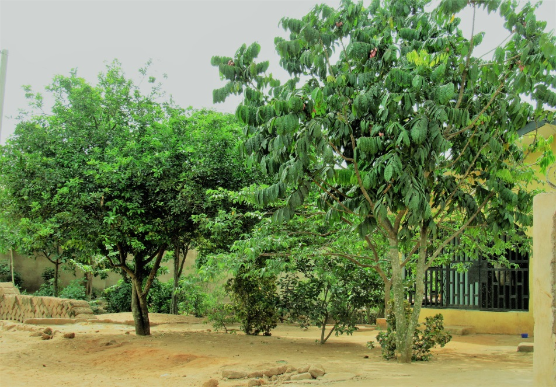
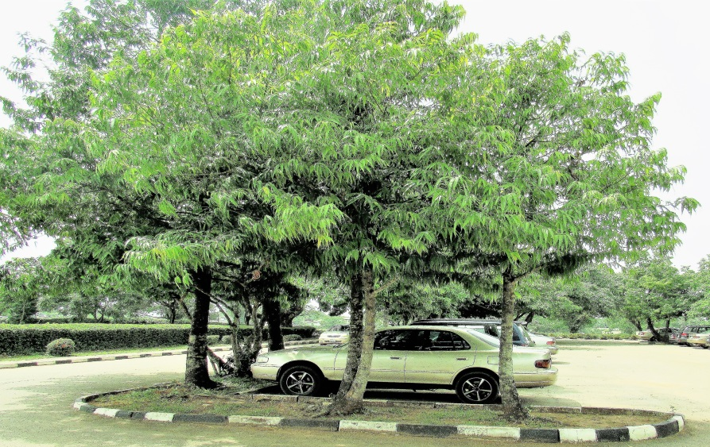
INTRODUCTION
Urban forests:
(Baur et al., 2016; Wolf and Kruger 2010)
Notes:
Urban forests include all naturally occurring or introduced trees in urbanized societies.
Specifically, the urban forests may consist of different tree species on avenues, roads, informal green spaces, free zones, residences inter alia.

Slide 3
PROBLEM STATEMENT&RATIONALE OF THE STUDY
Decline of global forests in cities from rapid urban sprawl and population increase (United Nations 2018).
In Nigeria, towns and cities are growing rapidly;
- Critical loss of urban trees and green spaces
Rapid expansion of Benin metropolis from the core to the fringe interface (Eseigbe and Ojeifo 2007; Ogbonna et al., 2011).
Timely detection of changes in urban forests structure are essential for planning.
Serious knowledge gap;
-current and up-to-date information on urban forests
Notes:
Unfortunately, despite the importance of the urban forests and their services, global forests in cities continue to decline at an alarming rate from rapid unplanned urban sprawl and population increase.
For instance, the United Nations reported that urban population accounted for 54% of the total world's population in 2014, and this growth is expected to continue in coming decades (United Nations, 2018).
In Nigeria, from a population of less than 6 million in the 60s' the urban dwellers came to about 19 million in the 80s' and to over 100 million in 2016.
In Benin City, built up areas have increased in size and complexity over time.
Benin City is expanding into the fringe interface from core areas thereby increasing the land areas occupied by settlements. This upsurge in population puts extreme pressure on the urban forests and has led to loss of trees for urbanization in many urban development projects. These may include expansion and construction of roads, estate development, infrastructure and amenities, and other land allocation priorities.
The result is negative effect on tree abundance, its services and overall environmental conservation.

Slide 4
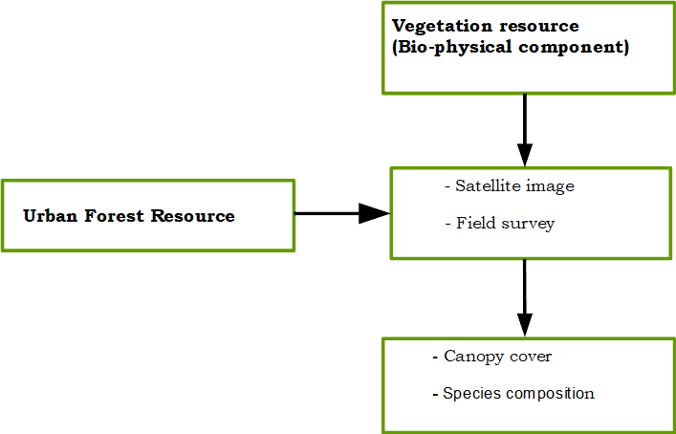
CONCEPTUAL FRAMEWORK AND OBJECTIVES
Specific Objectives:
(1)to examine the abundance and diversity of the urban forest species.
(2) to investigate the changes in vegetated areas for the period 1988 and 2018.
Notes:
Thus, the conceptual framework of this study operates on the premise that achieving sustainable development of urban forests require healthy tree resource and quality care. Therefore, this study employed an integrated approach of aerial and field survey to assess the status of the urban forests in developing countries, using Benin City, Nigeria as a case study.
Specific objectives were to (1) examine the abundance and diversity of the urban forest species (2) investigate the changes in vegetated areas for the period 1988 and 2018.

Slide 5
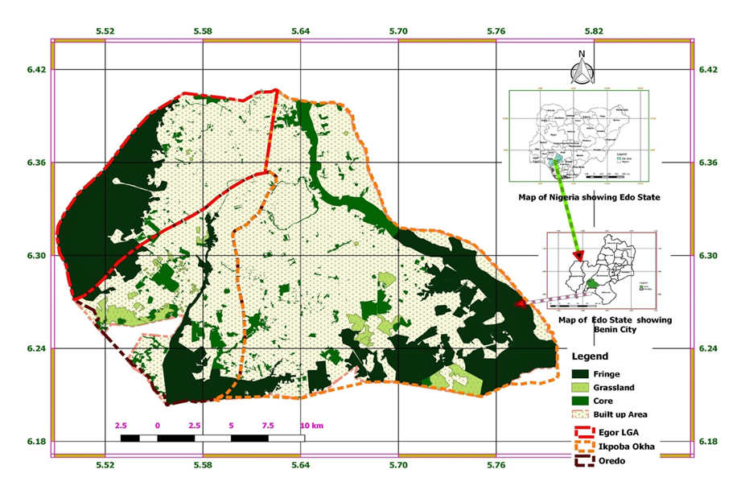
METHODS
Study area
Latitudes 6°10' and 6°30’N
Longitude 5°30' and 5°45’E
Southern region of Nigeria

Slide 6
DATA COLLECTION AND ANALYSIS
Objectives | Type of Data and Methods
Objective 1 | Tree survey: - In 27 selected sites (70%) of the total number of districts and 9 in each LGA in Benin City. - Standard transect line method - Plant ecological indices such as richness, relative density, diversity index, evenness and similarity index
Objective 2 | Geospatial analysis: Landsat images (1988 and 2018) - Image acquisition - Image subsetting - Image classification - Change detection analysis - Ground truthing

Slide 7
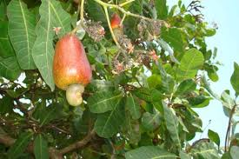
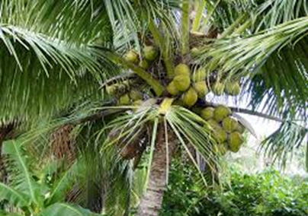
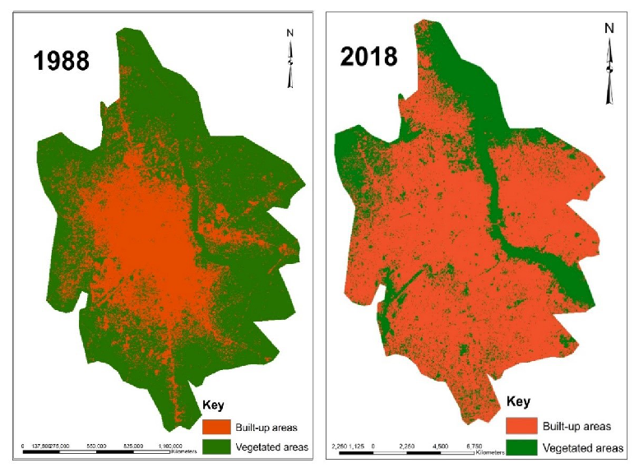
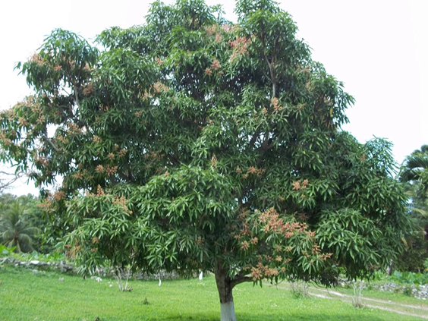
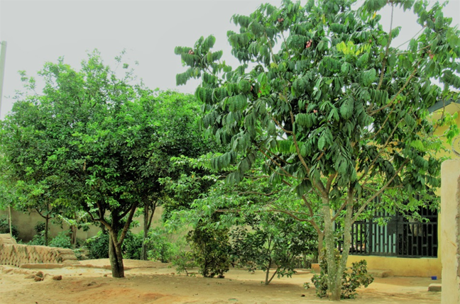
RESULTS AND DISCUSSION
Anarcardium occidentale (10%)
Cocus nucifera (8.08%)
Mangifera indica (7.60%)
Dacryodis edulis (11.6%)
Classified images of the Benin Environ
Notes:
Anacardiacea 2, Palmae, / Burseracea, Palmea, Moraceae

Slide 8
CONCLUSIONS
This study used an integrated approach to provide current information on the abundance and diversity of urban forests; and the trend of change in vegetated areas for the period 1988 and 2018.
It is envisaged that the results of this study will open-up public discourse;
decision makers, town planners and other change agencies concerned with forests and tree management;
towards regular monitoring of urban areas, and future development of cities in Nigeria, and elsewhere.

Slide 9
Thank you
Questions?

