Slide 1
Antihyperglycemic, insulin-sensitivity and antihyperlipidemic potential of Ganoderma lucidum, a dietary mushroom, on alloxan- and glucocorticoid-induced diabetic Long-Evans rats
Md. Moklesur Rahman Sarker, M.A.T.R. Zihad, Mohasiul Islam, Mazmun Nahar, Md. Mahfuzul Islam, Hasan Imam, Ahandra Ghosh, Mohd Shahimi Mustapha, and Nahlah Elkudssiah Ismail
Functional Foods in Health and Disease 2015; 5(12): 450-466
Olaosebikan Grace
Supervisor: Prof. Elemo B.O

Slide 2
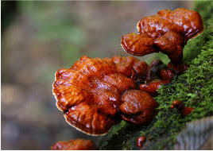
Introduction
Diabetes Mellitus
Characteristics
Associated risk
Prevalence
Treatment (oral anti-diabetic drugs)
Garnoderma lucidium
Description
Traditional uses
Bioactive ingredients

Slide 3
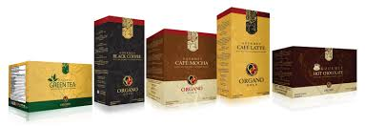

Slide 4
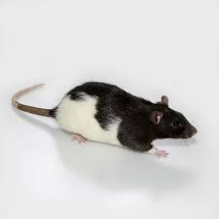
Aim
The objective of the present study was to evaluate the antihyperglycemic and insulin sensitivity potential of petroleum ether extract (PEE) and methanol extract (ME) of GL on alloxan- as well as corticosteroid-induced diabetic Long-Evans rats.

Slide 5
Materials and Methods
Ganoderma lucidum (GL/ Gano / Reishi/ Lingzhi mushroom)
Alloxan monohydrate (150 mg/kg)
Petroleum ether
Methanol
Metformin (150 mg/kg)
Dexamethasone (2 mg/kg)

Slide 6
Materials and Methods
Collection of mushroom
Preparation of extract
Experimental animals
Induction of diabetes by Alloxan monohydrate
Induction of diabetes by Corticosteroid (Dexamethasone)
Experimental Design
Oral Glucose Tolerance Test (OGTT) 2g/kg glucose
Determination of fasting glucose, insulin and HbA1c in blood serum
Measurement of serum lipid levels
Statistical analysis

Slide 7
Materials and Methods
Collection of mushroom
Preparation of extract
Experimental animals
Induction of diabetes by Alloxan monohydrate
Induction of diabetes by Corticosteroid (Dexamethasone)
Experimental Design
Oral Glucose Tolerance Test (OGTT)
Determination of fasting glucose, insulin and HbA1c in blood serum
Measurement of serum lipid levels

Slide 8
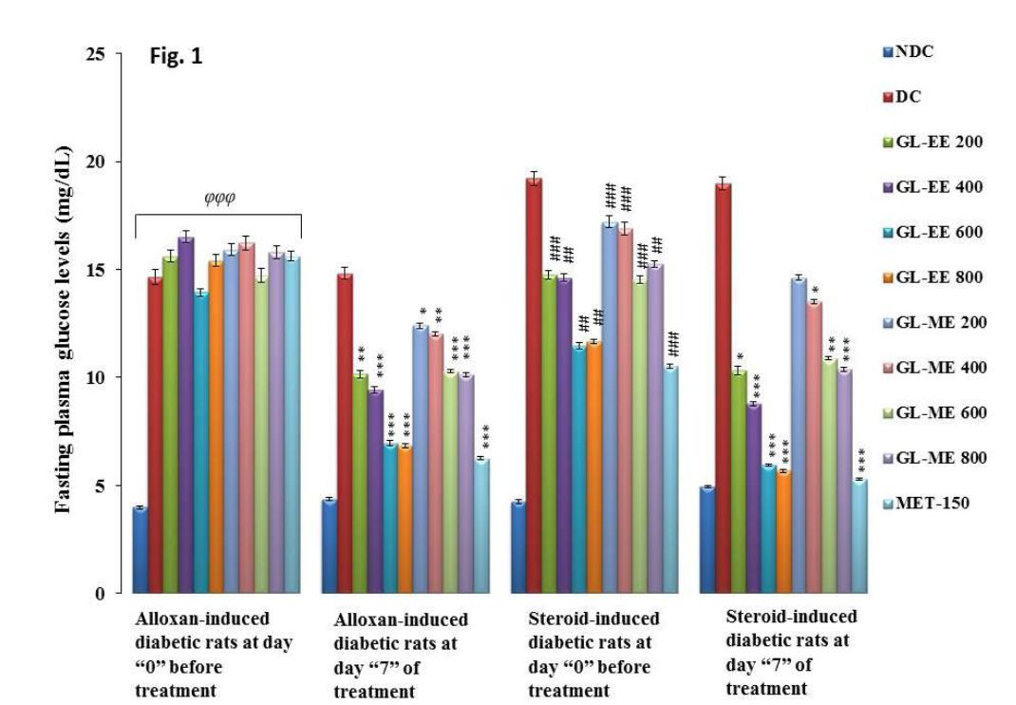
Results
Fig 1: Effect of GL-PEE and GL-ME on fasting plasma glucose levels in alloxan- and
steroid-induced diabetic Long-Evans rats.

Slide 9
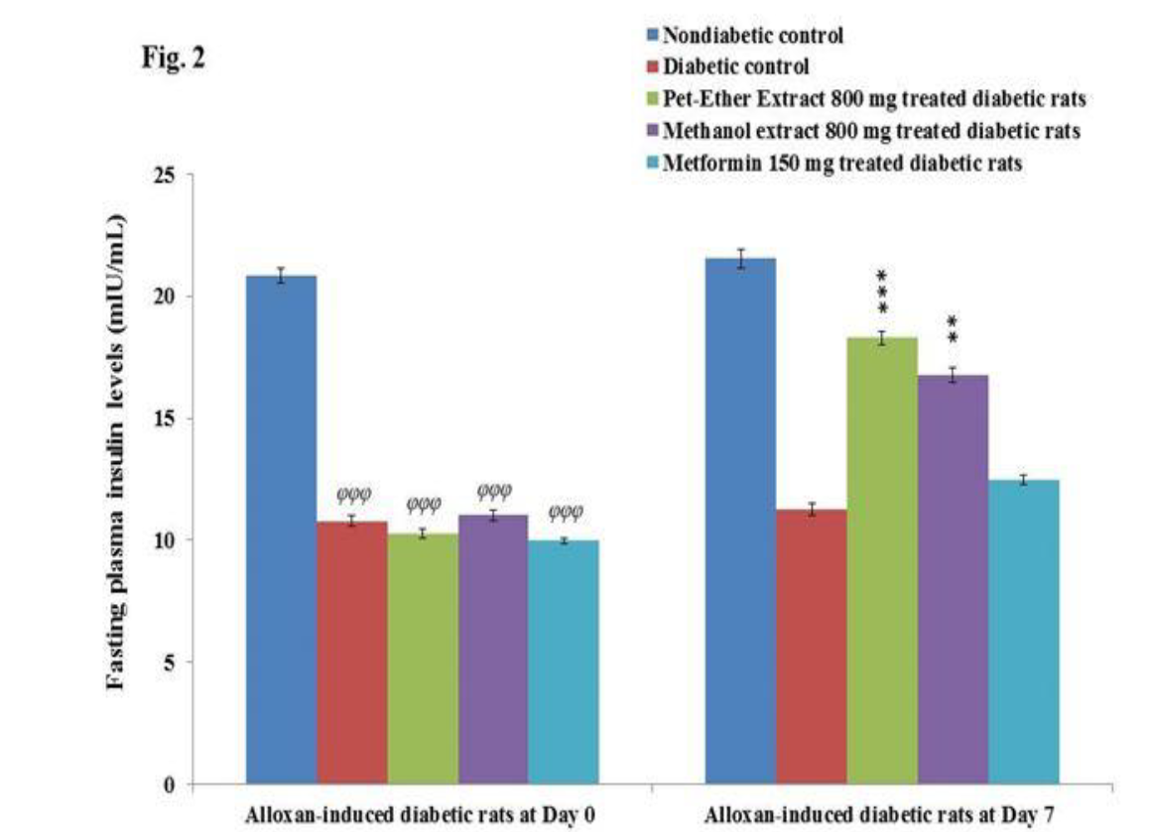
Results Cont’d
Fig 2: Effect of GL extracts on fasting plasma insulin levels in alloxan- and steroid-induced diabetic Long-Evans rats.

Slide 10
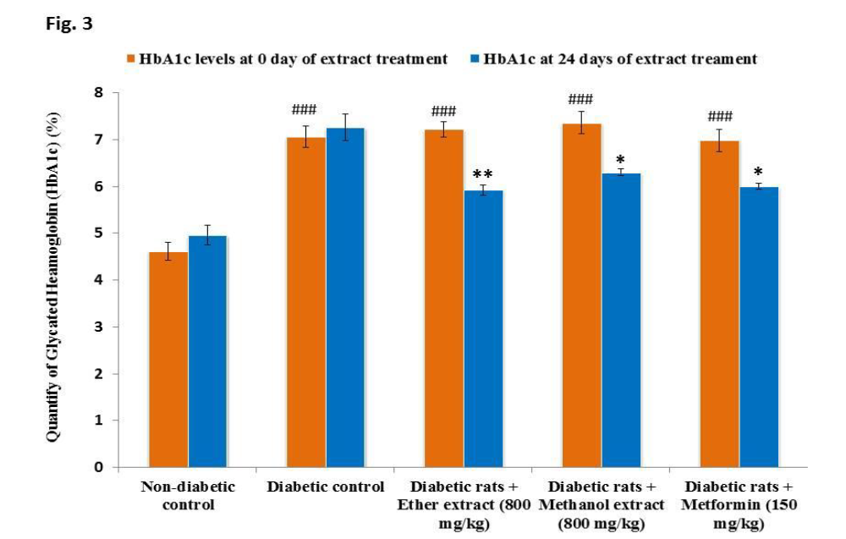
Results Cont’d
Fig 3: Effect of GL extracts and Metformin on HbA1c levels in alloxan- and steroid-induced diabetic Long-Evans rats.

Slide 11
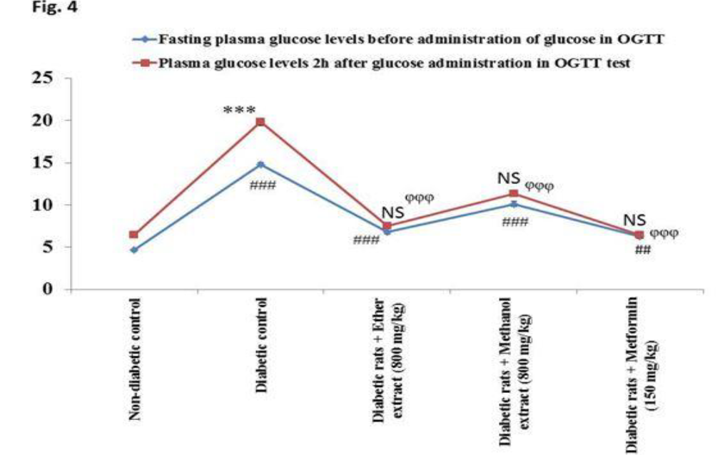
Results Cont’d
Fig 4: Effect of GL extracts and Metformin on OGTT in diabetic Long-Evans rats.

Slide 12
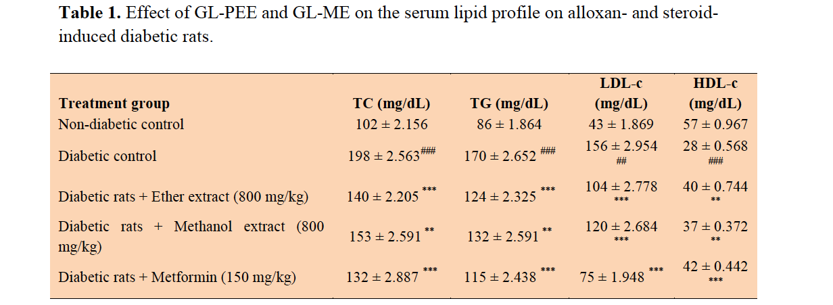
Results Cont’d

Slide 13
Discussion
Alloxan monohydrate
Drastic reduction of insulin release
Glucocorticoids
Decrease insulin signaling and contributes to insulin resistance
Fasting Plasma Glucose (Fig. 1)
Reduction of fasting hyperglycemia in diabetic rats after GL PEE and ME treatment
Plasma Insulin (Fig. 2)
GL extracts improves the protection and activity of beta cells for continuous
insulin production
Glycated Hemoglobin (HbA1c)
Reduced level via GL treatment
Glucose Tolerance
Extract increased the utilization of glucose and maintained glucose level
Hyperlipidemia
Extract revert back Cholesterol and triglyceride level to about normal

Slide 14
Conclusion
Petroleum ether and methanol extracts of Ganoderma lucidum (Gano mushroom) have the potential to reduce hyperglycemia with the enhanced glucose uptake, induce insulin production and secretion by pancreatic beta-cells, improves insulin sensitivity, and ameliorate lipid profile in alloxan and steroid-induced diabetic Long-Evans rats. Dietary intake or administration of extracts of Reishi mushroom will be effective for the management of diabetes and hyperlipidemia.

Slide 15
Thank you

