Slide 1
WASTE TO ENERGY:
Confectionery waste as a substrate for renewable energy production
By
Carol Z. Ngwenya, Dr Mariette Smart and Prof. Sue Harrison

Slide 2

Introduction
Approx. 625 tonnes of sugar-rich waste is produced per confectionery manufacturer every year and discarded into landfills.
The carbohydrate content = ideal bioprocess feedstock for renewable energy production
Contribute to the SA Bio-economy strategy (2014) which focuses on diverting waste from landfill sites → value-added products using sustainable and environmentally friendly production processes
Zero waste to landfill

Slide 3
Introduction
Approx. 625 tonnes of sugar-rich waste is produced per confectionery manufacturer every year and discarded into landfills.
The carbohydrate content = ideal bioprocess feedstock for renewable energy production
Contribute to the SA Bio-economy strategy (2014) which focuses on diverting waste from landfill sites → value-added products using sustainable and environmentally friendly production processes
Zero waste to landfill

Slide 4
Introduction
Approx. 625 tonnes of sugar-rich waste is produced per confectionery manufacturer every year and discarded into landfills.
The carbohydrate content = ideal bioprocess feedstock for renewable energy production
Contribute to the SA Bio-economy strategy (2014) which focuses on diverting waste from landfill sites → value-added products using sustainable and environmentally friendly production processes
Zero waste to landfill

Slide 5
Introduction
Approx. 625 tonnes of sugar-rich waste is produced per confectionery manufacturer every year and discarded into landfills.
The carbohydrate content = ideal bioprocess feedstock for renewable energy production
Contribute to the SA Bio-economy strategy (2014) which focuses on diverting waste from landfill sites → value-added products using sustainable and environmentally friendly production processes
Zero waste to landfill

Slide 6

Current Energy recovery from confectionery waste
Developed an anaerobic digestion system to convert chocolate and sugar confectionery waste from the site’s manufacturing processes into renewable energy and clean water.

Slide 7

Current Energy recovery from confectionery waste
Developed an anaerobic digestion system to convert chocolate and sugar confectionery waste from the site’s manufacturing processes into renewable energy and clean water.
Found means to reuse, recycle and generate fuel from produced waste. This initiative has ↓ waste to landfills by 250 tons.

Slide 8

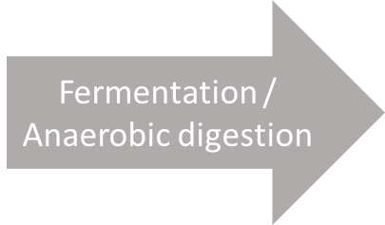



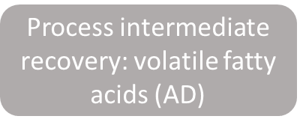
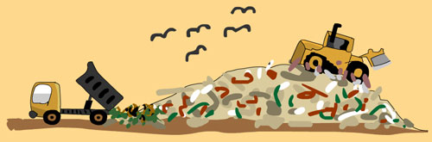
Project Overview
Notes:
Annually, the Confectionery industry generates approx. 625 tonnes of sugar-rich waste per manufacturing site which is discarded into landfills, which is a major environmental burden in South Africa. The carbohydrate content of confectionery waste makes it an ideal bioprocess feedstock for renewable energy production.
The objective is to develop a novel approach to using confectionery in different process technologies for energy recovery. This include microbial fermentation of biobutanol and bioethanol by Z.mobilis and C.saccharobutylicum as well as biogas recovery in anaerobic digestion (AD).

Slide 9
Bioenergy in the confectionery industry
Bioethanol from Zymomonas mobilis fermentation
Biobutanol from Clostridium saccharobutylicum fermentation
Biomethane from Anaerobic Digestion
Biohydrogen from Acidogenic and Acetogenic fermentation
Notes:
Both fuel and gaseous energy can be derived from confectionery waste using specific technologies. Biofuels and biogas can be used directly in heating boilers to generate steam, while combined heat and power (CHP) can be cogenerated from low carbon energy sources in electrically powered steam generators located alongside processing equipment (Adendorf, 2009). These bio-based energy sources can be used to supplement the processing plant’s energy requirements.

Slide 10
Research approach
Product selection
- Literature survey
- Waste characterisation
Flowsheet
- Experimental and TEA data
Experimental production of selected product
Techno-Economical Analysis
- Cost
- Feasibility
- Material and energy balances
- Market
- Substrate-product preferential matching

Slide 11
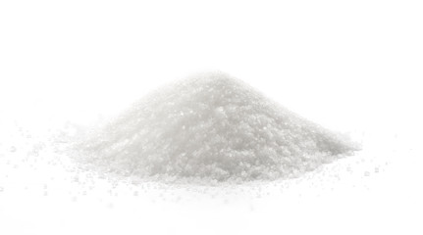
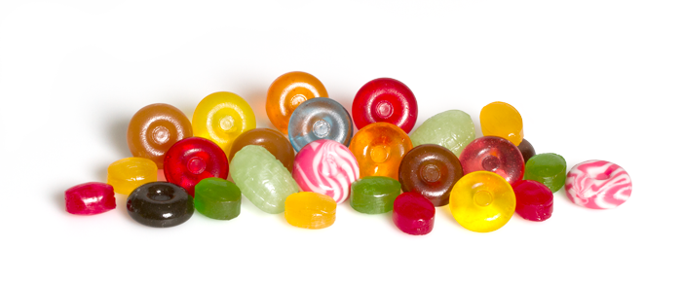
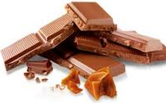
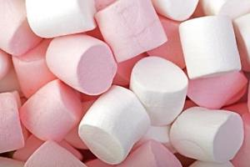
Ethanol production methodology
Synthetic sugar mix
Hard Candy
Chocolate
Marshmallows
Sucrose Glucose Fructose

Slide 12
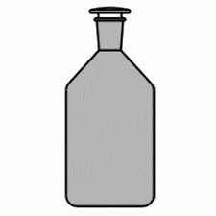

Ethanol production methodology
Synthetic sugar mix
Hard Candy
Chocolate
Marshmallows
Sucrose Glucose Fructose
20 g/L sugar
100 ml
C₆H₁₂O₆
2C₂H₅OH + 2CO₂
Zymomonas mobilis (ATCC 31821)

Slide 13
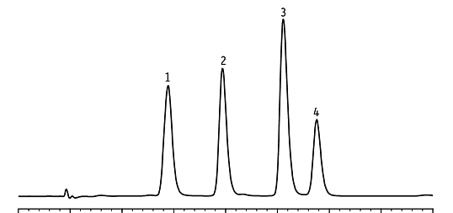
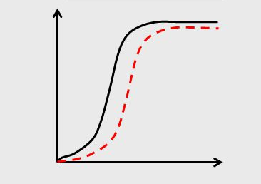
Ethanol production methodology
Synthetic sugar mix
Hard Candy
Chocolate
Marshmallows
Sucrose Glucose Fructose
20 g/L sugar
100 ml
C₆H₁₂O₆
2C₂H₅OH + 2CO₂
Zymomonas mobilis (ATCC 31821)
Sucrose
Glucose
Fructose
Ethanol
Biomass
Ethanol

Slide 14
Growth & ETHANOL production on a synthetic sugar mix

Slide 15
Growth and ethanol production from confectionery waste
Chocolate
Y_{X/S}
Y_{P/S}

Slide 16
Expected outcomes
Inform the potential implementation of a biorefinery in the confectionery industry for renewable energy generation → zero waste & off-set of operational costs
Further work: flow sheeting and techno economic analyses of renewable energy routes: bio-ethanol, -butanol, -hydrogen and –methane to inform on the most feasible and value-adding route for the specific confectionery waste type
Application in valorisation of other carbohydrate rich waste streams based on their composition
Notes:
The valorisation of confectionery solid waste to developing a bioenergy biorefinery servicing the confectionery manufacturing unit has not previously been investigated for South African confectionery manufacturers.

Slide 17
Expected outcomes
Inform the potential implementation of a biorefinery in the confectionery industry for renewable energy generation → zero waste & off-set of operational costs
Further work: flow sheeting and techno economic analyses of renewable energy routes: bio-ethanol, -butanol, -hydrogen and –methane to inform on the most feasible and value-adding route for the specific confectionery waste type
Application in valorisation of other carbohydrate rich waste streams based on their composition
Notes:
The valorisation of confectionery solid waste to developing a bioenergy biorefinery servicing the confectionery manufacturing unit has not previously been investigated for South African confectionery manufacturers.

Slide 18
Expected outcomes
Inform the potential implementation of a biorefinery in the confectionery industry for renewable energy generation → zero waste & off-set of operational costs
Further work: flow sheeting and techno economic analyses of renewable energy routes: bio-ethanol, -butanol, -hydrogen and –methane to inform on the most feasible and value-adding route for the specific confectionery waste type
Application in valorisation of other carbohydrate rich waste streams based on their composition
Notes:
The valorisation of confectionery solid waste to developing a bioenergy biorefinery servicing the confectionery manufacturing unit has not previously been investigated for South African confectionery manufacturers.

Slide 19



acknowledgements
Personnel
Tich Simkange
Emmanuel Ngoma
Sharon Rademeyer
Leslie Mapatano
Caryn Horns
Catherine Edward
National Research Foundation South African Research Chair initiative (GUN 64778) funding of the SARChI chair in Bioprocess Engineering

