Slide 1
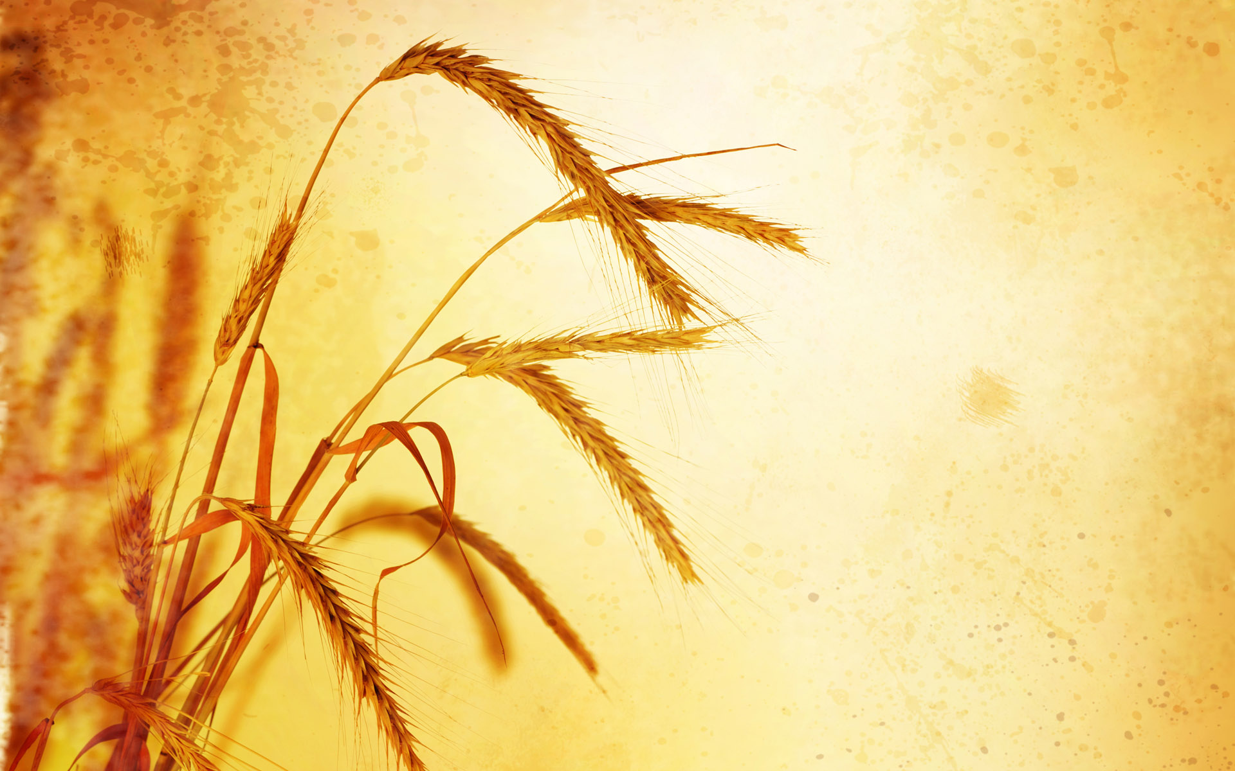


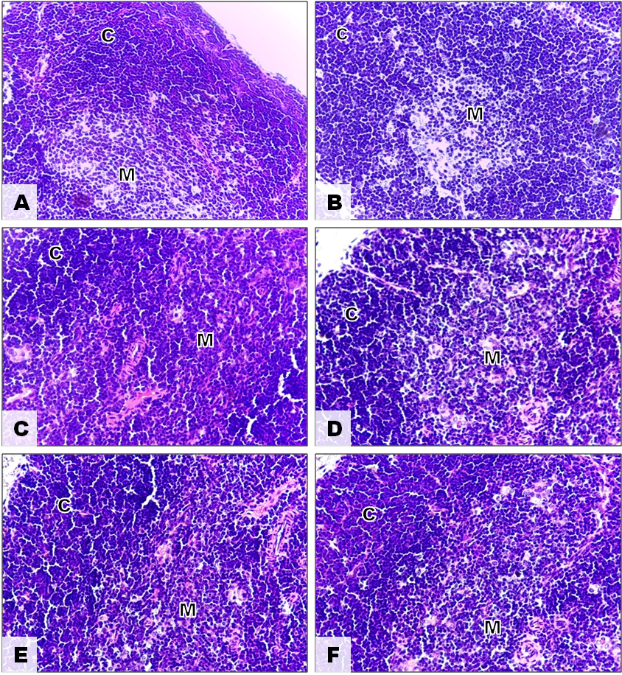
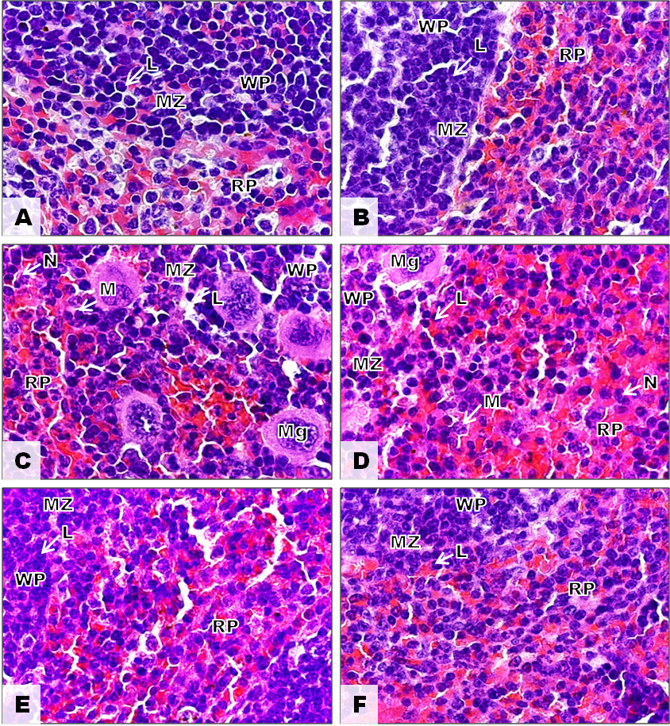
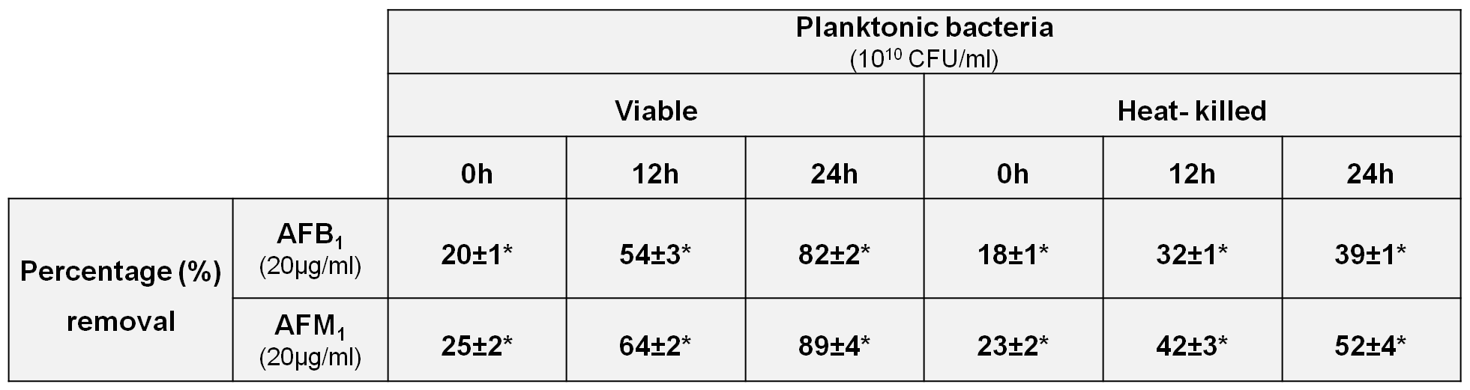
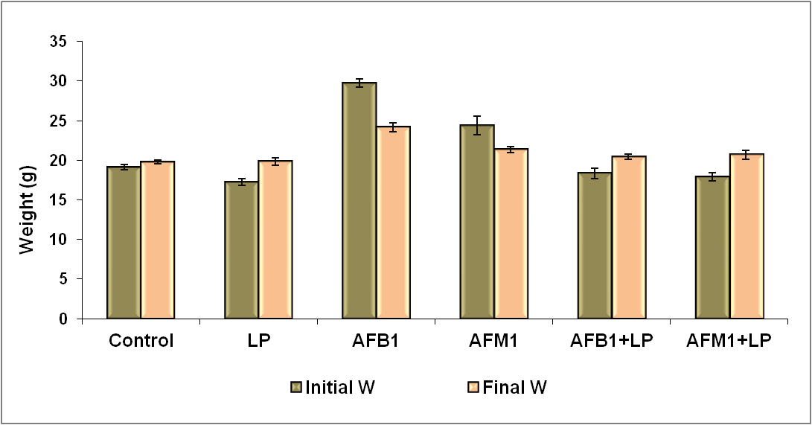
TWAS 13thConference/24rd meeting, 01-04 Octobre, 2013. Buenos Aires, Argentine
Ability of Lactobacillus plantarum MON03
to mitigate/counteract AFB₁ and AFM₁
in vitro and in vivo
Jalila Ben Salah-Abbès*, Rania Jebali, Samir Abbès, Ridha Ben Younes1, Ridha Oueslati 1
Unit of Immunology, Environmental Microbiology and Cancerology, Faculty of Sciences of Bizerte, University of Carthage, TUNISIA
*E-mail: jalila.bensalah@yahoo.fr
INTRODUCTION
Aflatoxins are secondary metabolites produced by fungi that grow on food and feed crops, causing great economic loses and human diseases. AFM₁ is derived from AFB₁ following ingestion of feed contaminated with AFB₁ and transferred to milk and milk products destined for human consumption. Recently, our lab demonstrated that in Beja province (Tunisia), milk and milk by-products were contaminated with high levels of AFM₁ [1]. To get ride against this problem numerous strategies of detoxification or/and inactivation were elaborated. Microbial binding/degradation of mycotoxin using lactic acid bacteria isolated from dairy products appeared efficacy and without hidden risks [2,3]. In this study, Lactobacillus plantarum MON03 (LP) isolated from Tunisian traditional butter was evaluated regarding its prevention against toxicological effects of AFB₁ and AFM₁.
MATERIALS AND METHODS
In vitro detoxification test: LP was tested for its ability to eliminate AFM₁ and AFB₁ from phosphate-buffered saline (PBS) containing 20 μg of AFB₁ or AFM₁/ml after 0, 6, and 24 hr at 37°C. The remaining mycotoxins were evaluated using HPLC. Tasting is done to track changes (taste, texture, color and appearance) of the products analyzed.
Animals and Experimental design: Balb/c mice were randomly divided into six groups (6 mice/group) and treated orally with the respective treatment with AFB₁, AFM₁ and LP separately or simultaneously for 2 weeks. the signs of overall toxicities were recorded along the period treatment. At the end of the treatment period, the body weights of the mice in each group were measured and scarified by cervical dislocation; spleen and thymus were collected and weighed. Parts of those organs were immediately placed into buffered-formalin for histological studies.
RESULTS AND DISCUSSION
The outcome of the in vitro study indicated that LP was more suitable for use in vivo study due to its highest capability to remove AFB₁ and AFM₁ from PBS (Tab. 1). After 2 weeks of AFB₁ and AFM₁ treatment, a general toxicity was observed in the mice. Specifically body and lymphoid organ weights were significantly decreased in in AFB₁ and AFM₁-treated mice (Fig. 1). In addition, the deaths of two mice (one on day 11 and one on day 13; ~16% overall mortality) were noted in AFB₁-treated group. In contrast, no overt general toxicities were observed from LP alone or in combination with AFB₁ or AFM₁. The histological studies using Hematoxylin and Eosin (H&E) coloration confirmed the above cited results. In fact, spleen and thymus showed general toxicity by alterations in their structure (Fig. 2 and 3).
Tab 1: Percentage of AFB₁ and AFM₁ removal from PBS by LP, living and killed by heat (90°C for 15 min)
*All Values shown are mean ± SD from three determinations per experimental scenario tested.
Fig 2: Photomicrographs of H&E strained Thymus of Balb/c mice (Magnification x 40)
(C: Cortex and M: medulla)
Fig 3: Photomicrographs of H&E strained Spleen of Balb/c mice (Magnification x 100)
(WP: white pulp, RP: Red pulp, MZ: Marginal zone, Mg: Megakaryocyte, L: Lymphocyte, M: Macrophage and N: Neutrophil)
After 2 weeks treatment, histological of mice spleen and thymus in control group revealed normal organ’s structures (micro-architecture) (A), The group of LP-treated mice shows a normal histological pictures as the control (B). However, the stains of treated mice with AFB₁/AFM₁ shows structural alterations of the tow organs studies in comparison with control. The strains of lymphoid organs of treated-mice with AFB1/AFM1 in combination with LP presents an attenuation of toxicities induced by AFB1/AFM1 treatment.
Fig 1: Treatment effect on the weight of Balb / c mice
CONCLUSION
The results revealed that AFB₁ and AFM₁ are toxic regarding the tested parameters. Meanwhile, the added bacteria in balb/c mice treated with AFB₁ and AFM₁ succeeded to eliminate the toxicities caused by both mycotoxins. Moreover, Lactobacillus plantarum MON03 was able to bind strongly AFB₁ and AFM₁ from PBS solution in time dependent manner. By itself, LP was safe and can be considered as strong candidate in biotechnology mycotoxin detoxification.
REFRENCES
[1] Abbès S., Ben Salah-Abbès J., Bouraoui Y., Oueslati S., & Oueslati R. 2012. Natural occurrence of aflatoxins (B1 and M1) in feed, plasma and raw milk of lactating dairy cows in Beja, Tunisia, using ELISA. Food Addit. Contam. 5, pp. 11-15.
[2] Abbès S., Ben Salah-Abbès J., Sharafi H., Noghabi KA., & Oueslati R., 2012. Interaction of L. plantarum MON03 with Tunisian Montmorillonite clay and ability of the composite to immobilize Zearalenone in vitro and counteract immunotoxicity In vivo. I Immunoph. Immunotox. pp. 1-7.
[3] Abbès S., Ben Salah-Abbès J., Sharafi H., Jebali R, Noghabi KA., & Oueslati R., 2012. Ability of Lactobacillus rhamnosus GAF01 to Remove AFM1 in Vitro and to Counteract AFM1 Immunotoxicity in Vivo. J. Immunotox. pp. 1-8.

