Slide 1
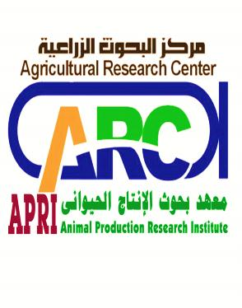

Case study PROBLEMS OF INVENTORY AND RECORDING OF DAIRY CATTLE AT SMALLHOLDERS IN EGYPT
By
Dr. Shereen kamal Genena
Researcher at Animal Production Research Institute
Egypt

Slide 2
PHYSICAL DESCRIPTION
Animal production represent 33 % of the total agricultural products in Egypt .
The Egyptian citizens consume 22 gm of animal proteins daily on average, it is less than the international recommended needs (29 gm/day).
Total livestock dairy animals is 8.5 million ( 4.7 cattle & 3.8 buffaloes, 2010).
Buffalo is the main dairy animal in Egypt and cattle is the main animals for meat production.

Slide 3
Milk production per year is 5.6 million tons.
Meat production per year is 4000 tons.
The total number of animal holders is 2.0 million.
Livestock holders who have less than 10 animals represent 95 % of the total holders. They have 84 % of the total animals.
Livestock holders who have more than 50 animals represent 0.1 % of the total holders. They have 4.2 % of the total animals.

Slide 4
Social Economic description
The small holders play an important role in animal production sector as they own about 88% of the livestock population.
Which considered the main source of their income through selling milk, weaned calves and culled animals. Also, they depend mainly on home consumption of milk products.
The awareness of the farmers to understand the importance of animal identification and recording is very important in order to control animal health and productivity.

Slide 5
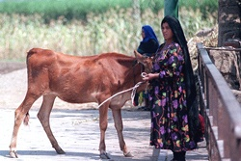
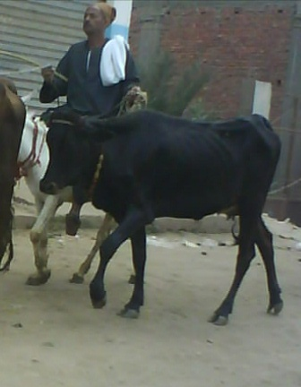
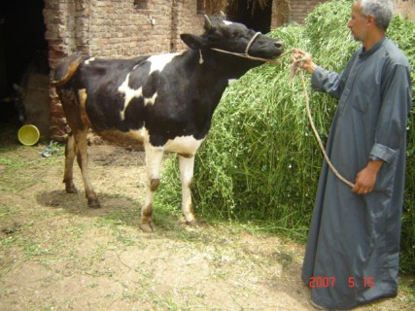
Local and Crossbred Dairy Cattle with Smallholders

Slide 6
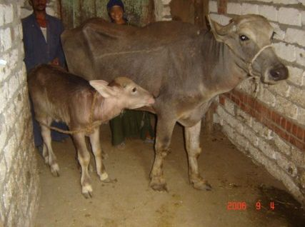
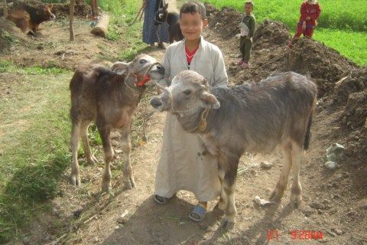
Egyptian buffalo animals raised by small holders

Slide 7

Changes I want to achieve in relation to the livestock system
Set up a governmental system for animal identification and recording to achieve important goals.
To conserve genetic resources of local breeds of cattle and buffaloes.
Planning for genetic improvement of dairy and meat producing animals.
To control spread of the infectious diseases and provide health care for those dairy animals.
To up grade productivity of local breeds which owned by the small holders.

Slide 8
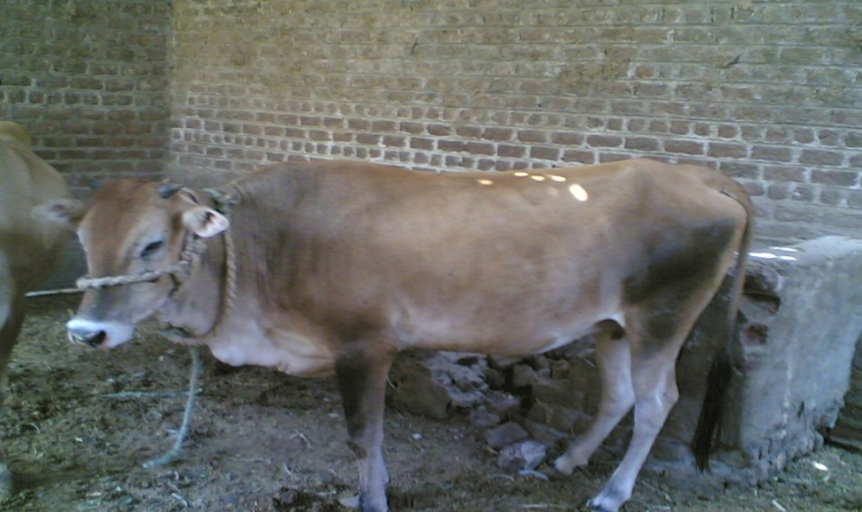
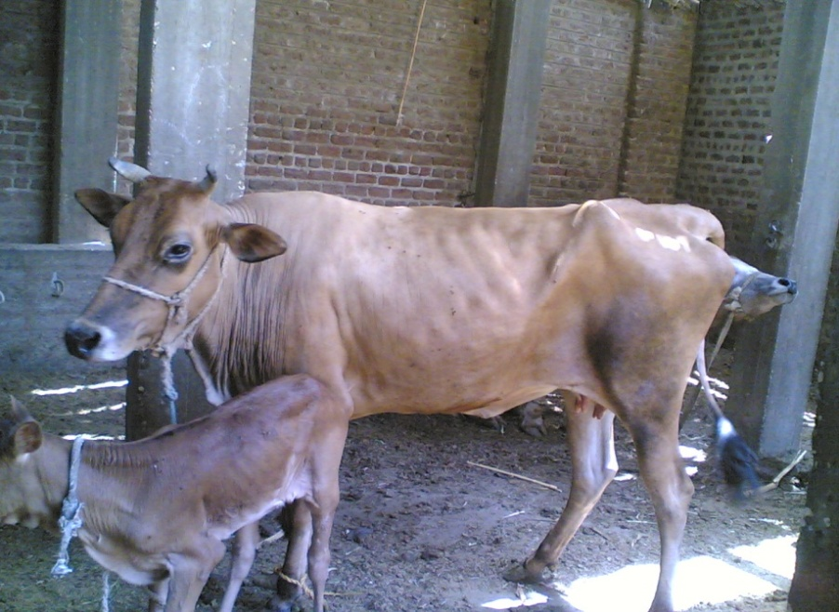

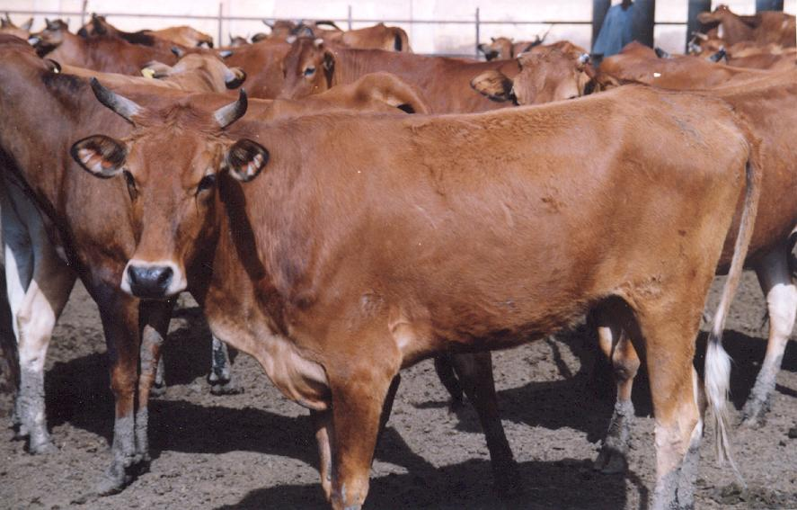
Egyptian native cattle breeds

Slide 9
Constraints and challenges to technological change
Low knowledge about the importance of livestock management and objective of animal recording.
The financial constraints were due to the poor income from the animals so the farmers are not able to pay for animal recording.
Lack of fund to establish a sustainable national recording system.
Farmers traditions act as a strong constraint on milk recording. They used to maintain animals only for feed and financial support.

Slide 10
Risks Assessment
Lack of breed associations and breeding programs for sustaining recording system for optimizing productivity of local dairy cattle in Egypt.
The recording cost is high due to low efficiency of the system. In the meantime, recording incentives are not remarkable or satisfactory to farmers.
The poor animals productivity makes the farmer consider milk traits recording as unnecessary burden.

Slide 11

My learning objectives
Sharing practical and scientific information with other participants
Developing my skills in management of livestock
Recognize new technologies regarding conservation of genetic resources of animals.
To get benifit of the Australian experience in animal production
To acquire skills on control of meat quality , safety food and milk production.

Slide 12
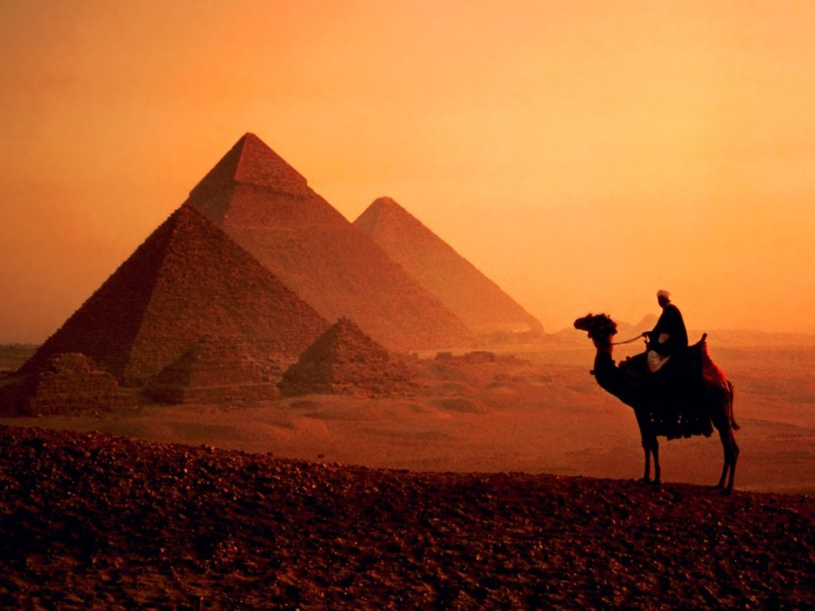
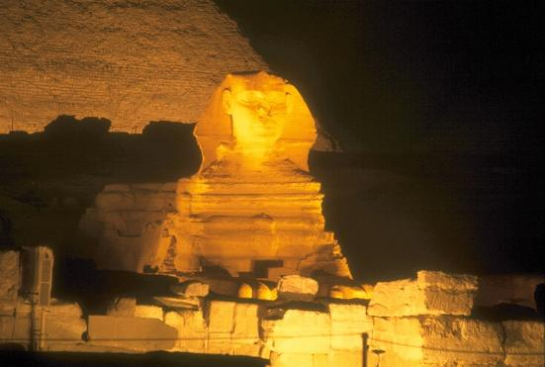
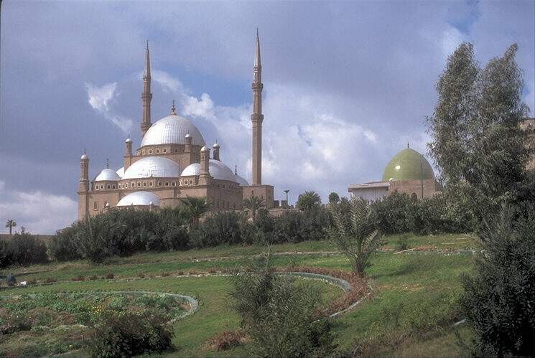
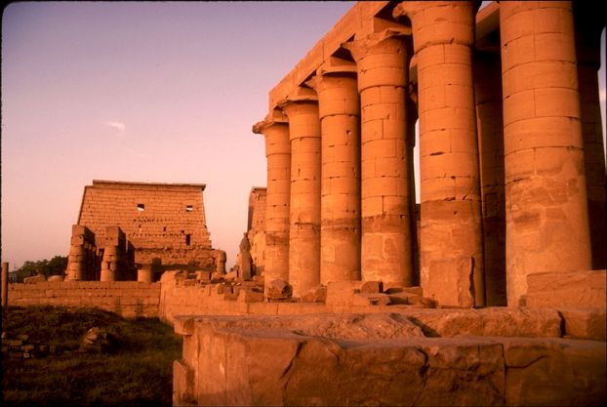
THANK YOU
Welcome to Egypt

