Slide 1


OVERVIEW, PROSPECTS AND FUTURE CHALLENGES OF METAL ORGANIC FRAMEWORKS AS ADSORBENT FOR DYES ADSORPTION
Ibrahim A. Omotayo^{1*}, Odunola O. Ayobami¹, Onawumi O. O. Esther¹, ²Adegoke K. Adesina, Yahaya A. AbdulWahab, Oyelami B. Victoria, Okon-Akan O. Abiodun¹
PRESENTED BY
OKON-AKAN OMOLABAKE
AT THE HUMBOLT-KOLLEG INTERNATIONAL CONFERENCE.
LADOKE AKINTOLA UNIVERSITY OF TECHNOLOGY
OGBOMOSO, NIGERIA.

Slide 2

INTRODUCTION
Soil, air, and water pollutions remain the major worldwide challenges for both human and eco-environment society.
Decontamination of pollutants such as organic and inorganic compounds from an ecosystem remains a bottleneck over the years.
Among several methods for removing pollutants, adsorption stands unique, simple and efficient.
However, the versatility of the adsorption technique is largely determines by the materials sorption capacities which also depends on the porous structures and surface property of the adsorbent.
K.A. Adegoke, O.S. Bello, Dye sequestration using agricultural wastes as adsorbents, Water Resour. Ind. 12 (2015) 8–24, doi:10.1016/j.wri.2015.09.002.

Slide 3
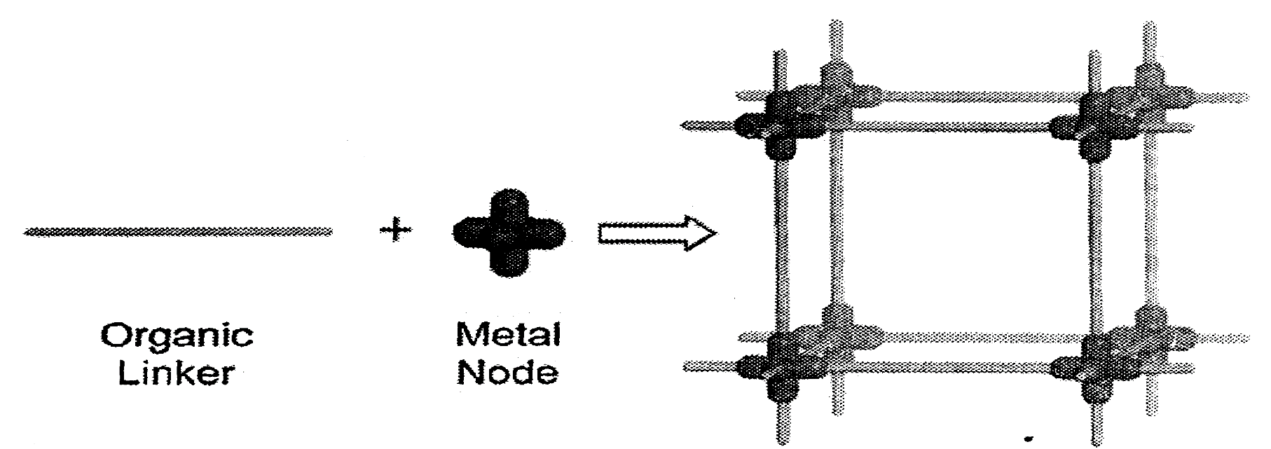
METAL ORGANIC FRAMEWORKS
Metal organic frameworks are compounds consisting of a metal ion or clusters coordinated to organic ligands to form one, two, or three dimensional structures that are porous (Wang et al., 2002).
Burnett et al, 2012).

Slide 4
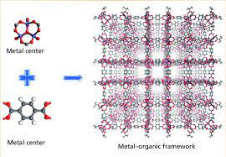
INTRODUCTION cont’d
Metal-organic frameworks (MOFs) are a novel class of carbonaceous nano-materials having larger specific surface areas and their oxides have unique functional groups required for good adsorption processes.
MOFs encompasses different aspects of inorganic materials chemistry due to their;
unique large surface area,
tunable pore sizes,
high thermal stability,
as well as magnetic, electrical, optical, and catalytic properties which make them attract considerable attention and show potential applications in gas purification and separation such as CO₂ adsorption, adsorption of dyes and sensing metal ions.
J. Albo, D. Vallejo, G. Beobide, O. Castillo, P. Castaño, A. Irabien, Copper-based metal–organic porous materials for CO2 Electrocatalytic reduction to alcohols, ChemSusChem. 10 (2017) 1100–1109, doi:10.1002/cssc.201600693.

Slide 5
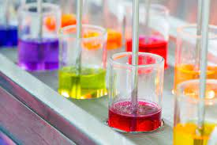
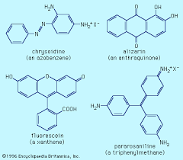
INTRODUCTION cont’d
Dyes are visible contaminants and their presence in the environments even minute amounts are undesirable owing to their notorious appearances.
Currently, over 40,000 dyes and pigments are available and they consist of over 7000 various chemical structures worldwide.
More than 100,000 dyes are commercially available
Dye molecules consist of chromophores and auxochromes.
The chromophores are responsible for color production
while the auxochromes, supplement the chromophores and also allow the solubility of the molecules in water.
K. Adesina Adegoke, O. Samuel Agboola, J. Ogunmodede, A. Oluyomi Araoye, O. Solomon Bello, Metal-organic frameworks as adsorbents for sequestering organic pollutants from wastewater, Mater. Chem. Phys. 253 (2020) 123246, doi:10.1016/j.matchemphys.2020.123246.

Slide 6
INTRODUCTION cont’d
Presently, larger amounts of wastewater containing the colors from dyes are produced from industries including, printing, textile, paper, leather, plastic, etc. [1,342]
Several methods for dye treatments have been reported including;
flocculation/coagulation,
biodegradation,
oxidation,
membrane filtrations,
and adsorption techniques were established to be efficient for dye removal from industrial effluents
J. Zhang, Q. Zeng, L. Zhao, M. Zhang, L. Zhang, Q. Gu, Association between parental exposure to environmental risk factors and the risk of childhood acute lymphoblastic leukemia, Chinese J. Endem. 37 (2016) 1413–1416, doi:10.3760/cma.j.issn.0254-6450.2016.10.019.

Slide 7
INTRODUCTION cont’d
No high operating temperature is needed for adsorption process and a large number of dye molecules and colored materials can be simultaneously removed.
The versatility of this process is a result of higher adsorption efficiency, economic practicability, and easiness of designs and operation.
Although, there are various operational parameters to effect the process of adsorption, including charge density and structural stability of the adsorbents.
T. Shen, J. Luo, S. Zhang, X. Luo, Hierarchically mesostructured MIL-101 metal-organic frameworks with different mineralizing agents for adsorptive removal of methyl orange and methylene blue from aqueous solution, J. Environ. Chem. Eng. 3 (2015) 1372–1383, doi:10.1016/j.jece.2014.12.006.

Slide 8
INTRODUCTION cont’d
FIG 1:Schematic representation of oriented and functionalized MOF crystals grown on SAM-modiﬁed gold substrates (left) followed by the post-synthetic modiﬁcation of the MOF thin ﬁlm with dye molecules (right) (Hinterholzinger et al 2012).

Slide 9
INTRODUCTION cont’d
FIG 2:Proposed mechanism for the adsorption of organic dyes onto CTF (Wang et al 2013)

Slide 10
REVIEW
The feasibility of crystalline triazine-based organic framework (CTF) as a promising adsorbent for removing organic dyes was reported to understand the process of adsorption including; kinetics and mechanism involved for a wider range of organic dyes with opposite charges.
An attempt was made to compare the adsorption ability of CTF material with conventional sorbents such as activated carbon (AC). Results reported indicated that CTF was more efficient for Rhodamine B (RhB) removal; showing the uptake of 0.48 mmol·g −1 for RhB within 55 min (weight ratio of RhB/CTF was 0.24), and the adsorption capability of RhB onto CTF for was 1.01 mmolg−1 .
Comparing with other sorbents, this sorption capacity was higher than its counterparts reported in the literature
T. Wang, K. Kailasam, P. Xiao, G. Chen, L. Chen, L. Wang, J. Li, J. Zhu, Adsorption removal of organic dyes on covalent triazine framework (CTF), Microporous Mesoporous Mater. 187 (2014) 63–70, doi:10.1016/ j.micromeso.2013.12.016.

Slide 11
REVIEW
Dadfarni et al., [2015] reported the utilization of MOFs loaded onto iron oxide nanoparticles (Fe3O4@MIL-100(Fe)) for methyl red (MR) dye removal using the batch adsorption method.
It was observed that MR removal onto MIL-100(Fe) exhibited an enhanced sorption capacity when compared with other previous adsorbents.
Li et al., [2013] studied the applicability of MOF/graphite oxide hybrid (MOF/HKUST1) materials for methylene blue (MB) dyes removal from aqueous media. The isothermal, kinetics and regeneration studies were also investigated.
The removal of MB was found to obey both Langmuir and Freundlich adsorption isotherms. The HKUST-1/GO was then concluded to have higher adsorption ability and excellent re-usability for MB dye removal.
Different other MOF-based adsorbents were used for dyes removal and Table 1 presents the examples of adsorption capacities derived from such MOF-based adsorbents.

Slide 12
REVIEW
Adsorption of methyl orange and methylene blue onto the Fe3O4-PSS@ZIF-67 core-shell (MZIF-67) was reported.
The remarkable performance of this adsorbent was attributed to its high porosity, presence of the unsaturated cobalt sites, and magnetic properties which further boosted the removal efficiency of methyl orange and methylene blue from the water.
Further observation showed that MZIF-67 had the selectivity capacity to increasingly separate the methyl orange dye from the mixtures of the solution that contained 0.04 mg/L of methyl orange and methylene blue dyes. This gave a higher removal rate and separation efficiency of 92 and 96% respectively.
The excellent removal capacity from the wastewater could be further attributed to the selectivity and charge characteristic effects of the MZIF-67 composites.
P. Kuhn, A. Forget, D. Su, A. Thomas, M. Antonietti, From microporous regular frameworks to mesoporous materials with ultrahigh surface area: dynamic reorganization of porous polymer networks, J. Am. Chem. Soc. 130 (2008) 13333–13337, doi:10.1021/ja803708s.

Slide 13
REVIEW
The sorption of malachite green onto zeolite imidazole frameworks (ZIFs) was also reported under different conditions.
An impressive adsorption capacity of 1500 mg/g was reported at 20 °C which increased rapidly to 2500 mg/g upon the increase in temperature 60 °C , thus illustrated that increasing the temperature of the adsorption process have a positive impact on the efficiency of the system.
The reusability and regeneration study of ZIF-67 after four rounds showed a regeneration efficiency of 95% discharge thus making it an efficient adsorbent for malachite green dye removal.
The kinetic and isotherm studies confirmed the fitness of the process to a pseudo-second-order and Langmuir respectively with a single layer on a homogenous surface.
P. Kuhn, A. Forget, D. Su, A. Thomas, M. Antonietti, From microporous regular frameworks to mesoporous materials with ultrahigh surface area: dynamic reorganization of porous polymer networks, J. Am. Chem. Soc. 130 (2008) 13333–13337, doi:10.1021/ja803708s.

Slide 14
REVIEW
Dyes | Adsorbents | Pseudo-second order kinetics constants k₂ (g/(mg min)) |  |  |  |  |  | Adsorption capacity, Q_{o} (mg/g)
 |  | 20ppm |  | 30ppm |  | 40ppm
 |  | k₂ | R² | k₂ | R² | k₂ | R²
MO MB | MOF-235 | 7.67×10⁻⁴ | 0.999 | 8.79×10⁻⁴ | 0.998 | 9.10×10⁻⁴ | 0.998 | 477
 |  | 9.58×10⁻⁵ | 0.995 | 1.67×10⁻⁴ | 0.993 | 2.18×10⁻⁴ | 0.998 | 187
MO MB | Activated carbon | 1.95×10⁻⁴ | 0.994 | 2.17×10⁻⁴ | 0.987 | 2.34×10⁻⁴ | 0.981 | 11.2
 |  | 9.71×10⁻⁵ | 0.997 | 1.14×10⁻⁴ | 0.979 | 1.48×10⁻⁴ | 0.972 | 26.0
TABLE 1: The pseudo-second-order kinetic constants (k₂) with correlation coefficients (R²) at various initial MO (Methyl Orange) and MB (Methylene Blue) concentrations and the maximum adsorption capacities (Q_{o}) of MOF-235 and activated carbon (Haque et al., 2011).

Slide 15
REVIEW
Dyes | Temp. (°C) | Q_{o} (mg/g) | ∆G (kJ/mol) | ∆H (kJ/mol) | ∆S (J/mol/K)
MO | 25 | 477 | -31.1 | 99.6 | 441
 | 35 | 448 | -35.9
 | 45 | 501 | -41.0
MB | 25 | 187 | -26.2 | 63.1 | 300
 | 35 | 230 | -29.5
 | 45 | 252 | -32.2
TABLE 2: The maximum adsorption capacity and thermodynamic parameters of MO and MB adsorption over MOF-235 at different temperatures (Haque et al., 2011).

Slide 16
CHALLENGES AND FUTURE PROSPECTS
Some as-synthesized MOFs suffer from the low surface area, thus sometimes undermine their utilization. To overcome such limitations, adsorbents modifications via physical and chemical activation is required-
Investigation of relationships between oxygen species of MOFs with varying extents of oxygen species greatly show significant negative effects on the adsorption behavior of dyes onto MOFs, with the results vary from one laboratory to another. Therefore, investigating the relationships between oxygen species of MOFs and their capacities become very important.
Another bottleneck for MOFs utilization lies in their small pore sizes having the diameters that fall within the micropore ranges. This poses a significant limitation on the number of pollutants adsorbed by the framework. This, henceforth, necessitates the synthesis of MOFs having pores in the mesoporous ranges as this will make their utilization become more superior to other adsorbent material.
In-depth researches are required in this area to find an alternative or improved physical method for regenerating the used MOF adsorbents to achieve a more viable economical possibility.
Selections of appropriate ligands and metal salts should be put into consideration during the designing of novel MOFs for the adsorption of pollutants

Slide 17
CONCLUSION
The utilization of MOFs as adsorbent can be concluded to be good alternative materials for curbing the great concerns pose to the ecosystem as a result of increasing amount of dyes and other pollutants on daily basis.
The threat can be averted if adsorption technology using novel MOFs is given considerable attention globally.
Finally, the actual feasibility and applicability of MOFs adsorbents for pollutants removal are needed to be scaled-up commercially, while the reusability of those adsorbents is a prerequisite to the cost reduction and total elimination of associated wastes produced from dye removal processes.

Slide 18


