Slide 1

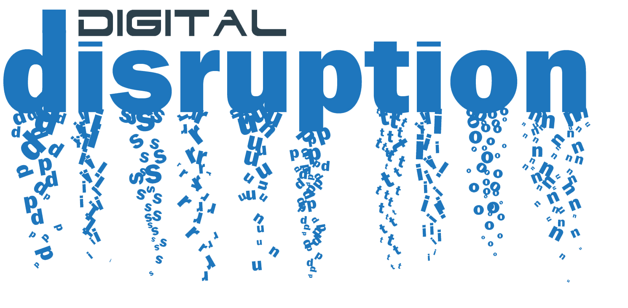
12th International Conference Perspectives, Practices and Research Trends THEME:BUSINESS MANAGEMENT & INNOVATION
Ganpat University, India
25th January, 2020

Slide 2
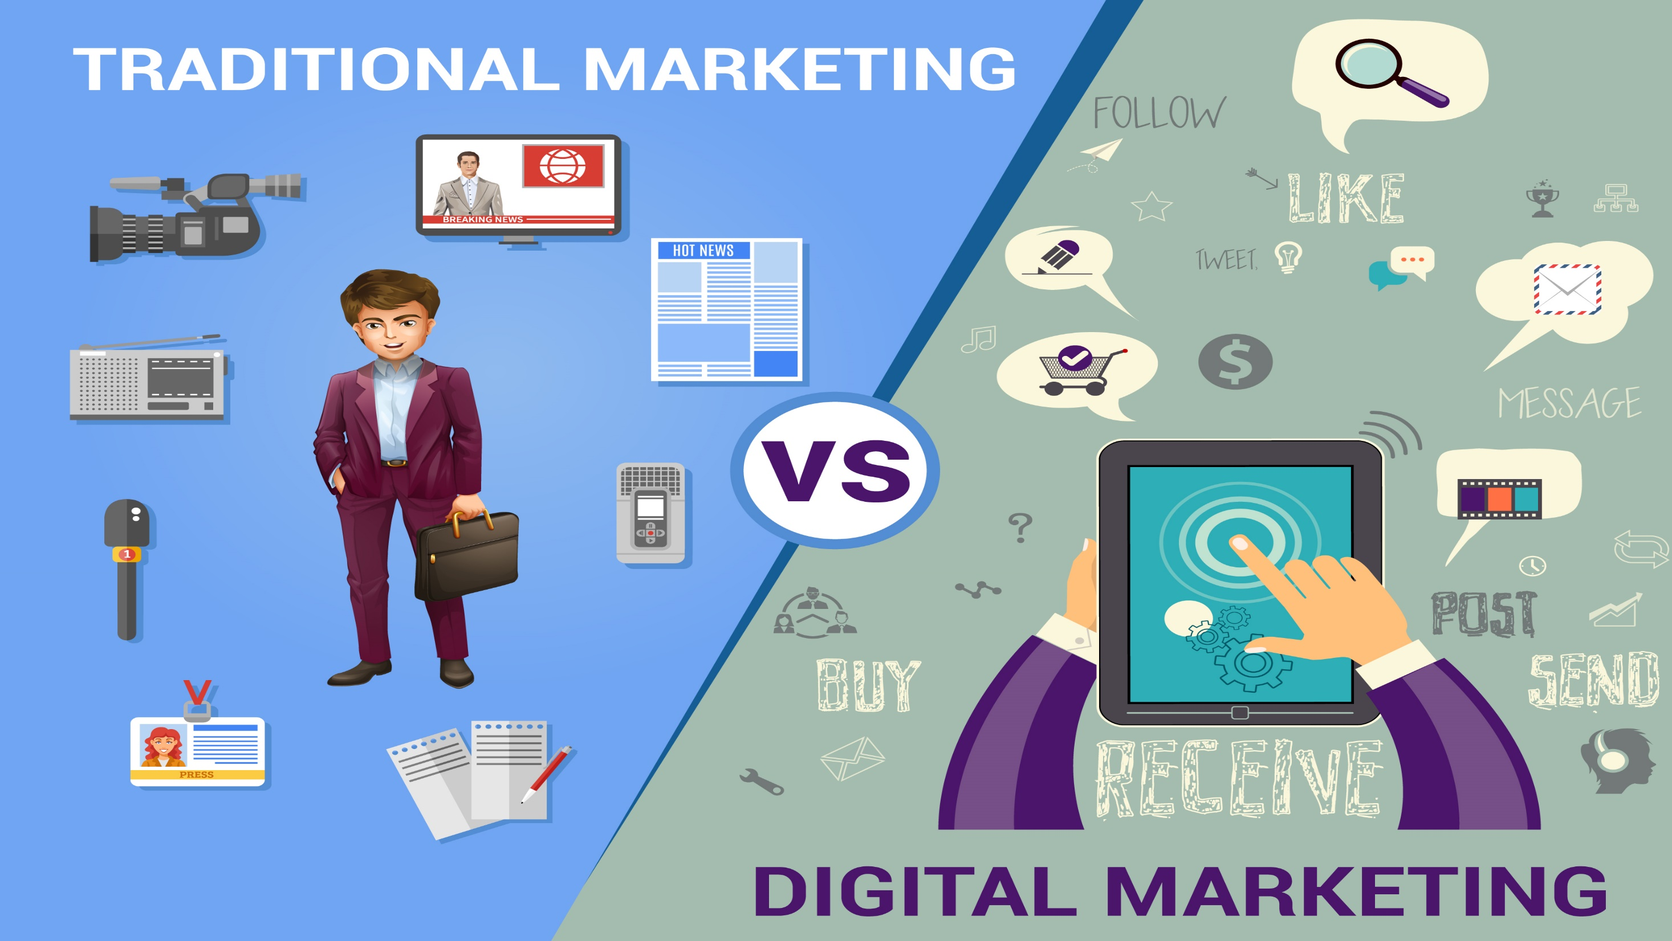
DISRUPTIVE DIGITAL MARKETING PRACTICES
A CURSE OR BOON FOR PRACTITIONERS
TOPIC:
LINET A. ODONDE
UNIVERSITY OF BOLOGNA, ITALY
BY:

Slide 3

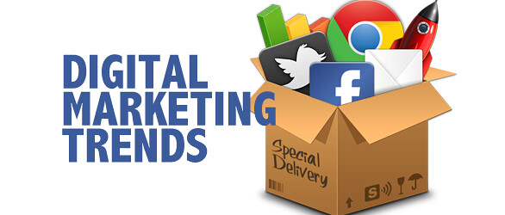
|Paper Outline
1.0| Introduction
1.1| Objective of the paper
2.0| DM Framework
4.0| Methodology
3.0| Literature Review
3.1| Digital Marketing (DM)
3.2| Pros & Cons of DM
3.3| Forms of DM
3.4| Future Steps in DM
5.0| Implications of DM on Practitioners
6.0| Conclusions & Recommendation

Slide 4
1.0| Introduction
Marketing as a technique to promote products and services has leaped tremendously over the years.
Before the 19th century, the only form of marketing known then was the traditional way of promoting products and services.
In the 19th century, evolution of technology gave birth to an enhanced form of marketing called Digital Marketing.
Since then, it has become one of the widely used form of marketing that marketing practitioners have embraced.
Thanks to the evolution of internet that gave Digital marketing wings to fly.

Slide 5

1.1| Objective
This paper aims at finding the impact of digital marketing disruption through rapid technological advancement on marketing practitioners. Its goal is to know whether this disruption is a curse or boon to practitioners.

Slide 6


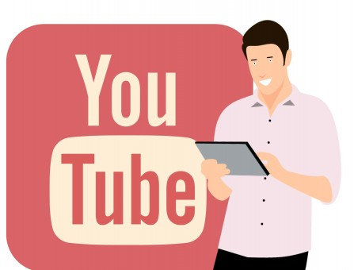



2.0| Internet & Digital Marketing
Practitioner
Changing Marketing Rules
Internet
Loyalty won
Trust won
Good relationship
Increased Revenues
Digital Marketing Forms
Physical network linking computers and other digital devices across the globe
Loyal Customers
Source: Author; Linet A. Odonde

Slide 7

4.0|Methodology
This paper gathered several related published literatures which were reviewed, analyzed and conclusions drawn on the subject matter.

Slide 8
3.0| Reviewed Subjects
Internet
Digital Marketing
Future Steps
Definition
Definition
Pros & Cons
Forms
Impact on DM
Partnership & Collaboration
Bridge Innovation Gap
Brand Atomization
Transform Digital Talent

Slide 9
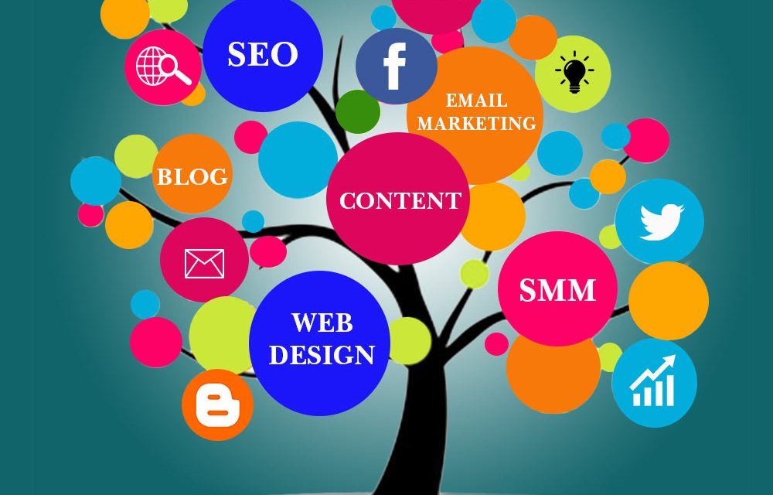
3.1| Digital Marketing…….What is it? (Internet + digital technologies to promote products & services)
3.3| Forms
SEO
SMM
3.2| Pros
Cost effective + efficient + audience
3.2| Cons
Privacy and Security
SEM
Email
Influencer
Affiliate
Mobile phone
Internet
Viral
Trust issues
Measurable
Lacks integrity + genuineness
Non Internet
No face to face
Personalization
Accessibility 24hrs
No geo boundaries

Slide 10
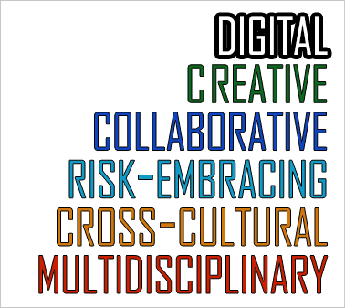
3.4| Next Steps
Partnership & Collaboration
Bridge Innovation Gap
Brand Atomization
Transform Digital Talent
Future Steps

Slide 11
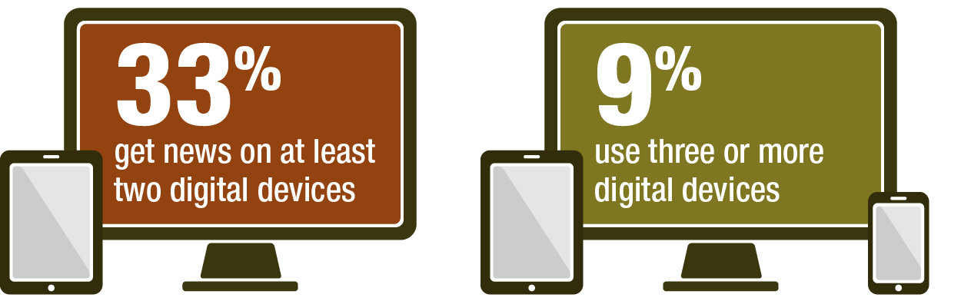
5.0| Implications on Practitioners
Boon | Curse
Cost - effective and efficient Information is online, no need for huge investment in same technology | DM works well when more than one form is implemented which increases tech budget. Practitioners forced to be on the watch for new innovations despite their curiosity
Reaches a large number of prospective customers | Investing without a clear picture of the impact of such investment
Promotes practitioner-customer relationship (one-on-one conversations, can personalize customers)
Benefit from huge sales Trackable performance (Can Plan)

Slide 12


6.0| Conclusions
Despite disruptions in Digital Marketing practices caused by rapid technological advancement, most literatures show that marketing practitioners have continued to embrace Digital Marketing practices developing good customer relations, retaining customers by giving them what they want hence selling more.
With regards to the findings, this paper concludes that there would be no harm if practitioners continued to invest in future beneficial innovations. This is because newer and emerging innovations have been reported to be cost-effected and efficient compared with the traditional way of marketing, and this is all what practitioners need.
This paper therefore calls upon practitioners to stop getting curious about future innovations and instead consider blending more than one Digital Marketing strategies (previous and current) as they keep their eyes on upcoming innovations for a better performance in their businesses.
In addition, before practitioners could invest in newer innovations like cognitive technology, they should conduct proper research and find out more about the potential technology. This is because research have shown that most practitioners invest in technologies without prior knowledge which end up backfiring in the long run.

Slide 13

Recommendation
The limitation faced was on almost no studies exploring directly on the subject matter. Many of the literatures reviewed in one way or another studied the effect of Digital Marketing practices on consumers, whereas neglecting the practitioners’ point of view.
This paper put into consideration related publications to be able to meet its objective. It is for this reason that this article is strongly advocating for solid research to be conducted on the effects of technological advancement in Digital Marketing on marketing practitioners. This will give their clear point of view on this subject matter.

Slide 14
|Thank You So Much for Your Attention!|

