Slide 1

Nelson Mandela African Institution of Science and Technology – Arusha
E-Government Meetting; 02 February, 2019 - UDOM
Machine Learning – Based Approach to Evaluate the Quality of Maternal, Neonatal and Child Health Services in Developing Countries
Sarah Nyanjara, Dina Machuve (Ph.D) and Pirkko Nykenan (Professor Emerita)

Slide 2
Background
For the past two decades, tremendous efforts have been made to reduce mortality and morbidity among mothers and children under five years.
Despite notable efforts, maternal and neonatal deaths are still high around the world; majority coming from developing countries.
The high occurrences of mortality are frequent linked with poor quality of Maternal Neonatal and Child Health (MNCH) services provided.

Slide 3
Background Cont.…….
A recent situational analysis shows that up to two thirds newborns could be saved if essential quality care reaches mothers and babies in Tanzania.
A study by Kruk et al., further emphasized that to reduce mortality rates, developing countries should systematically assess and improve the quality of MNCH services.

Slide 4
Nature of the problem study intends to solve
Quality measurement is important step in a process of improving quality of MNCH services. Essentially, it evaluates the performance of health services according to the acceptable standards, tells whether health services provided have the required standards that can improve health and survival of women and children.
Contrariwise, developing countries relatively lack effective approaches for quality measurement. Commonly they use facility quality assessment tools, frameworks and methods like exit interview, observation and surveys which all are manual and paper-based

Slide 5
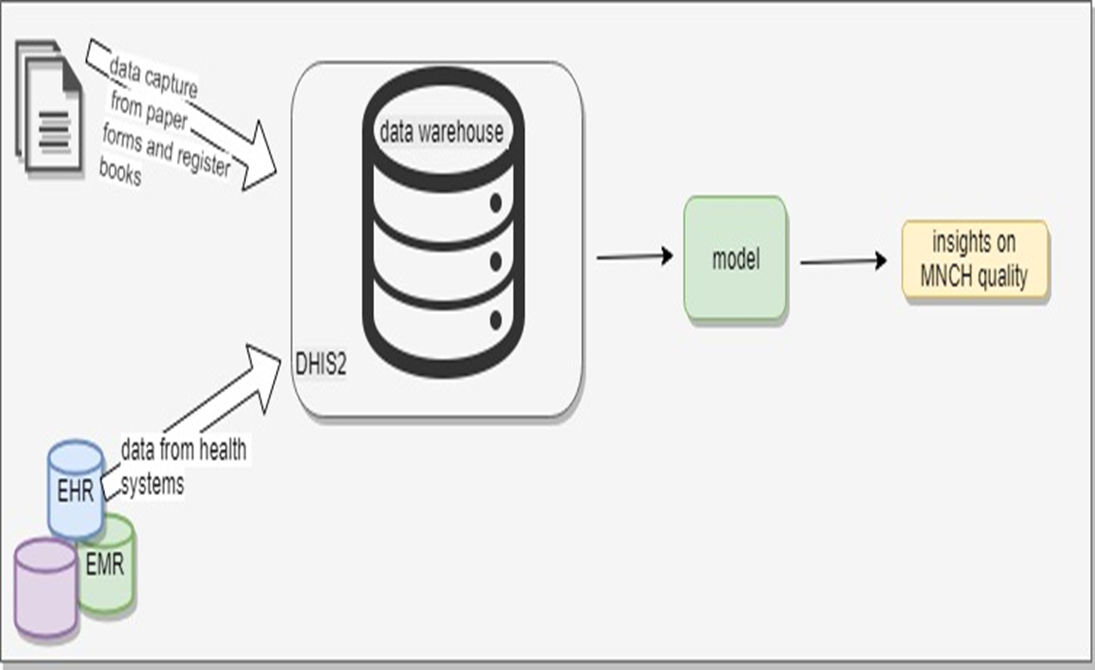
Technology Used

Slide 6
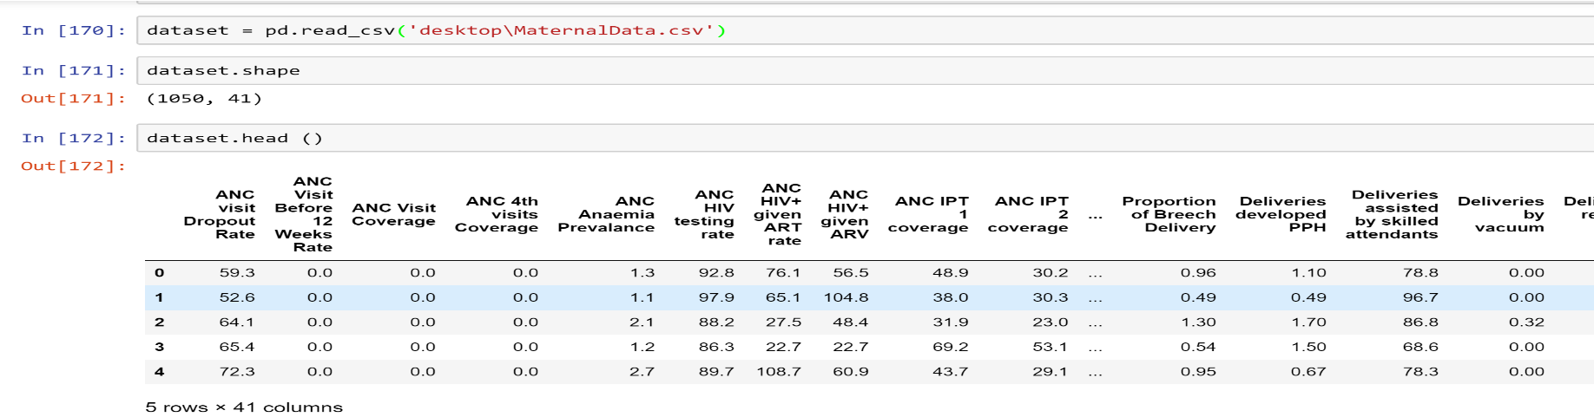
Methodology
Dataset
The dataset comprises of five (5) years MNCH data based on eleven (11) MNCH quality indicators acquired from District Health Information System (DHIS2). The data set had 41 columns and 1050 rows

Slide 7
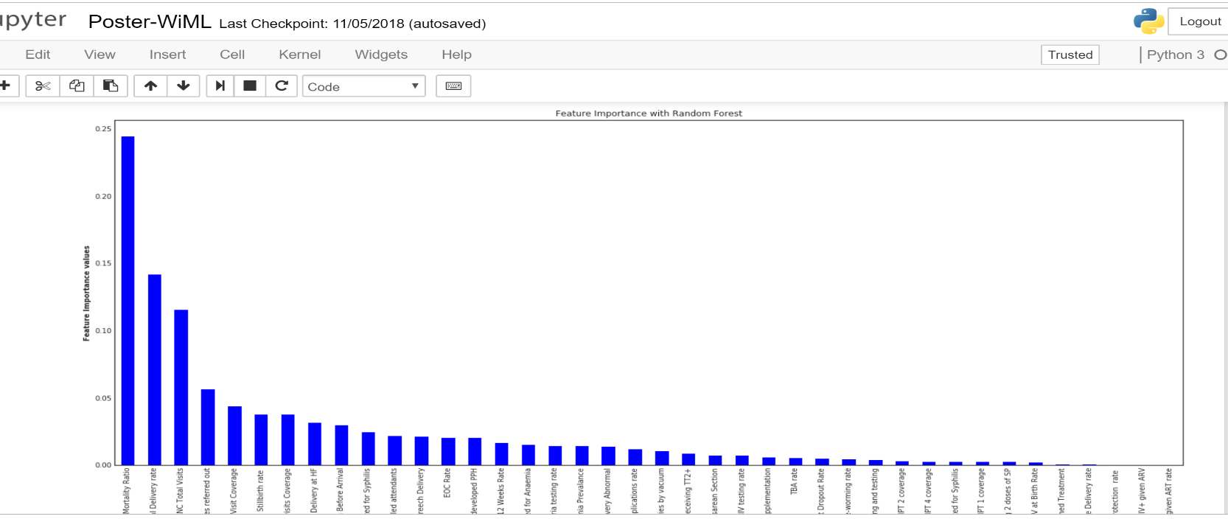
Feature engineering
Features
Features were selected using random forest

Slide 8
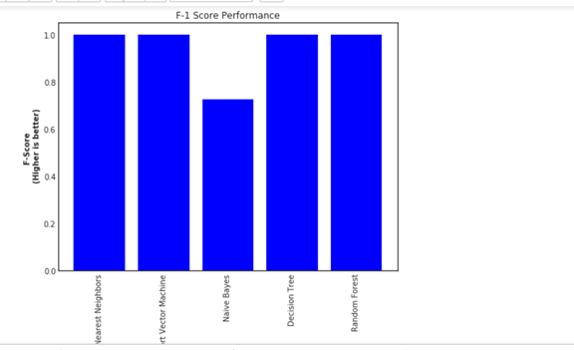
Results Cont. …….
Classifier
Using Python’s Scikit Learn Machine Learning classifier were developed

Slide 9
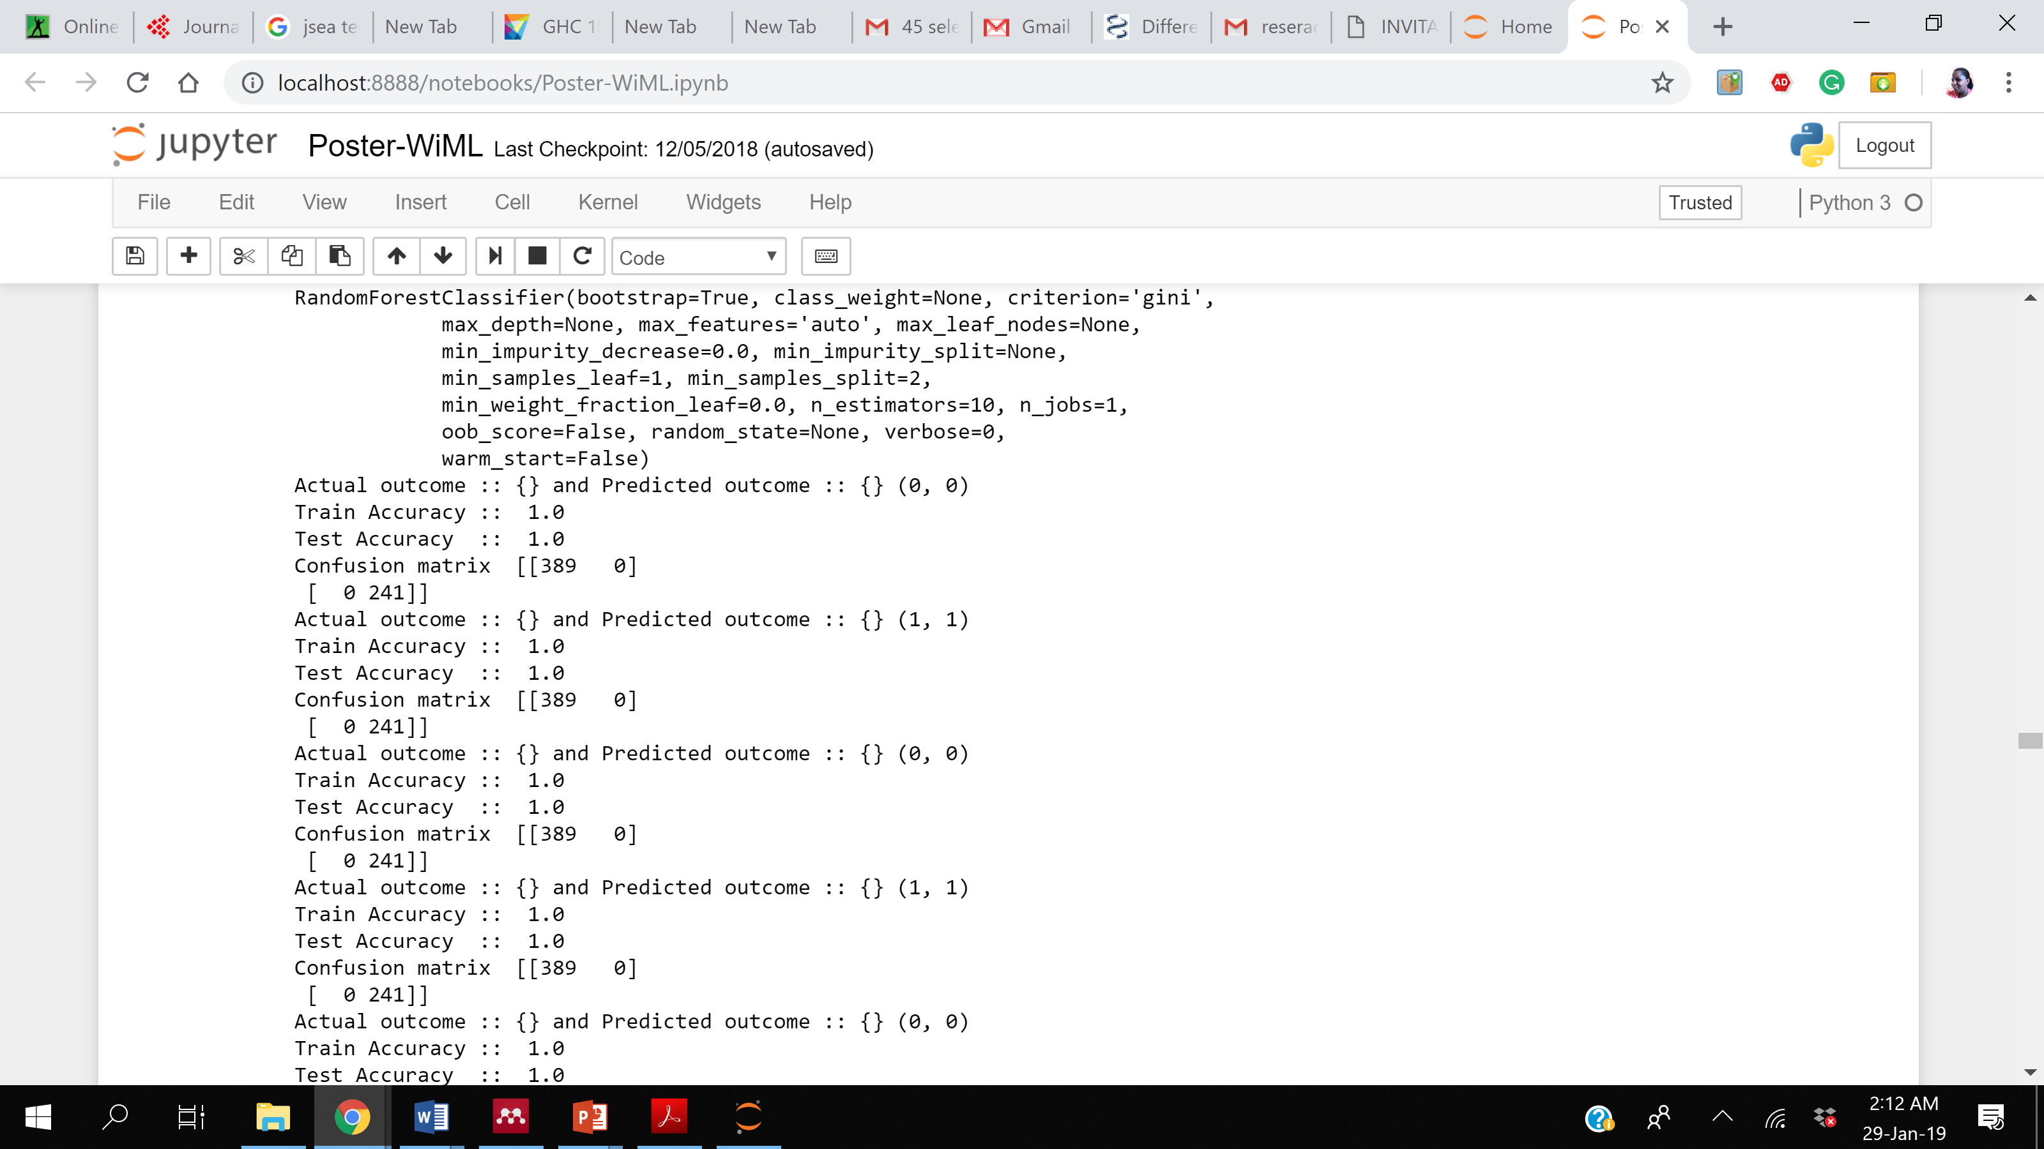
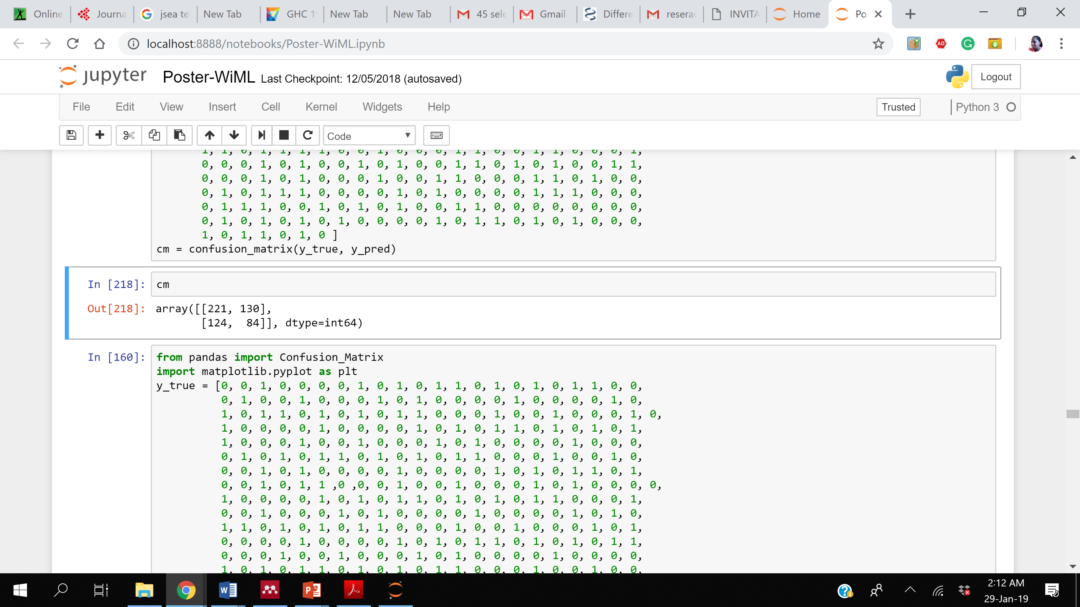
Results Cont. …….

Slide 10
Group of Users
G2G (Government officials responsible with monitoring and evaluation can use to report on quality status)
G2C (Government can use to inform citizens on the quality of MNCH services provided ) and
G2E (Government can use to evaluate the performance of employees as well as interventions geared to improve quality of MNCH care)

Slide 11
Expected Benefits
Machine learning speed-up quality measurement thus overcome costly, laborious and time consuming task of using traditional quality measure.
A learned quality measure algorithm (model) can provide more valid and reliable results than manual approach.
Machine learning has the potential to assess all components in continuum care concurrently to improve MNCH outcomes

Slide 12
Thank You!

