Slide 1
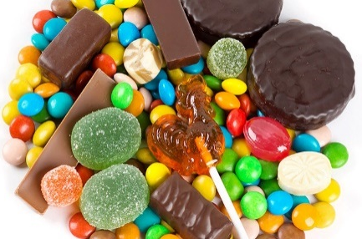

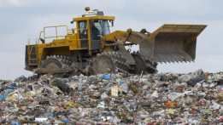

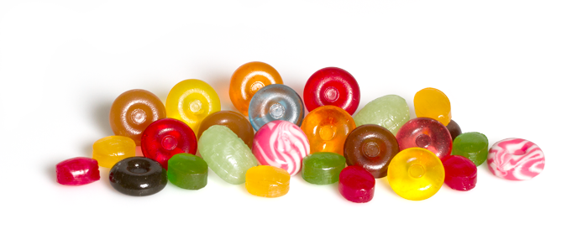
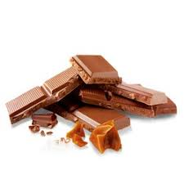
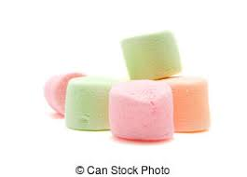

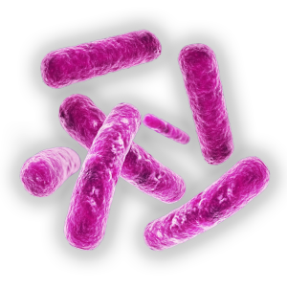
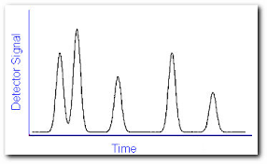
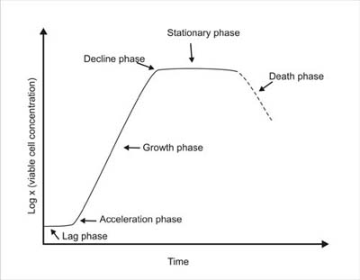
Waste to Energy: Confectionery waste as a substrate for renewable energy production
C.Z. Ngwenya, Dr M. Smart & Prof S.T.L Harrison
INTRODUCTION
Annually, the Confectionery industry generates approx. 625 tonnes of sugar-rich waste per manufacturing site which is discarded into landfills. Landfilling is a major environmental burden in South Africa. The carbohydrate content of confectionery waste makes it an ideal bioprocess feedstock for renewable energy production. Valorisation of confectionery waste, as suggested in Fig. 1, contribute to the national Bio-economy strategy (2014) of SA that focuses on diverting waste from landfill site into value added products using sustainable and environmentally friendly production processes.
Fermentation /
Anaerobic digestion
Bioethanol
Biobutanol
Biogas
Process intermediate recovery: volatile fatty acids (AD)
Figure 1: A diagrammatical representation of the valorisation of confectionery waste
ETHANOL PRODUCTION METHODOLOGY
RESULTS
Synthetic sugar mix
Hard Candy
Chocolate
Marshmallows
20 g/L Sugar
Figure 2: Growth and ethanol production by Z. mobilis on a synthetic sugar mix
C₆H₁₂O₆
100 ml
2C₂H₅OH + 2CO₂
Anaerobic culture of Zymomonas mobilis (ATCC 31821) @30°C
Analysis of sucrose, glucose, fructose and ethanol by HPLC
Analysis of microbial growth by optical density, cell dry weight and direct cell counting
Figure 3: Biomass productivities, yield coefficients and ethanol concentrations achieved using confectionery as substrate for the anaerobic cultivation of Z. mobilis.
FINDINGS & CONCLUSIONS
Z. mobilis can efficiently utilise sugars such as sucrose, glucose and fructose (the predominant sugars in confectionery waste) for biomass growth and ethanol production (Fig. 2). Similarly, Z. mobilis was able to ferment the sugars in confectionery products and produce ethanol and biomass. However, the ethanol concentrations achieved from confectionery products were lower than those of the synthetic mix (Fig. 3), possibly due to the presence of unknown additives in confectionery products such as acidifiers, acidulants and colourants. Bioethanol production will further be optimised (pH and temperature) using confectionery as substrate and Z. mobilis as production strain on a larger scale. Future work will include the investigation of confectionery products as feasible substrates for biobutanol production using Clostridium saccharobutylicum as production strain and also investigate biohydrogen and biomethane production.
ACKNOWLEDGEMENTS
REFERENCES
Funding for this project is provided by the Department of Science and Technology, the Council of Scientific and Industrial Research and the National Research Foundation of South Africa through the SARChI Chair in Bioprocess Engineering (UID 64778) held by Prof S Harrison.
Department of Science and Technology (2014). A waste research, development and innovation roadmap for South Africa (2015 – 2025). Summary report. Department of Science and Technology. Pretoria.

