Slide 1
Optimization of Irradiance and Initial Inoculum Concentration as Cultivation Conditions for Microcystis aeruginosa Using Response Surface Methodology
Samar A. El-Mekkawi,*, N. N. El-Ibiari , Ola A. El-Ardy , Nabil M. Abdelmonem, Ahmed H. Elahwany, Magdi F. Abadir, Ibrahim M. Ismail

Slide 2
Outline
Abstract
Keywords
Introduction
Material and Methods
Results
Discussion
Conclusions
References

Slide 3
Introduction
Biodiesel is a sustainable and renewable energy source with a positive environmental effect in reducing GHG emissions.
Third generation of bio-fuels is derived from microalgae.
The optimization of biomass and oil concentration in biodiesel production based on algal cultivation relies upon several factors as irradiance.
The present experimental work aims to optimize some of the cultivation conditions to obtain maximum oil and biomass yield.

Slide 4
First, a suitable strain (Microcystis aeruginosa) out of four local available strains Scenedesmus obliquus (green algae), Nannochloropsis sp. (genus of algae), Spirulina platensis (cyanobacteria), and M. aeruginosa (cyanobacteria) was selected based on its oil content.
The effects of geometric shape and the dimensions of bubble column photobioreactor on algal growth were studied.

Slide 5
This work also investigated the use of three models describing M. aeruginosa growth through relations between irradiance and either growth rate or specific growth rate. The models' constants (α, I_{k}, K_{I}) being obtained experimentally.
Moreover; two prediction models describe the effect of the initial inoculum concentration and irradiance on biomass yield and oil concentration were created using Design Expert Program 6.0.8.

Slide 6
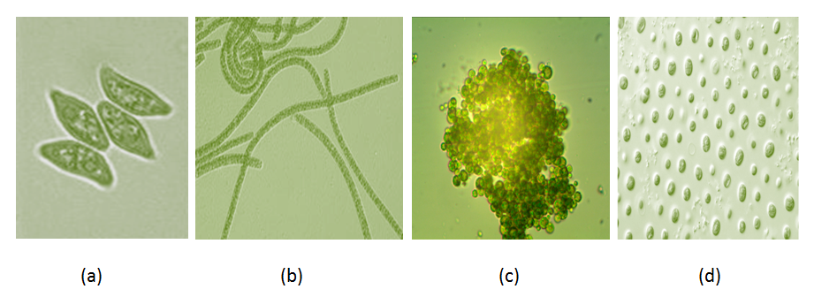
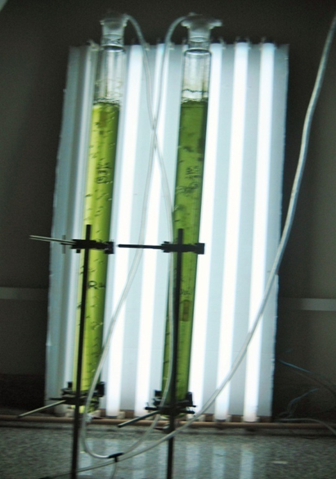
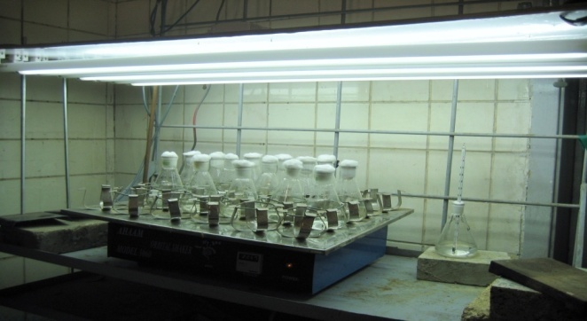
Nutrient Solution | Stock Weight (g/l)
K₂HPO₄ | 40
NaNO₃ | 1500
MgSO₄.7H₂O | 75
CaCl₂ anhydrous | 330.98
Citric acid | 6
Na₂CO₃ | 20
Na₂EDTA | 1
Ferric ammonium citrate | 6
Trace elements* | (2.86 g) H₃BO₃, (1.81 g) MnCl₂.4H₂O, (0.222 g) ZnSO₄.7H₂O, (0.39 g) Na₂MoO₄.2H₂O, (0.079 g) CuSO₄.5H₂O (0.0494g)Co(NO₃)₂.6H₂O Dissolved in 1L of distillate water.
Material and Methods
Scenedesmus obliquus, (b) Spirulina platensis,
(c) Microcystis aeruginosa, (d) Nannochloropsis sp

Slide 7
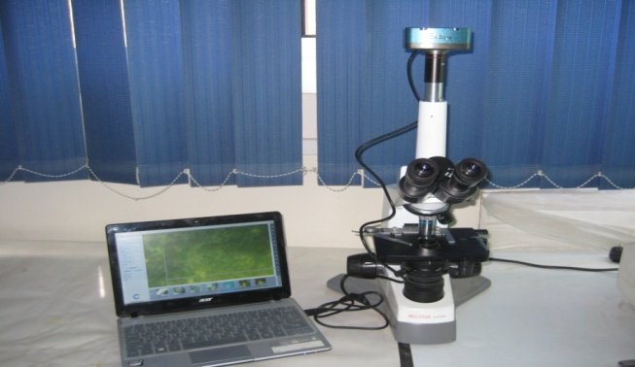
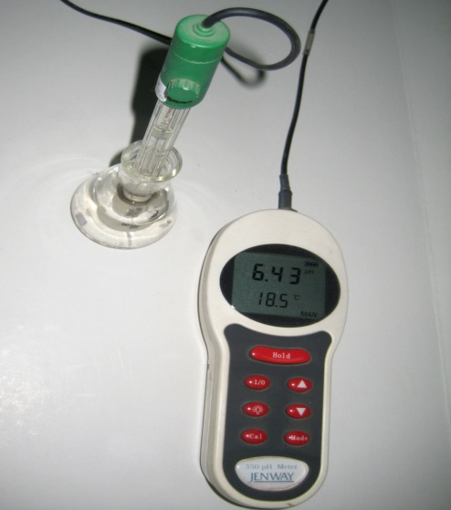
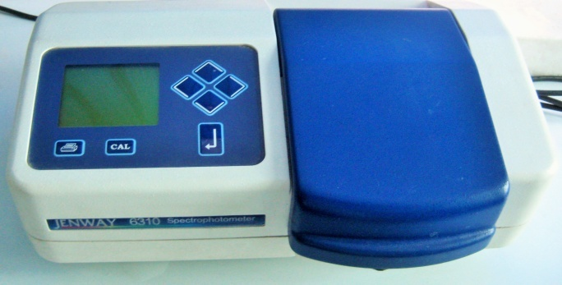
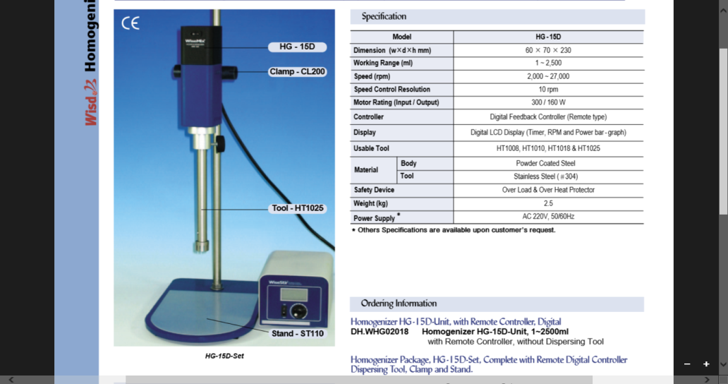
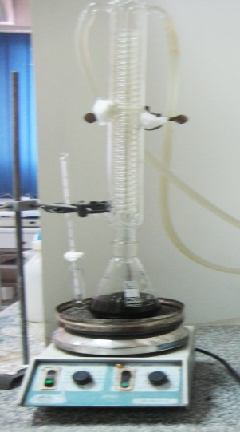
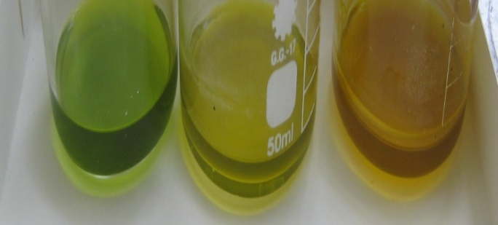
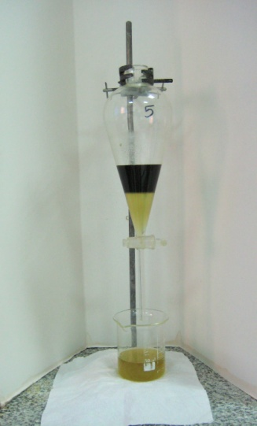
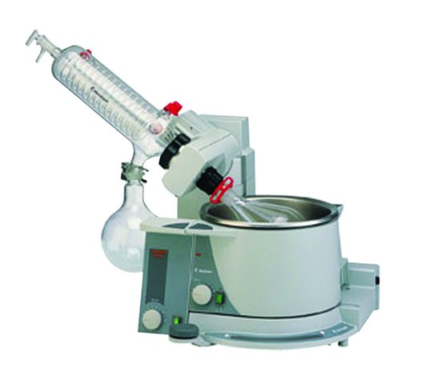
Cultivation Follow-up
Microscopic examination
Chlorophyll content
OD
pH
Oil extraction

Slide 8
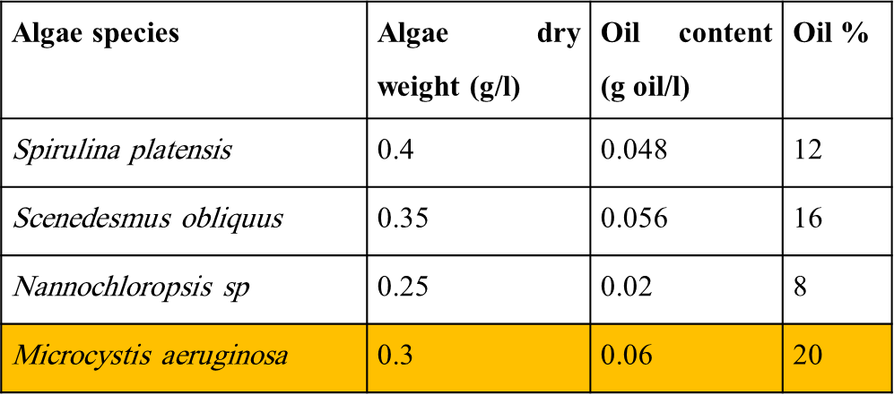
Results
Oil content of selected strains
S/V | Yield (mg/l.d) | µ (d⁻¹) | t_{d} (day)
1.8 | 23.3 | 0.328 | 2.113
0.9 | 45 | 0.344 | 2.015
0.63 | 42.4 | 0.336 | 2.063
0.48 | 33.8 | 0.331 | 2.094
Comparison between different S/V of PBR

Slide 9
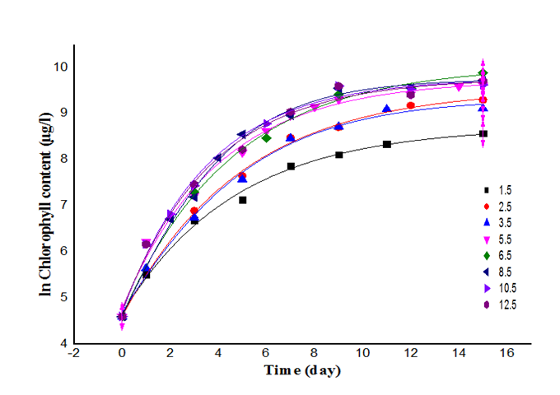
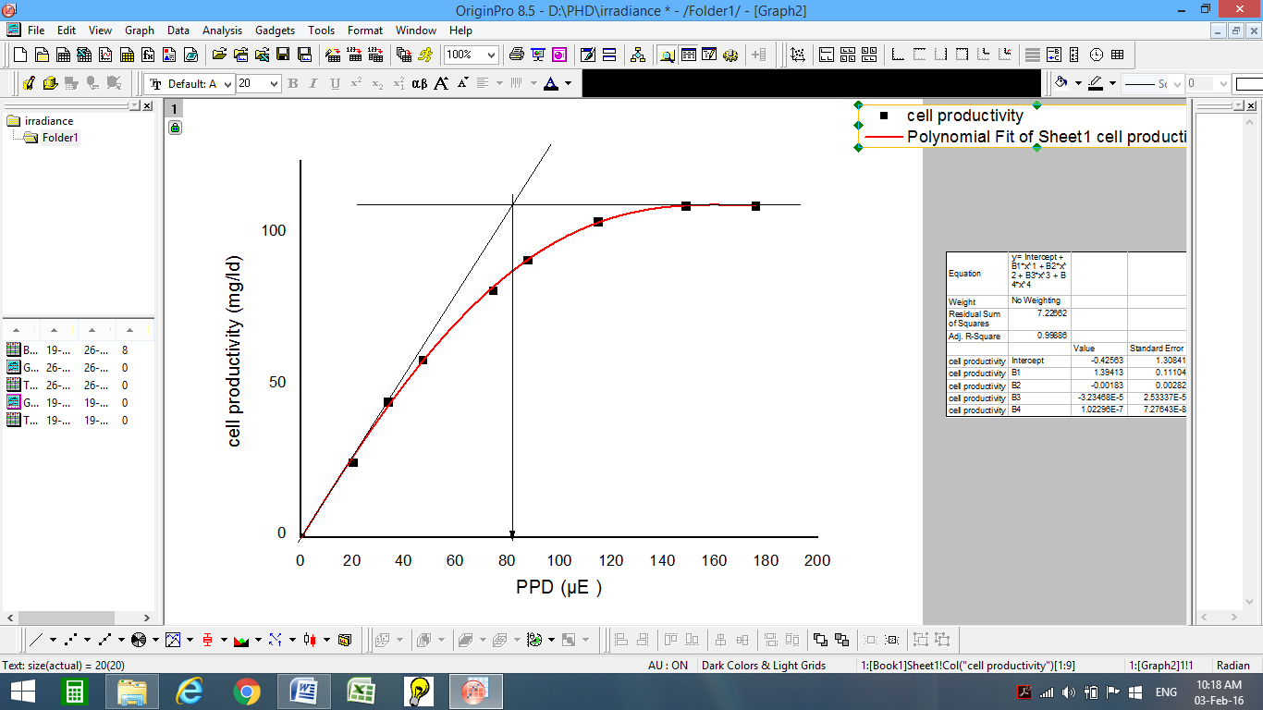
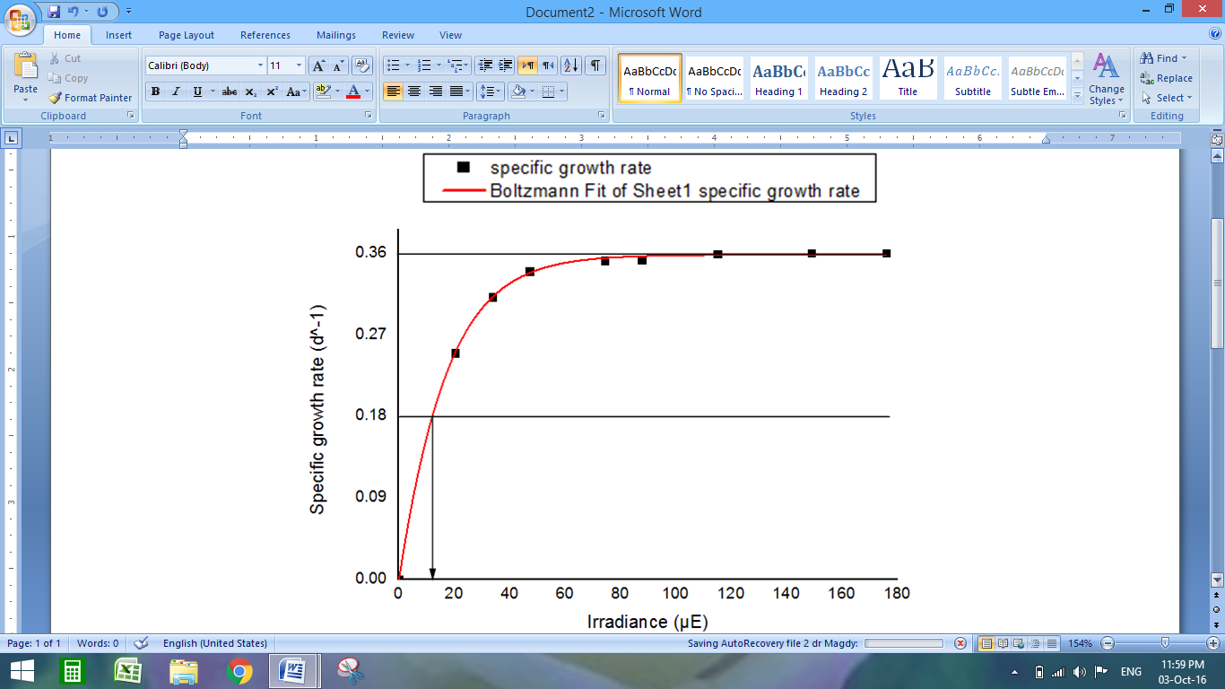


Growth Curves
Run | I (klx) | I (µE ) | yield (mg l⁻¹d⁻¹)
1 | 1.5 | 20.3 | 25
2 | 2.5 | 33.8 | 45
3 | 3.5 | 47.2 | 59
4 | 5.5 | 74.3 | 82
5 | 6.5 | 87.8 | 92
6 | 8.5 | 115 | 104.7
7 | 10.5 | 149 | 110
8 | 12.5 | 176 | 110
P- I curve
µ-I curve
K_{I} = I = 12.5 µE

Slide 10
Actual Versus Predicted Values

Slide 11
Known factors
Variable selection and Data set
Factors Effects and Interactions
Experimental design
No
Curvature
Yes
Response Surface Methodology
Optimization
Confirm
No
Back up
Verification
Model Equation
Yes

Slide 12
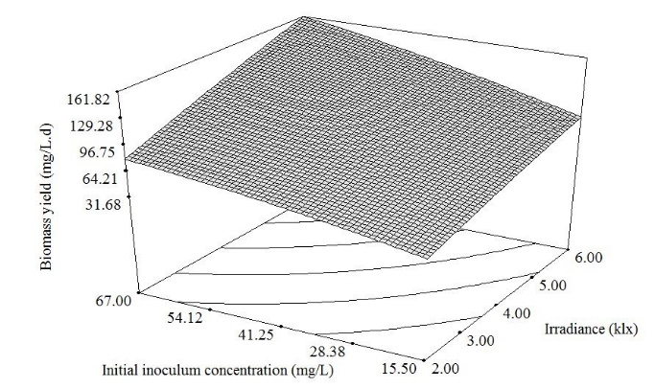
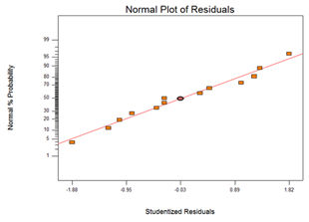
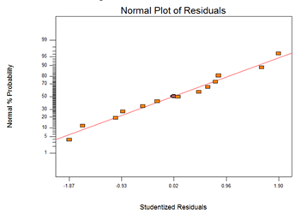
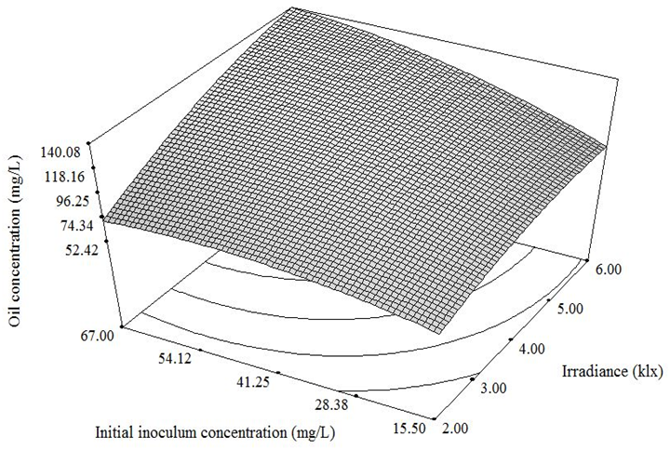
The Model equation of yield response in terms of actual variables is:
Yield= -19.00271+(15.5651×I)+(1.23044×C)-(0.51875×I²)-(6.8998×10³×C²)+ (0.1352×I×C)
The Model equation of oil content response in terms of actual variables is:
Oil content = -5.09018 + (22.23279×I) + (1.28624×C) - (2.31375×I²) - (0.015843×C²) + (0.19903×I×C)

Slide 13
Conclusions
Microcystis aeruginosa contains sufficient amount of oil content suitable for biodiesel production.
The optimum illuminated surface area to volume ratio is 0.9. This ratio is viable for diameter range 4-6 cm and length range 1.0-1.5 m.
The constants of Monod model, modified Monod model, and Hyperbolic Tangent model are defined experimentally;
K=12.5 µmol.m⁻².s⁻¹, I_{k} = 85 µmol.m⁻².s⁻¹ and α = 1.294 mg.l⁻¹.d⁻¹/µmol.m⁻².s⁻¹.

Slide 14
Hyperbolic Tangent model is the most viable one, since it has less deviation than the others.
Applying factorial design; the predicted yield is 161.82 mg/l.d and the predicted oil content is 140.1 mg/L under operating conditions of irradiance 81 µmol.m⁻².s⁻¹ and initial concentration 67 mg/L.

Slide 15
Prospective research
More studies about the factors affecting photosynthetic rate as temperature, light duration and solar light could be studied by modifying hyperbolic tangent model.
Further studies about algal biorefineries should be considered.

Slide 16

Thank you
Questions Please

