Slide 1
FLOODS AS AN EXAMPLE OF EXTREME EVENTS IN KHARTOUM
Workshop on Climate Change Adaptation in the Economic Development Sector Using Integrated Water
Resources Management (IWRM) Tools
Amman, 25-27 May 2016
DALAL SIDDIG
Economic and Social Commission for Western Asia (ESCWA)

Slide 2
Introduction
The extreme events such as floods, drought, heat waves, cold spells, strong winds, hurricanes are one of the critical issues regarding climate change.
A number of studies suggested that there are significant changes in the frequency and intensity of extreme events with only small changes in climate (ie Relatively higher frequencies and more intense extreme climate events).

Slide 3
Sudan is exposed to two types of extreme events:
Floods:
During the past 60 years the Khartoum State has witnessed many devastating floods incidences, e.g. 1946, 1988, 1996, 1998, 2003, 2007 and more recently in 2013.
Droughts:
The most devastating ones were in 1913, 1940, and 1954 which covered many parts of the country. In 1913 and 1940, about 1.5 million people were affected. In the 1984, 4.5 million people went hungry.

Slide 4
Background
The Greater Khartoum (Khartoum, Omdurman and Khartoum North),is the capital of Sudan, located at the confluence of the Blue Nile and White Nile rivers.
The normal population growth rate is about 2.6%, however, in the recent years it was about 6% due to people migration to the city.
The total population increased from 505,000 in 1956 to 1.7M in 1983, 3.4M in 1993, 6.0M in 2009 and 8.0M in 2012. Population increases to about 10.0 M during the day nowadays in Greater Khartoum.
Khartoum State is located in an arid climatic zone and the average annual rainfall is in order of 250 mm, the rainfall amount, intensity and frequency are characterized by very high variability which results in occasional flash floods.

Slide 5
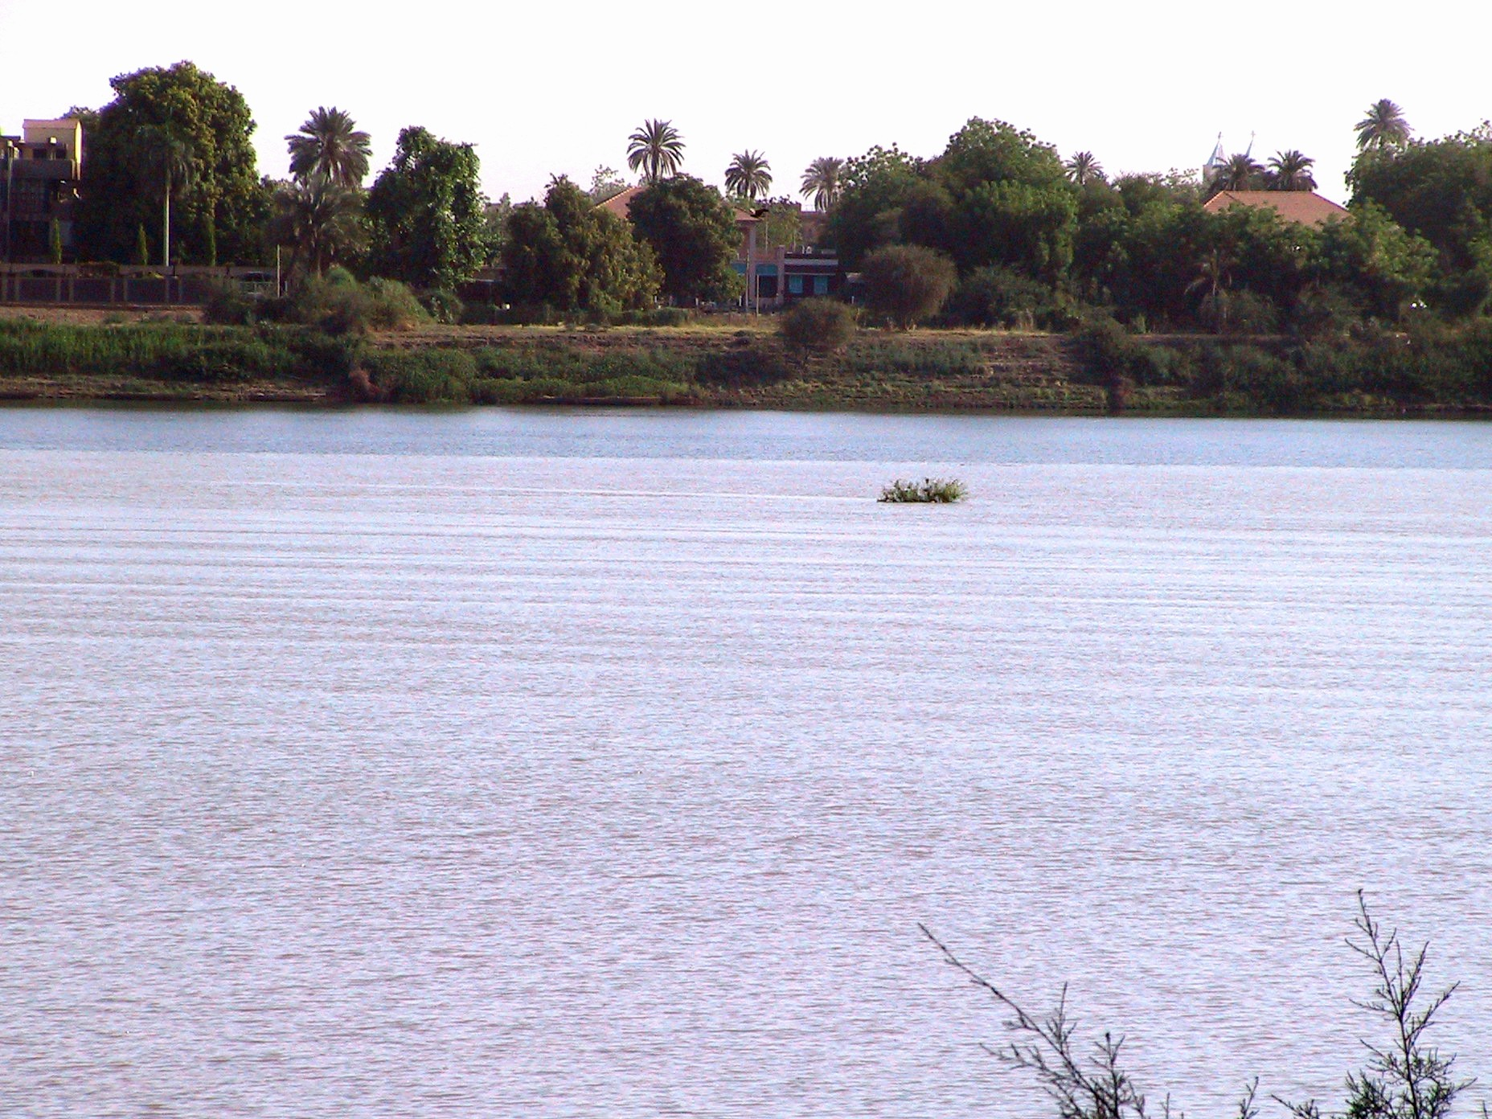
The Blue Nile and White Nile Rivers Confluence at Khartoum
(The White Nile pushes the Blue Nile to a narrow stream during the period (Nov-May) while the opposite happens during the Flood season (June – Oct).
Blue Nile
White Nile

Slide 6
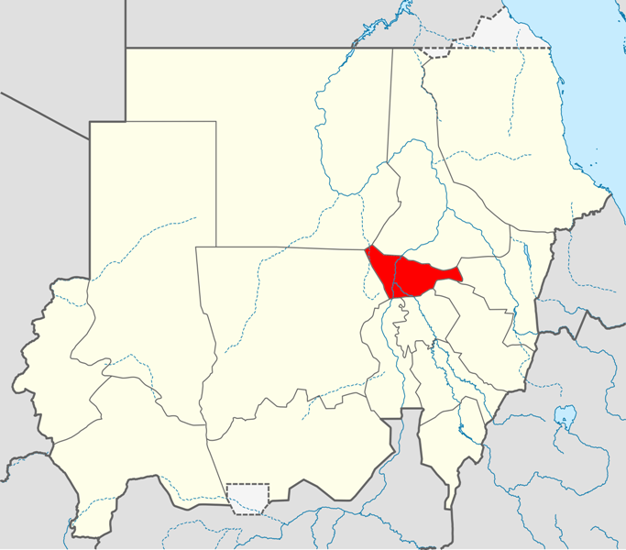
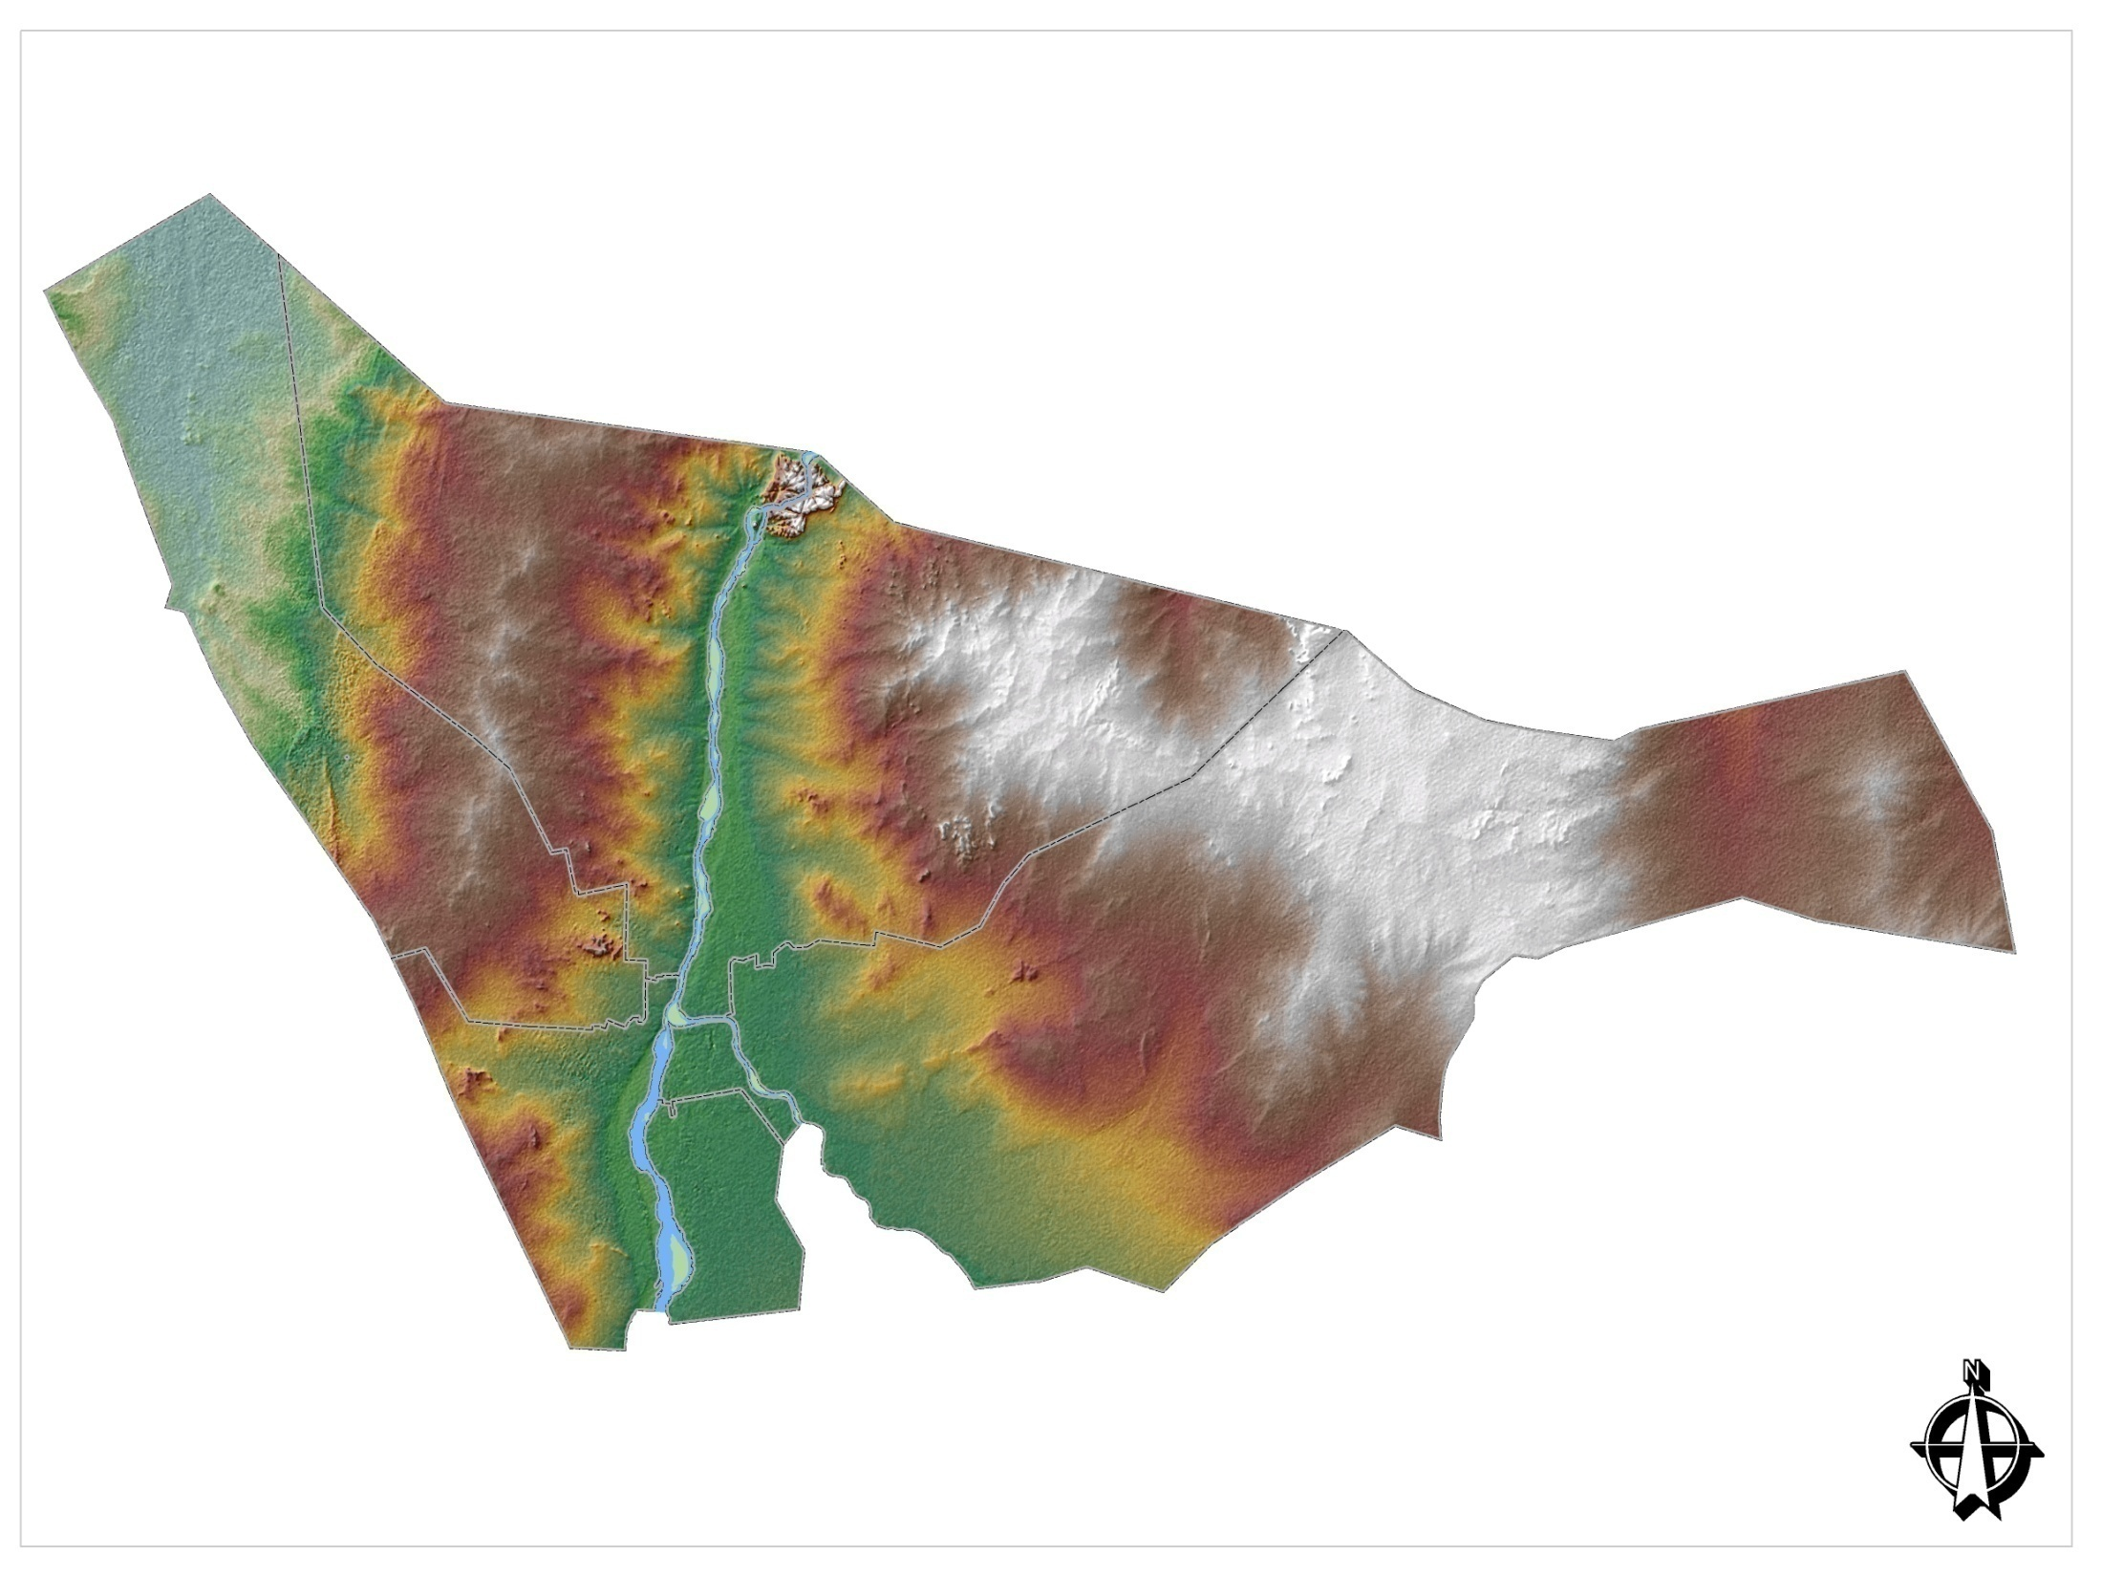


Slide 7
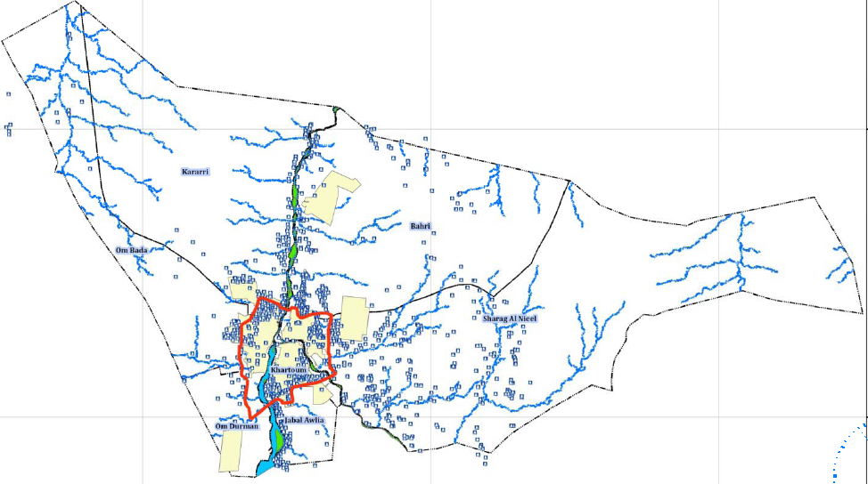
Khartoum State Natural Drainage Pattern

Slide 8
Many of these natural drainage courses (Khors) are passing through densely populated areas in cities of Khartoum North and Omdurman.
Part of these drainage courses are not clearly defined as they have been affected by sediment and sand encroachment over many years of relatively dry seasons.
Any coincidence of the high river Flood with the torrential rainfalls events produce damaging floods.

Slide 9
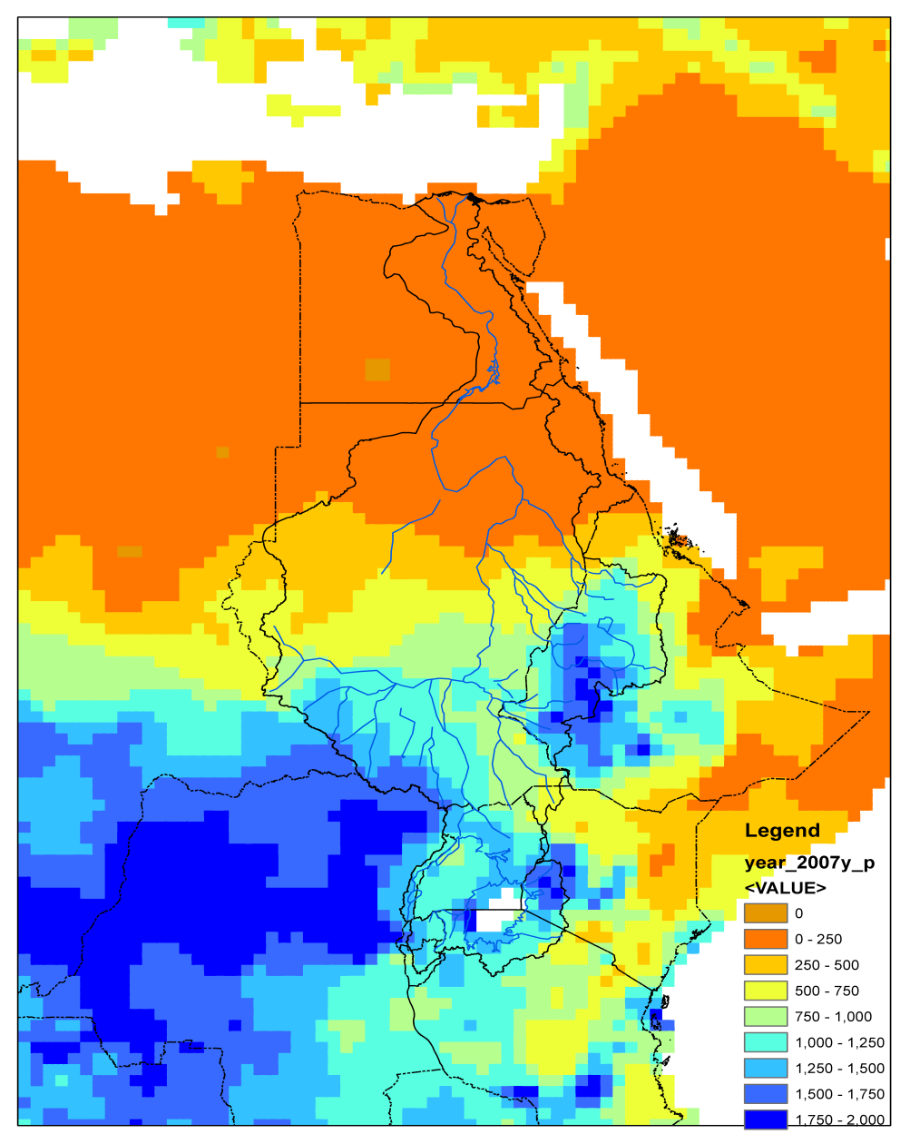
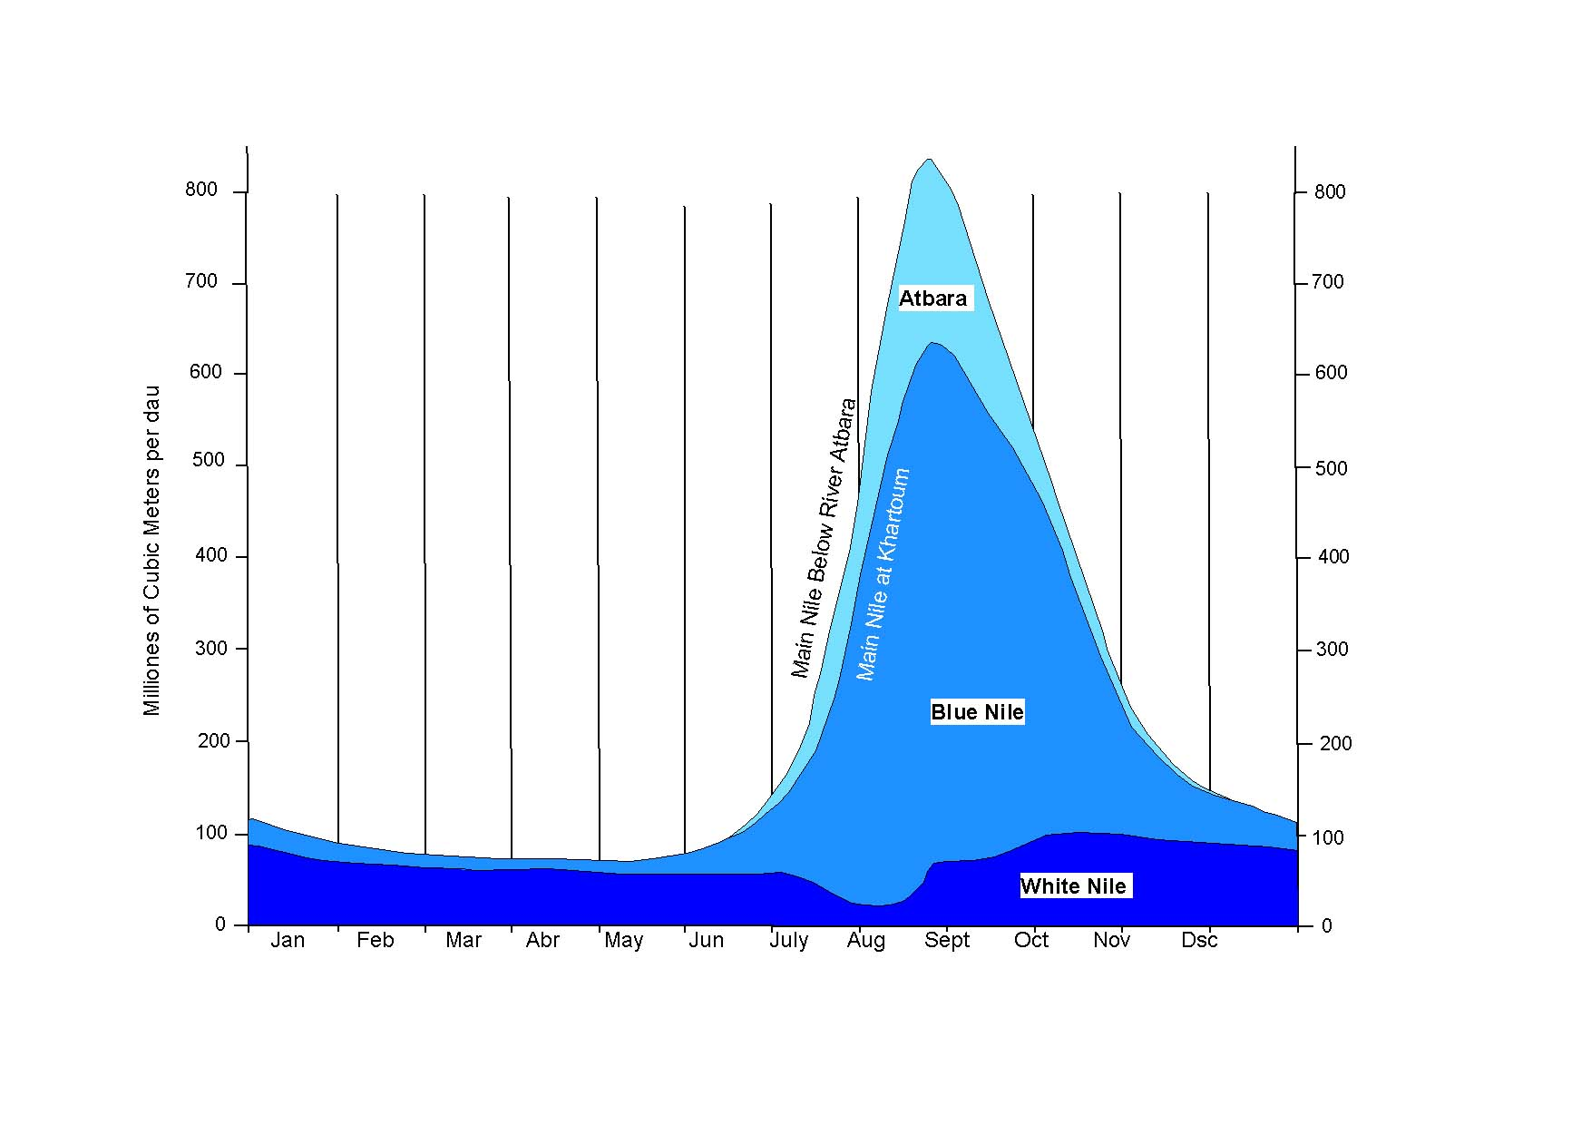
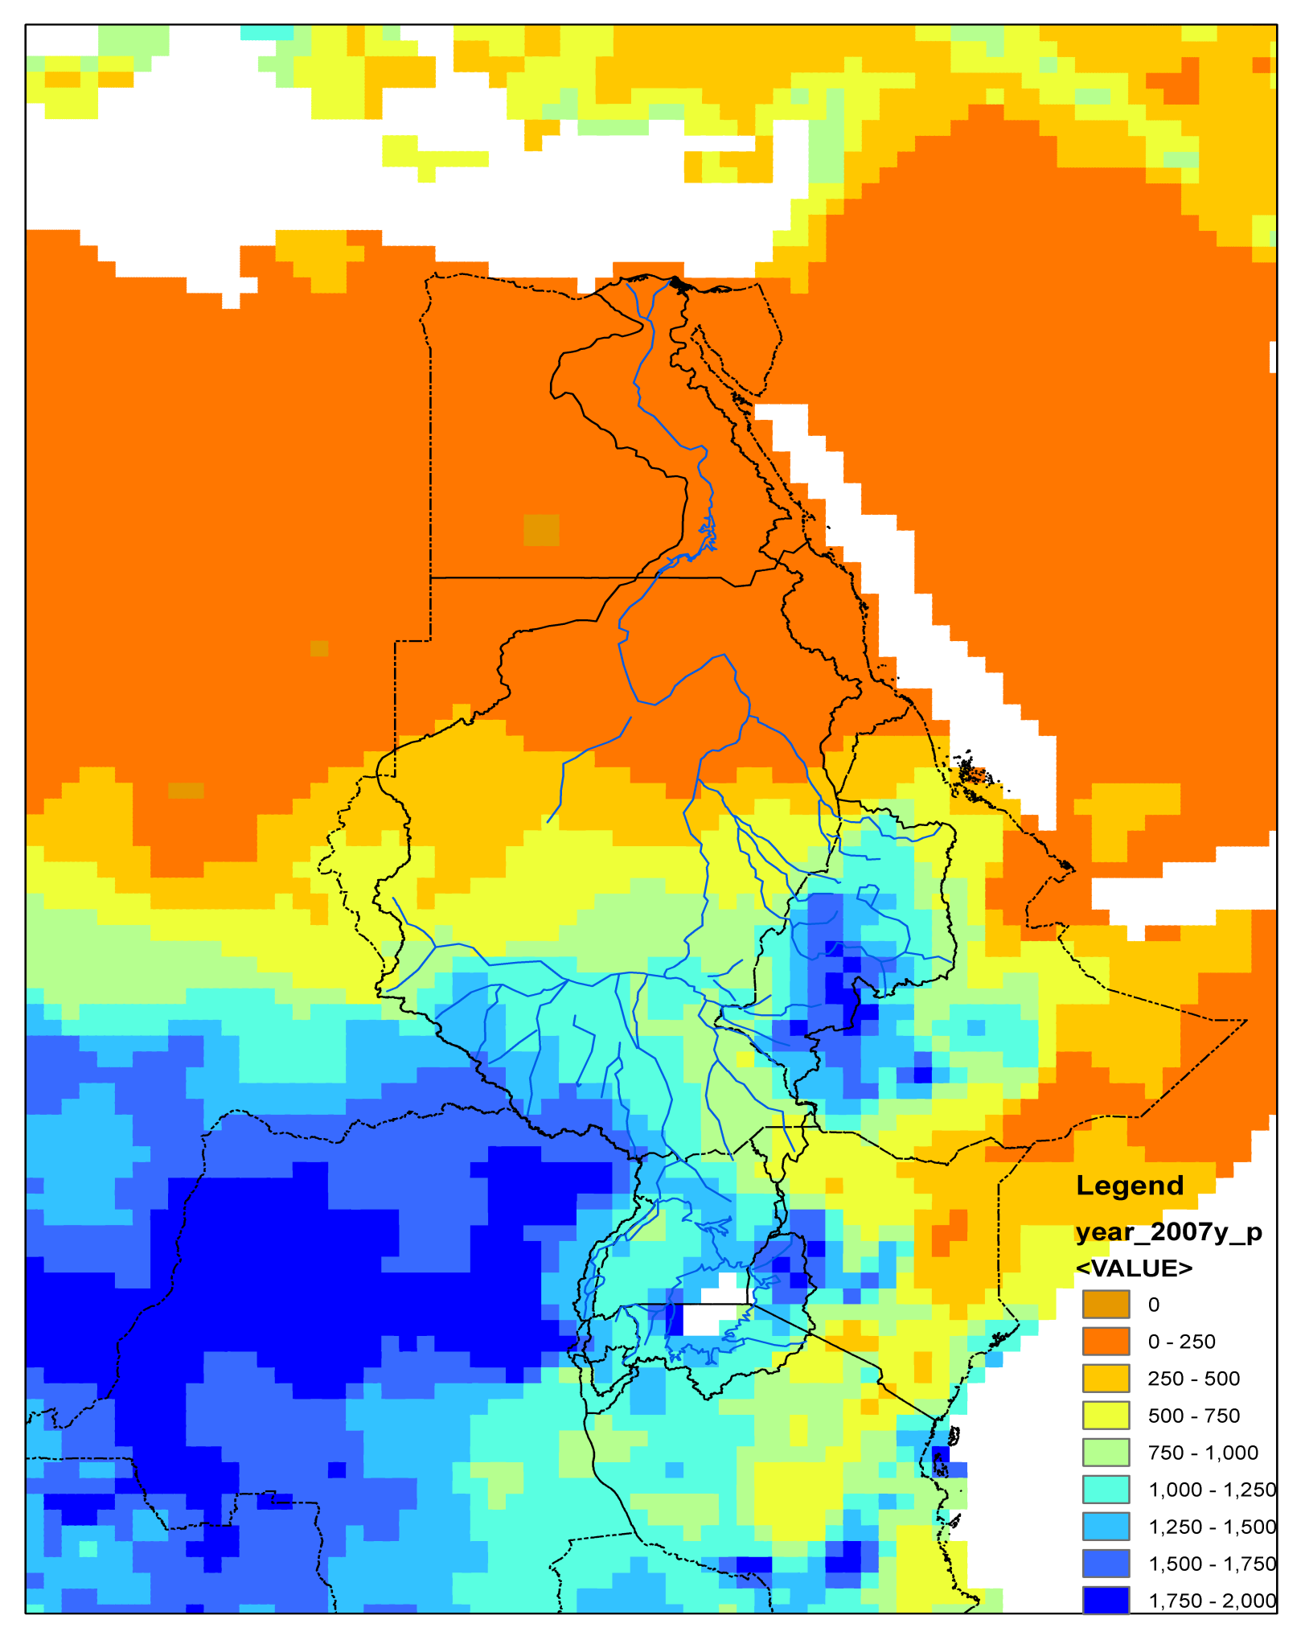
Rainfall and river flow
1000
1000
Hydrograph of the Nile River System

Slide 10
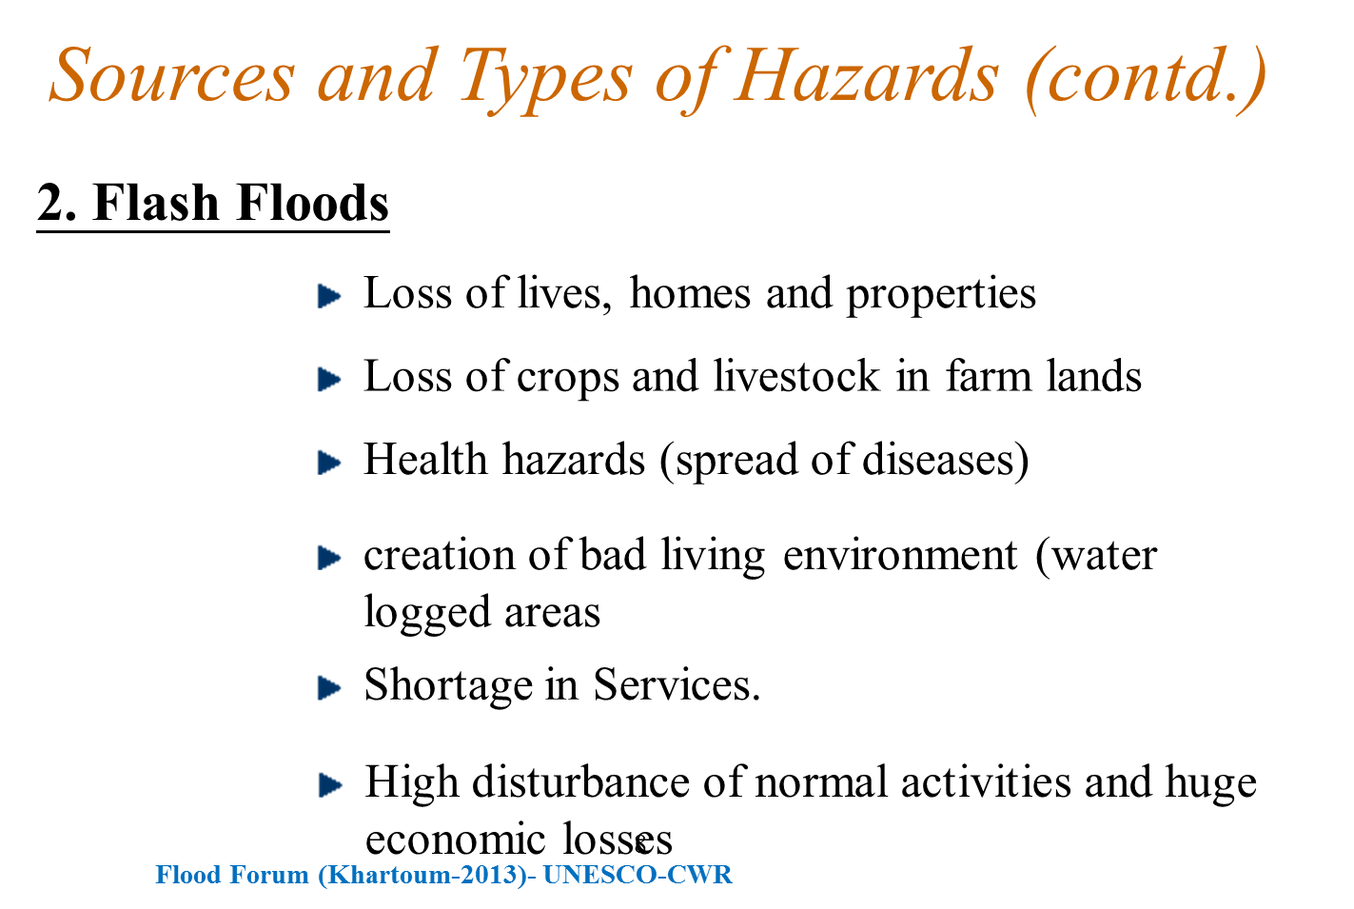
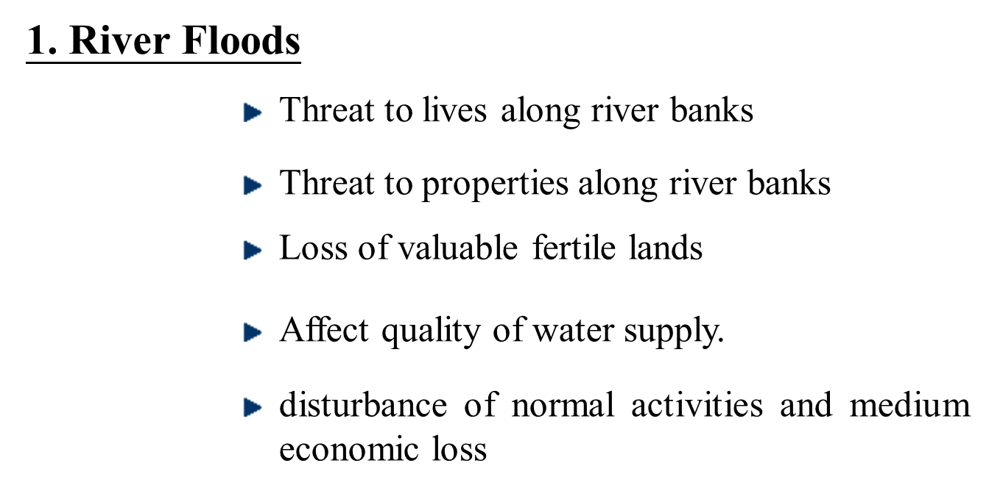
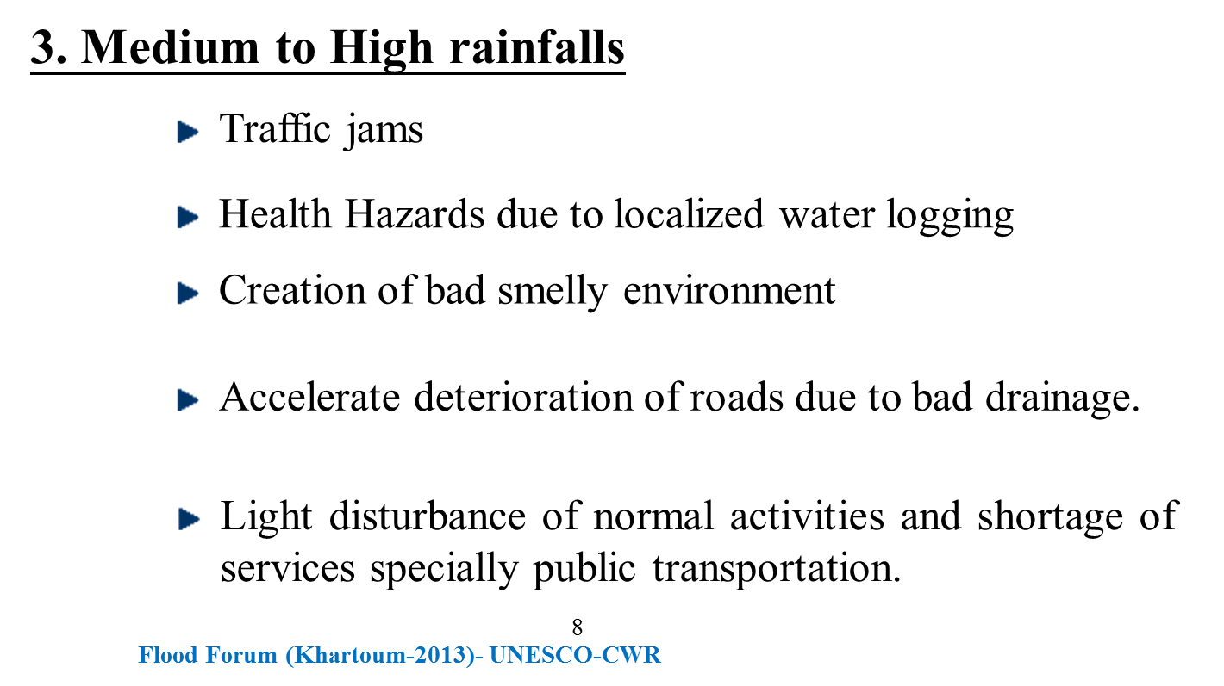
Sources and Types of Hazards

Slide 11
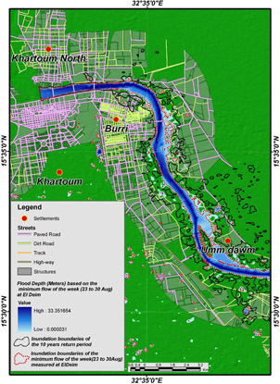
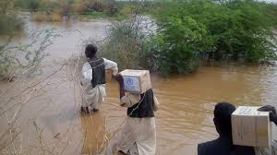
Cases of Floods in Sudan
River Nile Damaging Floods, e.g., 1946, 1988, 1998, 2006
Torrential rains (flash floods) e.g. 1999, 2007, 2009 and recently in 2013.
Heavy Rainfall compound with River Nile Flood (e.g., Khartoum 1988)
Source: ENTRO, (2010)

Slide 12
2013 Khartoum flood Impacts
In 2013 flood season, the capital Khartoum was suffering its worst flooding in 25 years.
Khartoum is vulnerable to flash floods because of weak drainage system and poor urban planning.
The 2013 floods were particular severe. More than 15,000 homes in Khartoum were destroyed (many families been homeless), with thousands more partially damaged and 180,000 people affected.
The Northern Part of Khartoum North is seriously affected socially and economically. Moreover, there was a Hugh health hazard which required great efforts to rectify.
The economic cost of the floods disasters in Khartoum in 2015 is counted by 1.5million US $

Slide 13
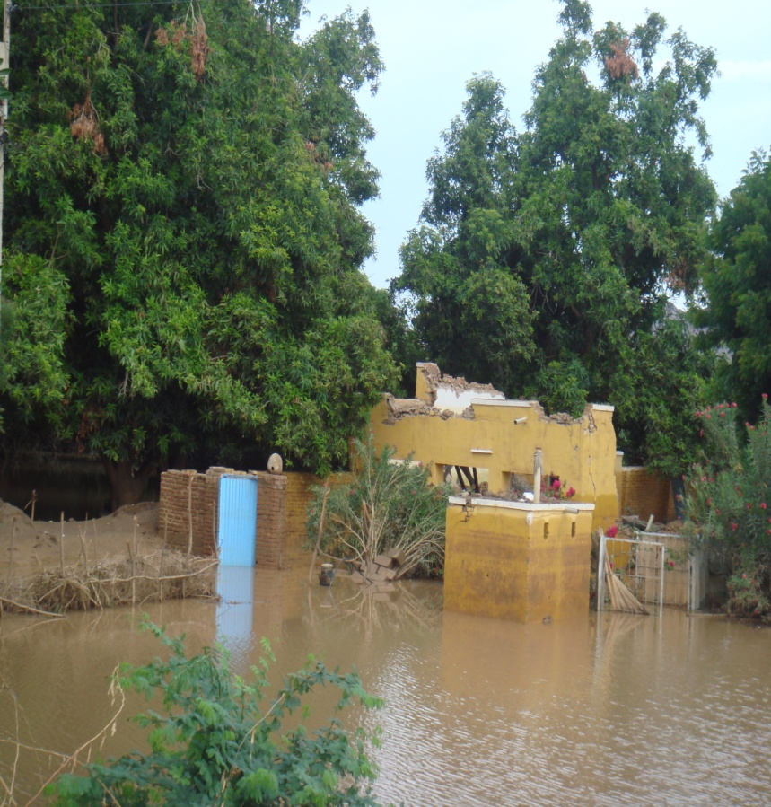
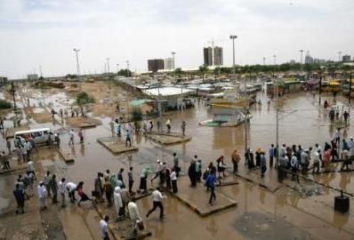
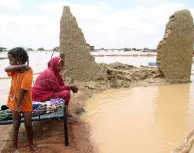
Examples of Floods damages in Khartoum
Flash Flood 2013
River flooding, Blue Nile 2013
Rainfall 2013
Flash flood of 2013

Slide 14
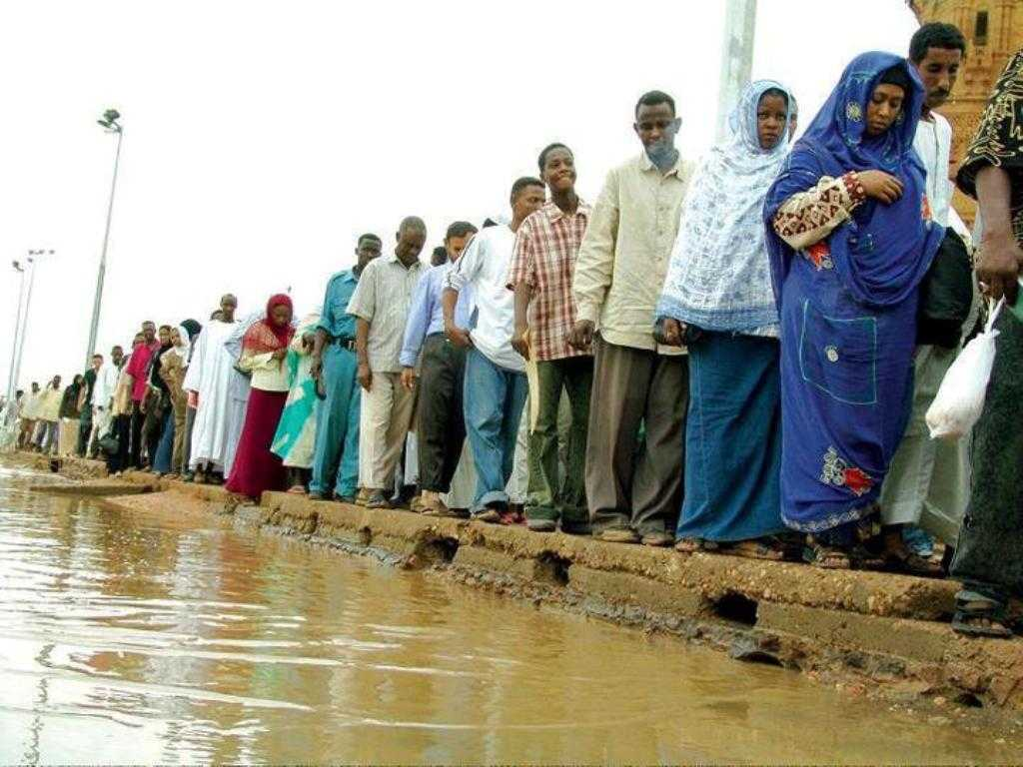
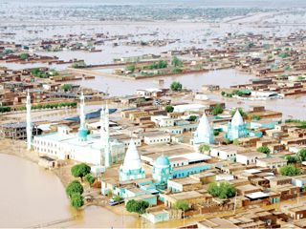
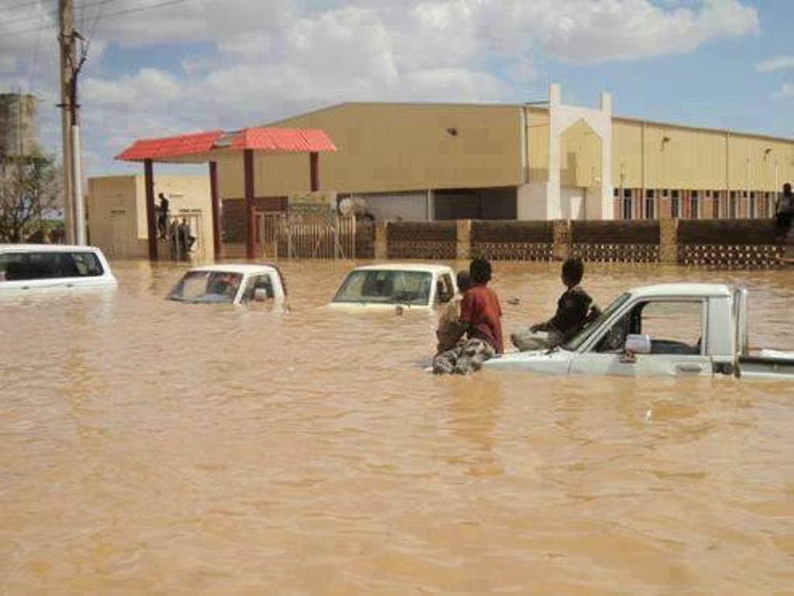
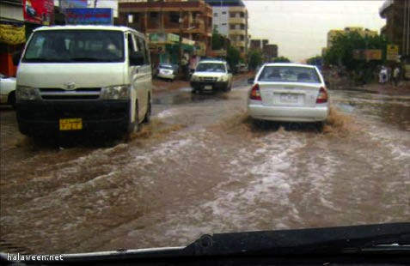
Examples of Floods damages in Khartoum(Contd.)
Rainfall 2013
Flash flood of 2013
Flash flood of 2013
Rainfall 2013

Slide 15
Challenges:
The exclusion of the scientific research in the urban planning process.
Lack of rainfall long-term records and damage of the stations.
Poor response of government.
Absence of early warning systems.
Actions to be taken:
Raising the Awareness of affected communities on how to avoid floods impacts.
Using the monitoring and analysis tools to detect floods behavior such as (GIS, DSS etc.).
Networking with regional and international organizations to find solutions for the disaster.
Invest in floods by using water harvesting techniques.

Slide 16
Suggested Solutions
There are two types of risk reduction methods which can be adopted in flooding affected areas:-
Structural measures: involve constructing physical works designed to contain floods and limit erosion from the river-such as stop banks, rock linings, revetments, gabions, groynes and vegetation buffers.
Non-structural measures: include land use planning regulations and voluntary actions, and steps that flood plain residents, groups, businesses, utility and emergency services can take to prepare for floods. These measures aim to keep people, possessions and development out of floodwater – or better still , away from flood – prone areas. They also improve the community’s ability to resound to and recover from floods. In nutshell, non-structural measures enable a community to be more resilient to flooding through flood awareness, preparation and sensible land use.

Slide 17
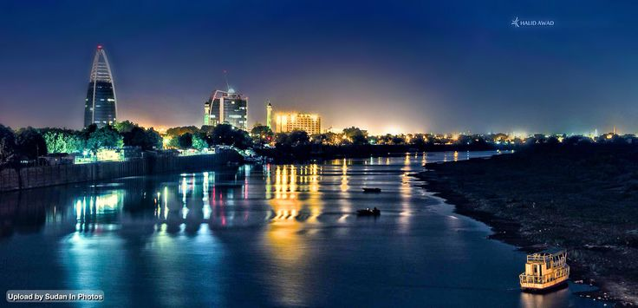
Thank you

