Slide 1


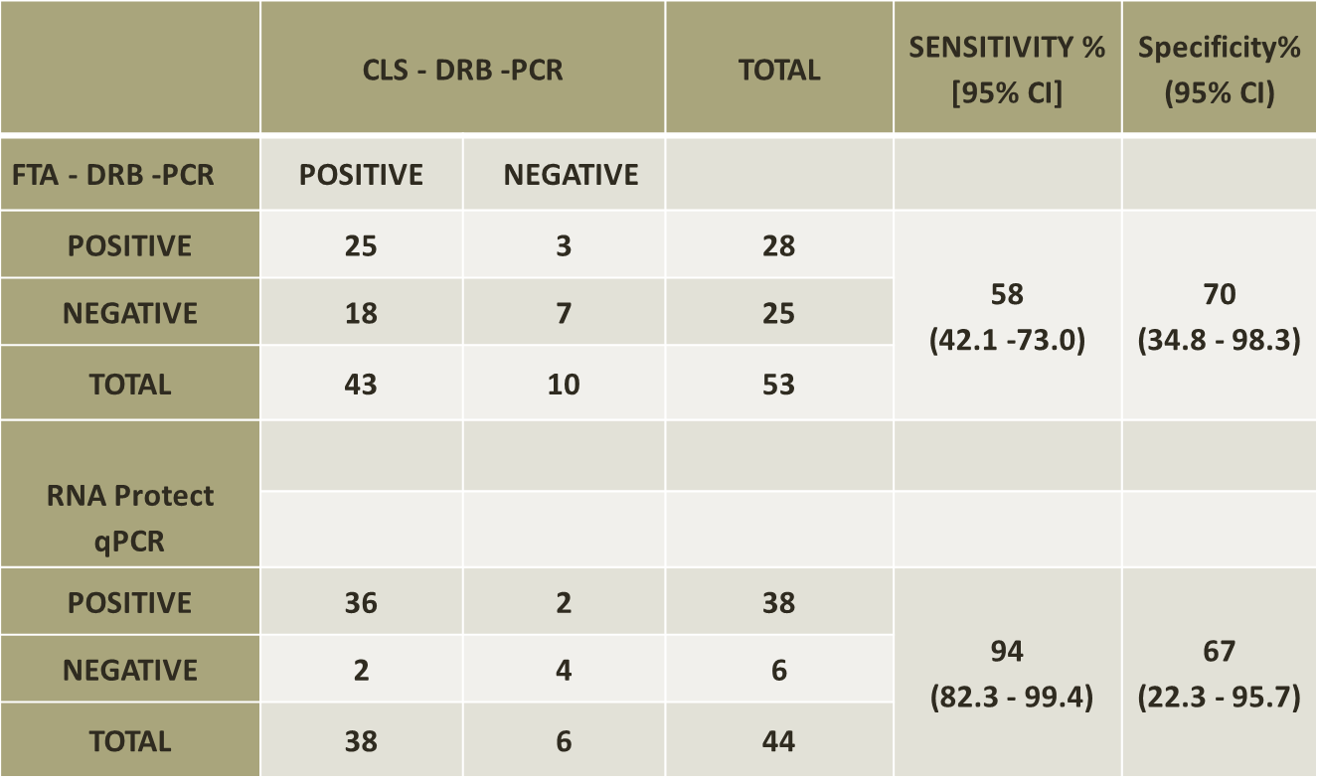
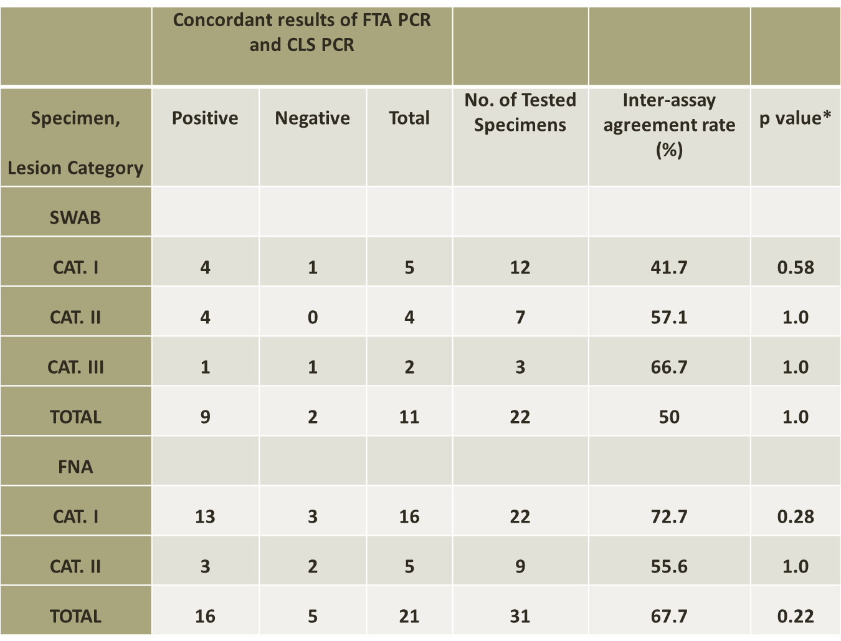
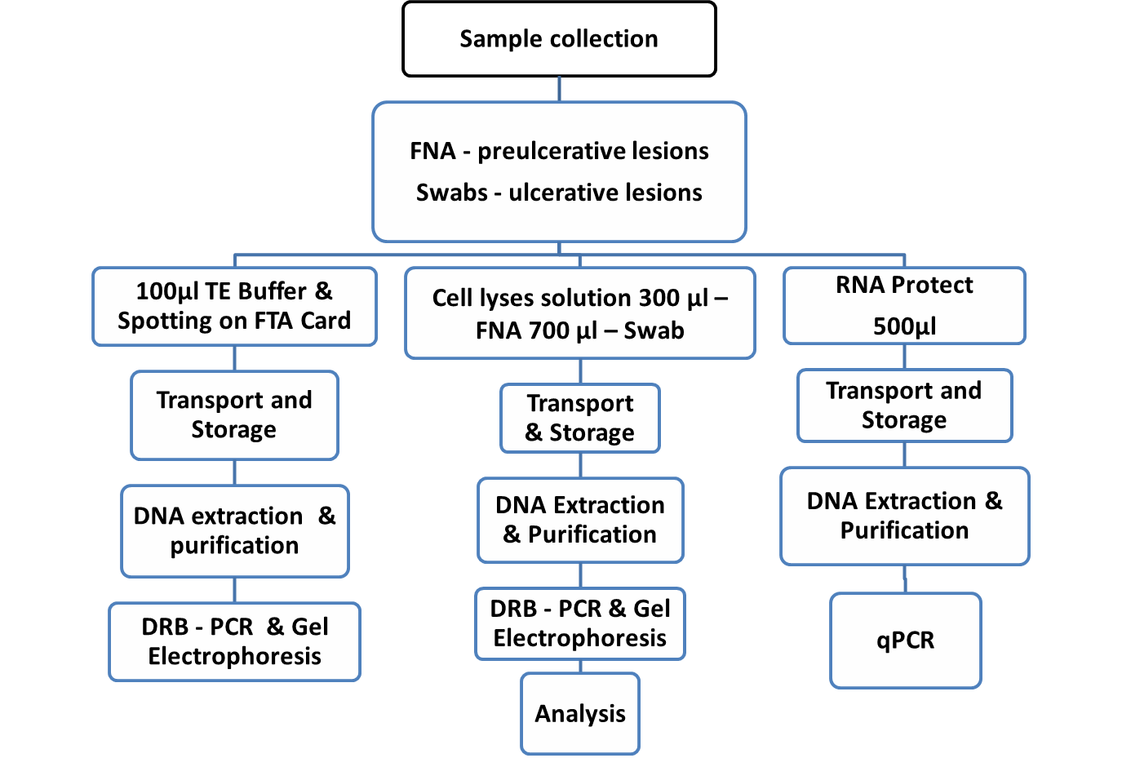
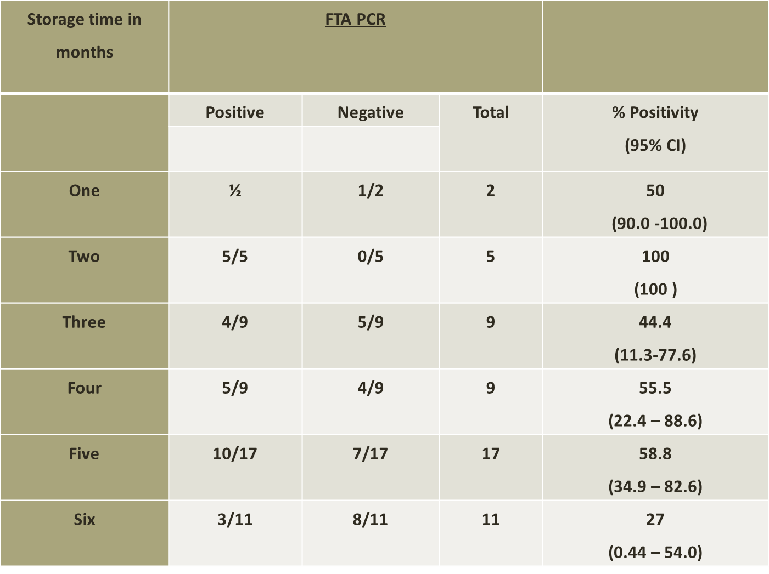
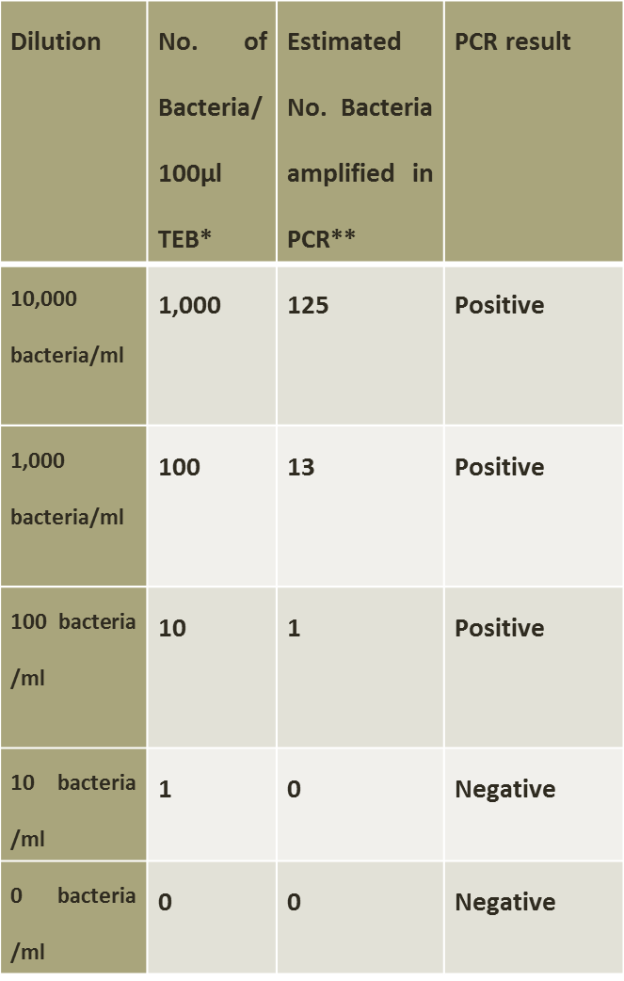
COMPARATIVE DETECTION OF MYCOBACTERIUM ULCERANS DNA BY PCR FROM FTA CARDS, CELL LYSIS SOLUTION AND RNA PROTECT SOLUTION.
B. Agbavor^{1, 2}, S. Asamoah-Sakyi¹, M. Frempong¹, M. Sarpong-Duah², M. Frimpong², R. O. Phillips^{2,3}
¹Dept. of molecular Medicine, KNUST, Kumasi; ²Kumasi Center for Collaborative Research, KNUST, Kumasi, ³ Komfo Anokye Teaching Hospital
Introduction
Buruli ulcer is the second most common mycobacterium disease after tuberculosis in Ghana and is caused by Mycobacterium ulcerans 1.
The disease is found in more than 33 countries worldwide but its burden is on west Africa, endemic mostly in deprived communities with little or no access to health facilities . There are currently four methods of diagnosing the disease with dry reagent based PCR as the gold standard. Samples for this methods are usually transported in liquid media mainly cell lysis solution(CLS), PANTA and RNA protect solution to reference laboratories which are far away from disease endemic communities.
FTA cards are treated filter papers designed for collecting and storing nucleic acid samples for further analysis 2. Samples get attached to the paper through the mechanism of entanglement. EDTA and uric acid are important components that maintain long term DNA stability 3.
Analysing samples from the cards can be done in simple steps all at room temperature.
The accuracy of PCR result depends on the integrity of the DNA and the sensitivity of the PCR. Buruli ulcer samples are transported to reference labs in liquid media which is thought to affect the integrity of the DNA. The introduction of FTA cards would therefore help in resolving issues concerning sample collection, storage, transport and hence DNA integrity for molecular analysis.
The FTA cards had a lower sensitivity of 58% and a specificity 0f whiles that of the qPCR was 94% with a lower specificity of 67% than the FTA.
Discussion
Unpurified cards were all negative indicating an inhibition from the chemicals in the card. 3 A concentration of 10bacteria/100µl indicating 1 bacterium in absolute numbers can be detected. In-house extraction procedure involving the addition of proteinase K not only helped lyse the cell but increased the DNA yield.
The low sensitivity of the FTA cards could be as a result of the design of the card not allowing for elution of DNA resulting in lower yield of DNA as well as presence of other inhibitors from the lesions which will require purification.
Ability of cards to store samples for a long time was confirmed but there was low positivity ratio as a result of localized trapping of the genomic material in the matrix of the card resulting in limited return of DNA after long term storage.
The general lower agreement rate could be attributed to the sampling technique which was improved by running tests in duplicates.4 FNA samples had higher positivity and agreement rate because FNA samples produce small sample of cells thus limits the possibility of collecting extra materials that would inhibit the PCR.
Results
Purpose
The main aim of the study was to evaluate FTA cards for sample collection and determine the detection limit for Mycobacterium ulcerans
Materials and methods
Unpurified sections showed negative bands together with their inhibition controls.
Conclusions
The FTA cards can be used for transport but will require a more vigorous method of extraction to elute enough DNA for amplification and analysis.
Can be a good transport and storage medium in the era of power outages. Low inter-assay agreement rates indicate the card can not replace the current transport procedures but can be used in the absence of CLS
Samples were collected from 53 patients from four study sites namely Agogo presbyterian Hospital, Tepa Government Hospital, Nkawie Toase government hospital all in the ashanti region and Dunkwa government hospital in the Central region. The study was conducted from October 2014 to March 2015.
In the initial experiments to determine the detection limit of the card, samples of known concentrations were spotted on the card, allowed to dry and sections of the card were cut out for further processing.
FNA samples were taken from pre-ulcerative lesions and swabs from ulcerative lesions.
Ability of the FTA cards to store samples was confirmed, however there was low positivity rates ranging from 27% to 100% after samples were stored for up to six months. There is no connection between the duration and positivity ratio.
References
1. Eddyani M., et al. (2009) Fine-needle aspiration, an efficient sampling technique for bacteriological diagnosis of nonulcerative Buruli ulcer. J Clin Microbiol 47(6), 1700-1704.
2. GE Healthcare W. (2011) www.gelifesciences.com/whatman Data file 28-9843-54 AA.
3.Ahmed H.A et. al. (2011) The best practice for preparation of samples from FTA(R)cards for diagnosis of blood borne infections using African trypanosomes as a model system. Parasit Vectors 468.
4. Phillips R.O., et. al. (2009b) Sensitivity of PCR targeting Mycobacterium ulcerans by use of fine-needle aspirates for diagnosis of Buruli ulcer. J Clin Microbiol 47(4), 924-926.
General agreement rate was low between FTA DRB PCR and CLS DRB PCR.
Overall agreement rate between FTA-PCR and CLS-PCR was 50% with a p value of 0.58 for swab samples and 67.7%, p value of 0.22 for FNA samples
At a concentration of 10bacteria /100µl indicating 1 bacteria in absolute numbers could be detected when spotted on the card.

