Slide 1


An Engineer

Slide 2
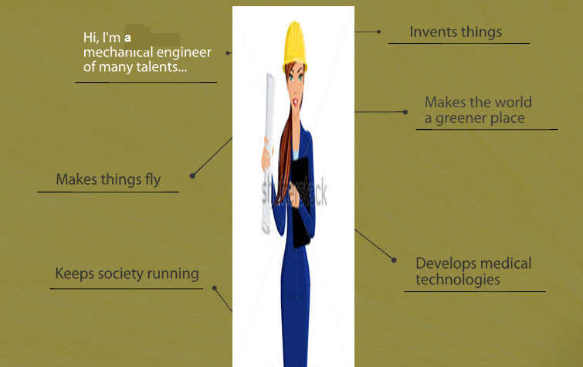
What is mechanical engineering about?

Slide 3


Slide 4

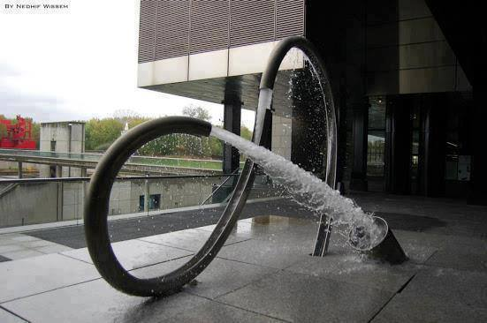




Branches of mechanical engineering

Slide 5
Why study mechanical engineering?

Slide 6


