Slide 1
TITLE
THE EFFECTS OF DISTRIBUTION NETWORK ON WATER QUALITY.
[A case study of Chimwemwe township(Kitwe)]
PRESENTER: CHISENGA JANE
SIN : 13060507
PROGRAM: BENG ENVIRONMENTAL 5
SUPERVISOR: Dr P. MWAANGA

Slide 2
INTRODUCTION
Water is one of the vital components of the physical environment,
quality of drinking water is closely associated with human health,
and providing safe drinking water is one of the important public health priorities (UNCED, 1992).
The world Health Organization (WHO) has observed that about 80% of diseases in the world are water related.
about 20% of the world lacks access to safe drinking water and
more than 5 million people die annually from illness associated with unsafe drinking water or inadequate sanitation (WHO, 2004).

Slide 3
INTRODUCTION CONT,D
NWSC is responsible for the provision, installation, distribution and management of urban water supply in Kitwe
Bulangililo water treatment water plant was built in the early 1950’s.It abstracts water from the Kafue River
Treated water from this plant is delivered to three distribution centers namely
Riverside Distribution Centre, Chimwemwe Distribution Centre and Kwacha Distribution Centre for supply to the customers primarily in Kitwe North

Slide 4
PROBLEM STATEMENT
Inadequacies of water supply along with the degradation of water quality in the distribution system are the major problems facing city water works all over the world.
The problem is especially severe in most developing- country cities including Kitwe, where there is increased urbanization, population growth and, poor city planning.

Slide 5
JUSTFICATION
Drinking water regulations are generally focused on water leaving the treatment plant and not at the point –of- use where exposure actually occurs.
A drinking water systems’ water quality may be acceptable when the water leaves a treatment plant.
However, a variety of physical, chemical and biological transformation can happen once the water enters and travels through distribution system (Rodriguez, 2001).

Slide 6
MAIN OBJECTIVE
To determine the quality of tap water that has been transported through a distribution system to consumers in Chimwemwe Township in Kitwe.
SPECIFIC OBJECTIVES
To determine the biological quality of tap water (fecal coliform and total coliform).
To analyze the physical parameters of tap water (pH, turbidity , E.C, TDS and TSS).
To analyze the chemical parameters of tap water (heavy metals ,alkalinity, total hardness and residual chlorine).
To identify sources of water quality degradation.

Slide 7
HYPOTHESIS
The tap water quality of Chimwemwe Township does not meet the ZABS acceptable standards for drinking water.

Slide 8
METHODOLOGY
20 tap water samples collected
Chimwemwe was classified into 5 sections namely; old Chimwemwe, Magwana, Kampemba, Nachibungulubwe and Kamunga.
4 tap water samples from each section.
control sample was collected from Bulangililo Water Treatment Plant

Slide 9
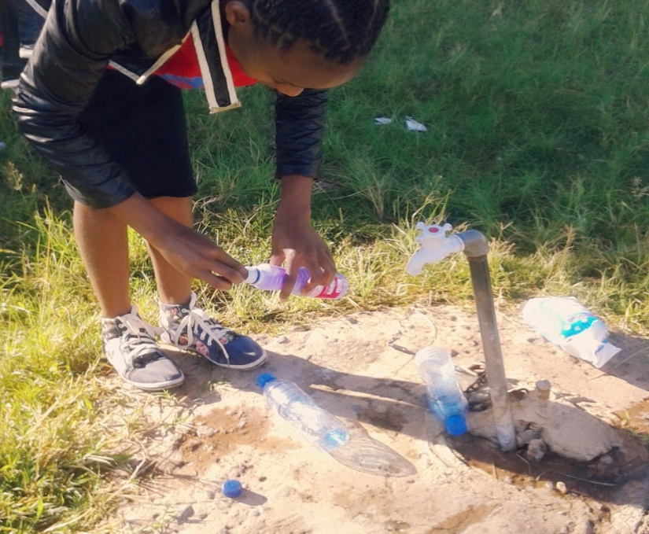
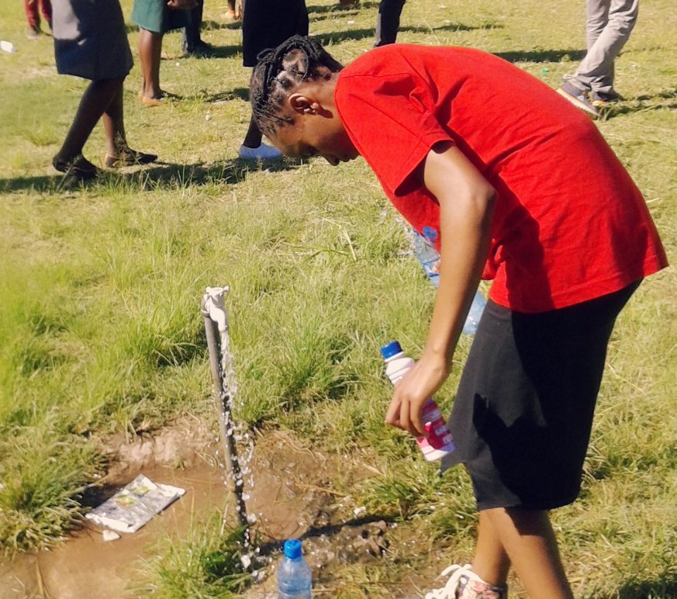
METHODOLGY CONT,D

Slide 10
METHODOLOGY CONT,D
OBJECTIVE | METHOD USED
1.0. Biological parameters
1.1Total Coliform Counts | Membrane filtration technique
1.2.Fecal Coliform Counts | Membrane filtration technique
2.0.Physical parameters
2.1. Turbidity (NTU) | Turbid meter
2.2. TSS (mg/l) | Atomic spectrophotometer
2.3 .TDS (mg/l) | Conductivity meter
2.4. Ph | Ph meter
2.5. E.C (us/cm) | Conductivity meter

Slide 11
METHODOLOGY CONT,D
OBJECTIVE | METHOD USED
3.0.Chemical parameters
3.1.Residual Chlorine (mg/l) | Atomic spectrophotometer
3.2.Alkalinity (mg/l) | Titration (0.02 N H2SO4)
3.3Total hardness (mg/l) | Titration (0.01 M EDTA)
3.4.Lead (mg/l) | AAS
3.5.Iron (mg/l) | AAS
3.6.Copper (mg/l) | AAS
3.7.Zinc (mg/l) | AAS
4.0.sources of water quality degradation | Physical survey & Camera

Slide 12
RESULTS
Mean ± S.D of water quality parameter of the sampled section,C.Sample and ZABS.
Parameter | ZABS | Control sample | Old Chimwemwe | Mangwana | kampemba | Nachibungulubwe | Kamunga
T.Coliform Counts | 0 | 0 | 6.8±4.3 | 7.5±5 | 9.9±6.4 | 15.5±9.5 | 18±10
F.Coliform Counts | 0 | 0 | 5.15±2.4 | 4.4±2.4 | 3±2 | 12.7±5.7 | 15.5±7.75
Turbidity | 5 | 2.56 | 3.6±0.26 | 4.3±0.5 | 3.75±0.4 | 4.5±0.5 | 29.1±17
TSS | 5 | ˂0.01 | ˂ 0.01 | ˂ 0.01 | ˂ 0.01 | ˂ 0.01 | ˂ 0.01
TDS | 1000 | 101.6 | 92.4±0.3 | 112.15±12 | 92.55±1.5 | 93.13±0.5 | 141.3±32.9
pH | 6.5-8 | 6.55 | 6.14±0.02 | 6.28±0.05 | 6.49±0.03 | 6.56±0.02 | 6.52±0.1
E.C | 1500 | 210 | 185.09±1.04 | 209.55±14.6 | 185.2±2.8 | 187.6±1.34 | 281.95±65
Lead | 0.01 | ˂ 0.01 | ˂ 0.01 | ˂ 0.01 | ˂ 0.01 | ˂ 0.01 | ˂ 0.01
Iron | 0.3 | 0.03 | 0.34±0.13 | 1.3±0.6 | 0.38±0.2 | 0.23±0.1 | 0.41±0.1
Copper | 1.0 | 0.18 | 0.29±0.06 | 0.5±0.2 | 0.19±0.06 | 0.15±0.05 | 0.11±0.04
Zinc | 3 | 0.11 | 0.11±0.05 | 0.48±0.2 | 0.24±0.09 | 0.05±0.02 | 0.45±0.21
R.Chlorine | 0.2-0.5 | 0.23 | 0.22±0.11 | 0.19±0.08 | 0.16±0.08 | 0.11±0.05 | 0.1±0.06
T.Hardness | 500 | 95.5 | 125±38.5 | 138.2±20.7 | 108.5±16 | 97.6±9.1 | 108.5±16
Alkalinity |  | 103.4 | 107.1±9.6 | 130.9±15.9 | 111.1±19.6 | 103.3±13.3 | 193.2±70.2

Slide 13
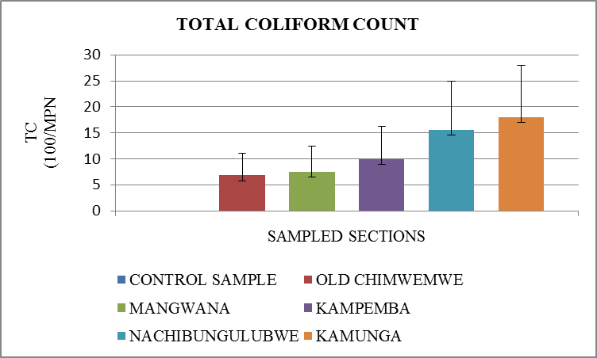
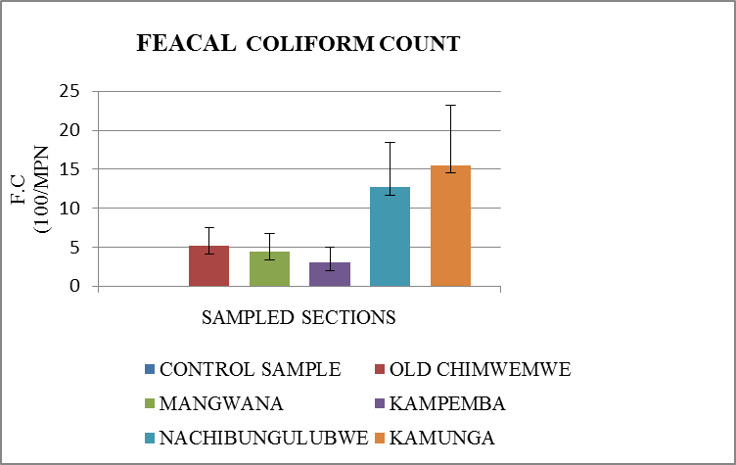
RESULTS CONT,D
:
Concertation of Total and Feacel coliform count of tap water in the sampled sections, mean ±S.D, n=4.

Slide 14
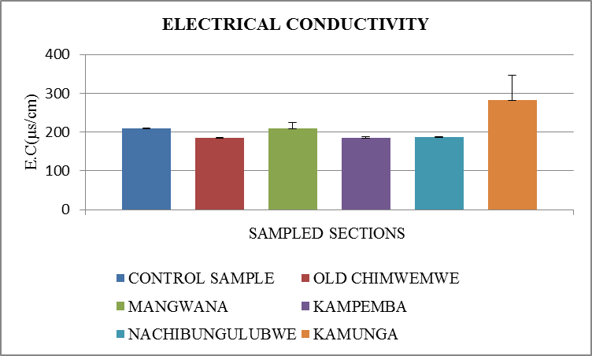
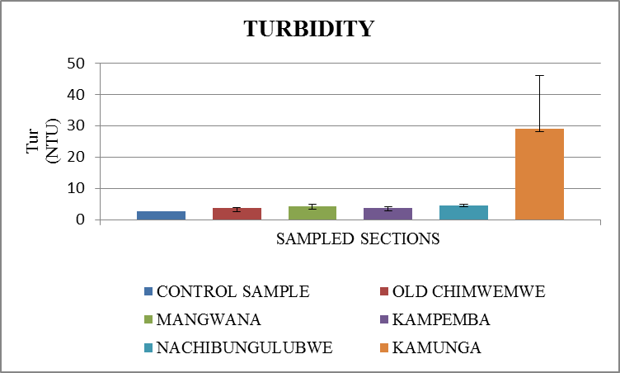
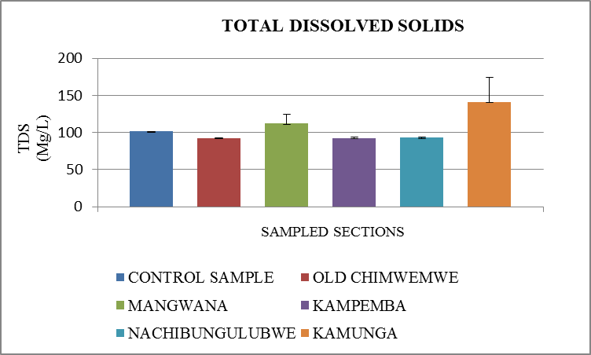
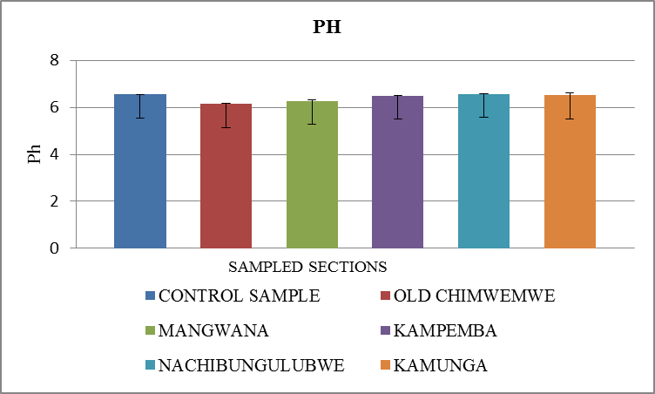
RESULTS CONT,D
Concertation of E.C, Turbidity ,TDS and pH of tap water in the sampled sections, mean ±S.D, n=4

Slide 15
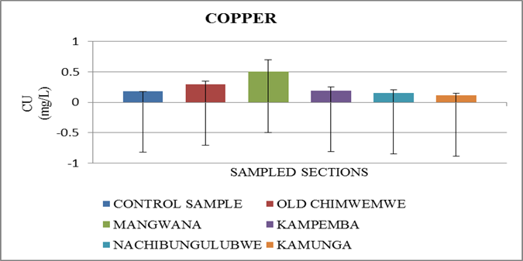
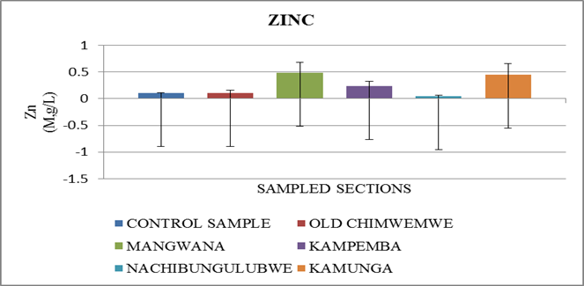
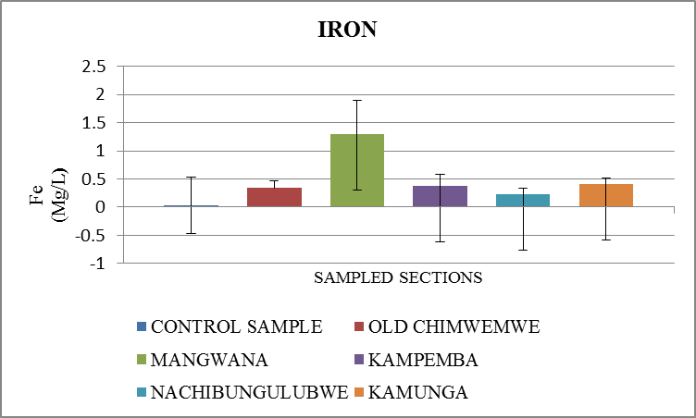
RESULTS CONT,D
Concertation of Cu, Zn and Fe of tap water in the sampled sections, mean ±S.D, n=4.

Slide 16
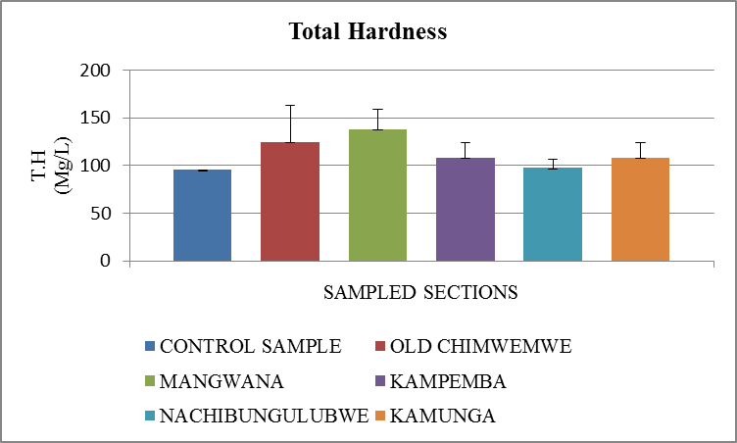
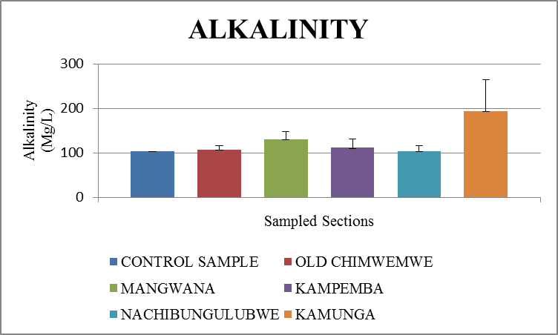
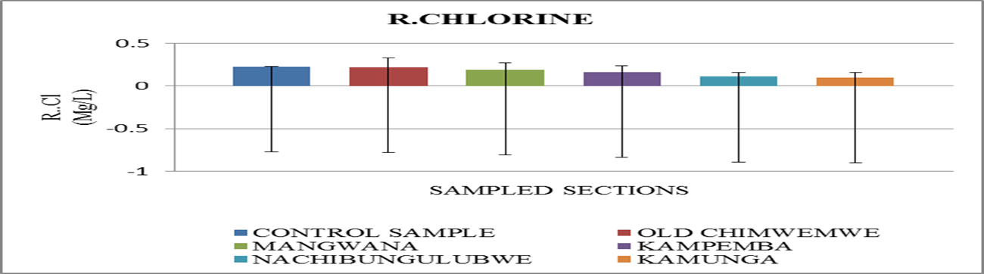
RESULTS CONT,D
:
Concertation of Total hardness, alkalinity and R.Chlorine of tap water in the sampled sections, mean ±S.D, n=4.

Slide 17
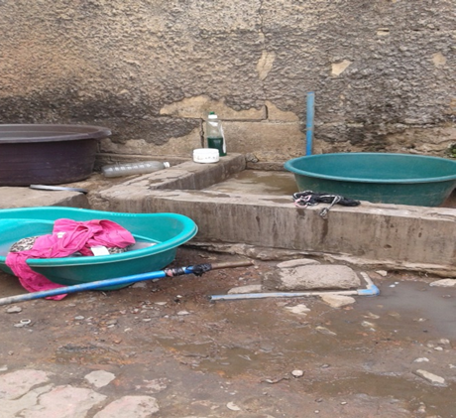
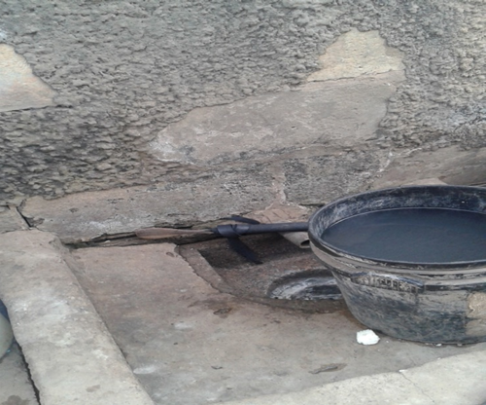
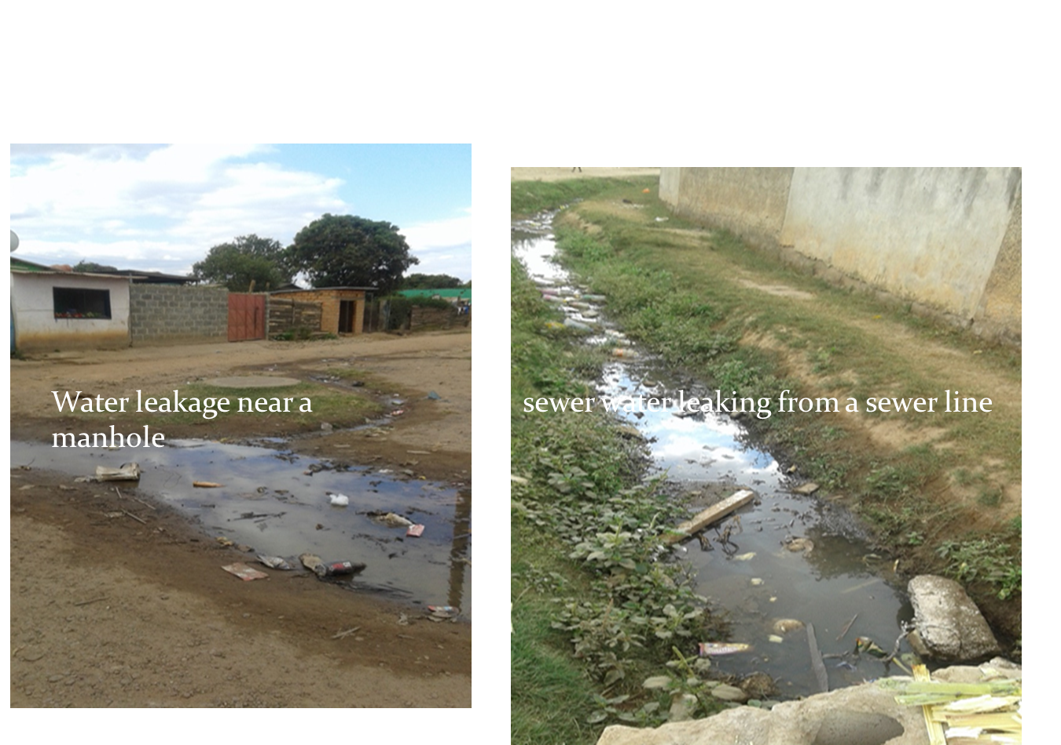
SOURCES OF CONTAMINATS
Illegal connections in Chimwemwe Township, photo taken by Jane Chisenga.

Slide 18
DISCUSSION
Total and fecal coliform present in all the sampled sections (83.3%) except for control sample
Pathogens get into the water while being distributed
Possible causes; illegal connections, leaky joints

Slide 19
DISCUSSION CONT,D
Physical parameters such as E.C, TDS and TSS concentration were within their acceptable limits
whereas pH and Turbidity concentrations indicated unsatisfactory concentration in some sections
3 sections had pH values below the 6.5 ZABS minimum acceptable limit
Low PH values are objectionable because of corrosive effect on metal pipes

Slide 20
DISCUSSION CONT,D
The variance in turbidity concentration
Due to dissolution of iron taken up within the distribution system & accumulation of sediments in the system
High turbidity values interfere with disinfection
chemical parameters such as alkalinity ,total hardness were within their acceptable limits
All the tested heavy metals were within their ZABS acceptable limits except for iron

Slide 21
DISCUSSION CONT,D
The variance in iron concentration from Bulangililo to the various sampled section
More iron is introduced in the water as it is transported through the distribution system
Due to corrosion and oxidation of metal-based materials .
The variance in residual chlorine concentration from Bulangililo Water Treatment Plant (control sample) to various sampled sections shows that concentration of chlorine depreciates as the water travels through the distribution system.

Slide 22
CONCLUSION
Although most of the water quality parameters are within the ZABS maximum permissible limits, however, there are noticeable variations of their concentration from Bulangililo Treatment Plant to various sections where the tap water samples were collected.
This study has shown that concentration of some selected tap water quality parameter varies from Bulangililo water treatment plant (control sample) to the various sampled sections .

Slide 23
RECOMMENDATIONS
• Leakages in the distribution systems should be quickly attended to, to reduce on the intrusion of pathogenic bacteria into the water.
• Illegal connections should be investigated in the area as it increases risk of water contaminations and reduces the systems pressure.
• Chlorine doses should be monitored more carefully to ensure residual chlorine level of at least 0.5mg/l.

Slide 24
RECOMMENDATIONS CONT,D
• Flushing of the water mains, reservoirs, distribution system should be undertaken at regular intervals based on accumulation of sediments.
• After any maintenance work within the distribution system water samples should be tested for PH, Chlorine and biological quality to verify the quality after completion of repairs
• Water supplied to consumers should be tested at the point of use where exposure actually occurs.

Slide 25
REFFERENCES
Jardine, C. G., Gibson, N., Hrudey, S. E. (1999). Detection of odor and health risk perception of drinking water. Water Sci. Technol. 40 (6).p.91–98.
Morran, J., Whittle, M., Leach, J. and Harris, M. (2009) A new source of NDMA in potable water supplies.36 (5).p.99–101.
Morran, J., Whittle, M., Fabris, R.B., Harris, M., Leach, J.S and Newcombe ,G. (2011). Nitrosamines from pipeline materials in drinking water distribution systems. J Am Water Works Assoc. 103(10).P.76–83.
National Research Council. (2006) Drinking water distribution systems: assessing and reducing risks. Washington (DC): The National Academies Press. Available from: http://www.nap.edu/catalog.php? record_id=11728. [Accessed: 6 May 2014].
Nicholas, A. and David, C. (2014) Water Safety in Distribution Systems. Geneva, Switzerland: WHO.
Ohwo, O. (2012) Nigeria Geographical Journal .Quality of Water supply from hand-dug wells in Warri-Effurun metropolis Delta State, Nigeria. 8 (2).p.73-86
Rodriguez, M. J., Se´rodes, J. B. (2001). Spatial and temporal evolution of trihalomethanes in three water distribution systems. Water Res. 35 (6).p.1572–1586 .
Sarin, P., Snoeyink, V.L., Lytle, D, A. and Kriven, W.M. (2004) Iron corrosion scales: model for scale growth, iron release and colored water formation. J. Environmental Engineering .130 (4).p.364-373.
Umur, M. (2012) Water Quality Deterioration in Piped Water and its Effect on Usage and Customers’ Perception. A thesis submitted for MSc. degree in Environmental Resources Management. Ghana: Kwame Nkrumah University.
UNCED.(1992). Application of integrated approaches to the development, management and use of water resources. protection of the quality and supply of fresh water resources, chapter 18,agenda 12.
WHO, 2004. Water and Sanitation, links to Health.
ZABS drinking water standards: available from: http://www.daneprairie.com ,[ acessed:2010/02/23].
Speight, V.L and Singer, P.C. (2005) Association between residual chlorine loss and HAA reduction in distribution systems. J.Amer.Water Works Assoc.97 (2).p.82-91.

Slide 26


