Slide 1
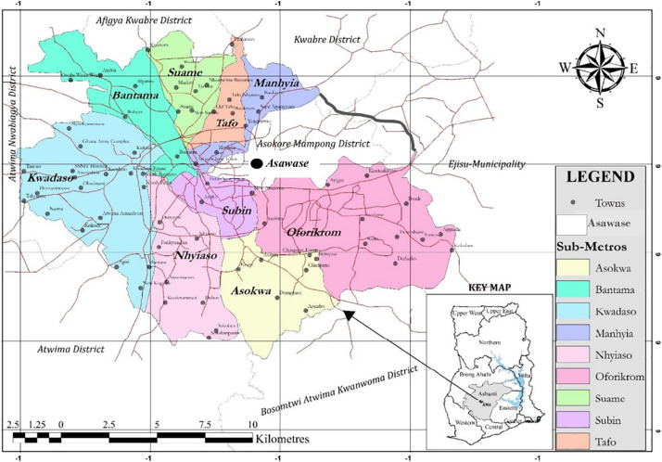

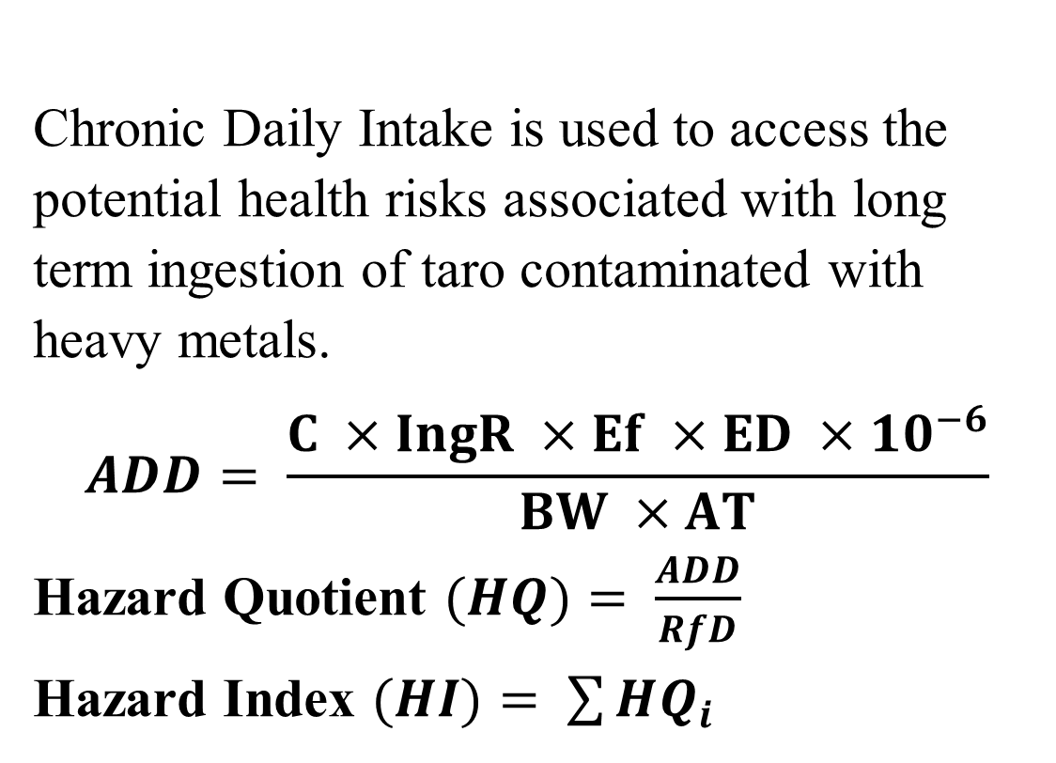
HEALTH RISK ASSOCIATED WITH THE PRESENCE OF LEAD AND ZINC IN TARO PLANT (Colocasia esculenta) FROM MARSHY AREAS IN THE KUMASI SUB-METRO
Benedicta Junior Nashiff*, Marian Asantewah Nkansah
Email: nashiffjuniorbenedicta@gmail.com
Department of Chemistry, Kwame Nkrumah University of Science and Technology, Kumasi, Ghana
HEALTH RISK ASSESSMENT
BACKGROUND
RESULTS
Chronic Daily Intake is used to access the potential health risks associated with long term ingestion of taro contaminated with heavy metals.
$$ADD= \frac{C ×IngR ×Ef ×ED ×{10}^{−6}}{BW ×AT}$$
Hazard Quotient $(HQ)= \frac{ADD}{RfD}$
Hazard Index $(HI)= \sum{HQ_{i}}$
Taro (Colocasia esculenta) is a widely cultivated and highly valued plant in many parts of the world, particularly Asia, Africa, and the pacific Islands [1]
Taro is a versatile food crop known for its high starch content, essential nutrients and dietary fibre [2]
However limited research has been conducted on the elemental composition of taro, particularly concerning essential nutrients and toxic elements and its potential health implications
Heavy metal toxicity can lower energy levels and damage the functioning of the brain, lungs, kidney, liver, blood composition and other important organs [3].
Fig 2: Mean Concentrations of Lead and Zinc in samples from selected sample sites (mg/kg)
MAJOR FINDINGS
Fig 3 Average Daily Dose of dissolved metals for a child and an adult exposure via oral route (mg/kg/day)
Analysis of taro samples revealed significant variations in the levels of essential and toxic elements.
Essential element zinc was found to be abundant, highlighting the potential nutritional benefit of taro consumption. Moreover, the taro plant exhibited low levels of lead, indicating the overall safety for human consumption.
The Human Risk Assessment calculated showed that ingestion of taro plant does not pose any health danger to humans
Fig 1: Corm of taro (Colocasia esculenta)
AIMS AND OBJECTIVES
Assess the concentration of lead and zinc in taro plants grown in marshy areas of Kumasi Sub-Metro.
Identify potential health risks associated with the consumption of contaminated taro.
Increase awareness about the impact of heavy metal contamination on food safety and public health.
Fig 4: Target Hazard Quotient of dissolved metals for a child and an adult exposure via oral route
CONCLUSION
This research provides an in-depth analysis of essential and toxic elements in taro plant
The findings underscore the nutritional value and safety of taro consumption in comparison with W.H.O and USEPA models
STUDY AREA
REFERENCES
Rashmi, D., et al. (2018) 'Taro (Colocasia esculenta): An overview', Journal of Medicinal Plants Studies, 6, pp. 156-161.
Luis-González, G., et al. (2015) 'Essential and toxic metals in taros (Colocasia esculenta) cultivated in the Canary Islands (Spain): evaluation of content and estimate of daily intake', Environmental Monitoring and Assessment, 187, pp. 1-7.
Jaishankar, M., et al. (2014) 'Toxicity, mechanism and health effects of some heavy metals', Interdisciplinary Toxicology, 7(2), pp. 60-72.
Fig 5: Non- carcinogenic indices of dissolved metals for a child and an adult exposure via oral route
METHODOLOGY
Sample collection
Sample preparation
Sample Digestion
Sample Analysis on MP-AES
Human Health Risk Assessment

