Slide 1

RELATIONSHIP BETWEEN THICKNESS AND PRECURSOR TEMPERATURE FOR DIP COATED TiO₂ THIN FILMS.
NAMISI MWANAIDI MAUWA
I20/5382/2017.
SUPERVISOR:
PROF. ROBINSON MUSEMBI.

Slide 2
1. INTRODUCTION
Thin films are materials with extremely low thickness (in nm).
They are deposited on substrates using various methods, both chemical and physical.
Dip coating is one of the simplest and accurate deposition methods .
Here, a precursor solution with different temperatures was used.
To obtain TiO₂ , titanium alkoxide precursors are dip coated.
Titanium Isopropoxide(TTIP) was used in this case.
After deposition, the relationship between TiO2 film thickness and TTIP precursor solution temperature was found.
Alkoxides are thermally stable hence form oxides at low temperature.
TiO_{2- Titanium Dioxide}
_{TTIP- Titanium Isopropoxide.}

Slide 3
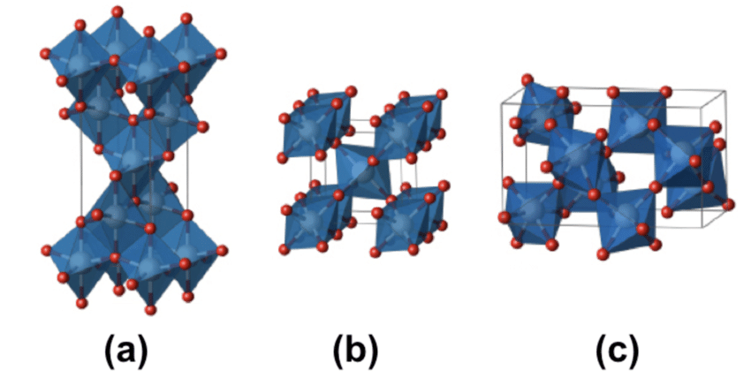
1.1: TiO₂
TiO₂ is one of the most studied materials in thin film technology due to its attractive properties and wide applications.
It occurs in three phases: anatase (a), rutile (b) and brookite (c)
It is applied in opto- electronic devices, DSCC, optical coatings, gas sensing, ceramics, protective layers and cosmetics.
Excellent photocatalytic properties.
Transparency.
Non toxity.
Self cleaning properties.
High transmittance in the visible region.
Fig 1: TiO2 phases

Slide 4
1.2. OBJECTIVES
Main Objectives.
To find the relationship between thickness and precursor temperature.
Specific Objectives.
To deposit precursor solution of TTIP by dip coating.
To anneal thin films using a furnace
To measure thickness using a surface profiler.
To measure the transmittance using a spectrophotometer.

Slide 5
1.3:SIGNIFICANCE OF THE STUDY.
To find out how thickness varies with the precursor temperature. This is crucial in industrial applications of TiO₂ to determine the optimum thickness values to be used in different applications.

Slide 6
2.MATERIALS AND METHODS.
TTIP was prepared and used as the pre cursor solution. Deposition was done on normal glass slides.
Preparation of the precursor solution and glass slides.
15ml of ethanol was added to a 5ml TTIP solution. Nitric acid of 5ml was then added in small amounts while stirring using a magnetic stirrer.
A beaker containing sodium hydroxide, liquid detergent and distilled water in the ratio of 1:2:3 respectively was prepared. The glass slides were then scrubbed using cotton ear buds to etch dirt from the surfaces. They were then rinsed in alcohol, acetone and distilled water in that order. After this, they were ultra sonicated in distilled water, ethanol, acetone and distilled water respectively in 15 minutes intervals. They were then air dried and ready for deposition.
TTIP: Titanium Isopropoxide.

Slide 7
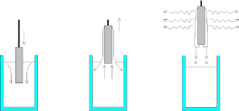
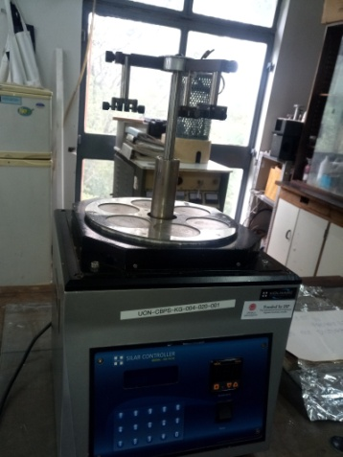
2.1:DEPOSITION BY DIP COATING .
Fig 2:
3 steps in dip coating.
Dip coating was done on 9 slides using a dip coater as shown below: coating was done only once.
Temperature (0C) | SPEED
 | 0.5mm/s | 1mm/s | 3mm/s
25 (0C) | Z1 | Z2 | Z3
37.5 | Z4 | Z5 | Z6
50 | Z7 | Z8 | Z9
Fig 3: Dip coater.
After deposition, the films were annealed in a muffle furnace at 400(0C) for 8 hours and cooled. Annealing is done to ensure uniformity of the thin films.

Slide 8
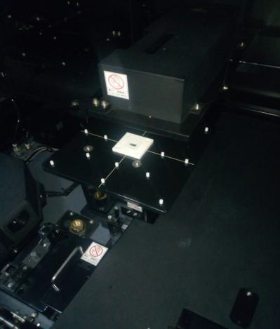
2.2:UV-VIS-NIR SPECTROPHOTOMETER
Finds transmittance of materials in the UV-VIS-NIR regions(0-3200nm) by measuring light intensity and absorbency.
The one used measured up to 800nm (UV, VIS).
Working Principle.
It measures how light passing through a sample is absorbed.
A wavelength range is selected and the instrument scans over it forming a graph as an output.
Sample Thin film
Fig 4: Inside a spectrophotometer

Slide 9
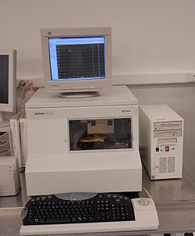
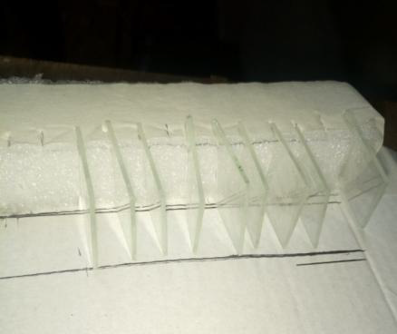
2.3:SURFACE PROFILER.
Is used to obtain the thickness and roughness of very thin materials(nm to several mm thick.
Fig 5: Surface Profiler
Working principle.
Sample is placed on the rotating centre stage and positioned.
It has a diamond stylus which touches the surface and scans along the sample surface acquiring the measurements as it goes.
The data is then captured and recorded.
Fig 6: Films to be deposited.

Slide 10
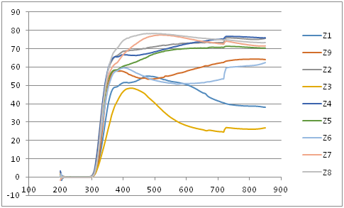
3:RESULTS AND DISCUSSIONS.
3.1: Transmittance values.
Values were recorded in excel and a graph of transmittance against wavelength plotted.
Transmittance is low for low temperatures and vice versa.
The higher the dipping speed the low the transmittance and vice versa.
Graph 1: Graph of transmittance against wavelength.
There is no transmittance in the UV region . In the visible region, there is transmittance which steadily increases at first. Z3, which we found to have the lowest thickness value, also has the lowest transmittance values

Slide 11
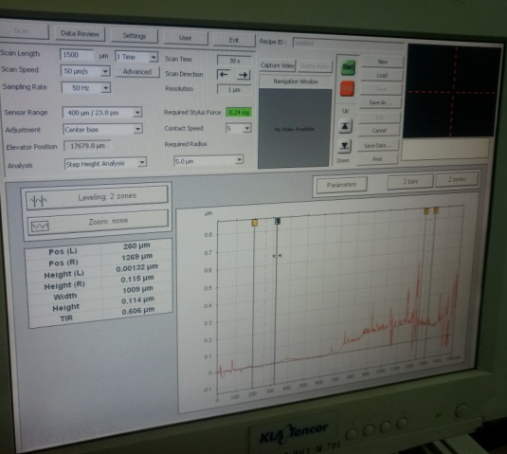
…Cotd
3.2: Thickness values.
Three values were taken at three different regions , tabulated and their average taken.
Fig 6:Sample Thickness values.
Films | Z1 25⁰C,0.5mms⁻¹ | Z2 25⁰C,1mms⁻¹ | Z3 25⁰C,3mms⁻¹ | Z4 37.5⁰C,0.5mms⁻¹ | Z5 37.5⁰C,1mms⁻¹ | Z6 37.5⁰C,3mms⁻¹ | Z7 50⁰C,0.5mms⁻¹ | Z8 50⁰C,1mms⁻¹ | Z9 50⁰C,3mms⁻¹
Thickness(nm) | 105 | 82.3 | 63.7 | 183.6 | 112 | 70.3 | 185 | 115.375 | 151
 | 119 | 82.4 | 65.8 | 179.59 | 99.16 | 88.8 | 174 | 101.59 | 149
 | 152 | 86.6 | 34.5 | 167.14 | 110.29 | 94.3 | 173 | 118.044 | 152
 | 125 | 118.5 | 50.3 | 160.63 | 124 | 92.6 | 179 | 129 | 140
Average | 125.25 | 92.45 | 53.575 | 172.74 | 111.363 | 86.5 | 177.75 | 116.002 | 148

Slide 12
Speed of 3mm/s
Temperature (⁰C) | Thickness (nm)
25 | 53.575
37.5 | 86.5
50 | 148
Relationship between same dipping speed films
Temperature of 25(0C)
Dipping speed (mms⁻¹) | Thickness (nm)
0.5 | 125.250
1.0 | 92.45
3.0 | 53.575
Relationship between same temperature films
For the same dipping speed, the higher the temperature the higher the thickness.
For the same temperature, the higher the speed the lower the thickness.

Slide 13
4:CONCLUSIONS.
Temperature increases with increase in thickness
.
The higher the speed the lower the thickness.
Films with higher precursor temperatures have high transmittance.

Slide 14
THE END!

