Slide 1
Made in Bangladesh
Nova Ahmed

Slide 2
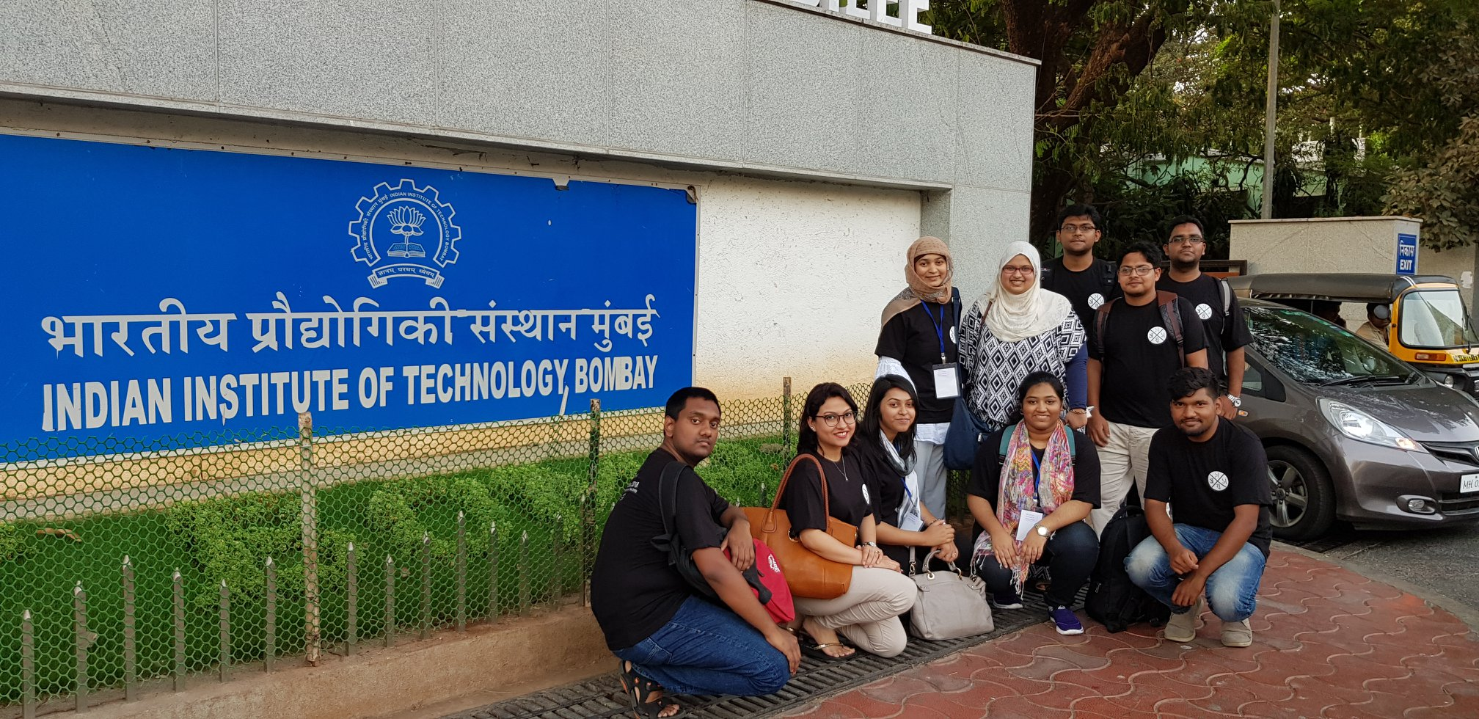
About me
We love Mumbai IIT

Slide 3
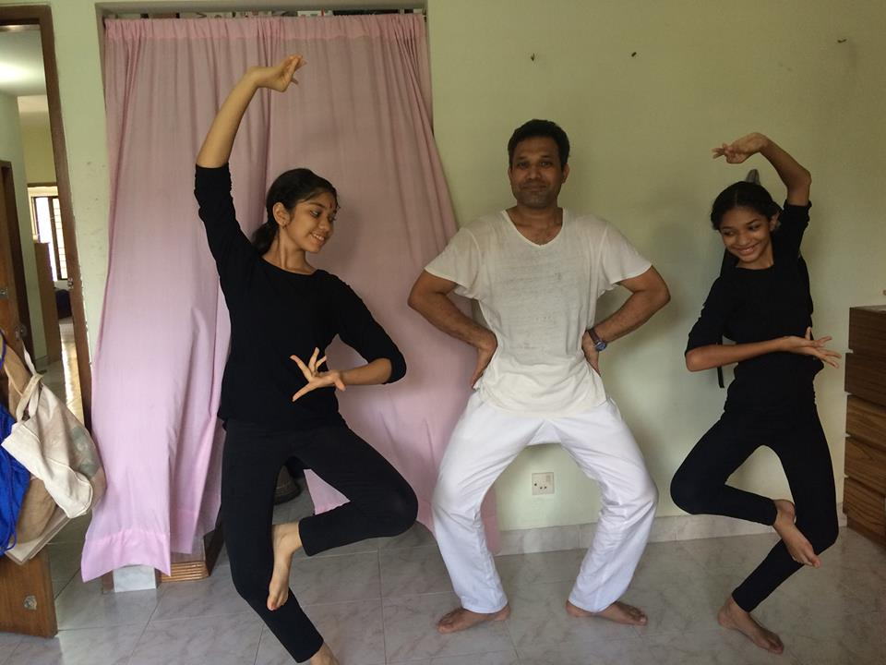
Background
PhD in USA
Came back to Bangladesh
Thought I will solve all the problems!
Had to consider HCI
Yes, that’s my family ☺

Slide 4
Protibadi Sexual Harassment .. Bad girls
Fighting Sexual Harassment

Slide 5
Protibadi Sexual Harassment .. Bad girls
Just when I returned to Bangladesh
Seemed like an easy problem to solve
Wanted to create a one touch solution
We must say, there is better awareness and conversations around it

Slide 6
Protibadi Sexual Harassment .. Bad girls cont.
What do you think were the possible design challenges?

Slide 7
Protibadi Sexual Harassment .. Bad girls cont.
We faced Silence.
It became a core issue to consider designing for women in Bangladesh

Slide 8
Our key papers on it
Ahmed, S. I., Jackson, S. J., Ahmed, N., Ferdous, H. S., Rifat, M. R., Rizvi, A. S. M., ... & Mansur, R. S. (2014, April). Protibadi: A platform for fighting sexual harassment in urban Bangladesh. In Proceedings of the SIGCHI Conference on Human Factors in Computing Systems (pp. 2695-2704).
Ahmed, N. (2016, May). Discussing about Sexual Harassment (Breaking Silence) The Role of Technology. In Proceedings of the 2016 CHI Conference Extended Abstracts on Human Factors in Computing Systems (pp. 459-472).
Ahmed, N. (2019). Protibadi: starting the fight against sexual abuse. XRDS: Crossroads, The ACM Magazine for Students, 26(2), 40-43.

Slide 9
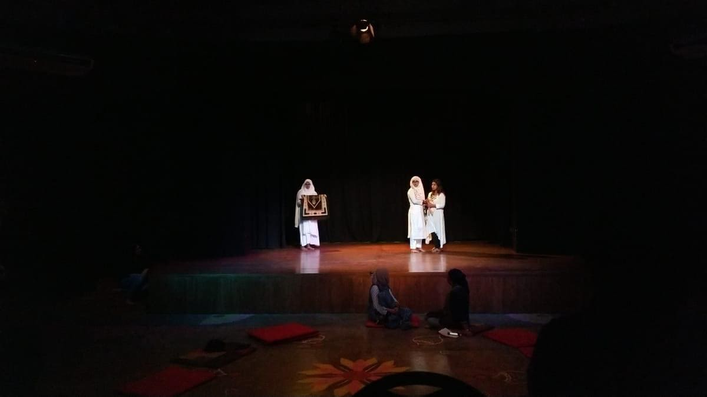
Design Ethnography: Islamophobia
Talking about Religion, Women, Problems

Slide 10
Handling critical conversations
How do we get a conversation going on when the topic is difficult?

Slide 11
Design Ethnography: Islamophobia
It was a performance
We shared stories about our journey and view about religion
Negative and positive stories came up
The performance developed and evolved as it went on

Slide 12
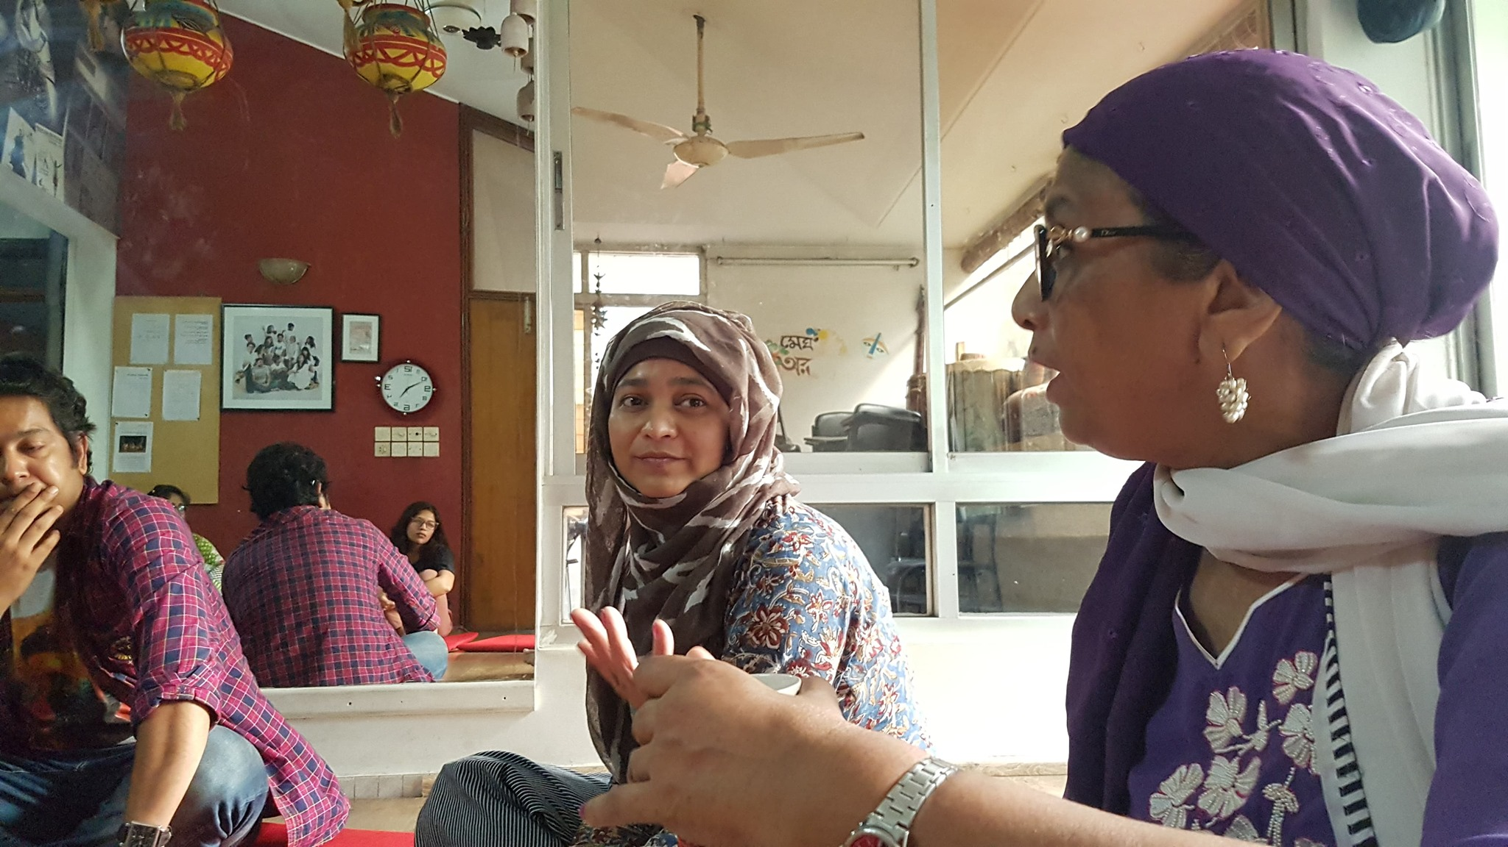
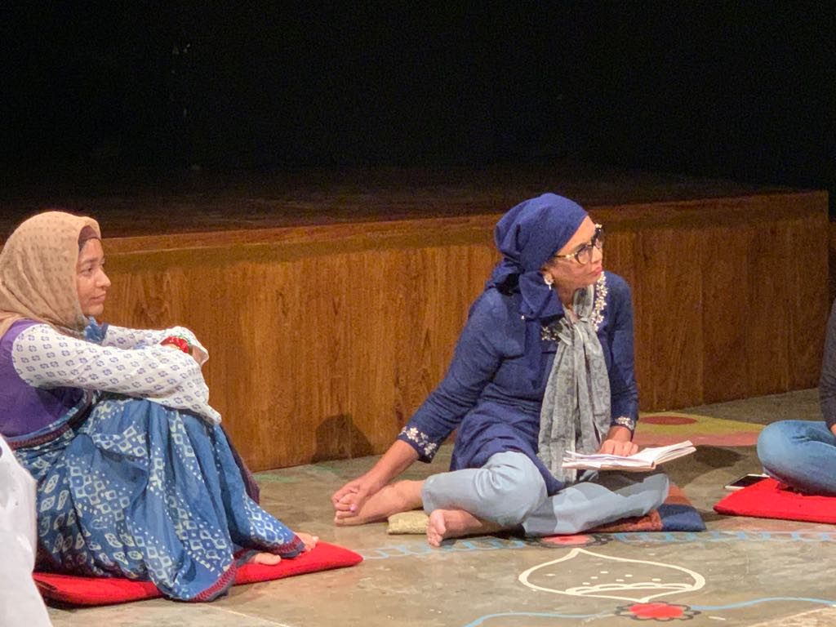
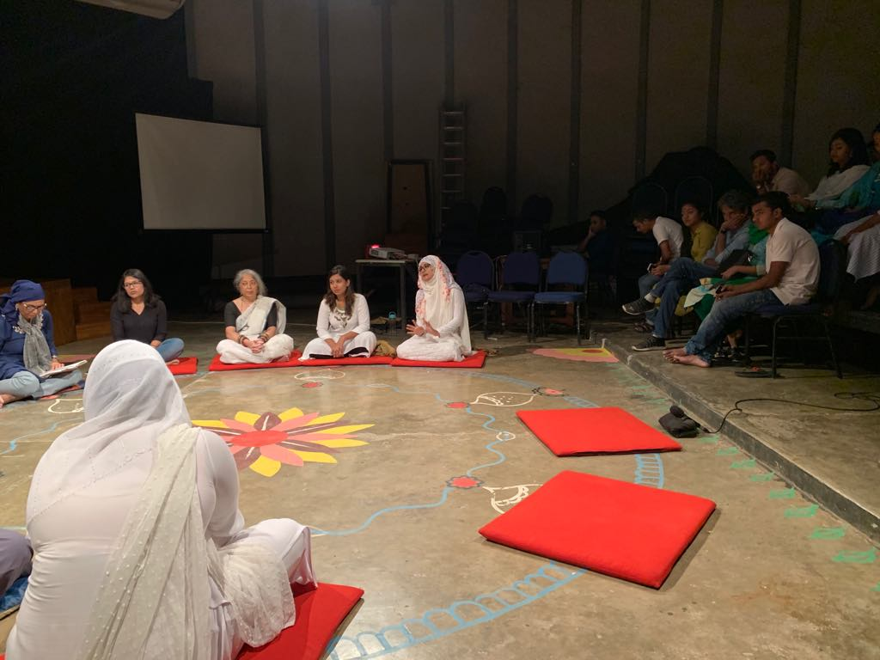
Design Ethnography: Islamophobia
Audience became part of the show
Many things could be shared which could be difficult otherwise
Would like to use in other aspects of design

Slide 13
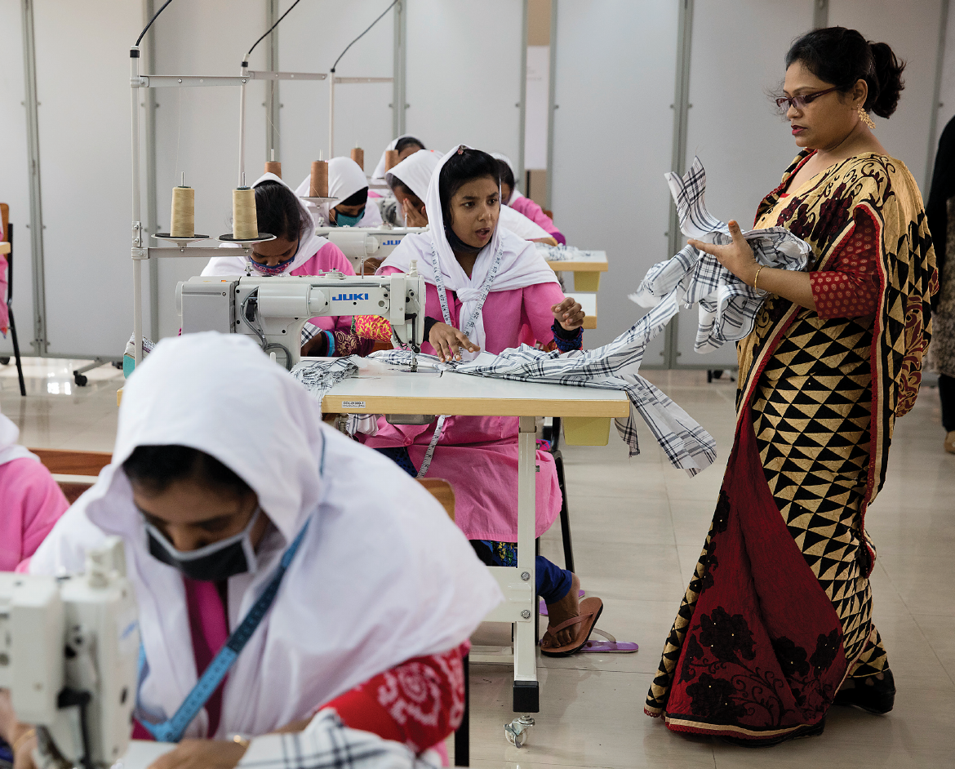
Garments Workers
Can there be a better design?

Slide 14
Garments Workers
Currently working with BRAC
A worker will not leave her space to leave for a short break
Misbehavior is common
Earning money is the sweet spot!
Qualitative study from place to place, quantitative is done by others (BRAC)

Slide 15
Reading
Nothing yet!
Hopeful ☺

Slide 16
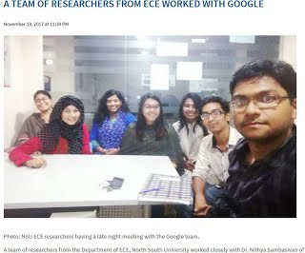
Technology and Women, People and Google
We worked with Google!

Slide 17
Technology and Women, People and Google
Many women in India, Bangladesh and Pakistan
Many have phones
Not so many use internet, technology, compared to men
Gender gap is around 30% in terms of ownership of phones

Slide 18
Google
What could be the possible barriers?
How can we design better?

Slide 19
Barriers for women
Came from access, time, exposure
Larger cases of harassment, not exposed to concept of privacy
Institutional barriers (evening rule that girls have to return to hostel by sun set)
Requires support from Men in the household

Slide 20
Reading Materials
Sambasivan, N., Checkley, G., Batool, A., Ahmed, N., Nemer, D., Gaytán-Lugo, L. S., ... & Churchill, E. (2018). " Privacy is not for me, it's for those rich women": Performative Privacy Practices on Mobile Phones by Women in South Asia. In Fourteenth Symposium on Usable Privacy and Security ({SOUPS} 2018) (pp. 127-142).
Sambasivan, N., Batool, A., Ahmed, N., Matthews, T., Thomas, K., Gaytán-Lugo, L. S., ... & Consolvo, S. (2019, May). " They Don't Leave Us Alone Anywhere We Go" Gender and Digital Abuse in South Asia. In proceedings of the 2019 CHI Conference on Human Factors in Computing Systems(pp. 1-14).
Sambasivan, N., Checkley, G., Ahmed, N., & Batool, A. (2017). Gender equity in technologies: considerations for design in the global south. interactions, 25(1), 58-61.

Slide 21
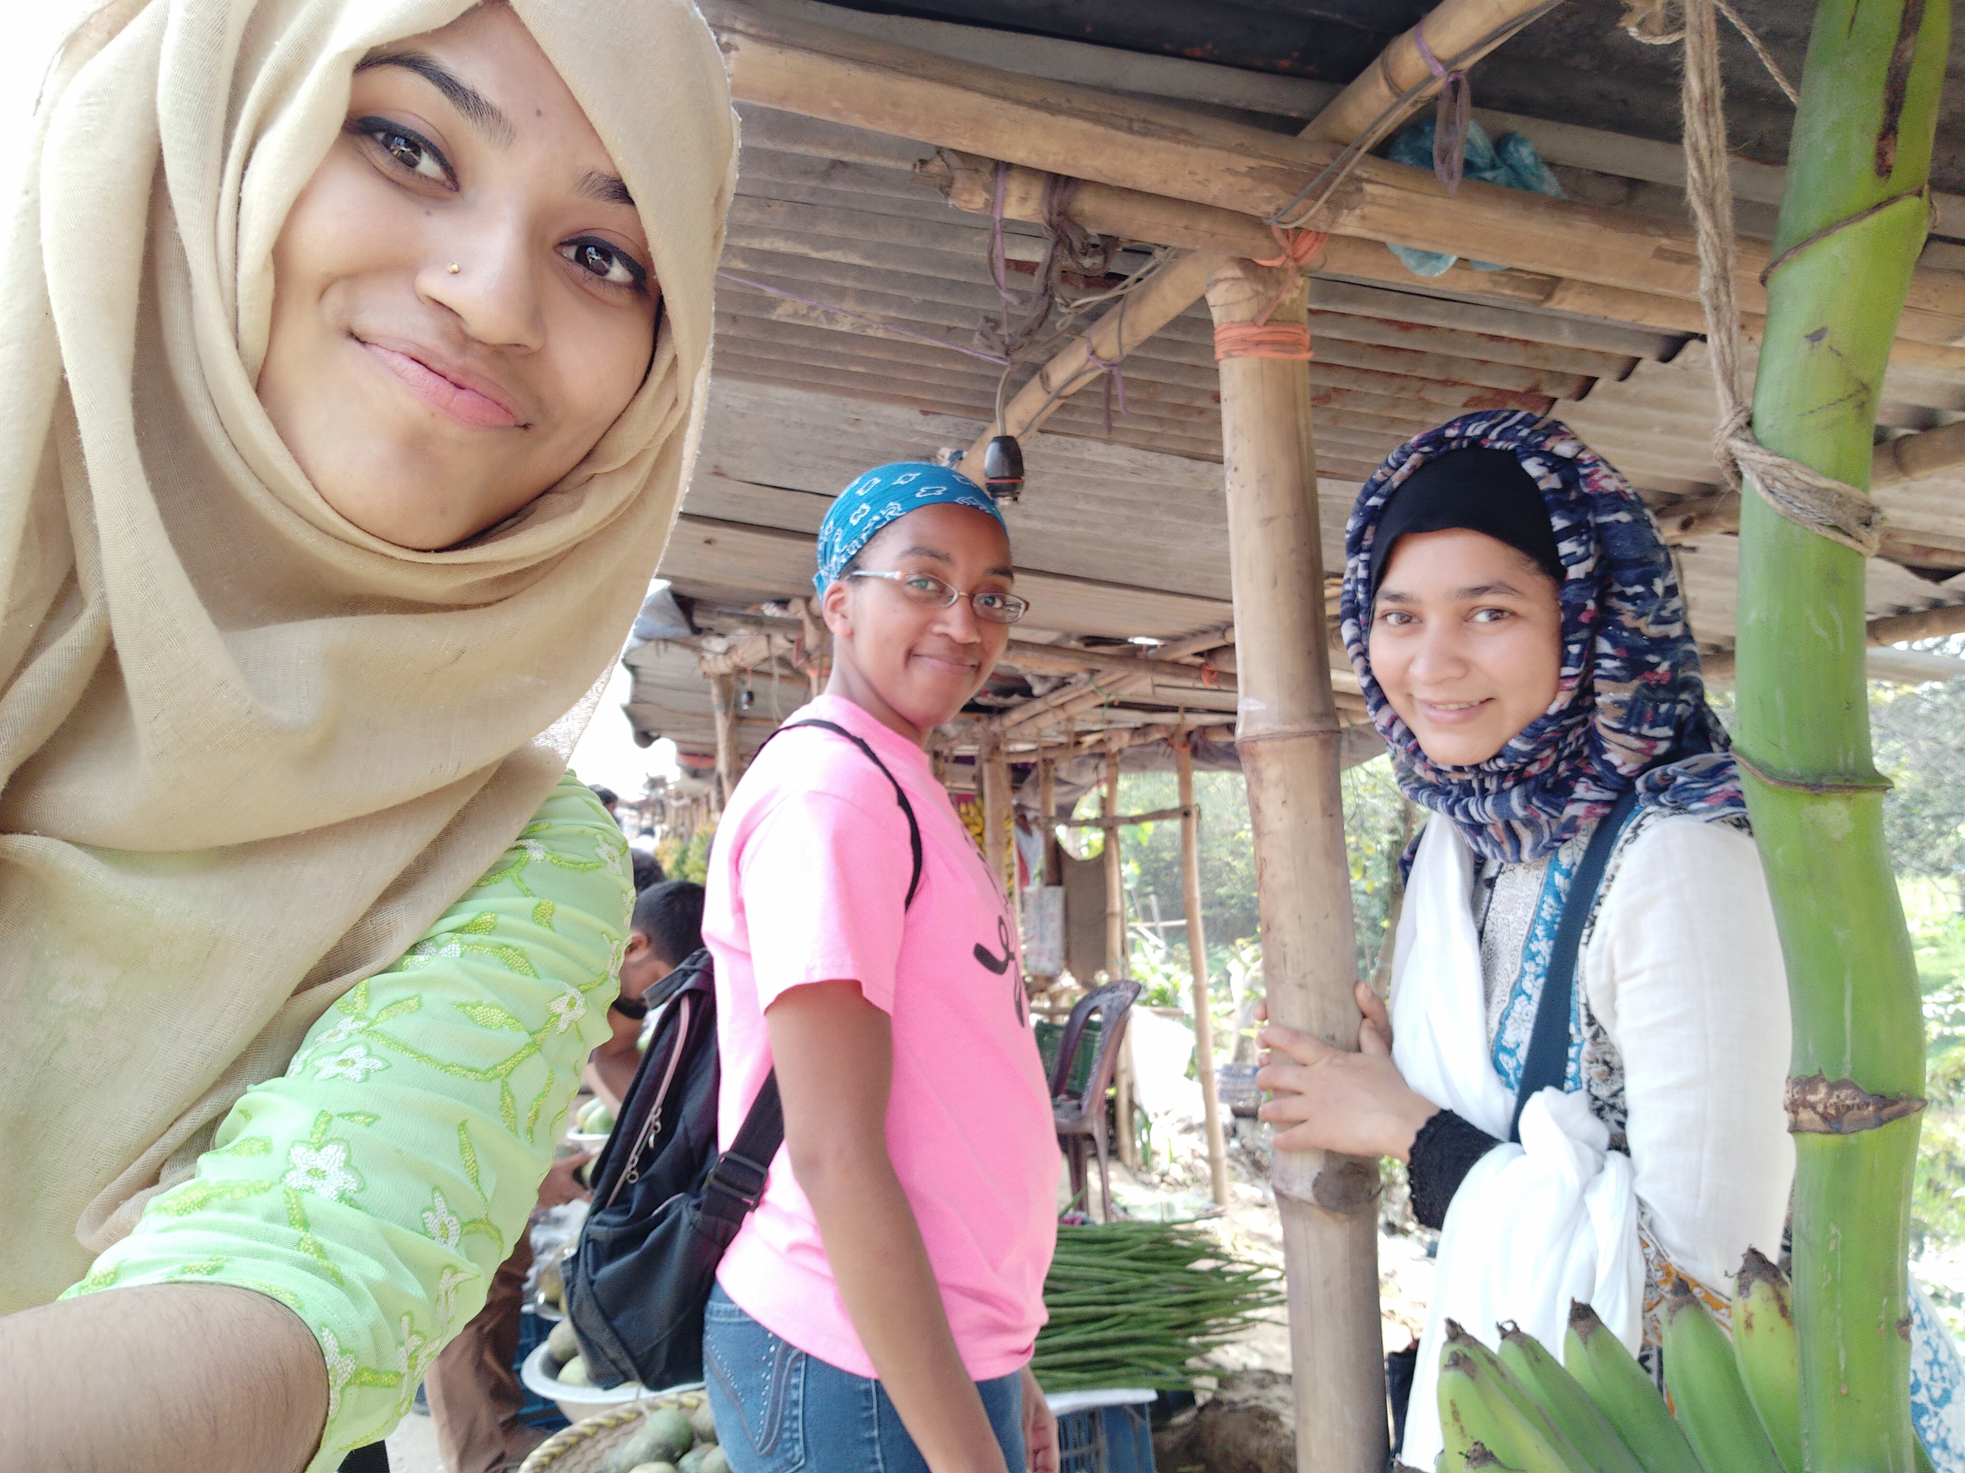
Going back to stories ….

Slide 22
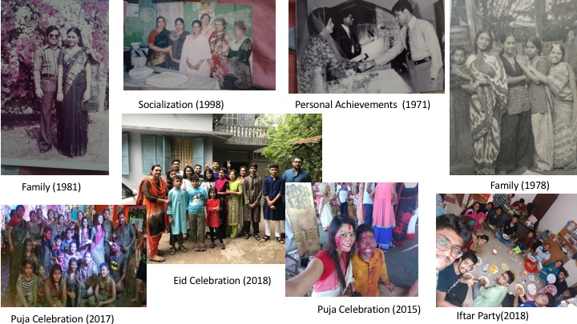
Golpokotha Stories, Difficult time, Freedom of speech
Started with a story sharing app for Dr. Jasmine Jones
It was very different from stories of USA
Families are very close knit

Slide 23
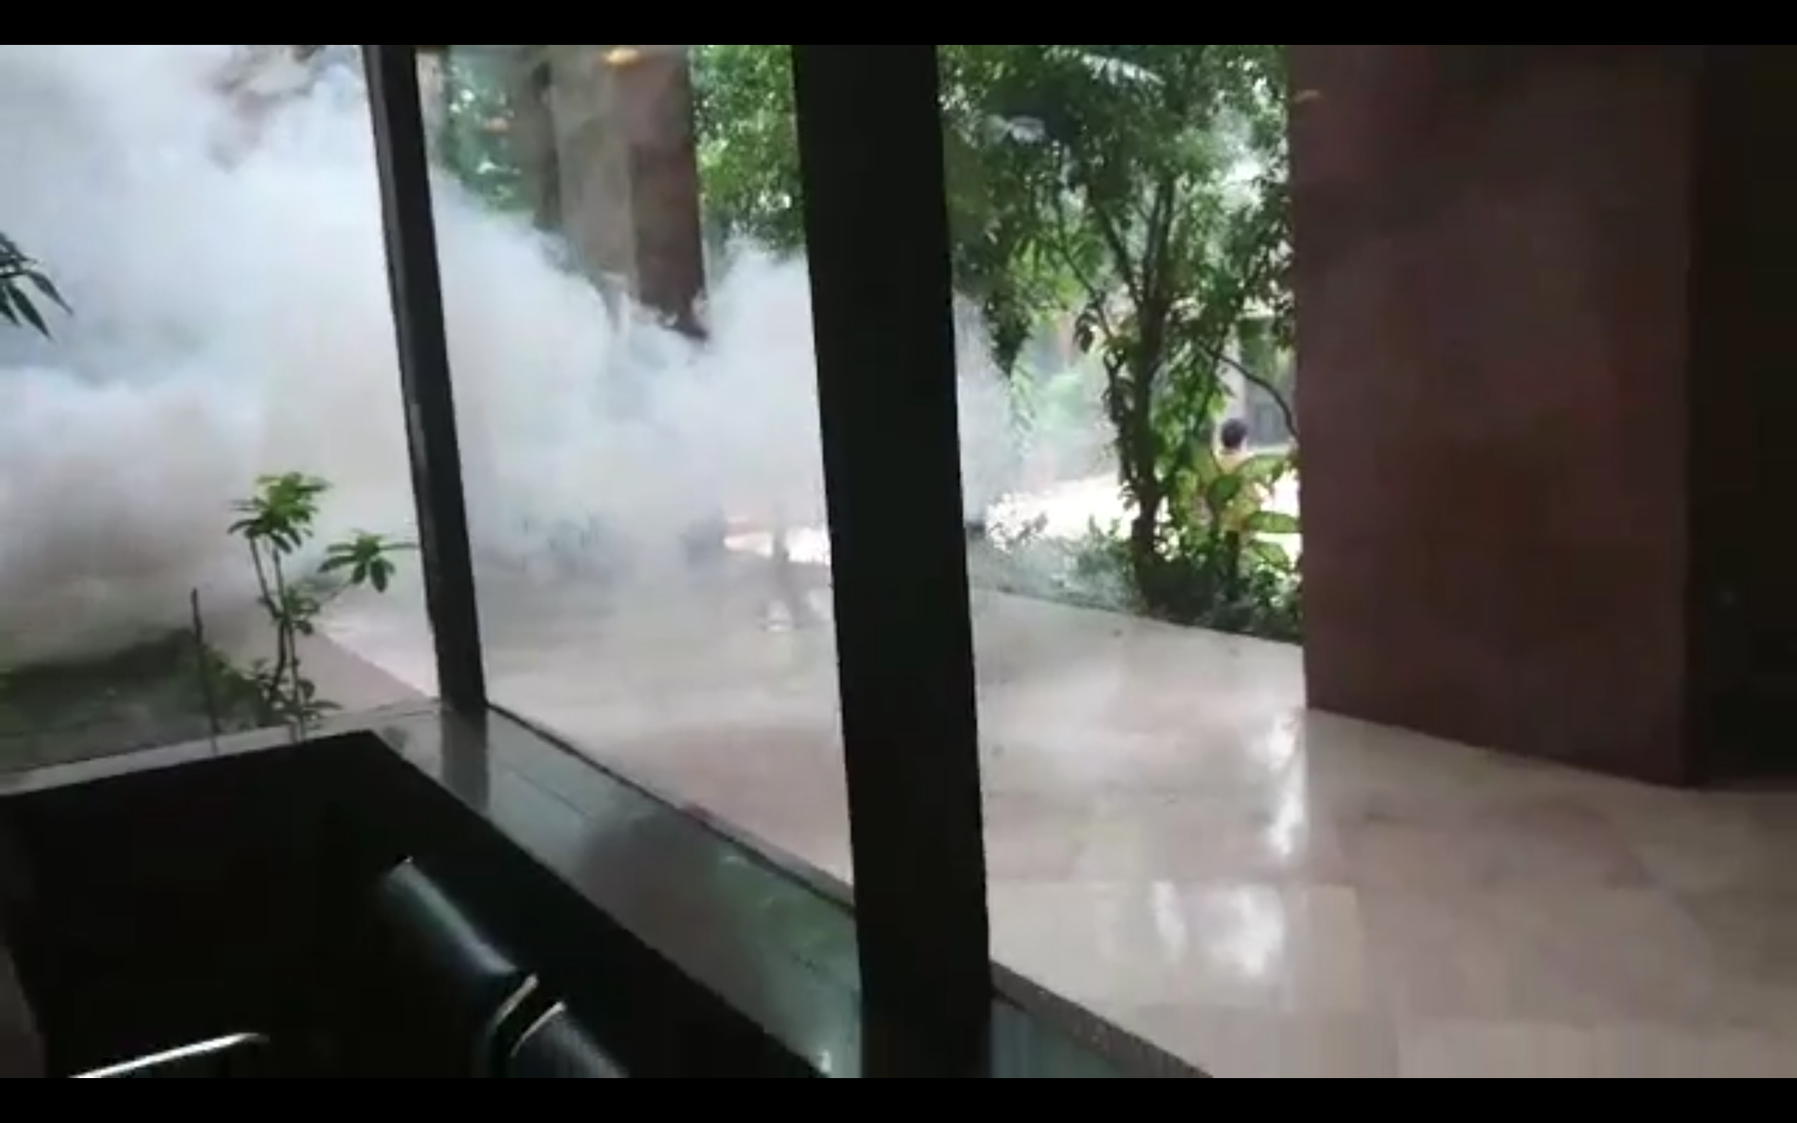
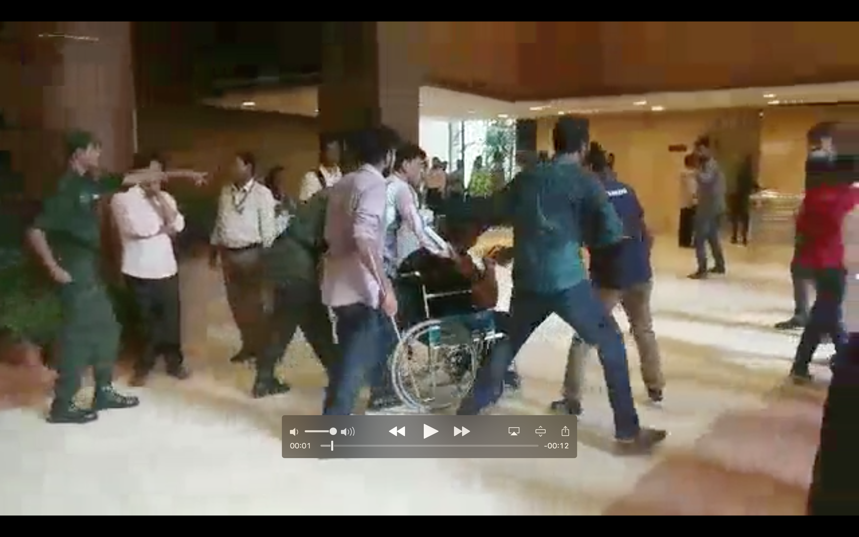
Golpokotha Stories, Difficult time, Freedom of speech
We started collecting stories of student driven protest
We started collecting stories
Had emotions and strong feelings shared over stories

Slide 24
Stories and you? Stories and us?
What do you think about stories and how we can connect to each other in design?

Slide 25
Papers
Mayeesha, T., Tasneem, Z., Jones, J., & Ahmed, N. (2018). Applying Text Mining to Protest Stories as Voice against Media Censorship. arXiv preprint arXiv:1812.11430.
Ahmed, N., Barik, F., Tasnim, Z., & Jones, J. (2019, January). Development through digital family stories in Bangladesh. In Proceedings of the Tenth International Conference on Information and Communication Technologies and Development (pp. 1-5).
Ahmed, N., Tasnim, Z., & Jones, J. (2019, May). Digital Silence and Liberating Stories: During a Student-Driven Movement. In Extended Abstracts of the 2019 CHI Conference on Human Factors in Computing Systems (pp. 1-10).

Slide 26
My old love, systems …

Slide 27
Shonabondhu Flash Flood and Women
Wanted a low cost solution
More of a political problem for us
There were initial local resistance (can you guess why?)

Slide 28
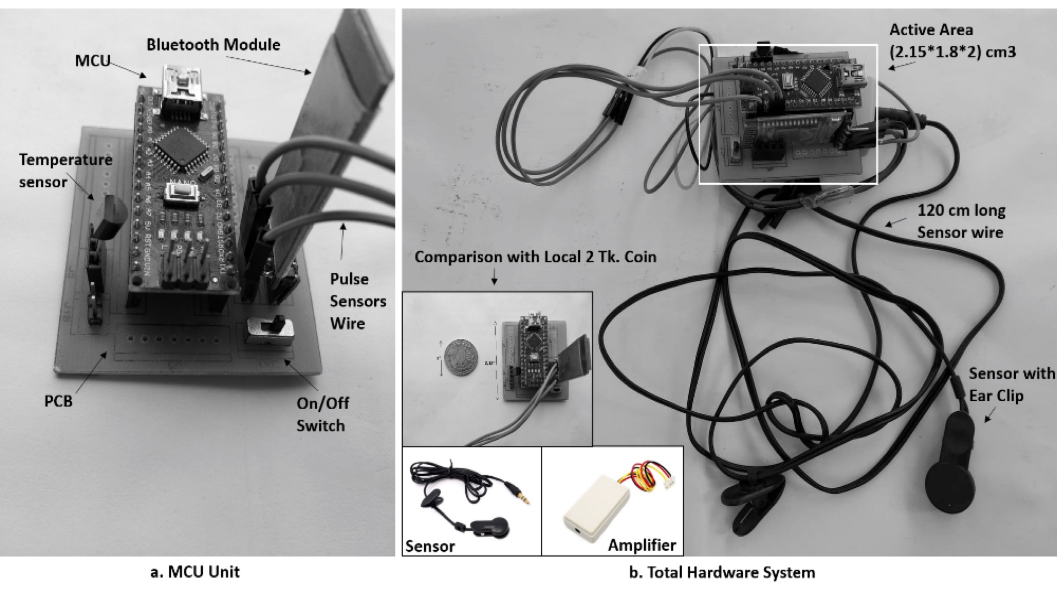
Bap re Bap Stress, Lifestyle and Us
Why use fitbit when we can make it with $5?

Slide 29
Bap re Bap Stress, Lifestyle and Us
We worked with stress level of drivers
It was low cost wearable
Drivers were monitored and found to be stressed

Slide 30
Combining all
Our problems requires our solution
Made in Bangladesh!

