Slide 1
THE NIGERIA ACADEMY OF SCIENCE 1st ANNUAL SCIENTIFIC CONFERENCE UNIVERSITY OF LAGOS, AKOKA, 2020
Development of Biological Agent for Post Harvest Yam Tuber rot – Trichoderma sp.
BY
Dr O. N. Akomah-Abadaike
Department of Microbiology Technology, School of Science Laboratory Technology, University of Port Harcourt, PMB 5323 Port Harcourt, Nigeria.
E-MAIL: onyinyechi.akomah@yahoo.com; onyinyechi.akomah@uniport.edu.ng

Slide 2
INTRODUCTION
Yam belongs to the family Dioscoreaceae and the genus Discorea.
In West Africa, there are at least seven species; Forest yam, Bitter yam, Chinese yam, Yellow yam, White yam, Guinea yam, Water yam.
The genus Trichoderma sp. belong to the family of hypocreacea, is the most abundant fungi found in climatic zones.
One of the most unique characteristics of this fungi compared to others, is their ability to parasitize other parasitic fungi in plants

Slide 3
SIGNIFICANT OF STUDY
PROBLEM | AUTHOR(S) | YEAR
About 0.5 – 18 % losses due to yam rot at harvesting. | FAO, Food and Agriculture Organization production year book, FAO , Rome. | 1998
About 50 % reduction of the total stored tuber within the first six months of storage. | Arinze, A.E; Plant Pathology and Post harvest Food loss | 2005
Losses affecting farmers and trader income, food security seed yams stored for planting. | Gwa,et al; In vitro Study of Antagonistic capacity of Trichoderma harzianum against Apergillus niger from rotten white yam (dioscorea rotundata). | 2019
The use of Synthetic chemicals to reduced yam rot but it has some challenges ; expensive, lack of expertise by the farmers, environmental pollution and pathogen resistance. | Amusa et al: The effect of Tecto (Thiobendazole) on the activities of yam rot causing fungi and on sprouting of yam set. | 2003

Slide 4
SIGNIFICANT OF STUDY
PROBLEM | AUTHOR(S) | YEAR
Tecto significantly reducing yam tuber weight and stimulating sprouting in yam minisetts | Amusa et al: The effect of Tecto (Thiobendazole) on the activities of yam rot causing fungi and on sprouting of yam set. | 2003
The application of antagonistic microoganisms such as Trichoderma sp. | Adebola and Amadi; Sreening three Aspergillus spp for antagonistic activities against the cocoa black pod organism (phytophlhora palmivora) | 2010
Biological control in post harvest has advantage over biological control in field, hence, a combination of both. | Okigbo; Biological control of post harvest fungal rot of yam (Dioscorea spp.) with Bacillus subtillis | 2005

Slide 5
OBJECTIVES
To molecularly characterize Trichoderma species from the six (6) geopolitical zones of Nigeria
To develop freeze dry (lyophilize) Trichoderma sp.
To evaluate the antagonistic capacity of Trichoderma sp. On yam seedling and post harvest yam.
To evaluate the concentration of salts and organic matter of yam farmlands (soil).

Slide 6
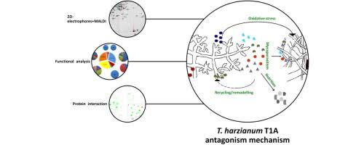
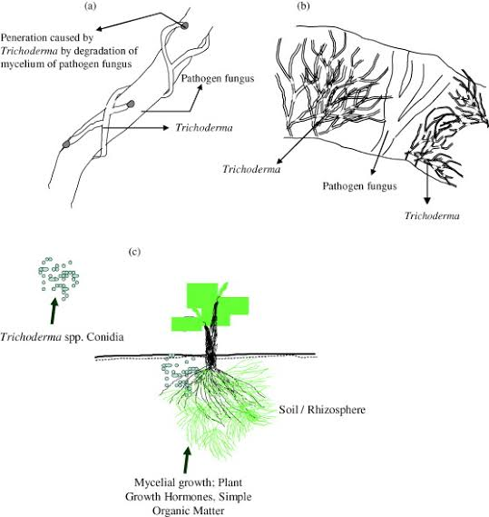
MECHANISM OF ANTAGONISM
Mycoparasitism
Antibiosis
Hyperparasitism

Slide 7
FACTORS INFLUENCING BIOCONTROL AGENT
Rhizoshere competence
Temperature
Moisture
Nutrient
Mechanism of diseases suppression

Slide 8
METHODS Experimental Design
Sample (yam tuber)
SS SE SW NC NE NW
Healthy tubers and unhealthy tubers
rot yam tissues (3 mm)
Isolation of Trichoderma sp (PDA media)
Isolation of Rot causing Microorganisms (PDA &NA
yam peels (back)

Slide 9
Identification of microorganisms
Microscopically(LPCB) Macroscopically Genetically
Pathogenicity of rot causing organisms
Antagonistic Testing (PDA plates and yam tubers)
Lypholization of Tricoderma sp.
KEY: SS=South south, SE= South East, SW= South West, NC= North Central, NE= North East, NW= North West. LPCB= Lacto-phenol cotton blue, PDA= Potato dextrose Agar

Slide 10
Methods cont.
Treatment Setup (sterile water/broth suspension)
Trichoderma sp. alone
Pathogen alone
Pathogen + Trichoderma simultaneously
Pathogen + Trichoderma 1 day later
Pathogen + Trichoderma 2 day later
Pathogen + Trichoderma 3 day later
Pathogenicity of B theobromae on different cultivars of water yam.

Slide 11
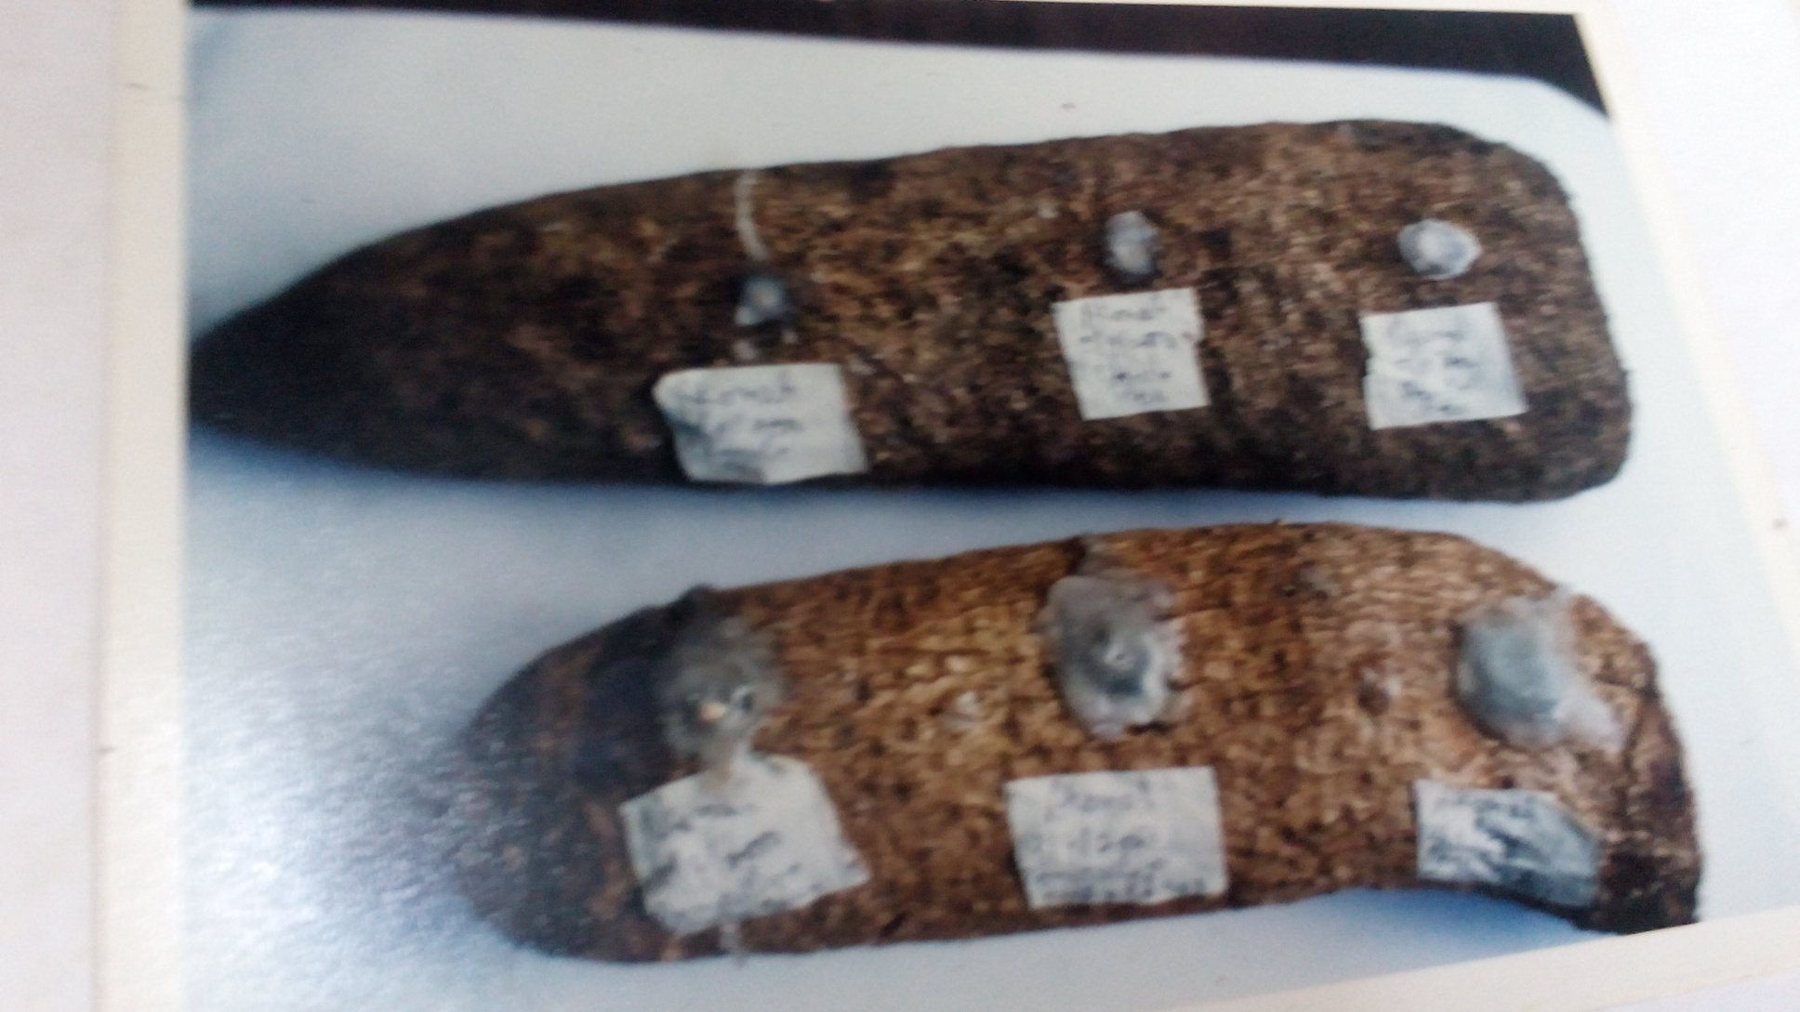
Fig. 1: Ondo and Edo yam inoculated with pathogen alone / with Trichoderma
simultaneously or days later

Slide 12
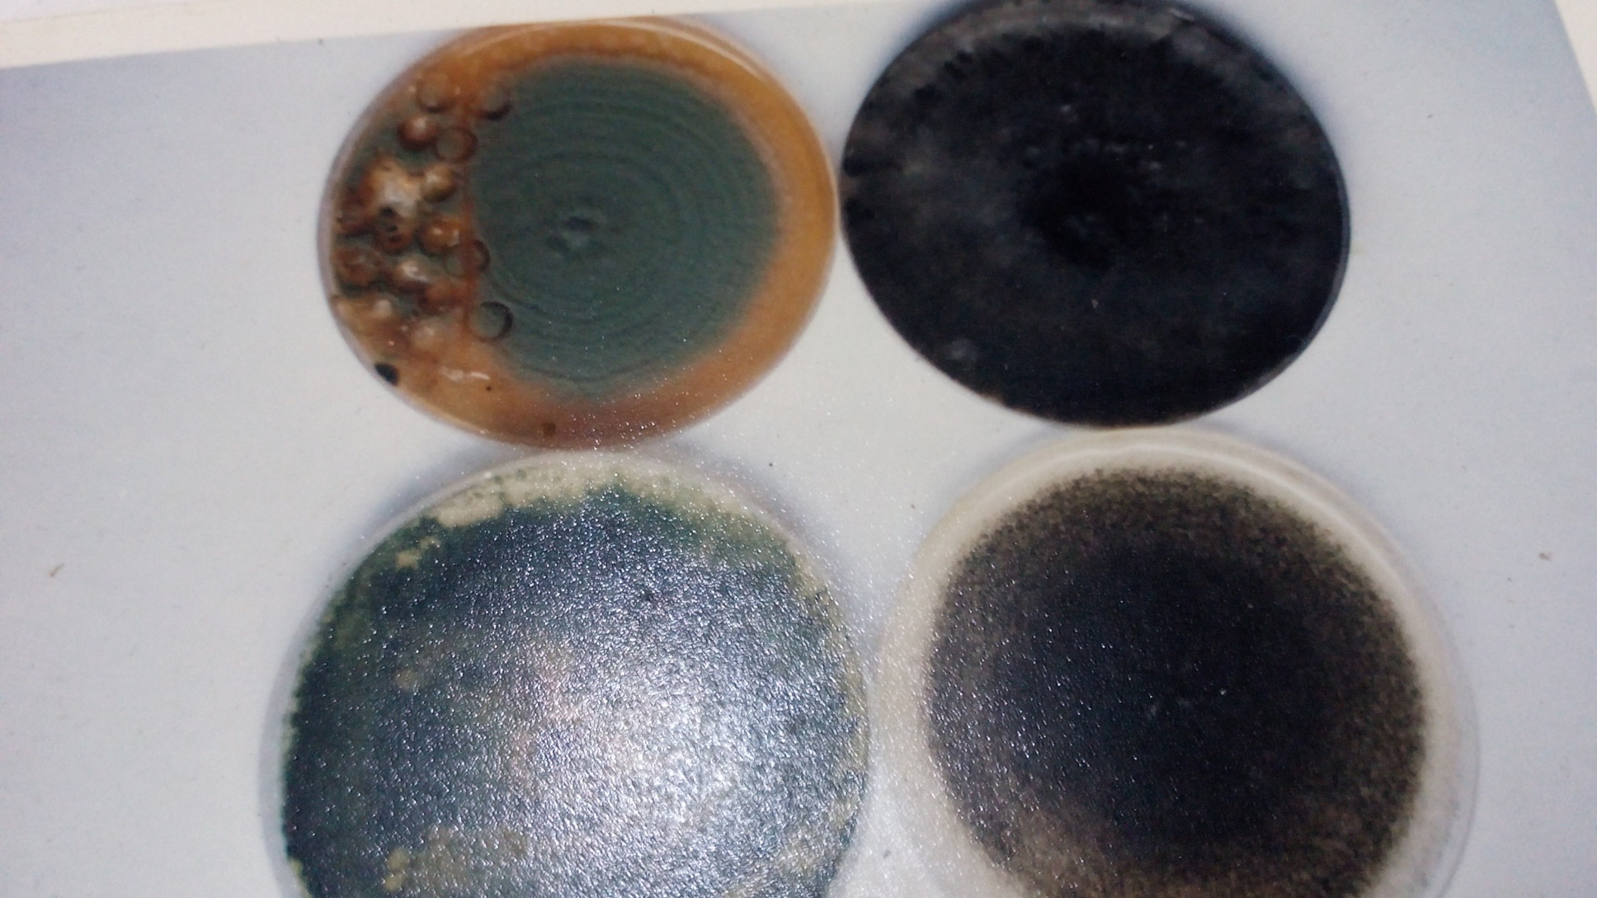
RESULTS AND DISCUSSION
1
2
3
4
Fig. 2: Fungi associated with rot of yam-tuber and Trichoderma sp. `
1= Trichoderma sp. 2= B theobromea, 3= P oxalicum, 4= A niger

Slide 13
Sensitivity of rot pathogens to Trichoderma sp. Antagonism
Table 1: Botrydioplodia sp vs Trichoderma sp.
TIME(DAY) | Replicate | a (mm) | b (mm) | a – b = (x) mm | x/a x 100% | Mean (%)
1 | 1 | 9 | 9 | 0 | 0
 | 2 | 15 | 10 | 5 | 33.3
 | 3 | 13 | 9 | 4 | 30.8 | 21.4
2 | 1 | 20 | 12 | 8 | 40
 | 2 | 30 | 13 | 17 | 56.7
 | 3 | 25 | 10 | 15 | 60 | 52.2
*Since the magnitude of inhibition for Botrydioplodia sp vs Trichoderma sp.is > 50 therefore, the inhibitory effect of the species of Trichoderma is effective using Sangoyomi (2004) scale.

Slide 14
Table 2: Aspergillus sp. vs Trichoderma sp.
TIME(DAY) | Replicate | a (mm) | b (mm) | a – b = (x) mm | x/a x 100% | Mean (%)
1 | 1 | 5 | 4 | 1 | 20
 | 2 | 5 | 4 | 1 | 20
 | 3 | 4 | 4 | 0 | 0 | 13.33
2 | 1 | 8 | 6 | 2 | 25
 | 2 | 9 | 7 | 2 | 25
 | 3 | 8 | 7 | 1 | 12.5 | 20.83
3 | 1 | 9 | 7 | 2 | 22.2
 | 2 | 10 | 8 | 2 | 20.0
 | 3 | 9 | 8 | 1 | 11.1 | 17.77
* Magnitude of inhibition > 0 – 20 slightly effective

Slide 15
Table 3: Pencillium sp. vs Trichoderma sp.
TIME(DAY) | Replicate | a (mm) | b (mm) | a – b = (x) mm | x/a x 100% | Mean (%)
1 | 1 | 6 | 4 | 2 | 33.3
 | 2 | 8 | 7 | 1 | 12.5
 | 3 | 4 | 4 | 0 | 0 | 13.3
2 | 1 | 11 | 7 | 4 | 36.4
 | 2 | 13 | 8 | 5 | 38.5
 | 3 | 6 | 5 | 1 | 6.7 | 30.5
3 | 1 | 15 | 6 | 9 | 60.0
 | 2 | 15 | 7 | 8 | 53.3
 | 3 | 7 | 6 | 1 | 14.3 | 42.5
* Magnitude of inhibition > 20 - 50 moderately effective

Slide 16
Table 4: Rot of yam tuber by A niger in the presence of Trichoderma sp.
ONDO YAM | WATER INOCULUM (mm) | BROTH INOCULUM (mm)
A niger alone | 16.2 | 11
A niger x Trichoderma simutaneously | 8.8 | 123.7
A niger x Trichoderma 1 day later | 112.5 | 10.2
A niger x Trichoderma 2 days later | 15.8 | 15.7
A niger x Trichoderma 3 days later | 14.2 | 15.2
*Rot inhibition not statistically significant

Slide 17
Table 5: Rot of yam tuber by B thoebromae in the presence of Trichoderma sp.
ONDO YAM | WATER INOCULUM (mm) | BROTH INOCULUM (mm)
B thoebromae alone | 9.3 | 11.2
B thoebromae x Trichoderma simutaneously | 8.2 | 10.7
B thoebromae x Trichoderma 1 day later | 10.2 | 9.8
B thoebromae x Trichoderma 2 days later | 12.3 | 12.3
B thoebromae x Trichoderma 3 days later | 8.3 | 10.2
*Rot inhibition not ststistically significant

Slide 18
Table 6: Rot of yam tuber by P oxalicum in the presence of Trichoderma sp.
EDO YAM | BROTH INOCULUM (mm)
P oxalicum alone | 55.7
P oxalicum x Trichoderma simutaneously | 25.7
P oxalicum x Trichoderma 1 day later | 26.3
P oxalicum x Trichoderma 2 days later | 40.0
*Rot inhibition statistically significant

Slide 19
Fig. 3: Mycelial extension of B theobromae on tissue disc of two cultivars of white yam
*Different cultivars of yam vary in their susceptibility to the same pathogen, this is reported
by other researchers (Okigbo and Ikediugwu (2000)

Slide 20
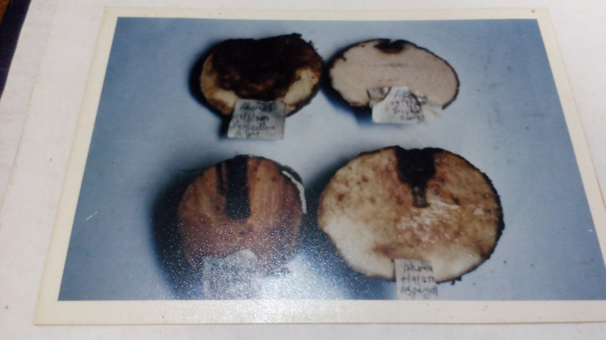
2
1
3
4
Fig. 4: Pathogenic effect of various fungi
1= P oxalicum, 2= Trichoderma sp., 3=B. theobromea, 4= A niger

Slide 21
CONCLUSION/RECOMMENDATION
Trichoderma sp. have a suppressive effect on the rot incited by B theobromae, A niger, and P oxalicum.
Different cultivars of white yam have varying level of susceptibility to rot pathogens.
Trichoderma sp have the capacity to control on going rot of tubers.
It is recommended that individuals spray their yam tubers with spore suspension of Trichoderma.

Slide 22
Expected outputs of Research
Expanded understanding of the phylogenetic of Trichoderma sp. In Africa.
Enhanced innovativeness
Freeze- drying (lyophilization) of Trichoderma sp.
Products commercially available

Slide 23
Expected outcomes and contribution
Increase income for local farmer and yam dealers
Increase foreign exchange.
Women empowerment.
More food, better health. Reduction in poverty and hunger, improved national security

Slide 24
REFRENCES
Amusa, N.A., Adegbite, A.A., Muhammed, S and Balyewu, R.A (2003). Yam diseases and its Management in Nigeria, African Journal of Biotechnology 2 : 497 – 503.
Okigbo, R. N (2005). Biological Control of post harvest fungal rot of yam (Dioscorea Spp.) with Bacillus subtillis, Mycopathologia, 159: 307-314.
FAO (1998). Food and Agriculture Organization production year book, FAO Rome.
Gwa, V.I., Nwankiti and Ekefan (3019). In vitro Study of Antagonistic capacity of Trichoderma harziamum against Aspergillus niger isolated from rotten white yam (Dioscorea rotundata) tuber, Journal of Advances in Biology and Biotechnology, 21 ; 1 – 10.

