Slide 1
Numerical Study of Pulsatile flow in Stenosed Carotid artery bifurcation
Presented by
Dr. Sarita Singh
School of Physical Science,
Department of Mathematics
Doon University Dehradun, India

Slide 2
Abstract
Human carotid arteries are elastic and perfused with a non-Newtonian fluid. The blood flow dynamics of a stenosed subject specific carotid bifurcation were numerically simulated using finite element method computationally. A coupling effect between elastic deformation of stenosed carotid artery wall and fluid. A flow rate at various location in stenosed carotid artery (CCA & ICA) for different-different frequencies 0, 60, 90,120 pulse/min with 600 Reynolds number by FLUIENT.
Keywords: carotid arteries, elastic, ICA, CCA, pulsatile, stenosed, etc.

Slide 3
Introduction
The flow patterns in arteries at bifurcation is of a great medical research of interest. This bifurcation of carotid artery where the CCA is divided into ICA and ECA. Generally the latter artery which shows a widening part, called as carotid sinus. At the bifurcation wall low shear are found [1].Thus it is mandatory to know the detailed flow behaviour.
A considerable reduction in shear stress is found in elastic models. A computer simulation of blood flow and vessel mechanics has been done in a carotid artery bifurcation model. By considering vessel wall elasticity the result are obtained [2]. Thus a qualitative flow investigations on bifurcation under pulsatile flow condition are increasing.
A pulsatile flow of non-Newtonian fluid has been studied in distensible models of arteries. By the various authors this study related to the pulsatile flow in human carotid artery has been done [3,4, 5]. To investigate the complexity of the blood flow pattern during pulsatile flow in healthy and stenoesd carotid artery bifurcation by MRI techniques. For the study of the impedance function of position not time using deformation of walls [10-17].

Slide 4
In our own study, we solved numerically Navier-Stokes equations and deformation equations with suitable inlet, outlet and boundary conditions. A qualitative and quantitative analysis is performed at the end of study graphically. Here we found a good agreement between the literature available practically and ours numerically.

Slide 5
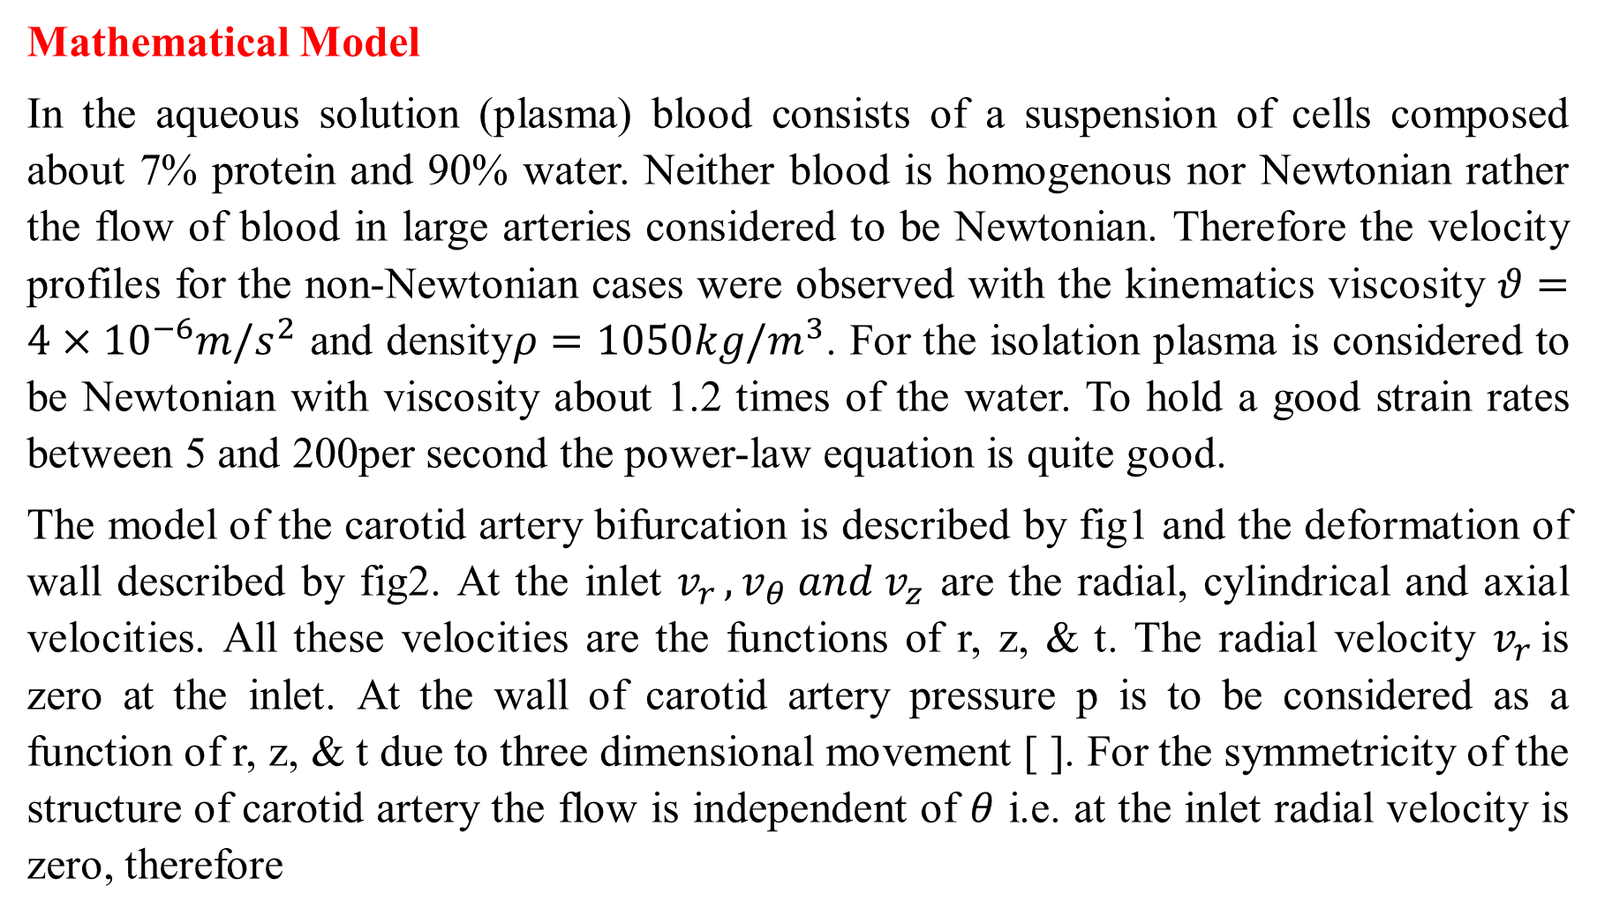
Mathematical Model
In the aqueous solution (plasma) blood consists of a suspension of cells composed about 7% protein and 90% water. Neither blood is homogenous nor Newtonian rather the flow of blood in large arteries considered to be Newtonian. Therefore the velocity profiles for the non-Newtonian cases were observed with the kinematics viscosity $θ=4×{10}^{−6}m/s^{2}$ and density$ρ=1050kg/m^{3}$. For the isolation plasma is considered to be Newtonian with viscosity about 1.2 times of the water. To hold a good strain rates between 5 and 200per second the power-law equation is quite good.
The model of the carotid artery bifurcation is described by fig1 and the deformation of wall described by fig2. At the inlet $v_{r }, v_{θ} and v_{z}$ are the radial, cylindrical and axial velocities. All these velocities are the functions of r, z, & t. The radial velocity $v_{r }$is zero at the inlet. At the wall of carotid artery pressure p is to be considered as a function of r, z, & t due to three dimensional movement [ ]. For the symmetricity of the structure of carotid artery the flow is independent of $θ$ i.e. at the inlet radial velocity is zero, therefore

Slide 6
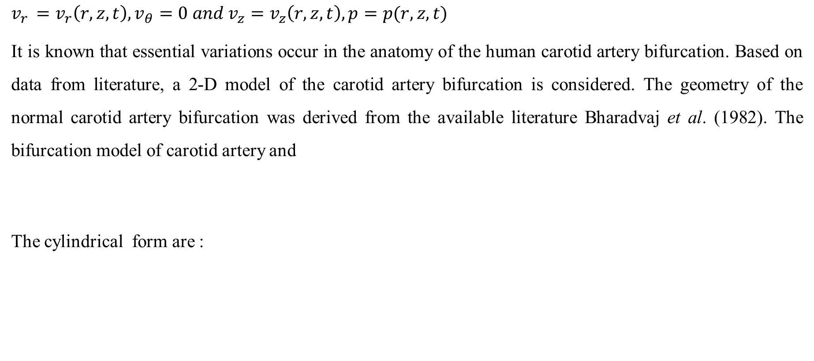
$$v_{r }=v_{r}\left(r, z, t\right), v_{θ}=0 and v_{z}=v_{z}\left(r, z, t\right), p=p(r, z, t)$$
It is known that essential variations occur in the anatomy of the human carotid artery bifurcation. Based on data from literature, a 2-D model of the carotid artery bifurcation is considered. The geometry of the normal carotid artery bifurcation was derived from the available literature Bharadvaj et al. (1982). The bifurcation model of carotid artery and
The cylindrical form are :

Slide 7
Continue….
The following non dimensional variables were used
Where p is the pressure,
the density,
the viscosity of the fluid (like air) in lungs, and
is the time-average velocity at inlet (nose/mouth).

Slide 8
Continue….
The velocities of the lung airways are always small than the speed of sound so the effects of compressibility is negligible. At the inflow boundary fully developed time velocity profiles are applied
At the walls no-slip condition

Slide 9
Numerical approach
Equation (1)-(3) with the proper boundary conditions stated above were solved by means of the Finite Element Method (FEM) using ANSYS Multiphysics Version 14.5, finite element solver package the 3-D cylindrical geometry of carotid artery is modeled as a 2-D geometry. The model was created in the software and was meshed with its mesh generator with FLUID141 element. The model is meshed automatically using ANSYS ‘mesh tool’. The mesh is created using ‘mapped meshing’ instead of ‘free meshing’ (Fig. 2). Mapped meshing is used when only quadrilateral (or triangular) elements are required. The meshing is specified as mapped when the command MSHKEY is set to 1. Smart sizing cannot be used for mapped meshing. For an area to accept a mapped mesh, the area must be bounded by either 3 or 4 lines (with or without concatenation). In order to achieve this in case near bifurcation, which is bounded by 6 lines in the model, the lines L15, L16, L19, L24, L25 and L26 (fig.1) were concatenated to form a single line. The grid had maximum 1660 elements with 1801 corner nodes. The loads (boundary conditions) are then applied. One pulse cycle was discretized into 100 time steps. The solution was obtained by a finite element method, and SIMPLEF was chosen for solution algorithm with desecrates the momentum equations with a Streamline Upwind/Petrov-Galerkin (SUPG) approach.

Slide 10
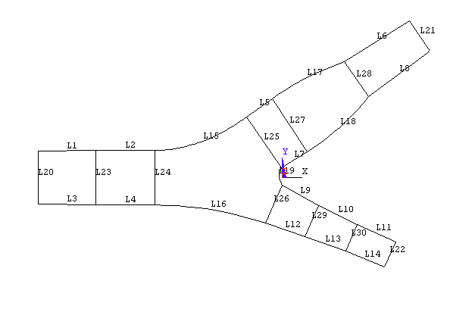
Fig.1. Geometry of two-dimensional model of carotid artery bifurcation.

Slide 11
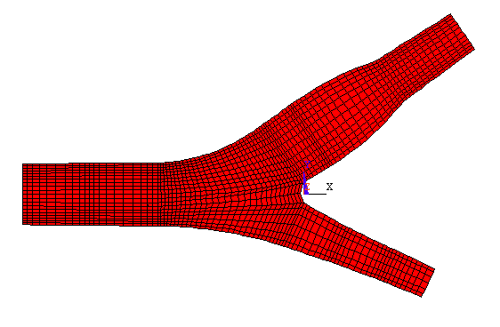
Fig. 2. Mesh generation of two-dimensional model of carotid artery bifurcation.

Slide 12
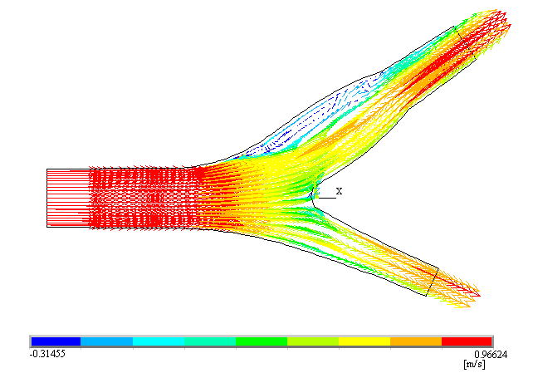
Fig. 3. The vector plot of velocity field in carotid artery over one cardiac cycle

Slide 13
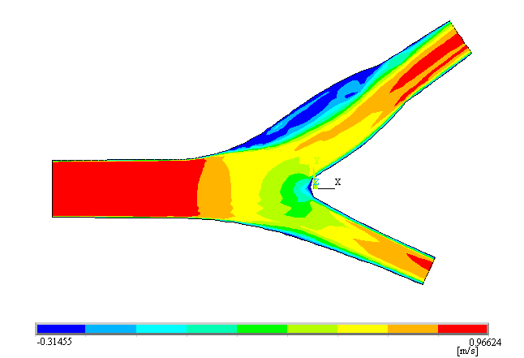
Fig. 4. The color contours describing the velocity distribution over one cardiac cycle.

Slide 14
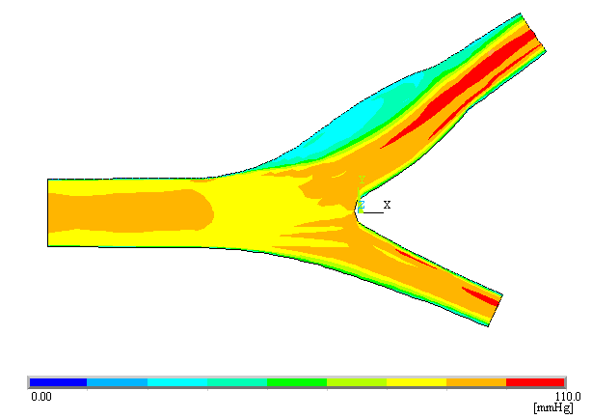
Fig. 5. Distribution of total stagnation pressure over one cardiac cycle in carotid artery.

Slide 15
Results and Discussions
At first calculation flow rate at the inlet of common carotid artery was selected 275 ml/min and the Reynolds number Re=250. Fig. 3 and 4 shows the velocity vector and contour field in the branching plane at the time of systolic acceleration. The flow separation occurs near the outer wall of the ICA in sinus. In this region flow recirculation occurred and pressure decreases. Fig. 5 shows the total stagnation pressure in carotid artery at systolic acceleration. The pressure decreases near the outer wall of carotid sinus.

Slide 16
Velocity profile
The axial velocity profiles were determined for t = 0.00sec (end diastole t = 0.08sec (peak systole), t = 0.16 sec (halfway systolic deceleration) and t=0.32 sec (end systole) respectively. These axial velocities were calculated at four different cross-sections, i.e., at inlet, near bifurcation, in carotid sinus and at outlet of ICA. During inlet (fig. 6) the axial velocity profile is almost parabolic at the end of diastolic phase t = 0.00sec. Then the velocity rapidly increases during systolic acceleration t = 0.08sec resulting in a slight flattening of the profile. During the systolic deceleration (t=0.16s) the profile show a tendency to flow reversal at both walls and finally develops a parabolic shape at the end of the systolic phase (t=0.32s) sec of the flow. Axial velocity profile near the bifurcation (Fig. 7) during the end diastole (t=0.00s) is almost parabolic similar to the profile at inlet. But during the peak systole (t= 0.08s) the velocity profile becomes blunt shaped as the flow separation occurs at the apex. Again during the systolic deceleration (t=0.16s) and end systole (t=0.32s) the velocity profile retains the parabolic shape due to flow reversal at both walls.

Slide 17
Fig. 6. Velocity profile at the inlet in CCA for different values of time.
Fig.7. Velocity profile near the bifurcation in CCA for different values of times.

Slide 18
A small local maximum is observed in the most distal part of the sinus where the walls converge maximally and develop into the parallel wall section of the internal carotid artery. During systolic deceleration (t=0.16s) large differences in the axial velocities are found in the carotid sinus (Fig. 8). Relatively large negative velocities are found at the non-divider side wall downstream the apex. The region of reversed flow occupies up to 30% of the local diameter and is associated with high positive velocities at the divider side wall where a large peak is found. Downstream of the carotid sinus the profile gradually recovers a parabolic shape. Near the end of the systolic deceleration phase (t=0.32s), the axial velocity profile in the carotid sinus becomes more complicated. At the mid-sinus, the axial velocity profile is characterized by a relatively large region with small negative velocities at the non-divider side wall, similar to the pattern at end diastolic flow (t=0.00s). During peak systole (t=0.08s) the profile has very small negative velocities for a relatively small region. The axial velocity profiles at the outlet of internal carotid artery are similar to the pattern at the inlet of common carotid artery (Fig. 9) but have small values of velocity.

Slide 19
Fig. 8. Velocity profile in the carotid artery sinus for different values of time.
Fig. 9. Velocity profile at the outlet in ICA for different values of time.

Slide 20
Flow and pressure curves
With the aim of examining the consistency of the model, flow and pressure curves are analyzed. The results are plotted at the inlet of common carotid artery and outlet of internal carotid artery during whole cardiac cycle of 1s. On analysis of the pressure generated we saw that the pattern of calculated pressure curve (Fig. 10 and 11) is of the form of the normal pressure curve Clementel et al. (2006) and Urquiza et al. (2006). There is not so much difference in the inlet and outlet pressure curves. The peak value of pressure at inlet is 110mm Hg and outlet is109.5mmHg during t=0.2s. The pressure distribution (Fig. 5) illustrated that in the common carotid artery, the pressure along axis in common carotid first decreases according to a straight line. When the non-divider wall of artery changes from a straight to a curved line (carotid sinus), the pressure reaches its minimum. After this minimum, the pressure increases slightly in the ICA. The flow rate curve (Fig. 10 and 11), during inlet and outlet are of same pattern but at inlet the pressure lags the inflow rate. The peak flow during inlet is 35ml/s and during outlet is 19ml/s at t=0.1s. The negative values of flow are due to the existence of reversal flow. The minimum value at inlet is12 ml/s and outlet is 7ml/s. Thus, the flow rate is maximum during the inlet.

Slide 21
Fig. 10. Flow rate and pressure curves at the inlet of carotid artery.
Fig. 12. Scattergram of cardiac output and total blood flow showing lack of correlation

Slide 22
Conclusion
In our paper, we have numerically discussed velocity profile, pressure and flow waveforms and influence of cardiac output. The study was carried out in 2-D model of carotid artery assuming the flow to be unsteady. Based on our analysis the following can be concluded:
The velocity profile shows major changes near bifurcation (at apex) and at the non-divider wall. Large negative velocities are found in the sinus region giving the largest recirculation zone.
The height of pressure peaks decreases with increase in time. The pressure is very low in the recirculation zone.
The flow is influenced by the flow divider and widening & tapering of the sinus. This widening features flow reversal at the end diastolic flow rate.
The impact of cardiac output on cerebral perfusion is controversial. Increase in blood flow does not increase cardiac output whereas a drop in cardiac output decreases the blood flow in carotid artery.
The results we obtained numerically shows close resemblance with the experimental data available. By using the more realistic conditions in the computations we believe that the measurements of the parameters can be improved.

Slide 23
References
Quarteroni, M. Tuveri, A. Vencziani, Comp. Visual. Sci. 2 (2000) 163–197.
B.K. Bharadvaj, R.F. Mabon, D.P. Giddens, J. Biomech. 15 (1982) 349–362.
B.K. Bharadvaj, R.F. Mabon, D.P. Giddens, J. Biomech. 15 (1982) 363–378.
Tu, M. Deville, J. Biomech. 29 (1996) 899–908.
Liepsch et al, Biorheology 29 (1992) 563–580.
Liepsch, R. Zimmer, Technol. Health Care 3 (1995) 185–199.
Liepsch, S. Moravee, Biorheology 21 (1984) 571–586.
D.N. Ku, D.P. Giddens, C.K. Zarins, S. Glagov, Atherosclerosis 5 (3) (1985) 293–302.
F.N. Van de Vosse, A.A. Van Steehoven, J.D. Janssen, R.S. Reneman, Biorheology 27 (1990) 163–189.
G.R. Zendehbudi, M.S. Moayeri, J. Biomech. 32 (1999) 959–965.
.E.V. Clementel, C.A. Figueroa, K.E. Jansen, C.A. Taylor, Comp. Met. App. Mech. Eng. 195 (2006) 3776–3796.
Marshall, S.Z. Zhao, P. Papathanasopoulou, P. Hoskins, X.Y. Xu, J. Biomech. 37 (2004) 679–687.
J. Chen, X.Y. Lu, J. Biomech. 39 (2006) 818–832.
J.N. Kapur, Mathematical Models in Biology and Medicine, East-West Press, 2000.
J.N. Mazumdar, Biofluid Mechanics, Cambridge University Press, 1992.
K. Perktold, G. Rappitsch, J. Biomech. 28 (1995) 845–856.

Slide 24
K. Perktold, M. Resch, H. Florain, J. Biomech. Eng., Trans. ASME 113 (1999) 464–475.
L. Formaggia, J.F. Gerbeau, F. Nobile, A. Quarteroni, Comp. Met. App. Mech. Eng. 191 (2001) 561–582.
M. Anand, K.R. Rajagopal, C.R. Mecanique 330 (2002) 557–562.
Agarwal, R., Katiyar, VK. and Pradhan, P. 2006. Pulsatile flow in carotid artery bifurcation. Journal of Biomechanics. 39( supplement 1): S321.
Augst, AD., Barrat, DC., Hughes, AD., Thom, SAM. and Xu, XY. 2003. Various issues relating to computational fluid dynamics simulations of carotid bifurcation flow based on model reconstructed from three-dimensional ultrasound images. Proceedings of The Institution of Mechanical Engineers Part H-Journal of Engineering in Medicine. 217: 393-403.
Baaijens, JPW., Steenhoven, AAV. and Janssen, JD. 1993. Numerical Analysis of Steady Generalized Newtonian Blood flow in a 2D-Model of the Carotid Artery Bifurcation. Biorheology. 30: 63-74.
Bharadvaj, BK., Mabon, RF. and Giddens, DP. 1982. Steady flow in a model of the human carotid bifurcation. Part I – Flow visualization. Journal of Biomechanics. 15: 349-362.
Bharadvaj, BK., Mabon, RF. and Giddens, DP. 1982. Steady flow in a model of the human carotid bifurcation. Part II – Laser-Doppler anemometer measurements. Journal of Biomechanics. 15: 363-378.
Castello, R., Vaughn, M., Dressier, FA., McBride, LR., Willman, VL., Kaiser, G C., Schweiss, JF., Oflli, EO. and Labovitz, AJ. 1995. Relation between pulmonary venous flow and pulmonary wedge pressure: Influence of cardiac output. American Heart Journal.130 (1): 127-134.

