Slide 1



ASSESSMENT OF AIR POLLUTION TOLERANCE INDEX ON SOME SELECTED TREE SPECIES IN SOUTHWEST NIGERIA
BY
OKON-AKAN OMOLABAKE
1 st AFRICA FORUM ON URBAN FORESTS 05-09 July 2021, Accra, Ghana.

Slide 2
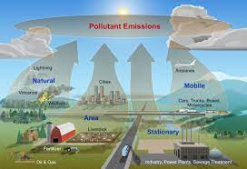
INTRODUCTION
Human lives, plant and animal have been endangered due to toxic environment from anthropogenic activities.
The principal pollutants emitted from gasoline-fuelled vehicles are CO, hydrocarbons (HC), and NO_{x} while particulate matter, NO_{x}, SO₂ and polyaromatic hydrocarbons (PAH) are emitted by diesel-fuelled vehicles (Bhandarkar 2013).

Slide 3

INTRODUCTION CONT’D
Urban forests and trees in the urban environment can improve air quality through filtering and uptake of gases and particles (Beckett et al. 2000).
Air pollutants on entering the plants through the stomata undergo complex interactions within the cells leading to series of reactions, some of which enhances the capacity of the plant to adapt to the stress (Mittler 2002), and invariably show diverse morphological, biochemical, anatomical and physiological responses.
These responses aids both trees and plant species in pollution tolerance development against air pollution which can be hypothetically measured using air pollution tolerance index (Enete et al., 2012). This index is related to plant leaves ascorbic acid, relative water content, leaf pH and total chlorophyll. The change of these parameters reveals the sensitivity and trees tolerance to air contamination.

Slide 4
MATERIALS AND METHOD
Description of study site
Sample collection
Analysis of samples
The following physiological and biochemical parameters were analyzed:
APTI
Leaf relative water content (RWC)
Ascorbic acid content (AAC)
Total leaf chlorophyll {TC}
pH of leaf extract

Slide 5
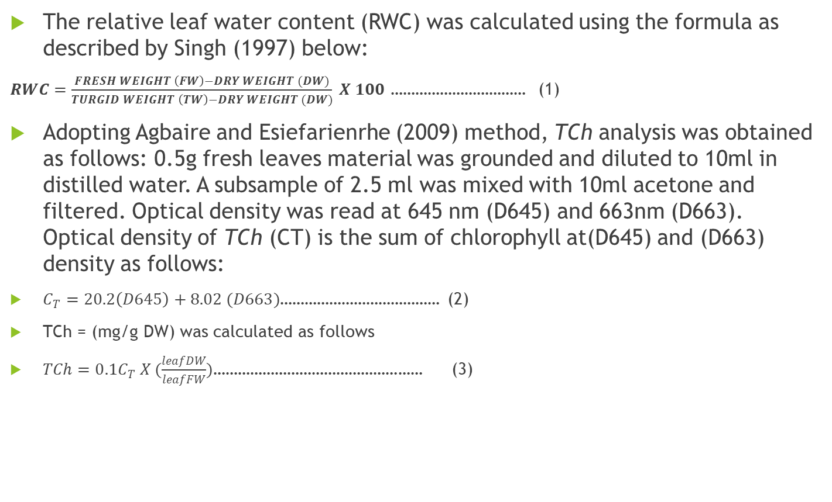
MATERIALS AND METHOD CONT’D
The relative leaf water content (RWC) was calculated using the formula as described by Singh (1997) below:
$RWC=\frac{FRESH WEIGHT \left(FW\right)−DRY WEIGHT (DW)}{TURGID WEIGHT \left(TW\right)−DRY WEIGHT (DW)} X 100$ …………………………… (1)
Adopting Agbaire and Esiefarienrhe (2009) method, TCh analysis was obtained as follows: 0.5g fresh leaves material was grounded and diluted to 10ml in distilled water. A subsample of 2.5 ml was mixed with 10ml acetone and filtered. Optical density was read at 645 nm (D645) and 663nm (D663). Optical density of TCh (CT) is the sum of chlorophyll at(D645) and (D663) density as follows:
$C_{T}=20.2\left(D645\right)+8.02 (D663)$………………………………… (2)
TCh = (mg/g DW) was calculated as follows
$TCh=0.1C_{T} X (\frac{leafDW}{leafFW})$…………………………………………… (3)

Slide 6
MATERIALS AND METHOD CONT’D
The leaf extract pH
5g of the fresh leaves was homogenized in 10ml distilled water. This was filtered and the pH of the leaf extract determined after the pH meter has been calibrated with buffer solution of pH 4 and 9.
Ascorbic Acid (AA) Content Analysis
Ascorbic Acid (AA) Content (expressed in Mg/g) was measured using spectrophotometric method (Bajaj and Kaur, 1981; Enete et al., 2012). Ig of the fresh foliage was put in a text-tube, 4 ml oxalic acid EDTA extracting solution was added, them 1 ml of Orthophosphoric acid and then 1 ml 5% tetraoxosulphate (vi) acid added to this mixture, 2 ml of ammonium molybdate was added and then 3ml of water. The solution was then allowed to stand for 15 minutes after which the absorbance at 760nm was measured with a spectrophotometer. The concentrations of ascorbic acid in the sample was then extrapolated from a standard ascorbic.

Slide 7
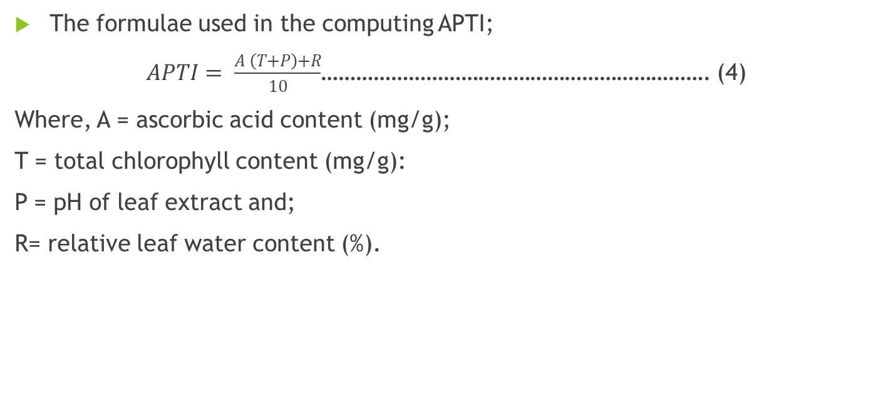
MATERIALS AND METHOD CONT’D
The formulae used in the computing APTI;
$APTI= \frac{A \left(T+P\right)+R}{10}$…………………………………………………………. (4)
Where, A = ascorbic acid content (mg/g);
T = total chlorophyll content (mg/g):
P = pH of leaf extract and;
R= relative leaf water content (%).

Slide 8
RESULTS AND DISCUSSION
RWC of a leaf is associated with protoplasmic permeability in the cells.
This suggested that trees at polluted site because of heavy traffic around the area retains more water than those at less polluted site (Tanee and Albert, 2013).
Trees at polluted site absorbed more water as an adaptive feature that helps in maintaining its physiological balance against pollution stress.
It also suggests that the absorbed pollutants are hydrophilic which enables the trees to retain water and be tolerant to pollution stress

Slide 9
RESULTS AND DISCUSSION CONT’D
The pH of leaf extract examined revealed the basicity of tree species across the three sites.
Because of the low pH concentrations, it implies there’s high concentration of hydrogen ion (H⁺).
It shows there’s a shift in the pH of cell sap towards the acid side in the presence of an acidic pollutant which decreases the efficiency of conversion of hexose sugar to ascorbic acid.
However, the reducing activity of ascorbic gives tolerance to trees against air pollution.

Slide 10
RESULTS AND DISCUSSION CONT’D
Ascorbic acid being a reducing agent activates quite a lot of physiological and defense mechanism.
(Raza and Murthy, (1988): Agbaire and Esiefarienrhe, 2009) confirms according to their findings that the reducing power of Ascorbic Acid is directly proportional to its concentration.
However it’s reducing activity is pH dependent meaning lower ascorbic acid contents were associated with lower pH of the leaf.
A shift in cell sap pH towards the acid zone in the presence of an acidic pollutant might decrease the efficiency of conversion of hexose sugar to ascorbic acid (Agbaire and Esiefarienrhe, 2009).

Slide 11
RESULTS AND DISCUSSION CONT’D
Chlorophyll is an index of productivity in plants and tree species and also the principal photoreceptor in photosynthesis.
chlorophyll content varies from species to species, age of leaf and also the pollution level as well as with other biotic and abiotic conditions (Katiyar and Dubey, 2001).
Certain air pollutants have been reported to reduce chlorophyll content (Tiwari et al., 2006; Joshi and Swami, 2007 and 2009, Joshi et al., 2009) while others increase it (Tripathi and Gautam, 2007, Agbaire and Esiefarienrhe, 2009).
This reduction in total chlorophyll may be due to the effect on the degradation of chlorophyll synthesis.

Slide 12
RESULTS AND DISCUSSION CONT’D
Joshi and Swami (2007) and Agbaire (2009)findings who reported that one of the most common impacts of air pollution is gradual disappearance of chlorophyll and concomitant leaf chlorosis which may be associated with a consequent decrease in photosynthetic carbon fixation.
APTI Value: Response
30 to 100: Tolerant
29 to 17: Intermediate
16 to 1: Sensitive
<1: Very sensitive

Slide 13
RESULTS AND DISCUSSION CONT’D
The five species showed APTI values of 21.6 to 25.47 which fall within the classification range of 17 to 29 and are designated as intermediate.
These trees are recommended for pollution abatement in heavy traffic urban areas, for aesthetic improvement or for microclimate modification and have the potential to serve as excellent quantitative and qualitative indices for controlling air pollution.

Slide 14
CONCLUSION
Air pollution tolerance index (A.P.T.I.) study proves significant in determining the tolerant and sensitive nature of tree species in environment.
Among the five (5) tree species considered for the experimental study, the order of trees tolerant to air pollution are
Gmelina arborea Roxb > Anacardium occidentale L.> Tectona grandis > Magnifera Indica > Polyalthia longifolia.
The order of sites because in terms of vehicular population, urbanization, and industrialization and the tolerance of tree species to APTI are
L3>L1>L2.
These results provides useful information in selecting tolerant species capable of reducing air particulates and adversely reduces air pollution.

Slide 15


