Slide 1

Integrated Quality Measurement Framework for Maternal, Neonatal and Child Health Services in Tanzania.
Sarah Nyanjara Programme: PhD-ICSE
Supervisors: Dr. Dina Machuve (NM-AIST) Prof. Pirkko Nykanen (Tampere University)

Slide 2
Background
For the past two decades, tremendous efforts have been made to reduce mortality and morbidity among mothers and children under five years.
Despite notable efforts, maternal and neonatal deaths are still high around the world; majority coming from developing countries.
The high occurrences of mortality in developing countries are frequent linked with poor quality of Maternal Neonatal and Child Health (MNCH) services provided.

Slide 3
Problem Statement
Quality measurement; it evaluates the performance of health services according to the acceptable standards also it tells whether health services provided have the required standards to improve health and survival of women and children.
However, most of developing countries lack effective approaches for quality
measurement.

Slide 4
Study Objectives
Main Objective
To develop Integrated Quality Measurement Framework for Maternal, Neonatal and Child Health Services in Tanzania.

Slide 5
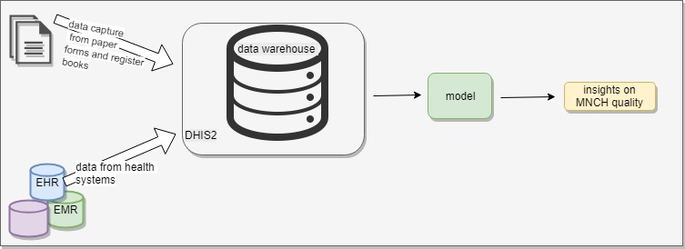
Conceptual Diagram

Slide 6
Study Objectives and Progress Made
Specific Objective 1: Review the current approaches and evaluate the state of art in MNCH quality assessment
Milestones Achieved
Manuscript titled “Machine Learning-based Approach for Measuring Quality of Maternal Neonatal and Child Health Services in Developing Countries; a review”

Slide 7
Study Objectives and Progress Made ….
Specific Objective 2: To develop quality assessment model for MNCH services in Tanzania
Sub-tasks;
Review on MNCH quality measurement indicators
Data Collection
Exploratory analysis on the collected data
Model Development

Slide 8
Study Objectives and Progress Made ….
Impending Tasks;
Specific objective 3: To Evaluate the effectiveness of quality assessment model for maternal, neonatal and child health services in Tanzania.
Specific objective 4: To develop Integrated Quality Measurement Framework for Maternal, Neonatal and Child Health Services in Tanzania.

Slide 9


