Slide 1

Application of life cycle assessment for improving the eco-efficiency of edible oil supply chains: concept, opportunities and case of rapeseed oil
Poonam Khatri and Suresh Jain
TERI University
February 17, 2017
International Conference on EAESE, GJU Hisar

Slide 2
Introduction
Food systems worldwide expected to increase production in a sustainable way
Food system activities have become energy intensive
Accounting for 20-35% resource consumption worldwide (Hertwich and Peters, 2009)
Agriculture is responsible for 30–35% of global greenhouse gas emissions (Foley et al. 2011)
Sustainability assessment of food systems has reached to the top of the policy goals
Edible oils constitute an important component of food, trade, and most increasing food commodities worldwide

Slide 3
Demand-Supply gap of edible oils in India
Around half of the domestic consumption needs are met through import
India imported 14 MT of edible oil worth ~ 65,000 Cr. INR during 2014-15

Slide 4
Eco-efficiency: Concept
Eco-efficiency is about achieving more output (quantity and quality) from less input of resources
Covers economic and environmental dimensions
Encourages to search for environmental improvements that yield parallel economic benefits
Eco-efficiency requires transition to sustainable patterns of consumption and production
Systems approach is recognized as most essential for making transition to sustainable food systems (Soussana, 2014)

Slide 5
Holistic concept of food production
Quality products for competing in global markets
Product quality
Synthesis
Production efficiency
Environmental protection
Increase in productivity for bridging the gap in demand-supply
Maximizing the resource consumption & minimizing the environmental emissions
Laufenberg et al., 2003

Slide 6
Case of rapeseed oil
Eco-efficiency: Challenges and opportunities

Slide 7
Eco-efficiency: Challenges
Production inefficiencies
Inefficiencies in both oilseed production and processing stages (50-65% combined)
Higher inefficiencies in processing stage
Small scale industries are the dominant players
Low quality products
Low valued use of rapeseed oil cake (4MT annual production)
High antinutritional constituents (glucosinolates >100μmole/g against international standards < 30 μmole/g)
Environmental impacts
No assessment studies on environmental impacts of edible oil systems
Environmental emissions from different foreground and background processes all through the life cycle
Use of hexane solvent, photochemical ozone creation potential

Slide 8
Eco-efficiency: Opportunities
Short term
Increased efficiency in production and processing
Reduced emissions, waste, and recycling of by-products, residues
Medium term
Development of new production processes for value added use of mustard cake
Competitive advantage to processing industries
Long term
Eco-efficient production of mustard oil
Reorientation in policy making

Slide 9
Life cycle assessment (LCA)
LCA is compilation and evaluation of the inputs, outputs and the potential environmental impacts of a product system throughout its life cycle
LCA helps answering the questions like
Which environmental impacts can be attributed to a product?
Which life cycle stage of a product cause most of the environmental problems?

Slide 10
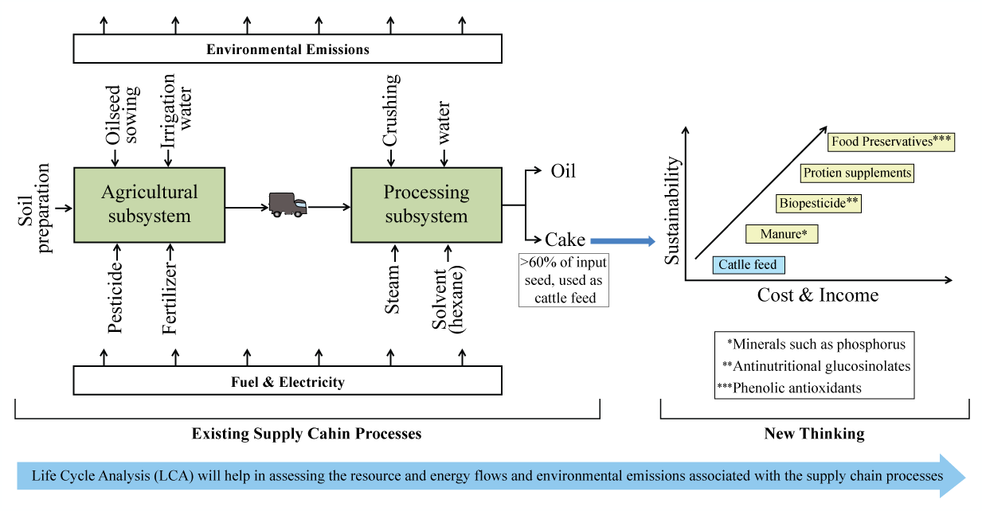
Convergence of eco-efficiency and LCA in rapeseed oil supply chain

Slide 11
Conclusions
An urgent need for taking a life cycle based approach for increasing the domestic production
Such an approach is essential for promoting cleaner production in the domestic edible oils sector
Agriculture stage found to be more significant in context of environmental impacts of rapeseed oil production
Policy focus expected to be on optimization of product systems rather than preferring one oil over other on the basis of prices and trade benefits

Slide 12
Acknowledgements
I wish to express my sincere gratitude for my supervisor, Prof Suresh Jain, for the constant support and encouragement to participate in the EAESE 2017 conference
Thank you Internal Grant Committee (IGC) of TERI University for the funds necessary to travel and participate in the EAESE 2017 conference
I also want to acknowledge the financial support from European Union for supporting current work under research project “Added value from high protein & high oil industrial co-streams: APROPOS” (FP7- KBBE-Grant no: 289170)

