Slide 1

Assessment of environmental impacts of mustard oilseed production using life cycle approach
Presentation by
Poonam Khatri and Prof. Suresh Jain
TERI University
March 29, 2017
NCEPIAR 2017, School of Environmental Sciences, JNU

Slide 2
Introduction
Food systems worldwide expected to increase production in a sustainable way (Khatri and Jain, 2017)
Food system activities have become energy intensive
  Accounting for 20-35% resource consumption worldwide (Hertwich and Peters, 2009)
Production of food commodities is increasing, and so is the pressure on resources (Sanjuan et al. 2014)
Sustainability assessment of food systems has reached to the top of the policy goals (Notarnicola et al., 2017)
Life Cycle Approach aimed at reducing the consumption of resources can play a central role in shifting toward sustainable food systems (Soussana, 2014)

Slide 3
Demand-Supply gap of edible oils in India
Around half of the domestic consumption needs are met through import
  Imported 14 MT edible oil worth ~ 65,000 Cr. INR during 2014-15

Slide 4
Life cycle assessment (LCA)
LCA is compilation and evaluation of the inputs, outputs and the potential environmental impacts of a product system throughout its life cycle (Agarwal et al. 2014)
  Determine the goals and scope of the LCA
  Compile an inventory of energy and material inputs and environmental outputs across all relevant life cycle stages
  Evaluate relevant environmental impacts associated with the life-cycle inputs and releases and
  Interpret the results to lead to a more informed decision
LCA helps answering the questions like
  Which environmental impacts can be attributed to a product?
  Which life cycle stage of a product cause most of the environmental problems?

Slide 5
Definition of goal and scope
Goal: To evaluate the potential environmental impacts of producing mustard oilseed
Scope of the study
  Functional unit: 1 kg of mustard oilseed
  Defining system boundary: A cradle-to-farm gate boundary with geographic scope intended to be limited to Alwar District in Rajasthan
  Decision of handling of co-products
  Criteria for inclusion of inputs and outputs on foreground and background levels
  Identification of data sources

Slide 6
Data collection and analysis: Life Cycle Inventory (LCI)
Foreground processes
  Questionnaire survey was carried out with the farmers located mainly in the proximity of Alwar oil mills cluster
  Input data from farmers was verified with the agricultural Package of Practices for mustard crop recommended by Rajasthan govt.
Background processes
  Secondary data sources were used
  The data on environmental emissions were obtained from literature and also calculated from published models, using assumptions specific to Indian conditions
Data quality was assessed using pedigree matrix of data quality indicators along with means & coefficient of variation for input data

Slide 7
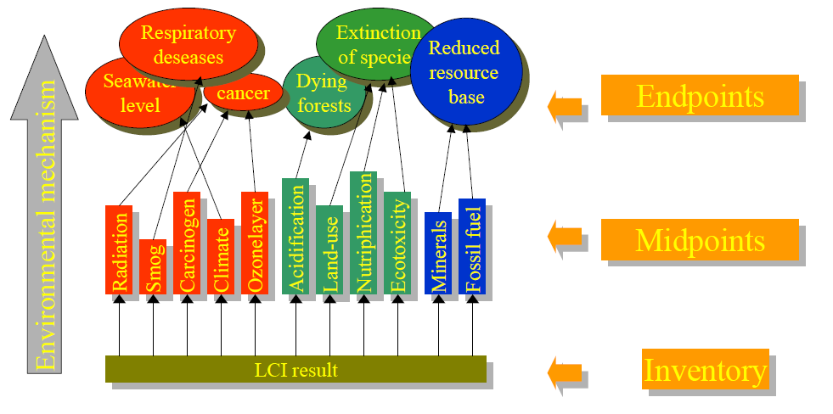
Life Cycle Impact Assessment

Slide 8
Life Cycle Impact Assessment
Different LCIA methodologies used in previous edible oil LCA studies

Slide 9
Midpoint impact category results/kg seed
7.3%
-20%
-27%
Climate change
Terrestrial acidification
Freshwater eutrophication
9%
-20%
-14%
Human toxicity
Photochemical oxidant formation
Particulate matter formation
SE- System expansion EA- Economic allocation

Slide 10
Key findings
The negative value for CCP (~-3 kg CO eq) indicate a positive contribution of crop
Fertilizers, electricity and diesel used were found to be major contributing inputs
Production of fertilizers, together with field emissions of NH₃ and N₂O, found responsible for
  ~40% of AP, ~33% of ecotoxicity and ~31% of FE impacts
Effect of avoided impacts due to system expansion were noticeable in all toxicity related impacts (~40%), FE (~37%), FD (~30%) and PMF (~9%)

Slide 11
Conclusions
An urgent need for taking a life cycle based approach for increasing the domestic production
Such an approach is essential for promoting cleaner production in the domestic edible oils sector
Study highlights an urgent need for detailed assessments focusing on seeing the trade-offs between environmental impacts and improvement measures
Policy focus expected to be on optimization of product systems rather than preferring one oil over other on the basis of prices and trade benefits

Slide 12
References
Agrawal, K.K., Jain, S., Jain, A.K.; Dahiya, S., 2014. Assessment of greenhouse gas emissions from coal and natural gas thermal power plants using life cycle approach. Int. J. Environ. Sci. Technol. 11 (4), 1157-1164.
Goedkoop, M., Heijungs, R., Huijbregts, M., De Schryver, A., Struijs, J., Van Zelm, R., 2009. ReCiPe - A life cycle impact assessment method which comprises harmonised category indicators at the midpoint and the endpoint level, Report I: Characterisation.
Hertwich, E. G., Peters, G. P. 2009. Carbon footprint of nations: A global, trade-linked analysis. Environ. Sci. Technol. 43(16), 6414-6420.
Khatri, P., Jain, S., 2017. Environmental life cycle assessment of edible oils: A review of current knowledge and future research challenges. J. Clean. Prod. 152, 63–76.
Sanjuán, N., Stoessel, F., Hellweg, S., 2014. Closing data gaps for LCA of food products: estimating the energy demand of food processing. Environ. Sci. Technol. 48 (2), 1132-1140.
Soussana, J.F., 2014. Research priorities for sustainable agri-food systems and life cycle assessment. J. Clean. Prod. 73, 19-23.

