Slide 1
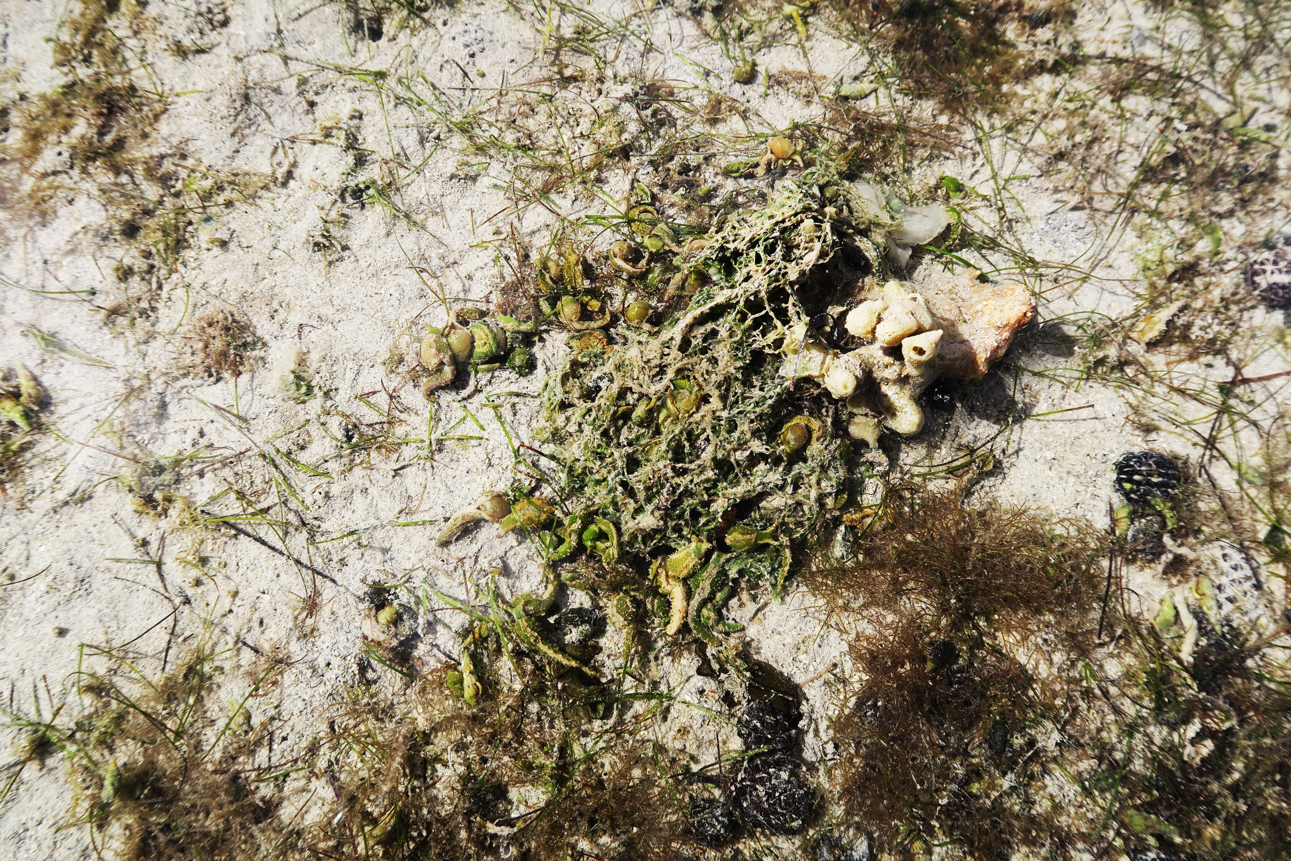
A STUDY OF THE DIVERSITY OF OPISTHOBRANCHS SEA SLUGS (MOLLUSCA, GASTROPODA) IN THE SOUTH WESTERN REGION OF MAURITIUS
AH SHEE TEE, L., PUCHOOA, D., APPADOO, C. & BHOYROO, V.
FACULTY OF AGRICULTURE, UNIVERSITY OF MAURITIUS
1. INTRODUCTION
Detailed biodiversity data provide information about the relationship of species to their environment and on the state of the species itself.
These are subsequently important for an effective management plan and conservation strategy.
Opisthobranchs are a diverse group of sea slugs which include the nudibranchs, head-shield slugs, sea hares, side-gilled slugs and sap-sucking slugs.
2. AIMS AND OBJECTIVES
Investigate the diversity and abundance of opisthobranchs sea slugs at Le Morne for a period of one year..
Sea slugs found within each belt transects were counted and photos taken in situ.
Collections and analysis of sediments within belt transects for any trace of nutrient pollution
Acknowledgement: Thankful to the
Ministry of Blue Economy, Marine Resources, Fisheries and Shipping
for sampling permit and the University of Mauritius.
3. METHODOLOGY
4. RESULTS
Survey was conducted at low tide, at a depth range of 0.5m to 1.5m
Sampling was carried out every 2 months, starting from August 2019.
Four belt transects of 50mx5m were laid with a distance of 2m in between
Species found within each transect were counted and photographs taken in situ
Sediments within each belt transect were collected for nutrient analysis such as nitrate, sulphate and phosphate
Species density within each belt transects were calculated.
Species diversity were computed using the indices Shannon-Wiener H’ Diversity Index and Pielou’s Evenness Index respectively.
Low Shannon-Wiener H’ Diversity index values were obtained for all transects, with the lowest value reported in transect 4 (0.23) (figure 2)
Transect 2 consisted mostly of the opisthobranchs Bulla with a value of 0.74.
Transect 2 consisted mostly of sand which is the habitat of Bulla sp.
Transect 3 reported an evenness value of 0.38, with a high proportion of Oxynoe (order Sacoglossa) (0.79).
In transect 3, different species assemblages were found on Caulerpa sp., namely: Oxynoe sp., Bulla sp., Volvatella sp., Polybranchia sp., Elysia sp., and Phanerophthalmus sp. (figure 3)
Figure 2: Diversity across each belt transect
5. DISCUSSION & CONCLUSION
The most speciose genus was the Bulla (Order Cephalaspidea) and Oxynoe (order Sacoglossa)
Sacoglossa species feed mostly on algal host such as seaweed explaining their low numbers (0.11/ m2) in transect 4 which was dominated by numerous patches of brown sponges.
Sacoglossan were mostly abundant in the month of August (density: 1.116 m²)
They were present only in area where their food resources (Caulerpa sp.) were abundant
Oxynoe
4. RESULTS
Among the four belt transects, transect 2 and 3 contained the most opisthobranchs as shown in figure 1.
Elysia
Volvatella
Figure 3: Different species assemblages in transect 3
Aplysia sea slugs were found in clusters during the month of October which could be an indication of their mating period.
This is still an on-going research, and the current findings represent a stocktaking of the species present, their densities and distribution.
Figure 1: Species density within each belt transect
6. REFERENCES
Baumgartner, F. A. & Toth, G. B. (2014). Abundance and size distribution of the sacoglossan Elysia viridis on co-occurring algal hosts on the Swedish west coast, PLoS ONE. 9 (3), 1-6

