Slide 1

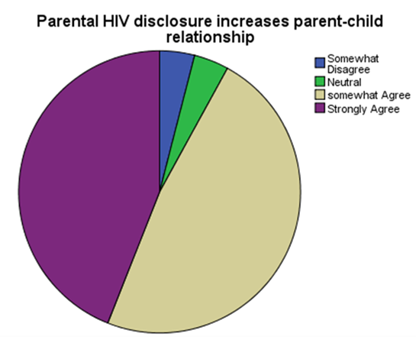


Reasons why parents are reluctant to disclose their
HIV positive status to their children: Lesson Learnt in Botswana.
Motseiwa Mokalake and Louis de Jager
Africa Centre for HIV/AIDS Management in the Faculty of Economic and Management Sciences
Stellenbosch University, South Africa
Introduction
Future Directions
Despite the Botswana’s provision of universal free antiretroviral treatment (ART) to all people
living with HIV (Treat All Strategy), it is one of the countries which are highly affected by HIV.
Some of socioeconomic, socio-demographic and sociocultural factors in relation to health issues
are left behind but are vital to health care system. With this background, the study wanted to
explore reasons why parents are reluctant to disclose their HIV positive status to their children.
It is important for health care providers to be equipped with HIV disclosure skills and comprehend the four phases of parental HIV disclosure preparations, which are; secrecy, exploratory, readiness and full disclosure, so that they can sufficiently help patients during counselling sessions.
Acknowledgments
Methods
Pie Chart 1: Participants’ response on the importance of parental HIV disclosure
This research project was supported by Africa Centre for HIV and AIDS Management Team, Stellenbosch University, South Africa, Mahalapye Sub-District District Health Management Team, Botswana, Kgatleng Sub-District Health Management Team, Molemane Lekoko(Shoshong Clinic) and Lame Bakwenabatsile (Oodi Clinic)
A quantitative cross sectional analytic survey was used to collect data from a sample of 50 HIV
positive parents from Infectious Disease Control Centre (IDCC) in two clinics in Botswana (25
participants from Oodi clinic and 25 from Shoshong clinic). The data was collected from 12 males and 28 females HIV positive parents selected randomly. The information about participants’ demographics, knowledge, attitudes and challenges experienced on parental HIV disclosure was collected. A data collection tool consisting close ended questionnaires was used to collect data from HIV positive participants visiting the clinic during allocated time frame from August 2016 to December 2016.
Bibliography
Table 1: Majority of participants believe that, it is important to disclose their HIV positive status considering child’s maturity. Study findings illustrate that, 52% of participants consider that, it is best to disclose their HIV positive status to their children if they are more than 15 years old.
1Averitt D and Averitt R. 2015. The Well Project. Talking with Your Children about Your HIV Status or Your Children's Status. From:www.thewellproject.org/hiv-information/talking-your-children-about (Accessed 22 July 2015).
2.Avert. 2016. Stigma, Discrimination and HIV. From: http://www.avert.org/professionals/hiv-social-issues/stigma-discrimination (Accessed 06 December 2016).
3.Gachanja G. 2016.The Amagugu Intervention: A Conceptual Framework For Increasing HIV Disclosure And Parent-Led Communication About HIV Infected Parents With HIV Uninfectected Primary School Aged Children. From:journal.frontiersin.org/article/10.3389/fpubh.2016.00183/full (Accessed 25 September 2015).
Results
Study results indicated that, 80% of participants believed that parental HIV disclosure has to be
done when the child is an adolescent and 32% of participants feel that if parents disclose their
HIV positive status to their children, this can make children to reject them. However, 88% of
parents feel it is vital for the government to introduce policies and guidelines on parental
disclosure.
Conclusions
Since main findings show that fear of rejection was the main factor for postponing disclosure, and that disclosing at a young age was not considered viable, the government should establish parental HIV disclosure policies and guidelines to help health care providers to support parents on HIV disclosure. This will be fruitful for the country because there is no prior study performed in Botswana which provides information on how parents living with HIV can be supported to prepare them and their children for parental HIV positive status disclosure.

