Slide 1
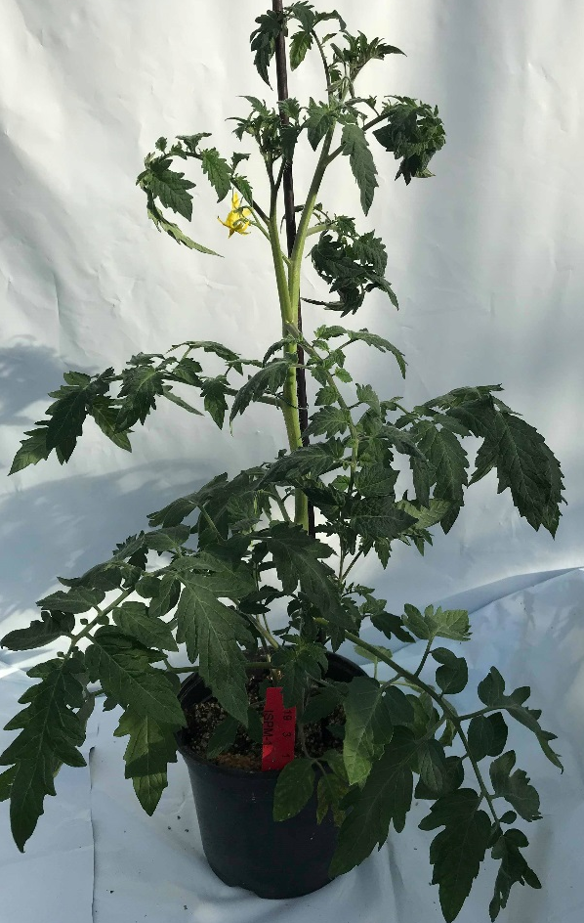
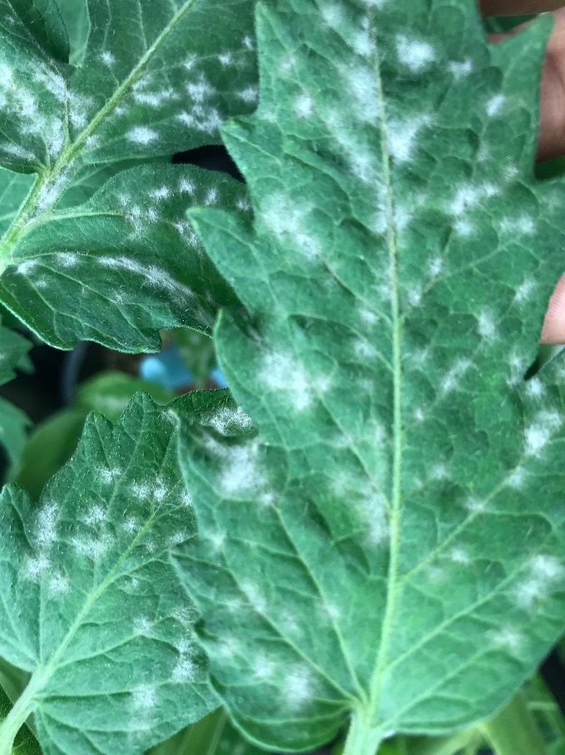

Roles of SlWRKY transgenes in Response to Salinity and Powdery Mildew inoculation in Tomato
Mst. Salina Akter
2nd January, 2019

Slide 2
Outline
1. Introduction
2. Objectives
4. Results and discussion
3. Materials and methods
5. Conclusions ands recommendations

Slide 3
Climate change
Effects of climate change of abiotic and biotic stress
Roles of WRKY transcription factors in plant physiology

Slide 4
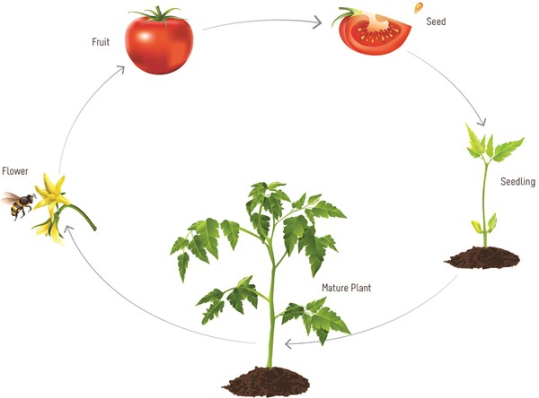
Tomato (Solanum lycopersicum)
Tomato is an interesting crop for using and breeding studies
Nutritional value: Vitamin-C, lycopene
Genetics of tomato: diploid, self-pollinating, tolerate inbreeding
Tomato genome sequence available for public

Slide 5
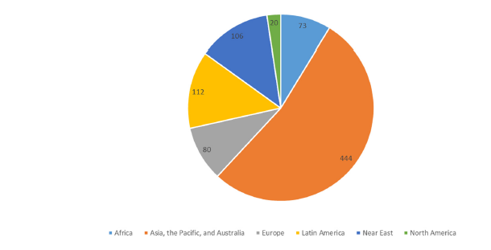
Download
Global distribution of salt- affected soil (million ha)
20% (45 million ha) of irrigated land, producing one-third of the world’s food, is salt-affected
2050, 50% of the world’s arable land will be affected by salinity
Source: Hoang et al. (2016)

Slide 6
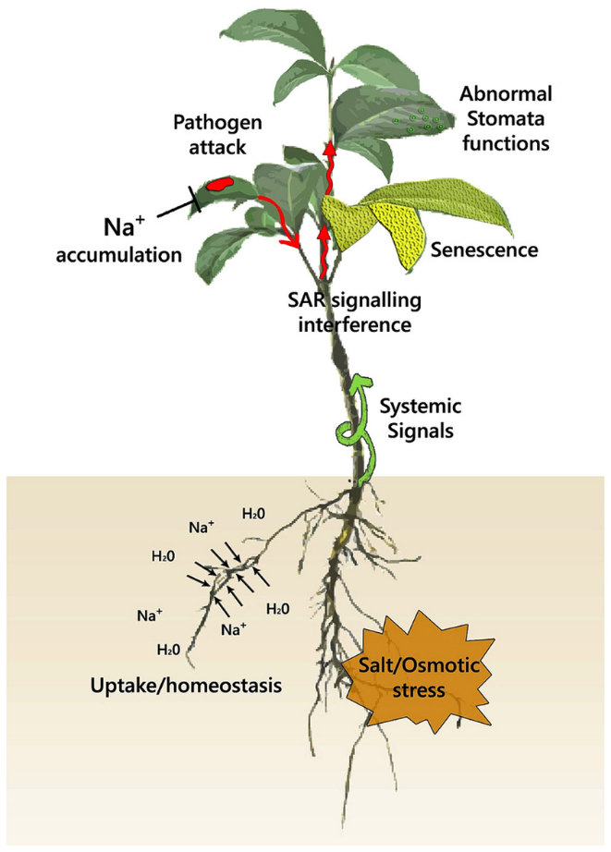
The effects of salinity stress at the plant level
Osmotic stress and
ionic stress
Source: Kissoudis et al. (2014)

Slide 7
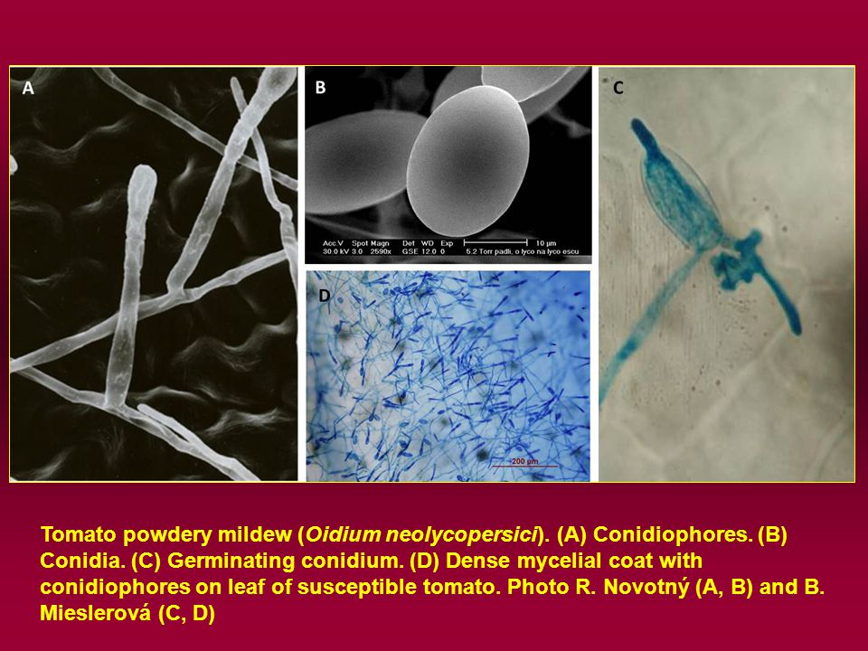
Powdery mildew
Obligate biotrophic fungus
(Odium neolycopersici)
Infection development
A. Conidia
B. Germinating conidium
c. Dense mycelial coat with conidiophores
D. Conidiophores

Slide 8
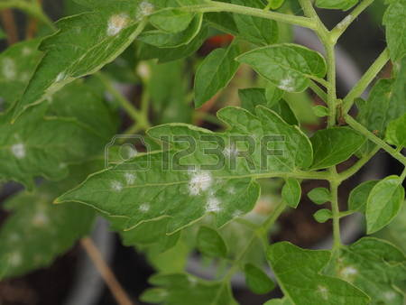
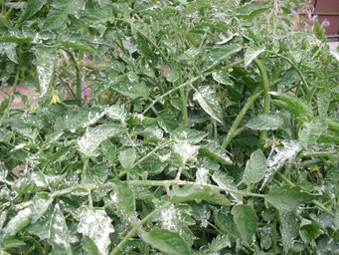
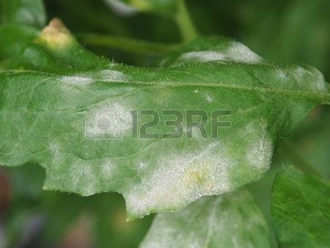
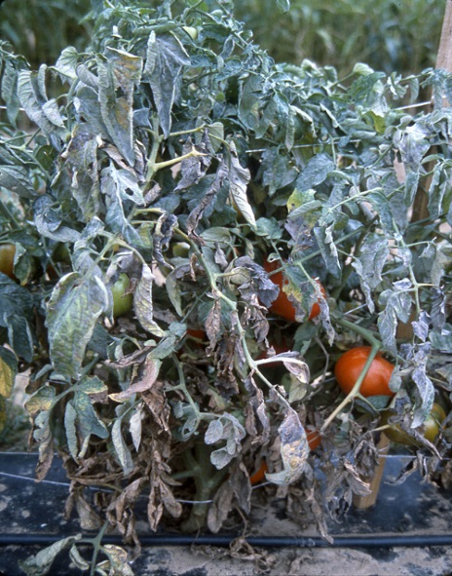
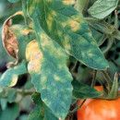
Powdery mildew affected tomato plants

Slide 9
WRKY transcription factors
Transcription factors contain a conserved WRKY domain and zinc-finger motif
Three groups of WRKY TFs:
Group I- two WRKY domains
Group II-one WRKY domain
Group III-one WRKY domain zinc-finger motif C₂–HC
zinc-finger motif C₂-H₂
Tomato WRKY transcription factors: Solanum lycopersicum WRKY (SlWRKY)
81 SlWRKY genes identified in tomato genome

Slide 10
Roles of WRKY Transcription Factors under abiotic & biotic stress
Biotic stress
Abiotic stress
Signal transduction
WRKY Transcription Factors
Target genes
Stress adaptation
Source: Samad et al. (2017)

Slide 11
Objectives
1.
To select transgenic SlWRKY overexpression (OE) and silencing (RNAi) genotypes in tomato by observing the phenotypic characters of the seedling under in vitro conditions in a kanamycin test
2.
To evaluate the phenotype responses of transgenic tomato SlWRKY overexpression (OE) and silencing (RNAi) genotypes to salt stress, powdery mildew and combined salt stress and powdery mildew

Slide 12
Kissoudis et al. (2016)
SIWRKY11OE and SIWRKY23S lines showed salt tolerance
SIWRKY7 and SIWRKY9 RNAi lines showed strongly tolerance to salt stress
SIWRKY23 RNAi lines also showed disease resistance

Slide 13
Material and methods
Plant materials
SlWRKY8-3OE
SIWRKY6-1&3OE
​SIWRKY11-1&3OE​
SIWRKY23-1&2OE​
SIWRKY 7-1&2S​
SIWRKY9-2&3S​
SIWRKY23-2&3S
Variety moneymaker
Treatments
T1= Control
T2= Salinity (100mM)
T3= powdery mildew ( a suspension of 3× 10⁴ conidia ml⁻¹)
T4= Combination of salt and powdery mildew (100mM+ a suspension of 3×10⁴ conidia ml⁻¹)
Experimental setup
Experimental design: Randomized Complete Block Design (RCBD)
Replications: 4

Slide 14
Data collection
Plant height (cm) at 3 different time points: Before salt (4 weeks after transplanting); after salt (1 week) and after PM (3weeks)
Necrosis before any treatments (4 weeks after transplanting)
Fresh weight only shoot (g) after PM (3 weeks)
Dry weight (g) after Oven dry at 70⁰C for 3 days
Relative water content (RWC) after PM (1week)
Chlorophyll content (Upper and lower leaves) after salt (1week)
Stomata conductance (mmolm⁻²s⁻¹) after salt (1week)
Disease index (score: 0 to 10) at 14 DPI

Slide 15
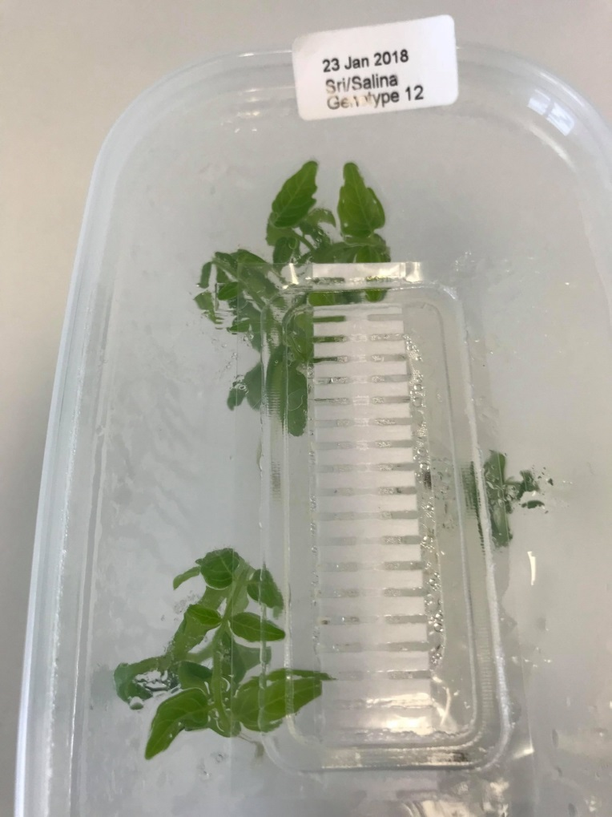
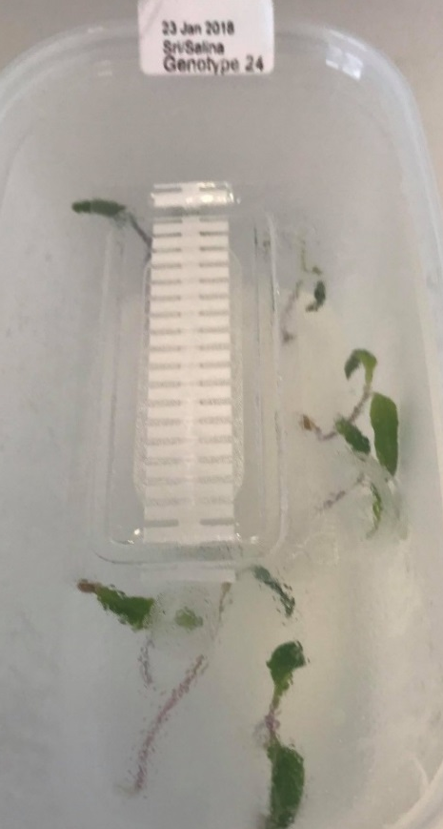
Results and discussion
Kanamycin test
Left picture shows transgenic seedling with normal growth, true leaves and right picture indicates non-transgenic plants showing cotyledon with colour changed from green to yellowish, no true leaves and ultimately the growth of seedling stunted (MM)
No true leaves
True leaves

Slide 16
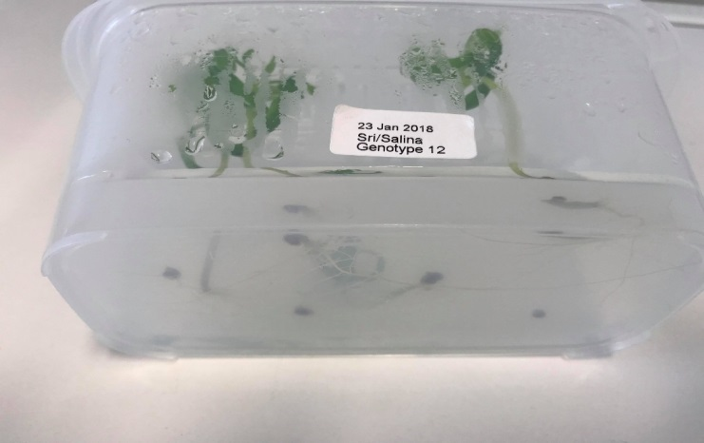
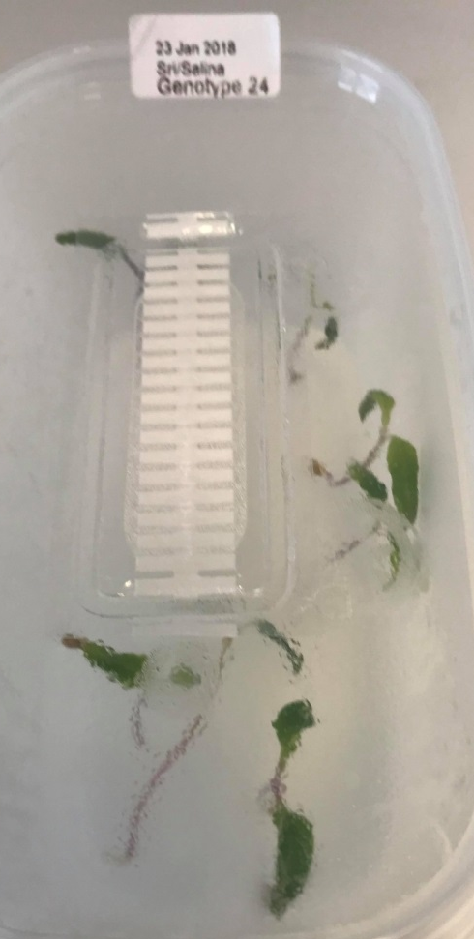
Results and discussion
Kanamycin test
The left picture shows lateral roots which indicated this genotype is transgenic while the right picture indicates non-transgenic (MM) where lateral roots are not observed
No lateral root
Lateral root

Slide 17
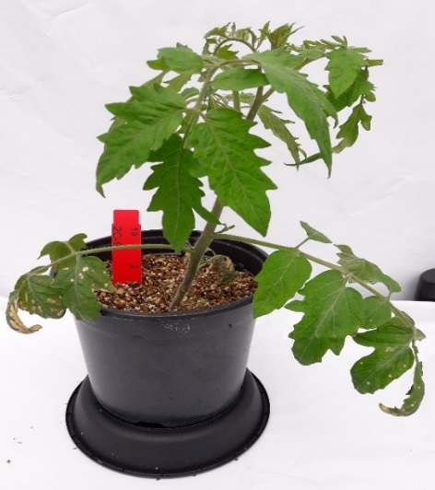
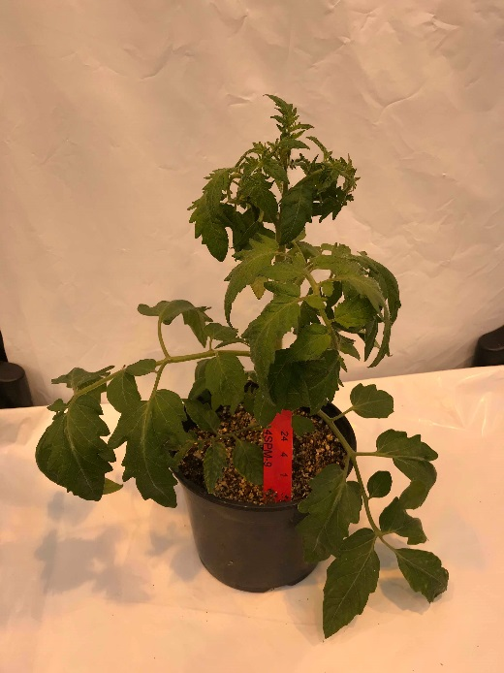
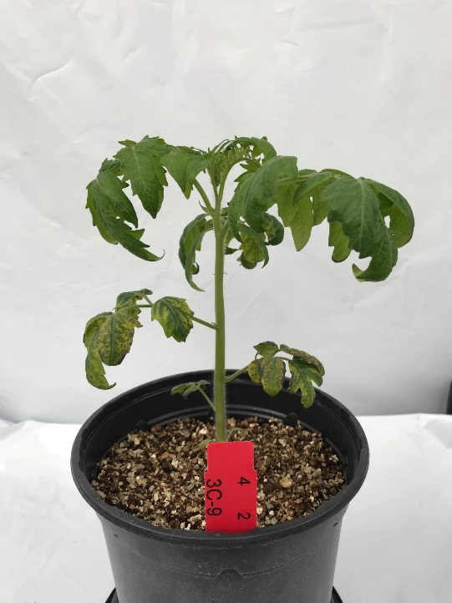
Results and discussion
Leaf necrosis before any treatment (4 weeks after transplanting)
SlWRKY23-3S
Moneymaker(MM)
SlWRKY6-3OE

Slide 18
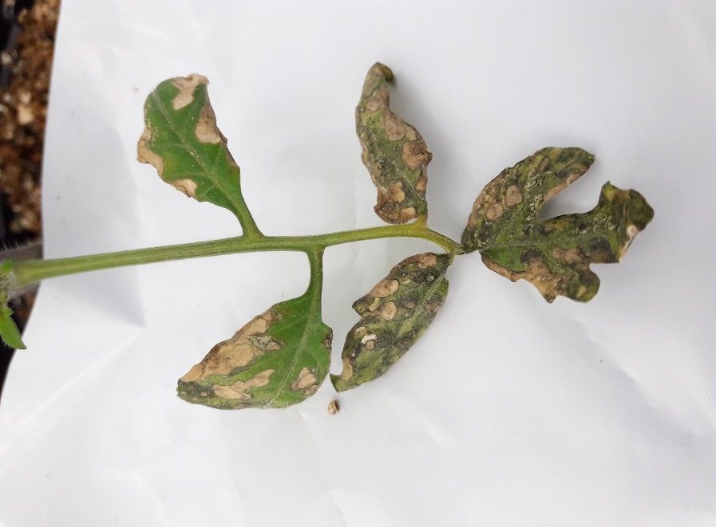
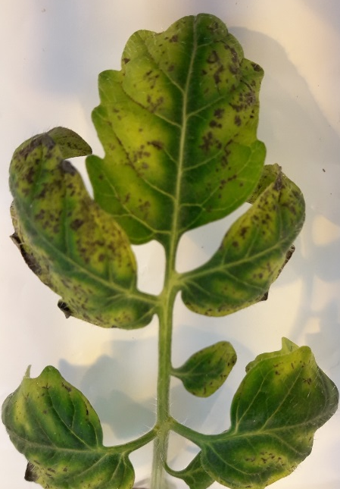
Results and discussion
Distinct necrosis leaf symptom between SlWRKY23-3S (left) and SlWRKY6-3OE (right)
Brownish spot
Yellowish black spot
SlWRKY6-3OE
SlWRKY23-3S

Slide 19
Results and discussion
Plant height (cm) before Salt (4 weeks after transplanting)

Slide 20
Results and discussion
Plant height (cm) after Salt (1week)

Slide 21
Results and discussion
Plant height (cm) after PM inoculation (3 weeks)

Slide 22
Results and discussion
Fresh weight (g) and dry matter (g) after PM inoculation (3 weeks)

Slide 23
Results and discussion
Relative water content (%) after PM inoculation (1 week)

Slide 24
Results and discussion
Upper and lower leaves Chlorophyll content after salt (1 week)

Slide 25
Results and discussion
Stomatal Conductance after salt treatment (1 week)

Slide 26
Results and discussion
Disease Index (14 DPI)

Slide 27
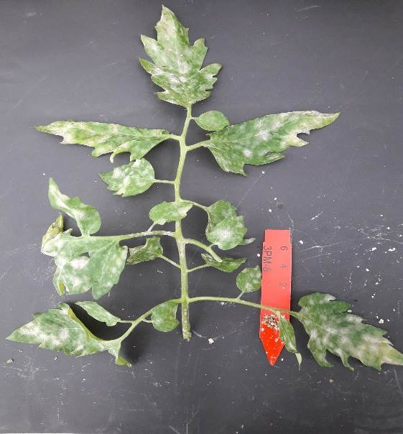
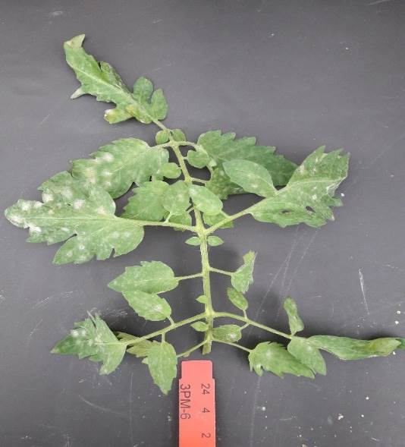
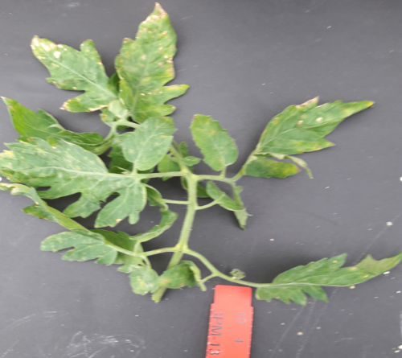
Leaf phenotype of disease symptom in SlWRKY23-2OE, MM and SlWRKY23-3S at 14 DPI under PM
SlWRKY23-2OE
Moneymaker (MM)
SlWRKY23-3S

Slide 28
Conclusions and recommendations
The pleiotropic effects were found on the SlWRKY6-1OE, SlWRKY6-3OE and SlWRKY8-3OE genotypes
The behaviour of genotypes was different in terms of phenotype aspects under various stresses
The pleiotropic effects was found in SlWRKY23-3S in case of disease resistance
Multiple copies of transgene can be incorporated into target plant genome. Therefore, number of T-DNA loci or number of T-DNA copies have to be test for single transgenic confirmation. Multiple T-DNA insertion into the genome may lead to erratic transgene expression

Slide 29
Conclusions and recommendations
Transgene manipulation into plant genome is a particularly random event. For this reason, the position of the transgene in the genome can have a marked effect on the transgene expression levels
Experiments should be repeated with genotypes of SlWRKY6-10E, SlWRKY6-3OE, SlWRKY8-3OE, SlWRKY23-2OE and SlWRKY23-3S that have the pleiotropic effects in various stages

Slide 30
Acknowledgement
Gerard van der Linden
Clemens van de Wiel
Sri Sunarti
Abiotic Stress group

Slide 31
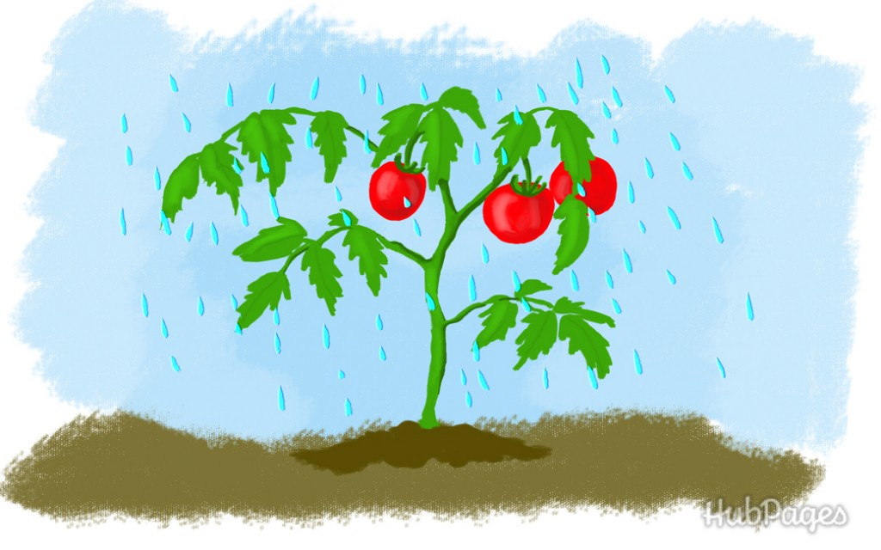
Thank to all

