Slide 1




Stable Assembled Multilayers Based on Hyperbranched Glyconanomaterials for reusable colorimetric Biosensing applications
By Dr. Samaa Salem
Researcher
National Research Center (NRC) , Cairo, Egypt
Modern and future approaches to medical diagnostics
Date: 31.08.2016

Slide 2
Why is the research needed?
Research Gap
Aim
Objectives
Leading Idea
Results
Budget
Biosensor Classical definition
Problem
A device that utilises biological component e.g. enzymes to indicate the amount of a biomaterials
This will help both patient and physician to recieve the analytical results more rapidly
Still missed
Reproducibility
Long term Stability
Accuracy
What Inhibit the polymeric BS Rapid Progress?
The lack of innovated polymeric materials with the suitable properties and features
Samaa Salem

Slide 3
Research Gap
Aim
Objectives
Leading Idea
Results
Budget
Aim of the Work
Fabricate a polyelectrolyte multilayer (PEM) or complex (PEC) system based on hyperbranched glyconanomaterial which is mainly directed to create a reusable colorimetric biosensor (BS).
In these kind of biosensors, it is possible to indicate the presence of an analyte by a detectable change in color of the included coloring agent.
Samaa Salem

Slide 4
Research Gap
Aim
Objectives
Leading Idea
Results
Budget
Enzyme Encapsulation
(Hyperbranched polymer)
Enzyme immobilization
(PEM or PEC)
Investigation
in buffer
Stability
Selectivity
Reproducibility
Measurement for glucose level
in blood and urine
Objectives
(1)
(2)
(3)
(4)
Samaa Salem

Slide 5

Research Gap
Aim
Objectives
Leading Idea
Results
Budget
Why Hyperbranched Poly(ethyleneimine) for Biosensors?
Why Hyperbranched Polymers for Biosensors?
Major Disadvantage:
HPEI cationic functional groups (especially of higher M_{w}) damaged cells and their viability.
Super Advantages:
Highly branched macromolecules with a large number of functional groups
Tunable properties
Providing well controlled encapsulation for the bioactive compound
High transfiction efficiency
Biological Element
Samaa Salem

Slide 6
Research Gap
Aim
Objectives
Leading idea
Results
Budget
Maltose Modified Hyperbranched Poly(ethyleneimine) HPEI
Hyperbranched PEI
M_{w} 25000 g/mol
(BASF)
Structure A
(PEI-Mal-A)
90% DS %
dense maltose shell
1:10
Mal
N
N
Mal
Mal
Mal
Structure B
(PEI-Mal-B)
40% DS%
open maltose shell
BH₃·Py
1:0.5
N
Maltose
HN
Mal
NH
Structure C
(PEI-Mal-C)
20% DS%
open maltose shell
Mal
1:0.2
NH
HN
Mal
=
NH₂
D. Appelhans, Hyperbranched PEI with Various Oligosaccharide Architectures: Synthesis, Characterization, ATP Complexation, and Cellular Uptake Properties. Biomacromolecules, 2009. 10(5): p. 1114-1124.

Slide 7
Research Gap
Aim
Objectives
Leading Idea
Results
Budget
Scientific Results
Fabricate a promising approach to medical diagnostics
Increase BS selectivity, stability, cheapness and long term storage
Outcome fot the project
Readily prepared glucose biosensor to medical diagnostics for patients or in doctors clinics
Rapid and convenient diagnostics will lead to more timely and effective treatment
Samaa Salem

Slide 8
Research Gap
Aim
Objectives
Leading Idea
Results
Budget
Budget
Duration: 2 years
Project Team: PI , Post Doctoral, 2 Graduate Researchers
Total Project Costs: € 102,228.75
Samaa Salem

Slide 9
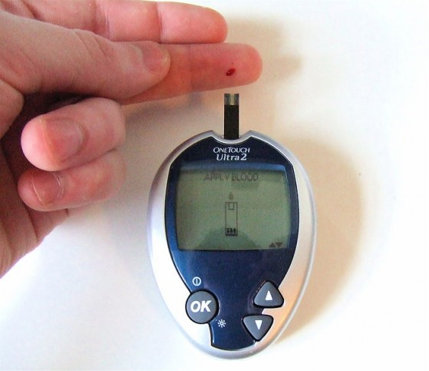
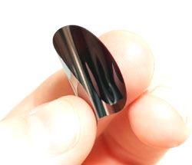
it‘s only a word
not a sentence
Diabetes
ATR-FTIR
Stability and Reproducibility
-
-
-
-
+
+
+
+
Glucose Biosensor
+
+
+
-
+
-
-
-
-
-
-
-
-
-
+
-
-
-
-
-
-
+
+
+
+
+
+
+
+
+
+
+
+
-
-
-
-
-
-
-
-
-
-
-
+
+
+
-
+
+
+
+
+
+
+
-
+
-
-
-
-
-
-
-
-
-
-
-
+
+
+
+
+
-
+
+
+
+
+
+
+
BEFORE
AFTER
PEM System
Dr. Samaa Salem

Slide 10
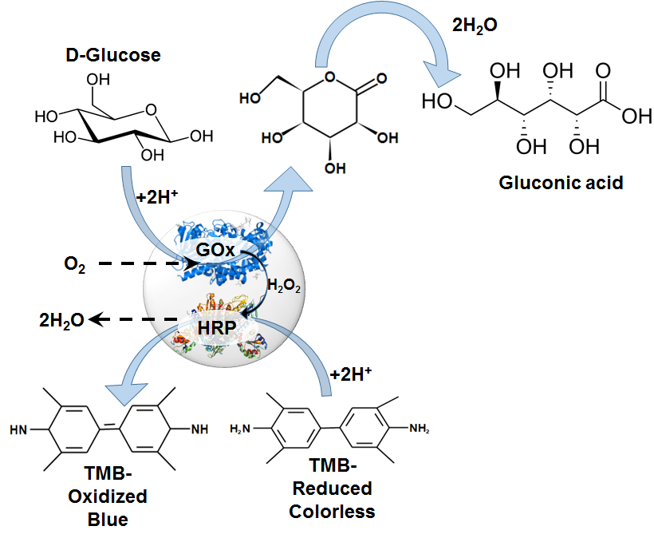
Experimental Work
Gox: Glucose oxidase
HRP: Horseradish peroxide
TMB: 3,3’,5,5’-tetramethylbenzidine

Slide 11
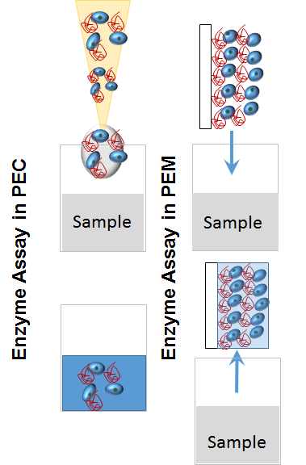
Experimental Work

Slide 12
Impact &Outlook
Promising approach to medical diagnostics by patients or in doctors clinics
Rapid diagnostics may lead to more timely and effective treatment
Increasing selectivity, stability, cheapness and long term storage

Slide 13
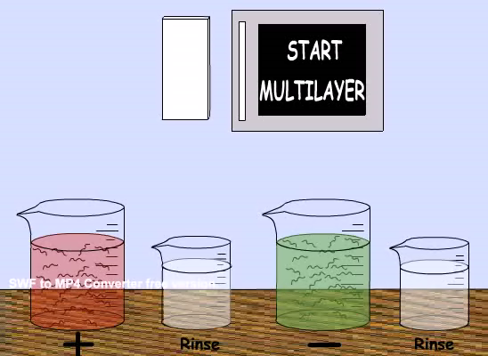
Polyelectrolyte Multilayers
The bilayers deposition and wash steps can be performed in many different ways including:
Dip-coating
Spin-coating
Spray-coating
Flow-based techniques
R. K. Iler, Multilayers of Colloidal Particles. J. Collid Interface Sci., 1966. 21 (6): p. 569-594.
G. Decher, Buildup of Ultrathin Multilayer Films by a Self-assembly process: III. Consecutively Alternating Adsorption of Anionic and Cationic Polyelectrolytes on Charged Surfaces. Thin Solid Films, 1992. 210-211 (part 2 ): p. 831-835.

