Slide 1
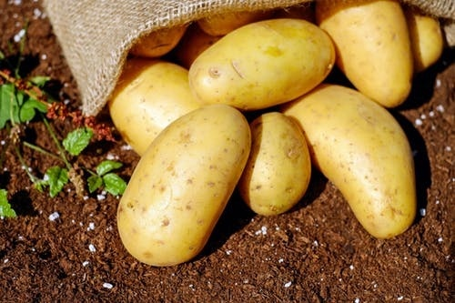
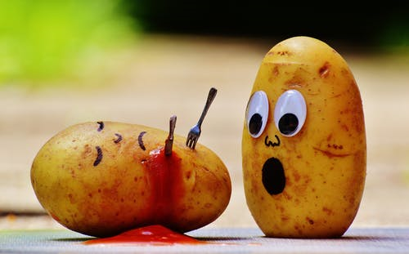
WELCOME

Slide 2

Sayma Serine
MS Student
Registration no.: 16-07569
Department of Plant Pathology
Supervisor: Dr. Md. Belal Hossain
Professor
Department of Plant Pathology
Sher-e-Bangla Agricultural University
Co-Supervisor: Dr. Md. Ekramul Hoque
Professor
Department of Biotechnology Sher-e-Bangla Agricultural University
Department of Plant Pathology, Sher-e-Bangla Agricultural University, Dhaka-1207

Slide 3
Title
VIRUS FREE POTATO MINI-TUBER PRODUCTION THROUGH MERISTEM CULTURE

Slide 4

Introduction

Slide 5
The potato (Solanum tuberosum L)
Food crop.
In terms of vegetable;
BBS estimates yield: 80-85 lack metric ton. in 2017-2018 production year.
Major biotic stresses; Viruses, Bacteria and Fungi.

Slide 6
INTRODUCTION Contd….
Potato viruses are the major constraint in potato production, particularly in seed tuber production.
The production cost through seed is much higher than the other agricultural crops.
BADC reported that the seed cost of potato is liable to 30 - 40% of total production cost (Anon. 2005).

Slide 7
INTRODUCTION Contd….
Imported high yielding foreign potato varieties which engross large amount of foreign currency every year at the same time result new viral problems like;
-Potato Leaf Roll Virus (PLRV).
-Potato Virus Y (PVY).
-Potato Virus X (PVX).
have been reported in Bangladesh that causes
10-90% yield losses.

Slide 8
Techniques for Viral Disease Resistance
Modern techniques
Meristem Tip Culture
siRNA/RNAi Technology
Conventional breeding methods

Slide 9
OBJECTIVES
-To produce and multiply virus free mini-tuber
through meristem culture.
-To develop reproducible protocol for producing
of virus free potato seed tubers.
-To assays true potato plants growing from
mini-tuber against major potato viruses.

Slide 10
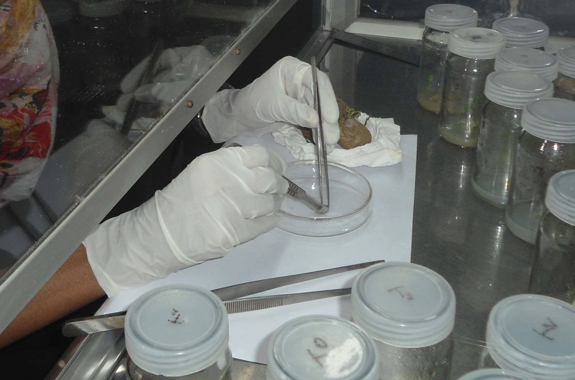
Methodology

Slide 11
METHODOLOGY
Collection of Planting materials used for experiment
Selection of Treatments
Experimental design
Potato tubers treated with GA3 for sprouting
Collection of meristem tip from sprouts for explant preparation
The explant containing meristem was transfer to MS media containing growth hormones for primary establishment.
The developed meristems callus were sub cultured on MS medium with IBA, 2,4-D and BAP
DAS-ELISA test of potato plantlets for viruses detection.
Acclimatization

Slide 12
Treatments of the experiment
Treatment was considered as following-
T₁= Normal MS
T₂= 0.25 mg/L IBA + 0.125 mg/L 2, 4-D + 0.5 mg/L BAP
T₃= 0.25 mg/L IBA + 0.25 mg/L 2, 4-D + 1.0 mg/L BAP
T₄= 0.25 mg/L IBA + 0.37 mg/L 2, 4-D + 1.5 mg/L BAP
T₅= 0.25 mg/L IBA + 0.50 mg/L 2, 4-D + 2.0 mg/L BAP
T₆= 1.50 mg/L IBA + 1.0 mg/L 2, 4-D + 0.5 mg/L BAP
T₇= 1.50 mg/L IBA + 2.0 mg/L 2, 4-D + 1.0 mg/L BAP

Slide 13
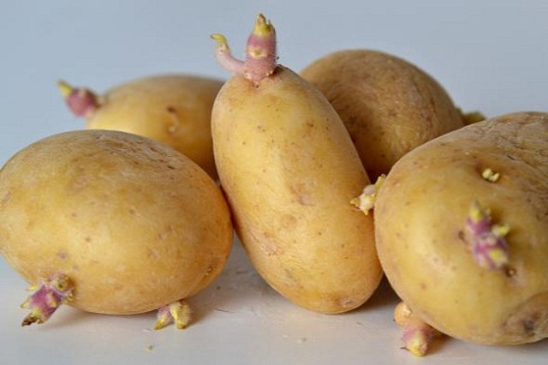
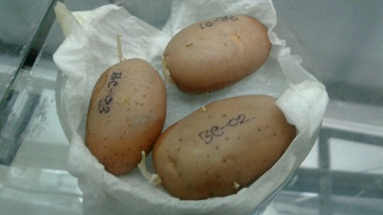
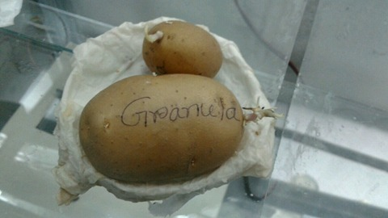
Potato tubers treated with GA3 for sprouting
Diamant
Cardinal
Granola
Figure 1. Maximum sprouts obtained at 400 ppm/L GA3 concentration
in three potato varieties.

Slide 14
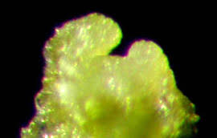
Meristem tip from sprouts that used for explant preparation
Figure 2. Potato tuber meristem seen under the
stereomicroscope

Slide 15
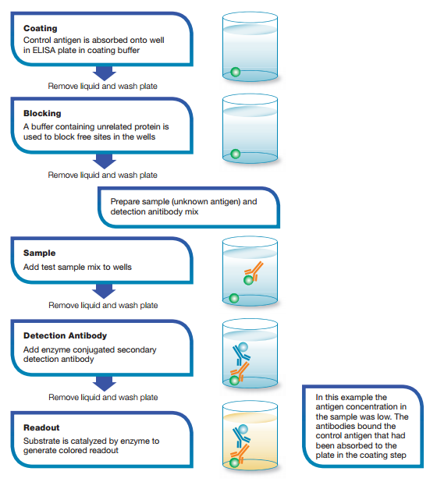
Das-elisa protocol

Slide 16
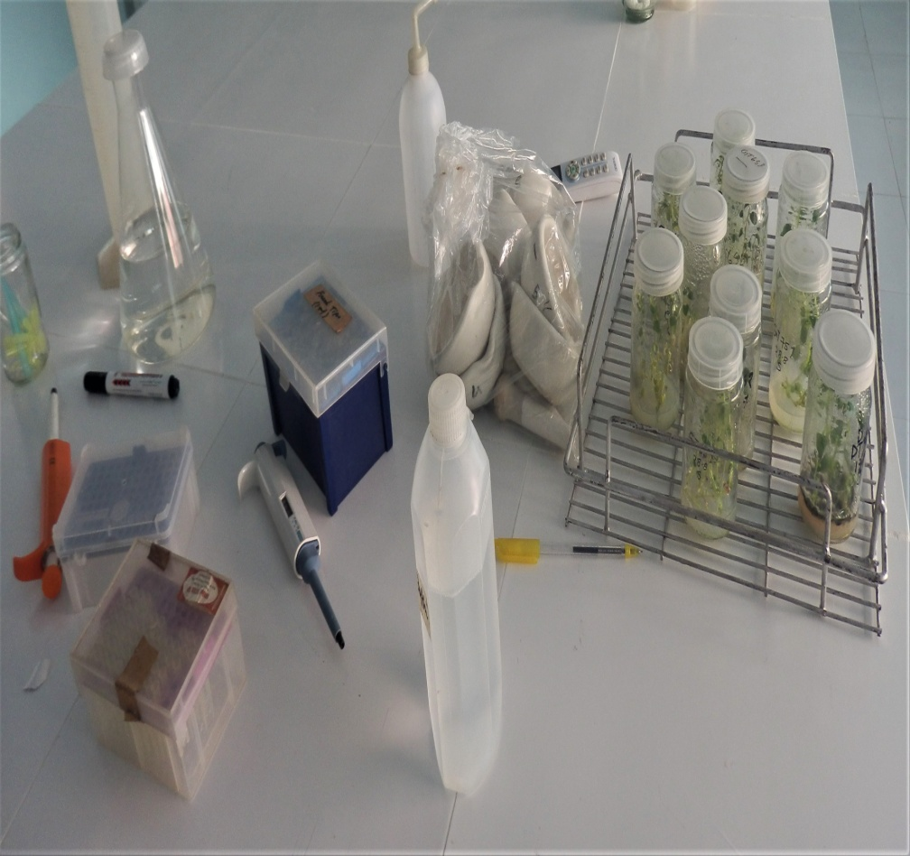
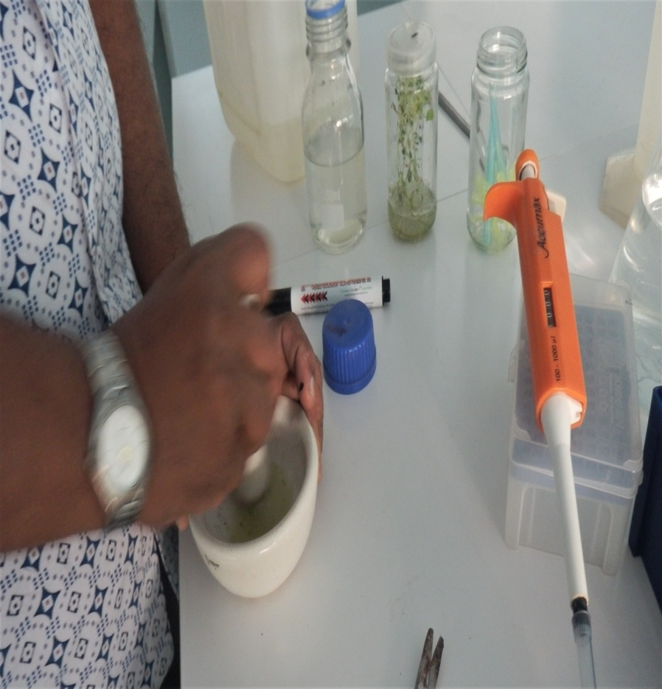
DAS-ELIZA Test in BCSIR Tissue Culture Laboratory
Figure 3. DAS-ELISA test work going on in the laboratory for virus
detection

Slide 17

Results and Discussion

Slide 18
Table 1: sprouting potentiality of three bari released potato tubers under different concentrations of ga3 treatment
GA3 Treatment (ppm/L/) | Variety | Days to sprout initiation |  | Number of sprout /potato |  | Number of sprouts/ eye | Length of sprout (cm)
0 | Granola | Sprouting was not occurred in off-season
 | Diamant
 | Cardinal
400 | Granola | 3 | 6 |  | 4 |  | 1-1.6
 | Diamant | 5 | 5 |  | 3 |  | 3-3.5
 | Cardinal | 4 | 5 |  | 5 |  | 4-4.2

Slide 19
Table 2: Texture and color of callus of three potato genotypes at 28 DAI
Variety | Callus color | Callus texture
Granola | Yellowish green | Friable
Diamant | Greenish | Friable
Cardinal | Whitish green | Non friable

Slide 20
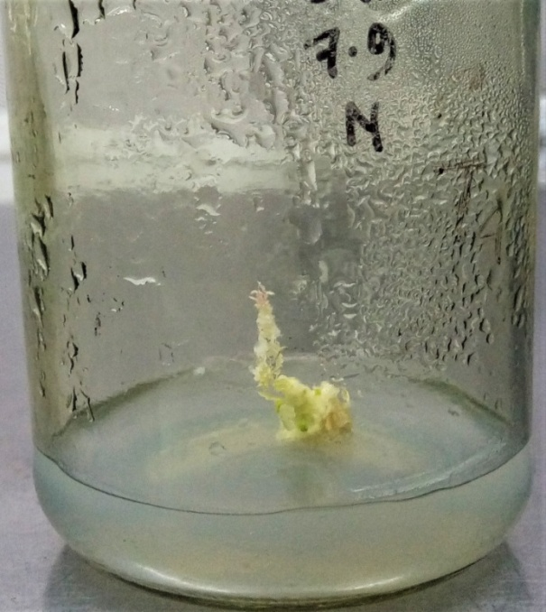
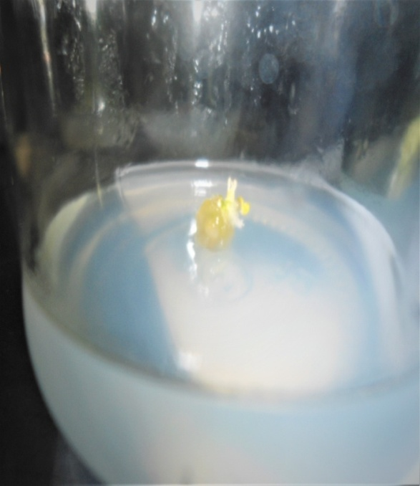
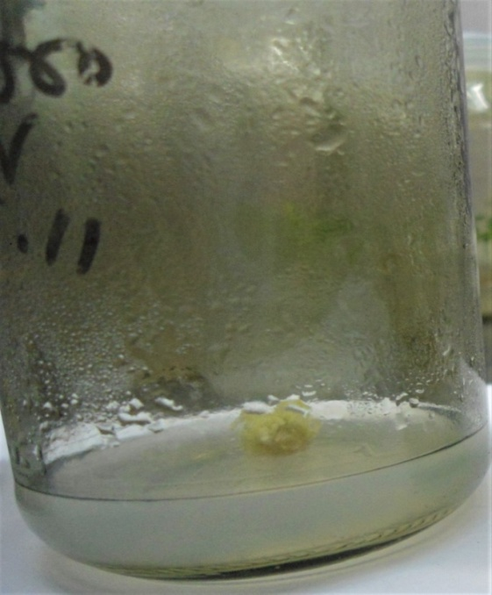
Callus induction and plant regeneration of three potato varieties
Granola
Diamant
Cardinal
Figure 4. Initiated callus after inoculation at 2-3 DAI on MS media
supplemented with 0.25 mg/l IBA+0.25 mg/l 2,4-D +1.0
mg/l BAP

Slide 21
table 3: combined effect of different varieties and different hormones on callus initiation and callus size
Granola | Treatment | Days of callus initiation | Callus size (cm)
 | T₁=Normal MS | - | -
 | T₂=0.25 IBA+0.125 2,4-D+0.5 BAP | 6.00 | 0.24
 | T₃=0.25 IBA+0.25 2,4-D +1.0 BAP | 2.00 | 0.74
 | T₄=0.25 IBA +0.37 2,4-D +1.5 BAP | 3.00 | 0.58
 | T₅=0.25 IBA +0.50 2,4-D +2.0 BAP | 8.00 | 0.60
 | T₆=1.50 IBA +1.0 2,4-D +0.5 BAP | 7.00 | 0.25
 | T₇=1.50 IBA +2.0 2,4-D +1.0 BAP | 7.00 | 0.36
Diamant | T₁=Normal MS | - | -
 | T₂=0.25 IBA+0.125 2,4-D+0.5 BAP | 7.00 | 0.18
 | T₃=0.25 IBA+0.25 2,4-D +1.0 BAP | 4.00 | 0.44
 | T₄=0.25 IBA +0.37 2,4-D +1.5 BAP | 4.00 | 0.30
 | T₅=0.25 IBA +0.50 2,4-D +2.0 BAP | 3.00 | 0.35
 | T₆=1.50 IBA +1.0 2,4-D +0.5 BAP | 3.00 | 0.21
 | T₇=1.50 IBA +2.0 2,4-D +1.0 BAP | 9.00 | 0.20

Slide 22
Table 3. Contd….
Cardinal | T₁=Normal MS | - | -
 | T₂=0.25 IBA+0.125 2,4-D+0.5 BAP | 7.00 | 0.36
 | T₃=0.25 IBA+0.25 2,4-D +1.0 BAP | 3.00 | 0.63
 | T₄=0.25 IBA +0.37 2,4-D +1.5 BAP | 5.00 | 0.69
 | T₅=0.25 IBA +0.50 2,4-D +2.0 BAP | 5.00 | 0.66
 | T₆=1.50 IBA +1.0 2,4-D +0.5 BAP | 5.00 | 0.56
 | T₇=1.50 IBA +2.0 2,4-D +1.0 BAP | 6.00 | 0.63
 | LSD | 1.88 | 0.11
 | Level of significance | ** | **

Slide 23
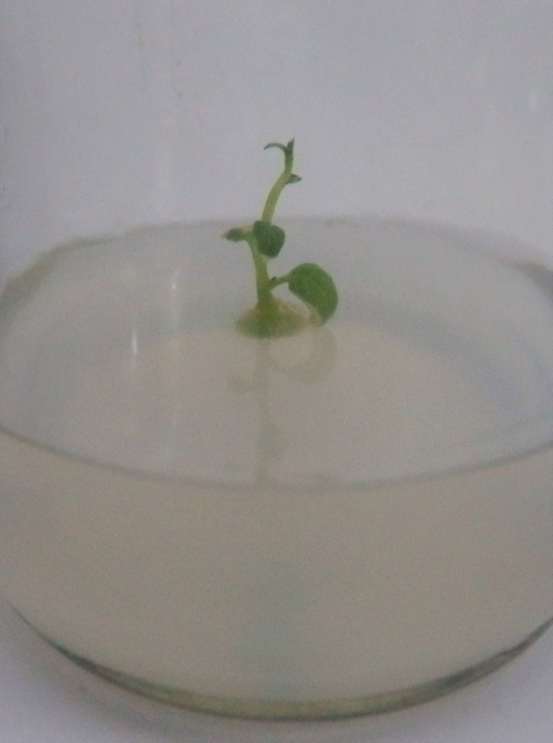
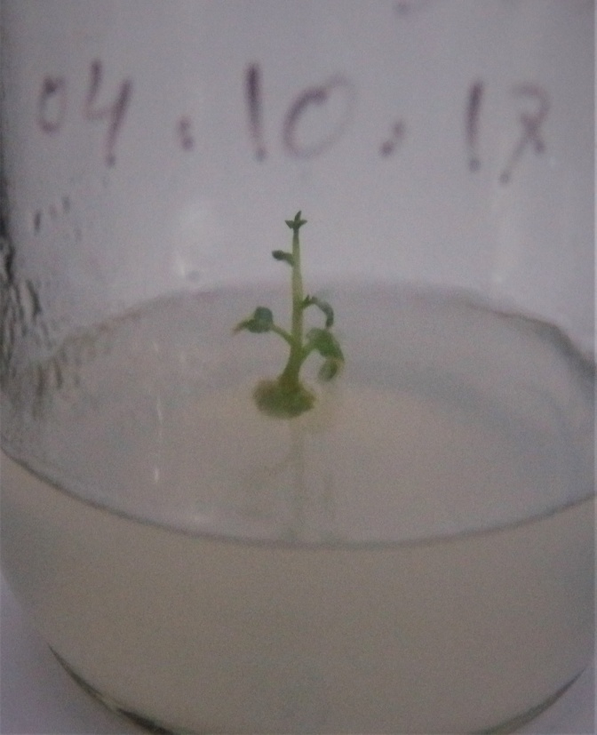
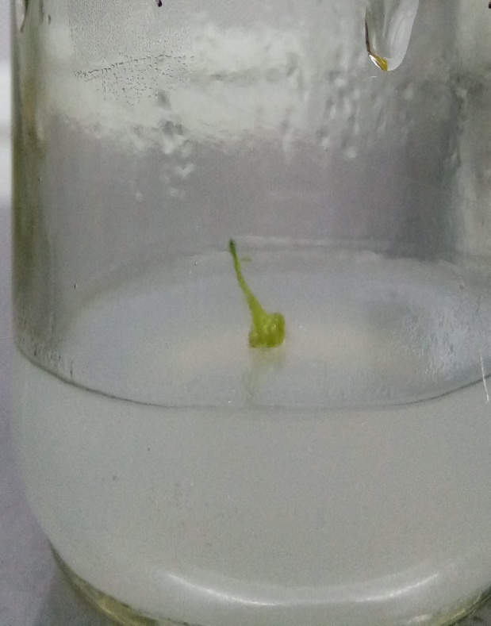
Shoot initiation from meristem tip
Granola
Diamant
Cardinal
Figure 5. Initiated shoot at 7 DAI on MS media supplemented with 0.25 mg/L
IBA+0.25 mg/L 2,4-D+ 1.0 mg/L BAP in Granola, Diamant and Cardinal

Slide 24
Figure 6. Effect of different hormones on percentage of days to shoot initiation of Granola

Slide 25
Figure 7. Effect of different hormones on percentage of days to shoot initiation of Diamant

Slide 26
Figure 8. Effect of different hormones on percentage of days to shoot initiation of Cardinal

Slide 27
Table 4: Combined effect of different varieties and different hormones on length of shoots/plantlets
Granola | Treatment | Length of shoots/plantlets (cm)
 |  | 7 DAI | 14 DAI | 21 DAI | 28 DAI
 | T₁=Normal MS | 2.4 a | 5.86 a | 6.90 a | 8.17 c
 | T₂=0.25 IBA+0.125 2,4-D+0.5 BAP | 2.14 b | 2.26 b | 3.74 c | 9.32 a
 | T₃=0.25 IBA+0.25 2,4-D +1.0 BAP | 1.90 c | 2.11 c | 2.37 f | 6.63 e
 | T₄=0.25 IBA +0.37 2,4-D +1.5 BAP | 1.6133 d | 2.11 b | 2.61 e | 4.00 f
 | T₅=0.25 IBA +0.50 2,4-D +2.0 BAP | 0.51 e | 1.63 d | 1.88 g | 3.31 g
 | T₆=1.50 IBA +1.0 2,4-D +0.5 BAP | 0.00 f | 1.31 e | 2.96 d | 8.01 d
 | T₇=1.50 IBA +2.0 2,4-D +1.0 BAP | 0.00 f | 0.75 f | 4.11 b | 9.03 b
Diamant | T₁=Normal MS | 2.86 a | 3.81 a | 4.54 a | 6.66 c
 | T₂=0.25 IBA+0.125 2,4-D+0.5 BAP | 2.11 b | 2.20bc | 3.11 c | 7.53 a
 | T₃=0.25 IBA+0.25 2,4-D +1.0 BAP | 1.74 c | 2.14 c | 2.21 e | 5.46 e
 | T₄=0.25 IBA +0.37 2,4-D +1.5 BAP | 1.71 d | 2.54 b | 2.92 d | 3.28 f
 | T₅=0.25 IBA +0.50 2,4-D +2.0 BAP | 0.00 e | 0.00 d | 0.00 g | 0.00 g
 | T₆=1.50 IBA +1.0 2,4-D +0.5 BAP | 0.00 e | 0.00 d | 1.73 f | 5.66 d
 | T₇=1.50 IBA +2.0 2,4-D +1.0 BAP | 0.00 e | 0.00 d | 3.20 b | 7.31 b

Slide 28
Table 4. Contd….
Cardinal | T₁=Normal MS | 2.65 a | 3.56 a | 4.40 a | 6.23 d
 | T₂=0.25 IBA+0.125 2,4-D+0.5 BAP | 1.64 c | 1.76 d | 2.01 e | 6.82 c
 | T₃=0.25 IBA+0.25 2,4-D +1.0 BAP | 1.91 b | 2.27 c | 2.37 c | 6.22 d
 | T₄=0.25 IBA +0.37 2,4-D +1.5 BAP | 1.64 c | 2.41 b | 2.77 b | 3.10 f
 | T₅=0.25 IBA +0.50 2,4-D +2.0 BAP | 0.41 d | 1.23 e | 1.75 f | 3.30 e
 | T₆=1.50 IBA +1.0 2,4-D +0.5 BAP | 0.00 e | 0.00 f | 1.36 g | 6.91 b
 | T₇=1.50 IBA +2.0 2,4-D +1.0 BAP | 0.00 e | 0.00 f | 2.12 d | 7.62 a
 | CV | 0.74 | 0.43 | 0.43 | 0.14
 | LSD | 0.0153 | 0.0121 | 0.0179 | 0.0138

Slide 29
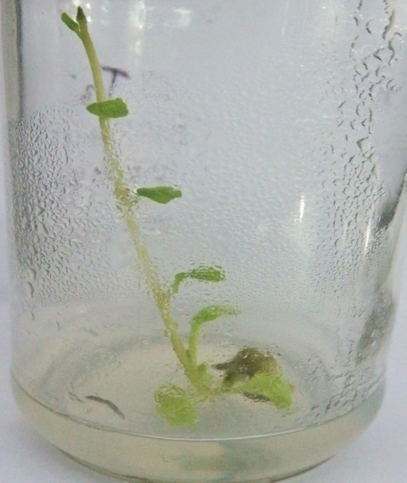
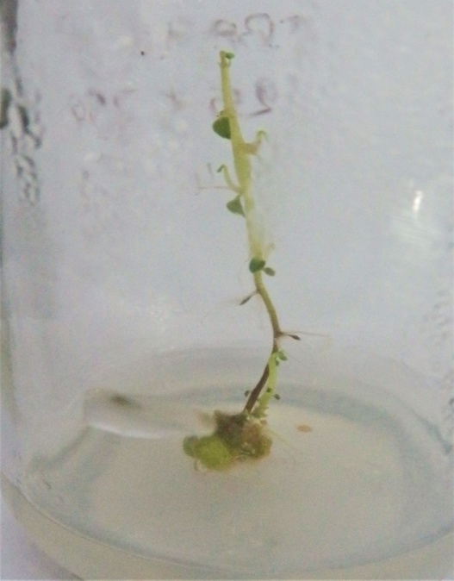
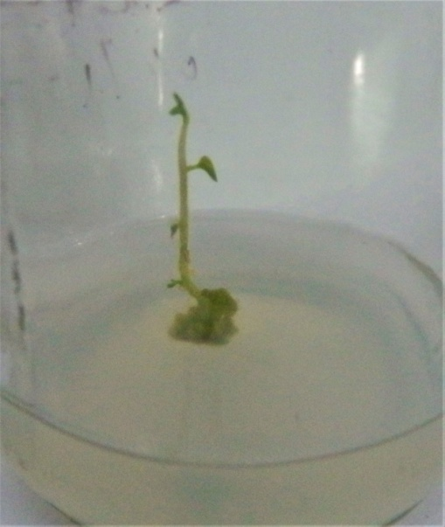
Length of shoots at 14 days after inoculation
Granola
Diamant
Cardinal
Figure 9. Maximum length of shoots at 14 DAI on MS media supplemented
with T2 (0.25 mg/L IBA +0.125 2,4-D mg/L+0.5 mg/L BAP) in Granola,
Diamant and Cardinal

Slide 30
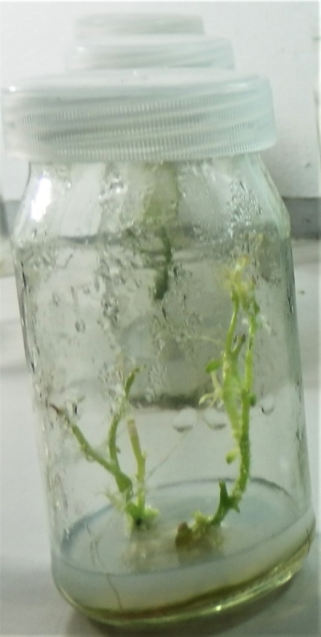
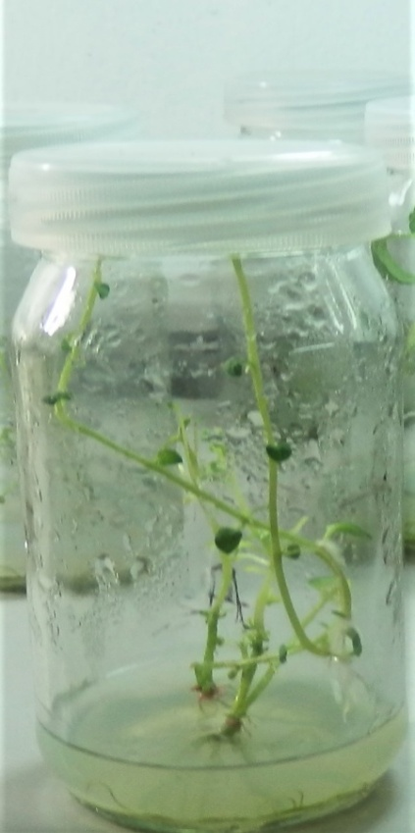
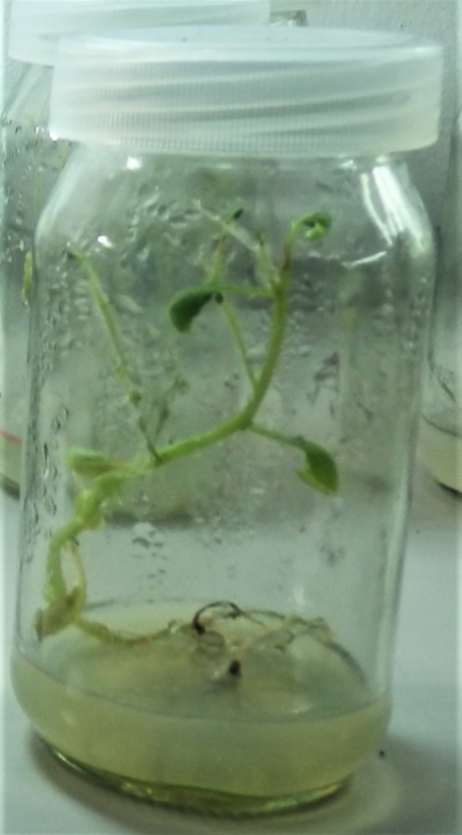
Length of shoots at 28 days after inoculation
Granola
Diamant
Cardinal
Figure 10. Length of shoot at 28 DAI on MS media supplemented with 0.25
mg/L IBA+0.25 mg/L 2,4-D+ 1.0 mg/L BAP in Granola, Diamant and
Cardinal

Slide 31
Number of leaves/ plantlets Table 5:Combined effect of different varieties and different hormones on number of leaves/plantlets
Granola | Treatment | Number of Leaves/plantlets
 | T₁=Normal MS | 8.67 b
 | T₂=0.25 IBA+0.125 2,4-D+0.5 BAP | 15.00 a
 | T₃=0.25 IBA+0.25 2,4-D +1.0 BAP | 6.33 c
 | T₄=0.25 IBA +0.37 2,4-D +1.5 BAP | 5.33 c
 | T₅=0.25 IBA +0.50 2,4-D +2.0 BAP | 6.00 c
 | T₆=1.50 IBA +1.0 2,4-D +0.5 BAP | 8.67 b
 | T₇=1.50 IBA +2.0 2,4-D +1.0 BAP | 8.33 b
Diamant | T₁=Normal MS | 14.33 a
 | T₂=0.25 IBA+0.125 2,4-D+0.5 BAP | 11.33 b
 | T₃=0.25 IBA+0.25 2,4-D +1.0 BAP | 4.00 d
 | T₄=0.25 IBA +0.37 2,4-D +1.5 BAP | 6.67 c
 | T₅=0.25 IBA +0.50 2,4-D +2.0 BAP | 0.00 e
 | T₆=1.50 IBA +1.0 2,4-D +0.5 BAP | 6.67 c
 | T₇=1.50 IBA +2.0 2,4-D +1.0 BAP | 7.33 c

Slide 32
Table 5. Contd….
Cardinal | Treatment | Number of Leaves/plantlets
 | T₁=Normal MS | 4.67 d
 | T₂=0.25 IBA+0.125 2,4-D+0.5 BAP | 13.33 a
 | T₃=0.25 IBA+0.25 2,4-D +1.0 BAP | 5.67 cd
 | T₄=0.25 IBA +0.37 2,4-D +1.5 BAP | 5.67 cd
 | T₅=0.25 IBA +0.50 2,4-D +2.0 BAP | 5.33 cd
 | T₆=1.50 IBA +1.0 2,4-D +0.5 BAP | 6.33 c
 | T₇=1.50 IBA +2.0 2,4-D +1.0 BAP | 7.67 b
 | CV | 0.11
 | LSD | 0.122

Slide 33
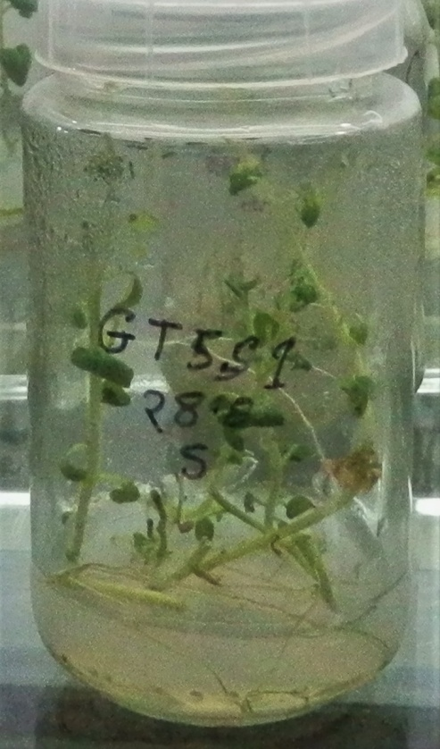
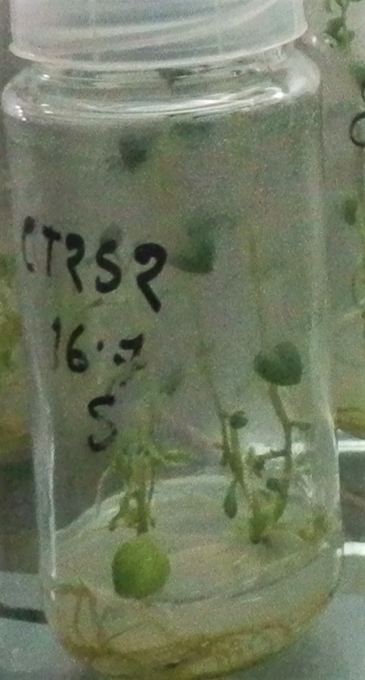
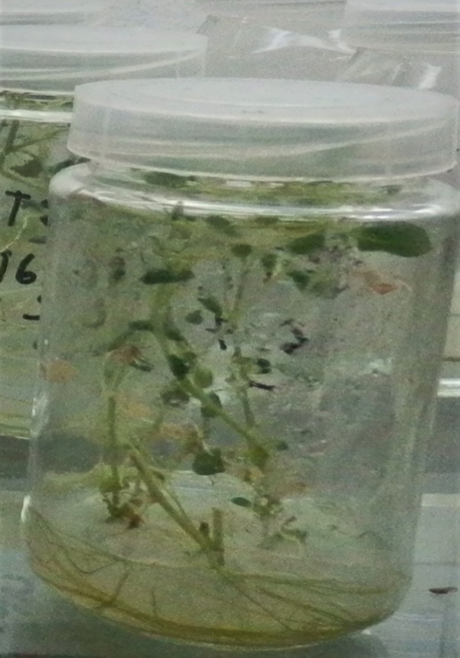
Number of leaves/plantlets
Granola
Diamant
Cardinal
Figure 11. Maximum number of leaves/plantlets at 28 DAI on MS media
supplemented with 0.25 mg/l IBA+0.125 mg/l 2,4-D+0.5 mg/l
BAP Granola, Diamant and Cardinal

Slide 34
Initiation of roots
Table 6: Combined effect of different varieties and different hormones length
of roots/plantlet s at different days after inoculation
Granola | Treatment | Length of roots/plantlets
 |  | 7 DAI | 14 DAI | 21 DAI | 28 DAI
 | T₁=Normal MS | 0.00 b | 0.00 b | 0.00 f | 2.11f
 | T₂=0.25 IBA+0.125 2,4-D+0.5 BAP | 0.00 b | 0.00 b | 1.98 c | 5.64 b
 | T₃=0.25 IBA+0.25 2,4-D +1.0 BAP | 0.00 b | 0.00 b | 1.88 d | 6.55 a
 | T₄=0.25 IBA +0.37 2,4-D +1.5 BAP | 0.00 b | 0.00 b | 1.31 e | 2.11 f
 | T₅=0.25 IBA +0.50 2,4-D +2.0 BAP | 1.24 a | 2.54 a | 3.10 a | 3.98 c
 | T₆=1.50 IBA +1.0 2,4-D +0.5 BAP | 0.00 b | 0.00 b | 2.73 b | 3.64 d
 | T₇=1.50 IBA +2.0 2,4-D +1.0 BAP | 0.00 b | 0.00 b | 0.00 f | 2.86 e
Diamant | T₁=Normal MS | 0.00 b | 0.00 b | 0.00 d | 1.99 g
 | T₂=0.25 IBA+0.125 2,4-D+0.5 BAP | 0.00 b | 0.00 b | 0.00 d | 3.47 c
 | T₃=0.25 IBA+0.25 2,4-D +1.0 BAP | 0.00 b | 0.00 b | 1.34 c | 3.31 e
 | T₄=0.25 IBA +0.37 2,4-D +1.5 BAP | 0.00 b | 0.00 b | 1.49 b | 2.10 f
 | T₅=0.25 IBA +0.50 2,4-D +2.0 BAP | 1.55 a | 3.06 a | 3.55 a | 4.00 a
 | T₆=1.50 IBA +1.0 2,4-D +0.5 BAP | 0.00 b | 0.00 b | 0.00 d | 3.34 d
 | T₇=1.50 IBA +2.0 2,4-D +1.0 BAP | 0.00 b | 0.00 b | 0.00 d | 3.71 b

Slide 35
Table 6. Contd….
Cardinal | T₁=Normal MS | 0.00 b | 0.00 b | 0.00 d | 1.87 f
 | T₂=0.25 IBA+0.125 2,4-D+0.5 BAP | 0.00 b | 0.00 b | 0.00 d | 4.53 a
 | T₃=0.25 IBA+0.25 2,4-D +1.0 BAP | 0.00 b | 0.00 b | 2.19 c | 4.32 b
 | T₄=0.25 IBA +0.37 2,4-D +1.5 BAP | 0.00 b | 0.00 b | 2.32 b | 3.11 c
 | T₅=0.25 IBA +0.50 2,4-D +2.0 BAP | 0.99 a | 1.85 a | 2.43 a | 3.11 c
 | T₆=1.50 IBA +1.0 2,4-D +0.5 BAP | 0.00 b | 0.00 b | 0.00 d | 2.79 d
 | T₇=1.50 IBA +2.0 2,4-D +1.0 BAP | 0.00 b | 0.00 b | 0.00 d | 2.25 e
 | CV | 1.71 | 0.50 | 0.72 | 0.39
 | LSD | 6.619 | 3.821 | 0.0115 | 0.0216

Slide 36
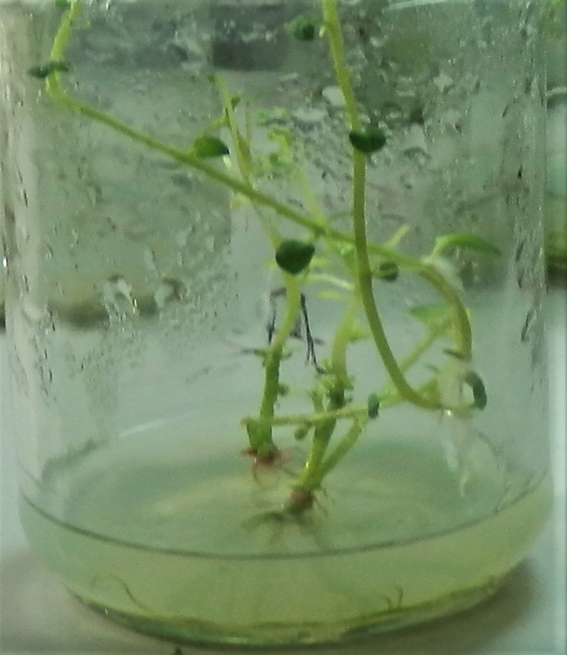
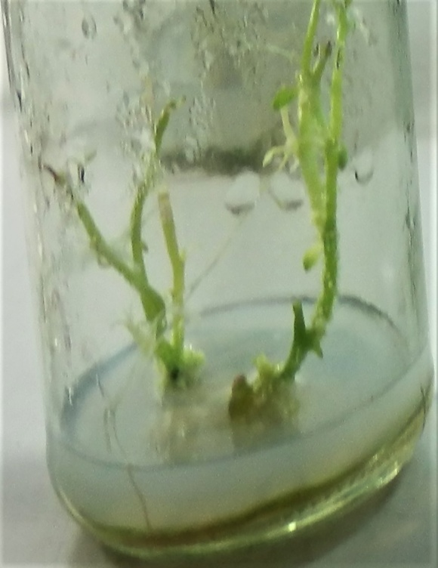
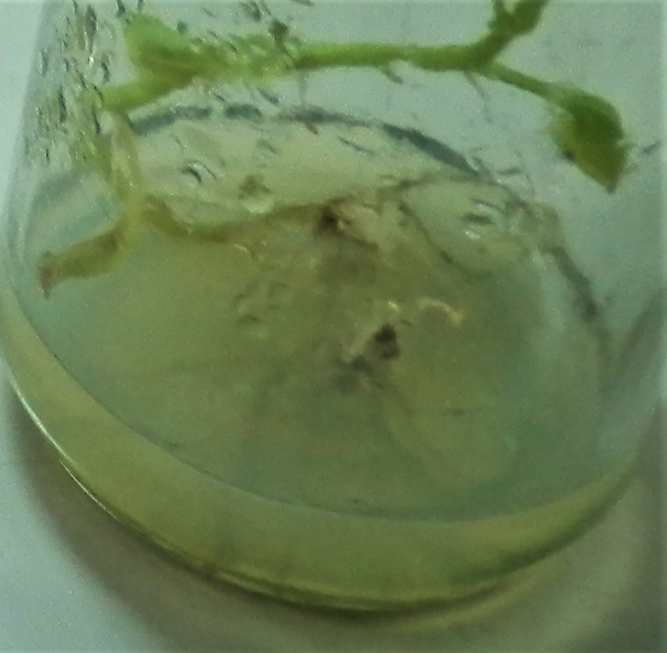
Length of roots
Granola
Diamant
Cardinal
Figure 12. Maximum length of roots with longest root at 28 DAI on MS media
supplemented with T3 0.25 mg/L IBA+0.25 mg/L 2,4-D+ 1.0 mg/L
BAP in Granola, Diamant and Cardinal

Slide 37
Figure 13. Effect of different hormones on percentage of days to shoot initiation of Granola

Slide 38
Figure 14. Effect of different hormones on percentage of days to shoot initiation of Diamant

Slide 39
Figure 15. Effect of different hormones on percentage of days to shoot initiation of Cardinal

Slide 40
DAS-ELISA Test
Table 7: DAS-ELISA test of potato plantlets for viruses detection
Sl. No. | Sample ID | Potato Viruses | Result
1. | GT1S1 | PLRV, Potato Virus A, Y, X,M, S, V | (-)ve
2. | GT2S1 | PLRV, Potato Virus A, X, V | PVY, PVM, and PVS are detected
3. | GT2S3 | PLRV, Potato Virus A, Y, X,M, S, V | (-)ve
4. | GT5S1 | PLRV, Potato Virus A, Y, X,M, S, V | (-)ve
5. | GT6S3 | PLRV, Potato Virus A, Y, X,M, S | PVV detected
6. | GT7S1 | PLRV, Potato Virus A, Y, X,M, S, V | (-)ve
7. | CT2S2 | PLRV, Potato Virus A, Y, X,M, S, V | (-)ve
8. | CT12S1 | PLRV, Potato Virus A, Y, X,M, S, V | (-)ve
9. | DT3S1 | PLRV, Potato Virus A, Y, X,M, S, V | (-)ve
10. | DT4S1 | PLRV, Potato Virus A, Y, X,M, S, V | (-)ve

Slide 41
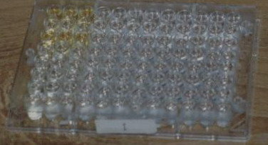
Detection of Virus through Serological test (DAS-ELISA)
GT2S1
GT6S3
Figure 16.In ELISA test, development of yellow colour in two micro titer wells
indicating presence of virus and in other micro titers no development of
color indicating are freeness of the sample plantlets derived from
meristem culture.

Slide 42
Table 8: Survival rate of in vitro regeneration plantlets of three potato varieties
Acclimatization | Variety | No. of transplanted plants | No. of plants survives | Survival rate (%)
Initially small plastic pots used as growth chamber | Granola | 27 | 22 | 81.48
 | Diamant | 27 | 20 | 74.07
 | Cardinal | 26 | 19 | 73.07
Subsequently when moved to net house | Granola | 22 | 20 | 90.90
 | Diamant | 20 | 17 | 85.00
 | Cardinal | 19 | 17 | 89.47

Slide 43
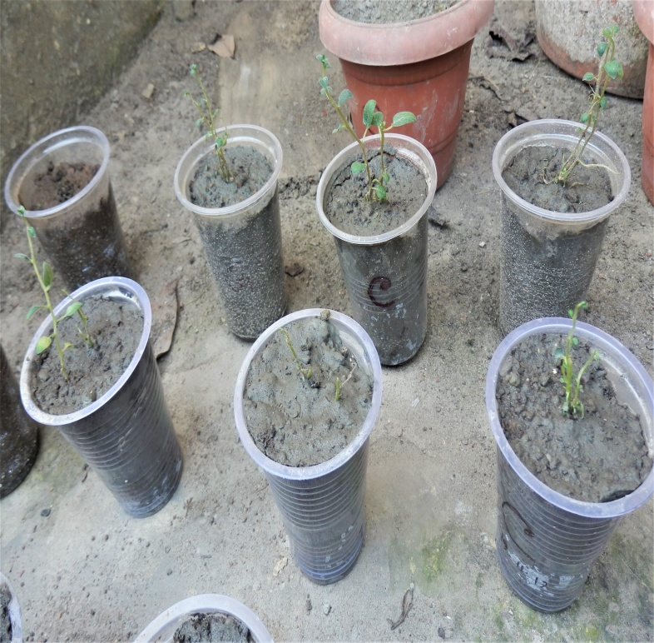
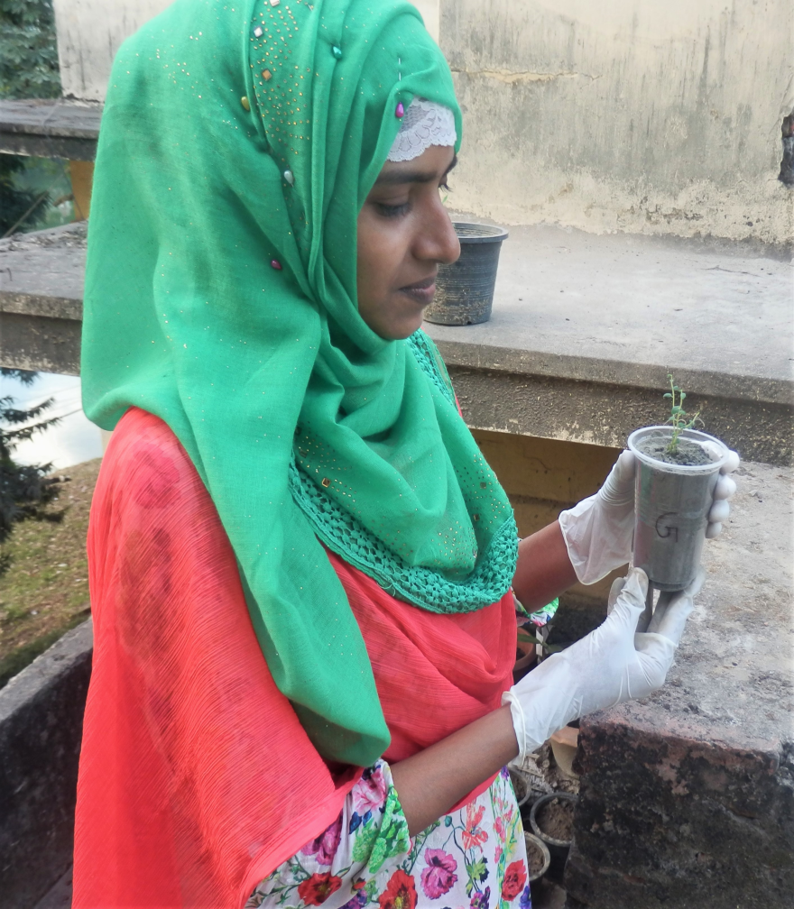
Acclimatization and establishment of plantlets in soil
Figure 17. In vivo acclimatization of regenerated plantlets in open
atmosphere

Slide 44
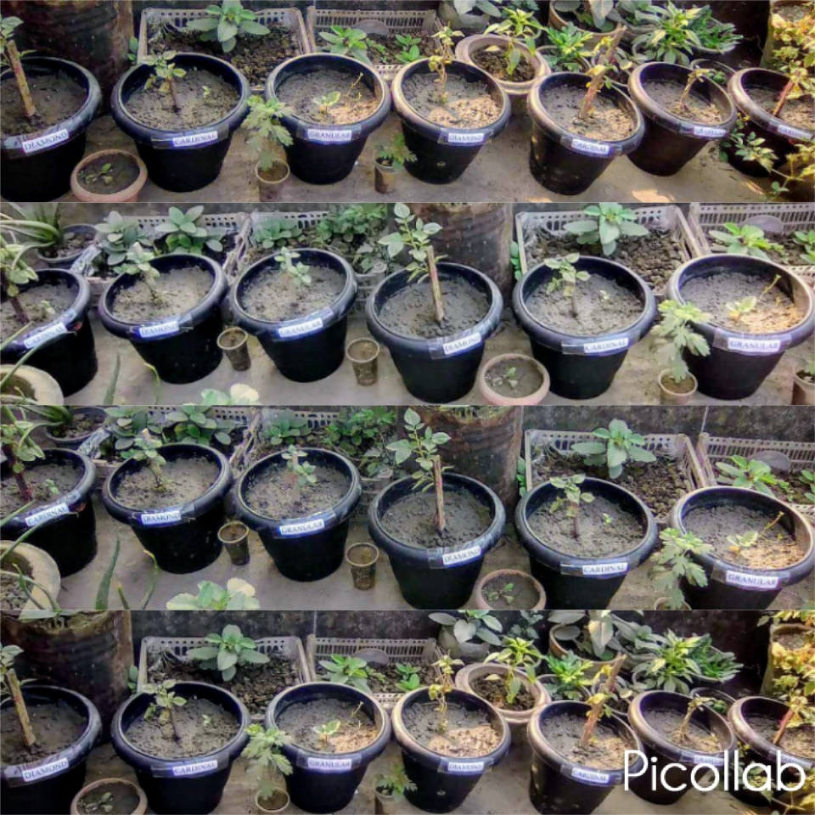
Figure 18. Acclimatization of plantlets in pots, transplantation of
healthy plantlets to the pots under net house.

Slide 45
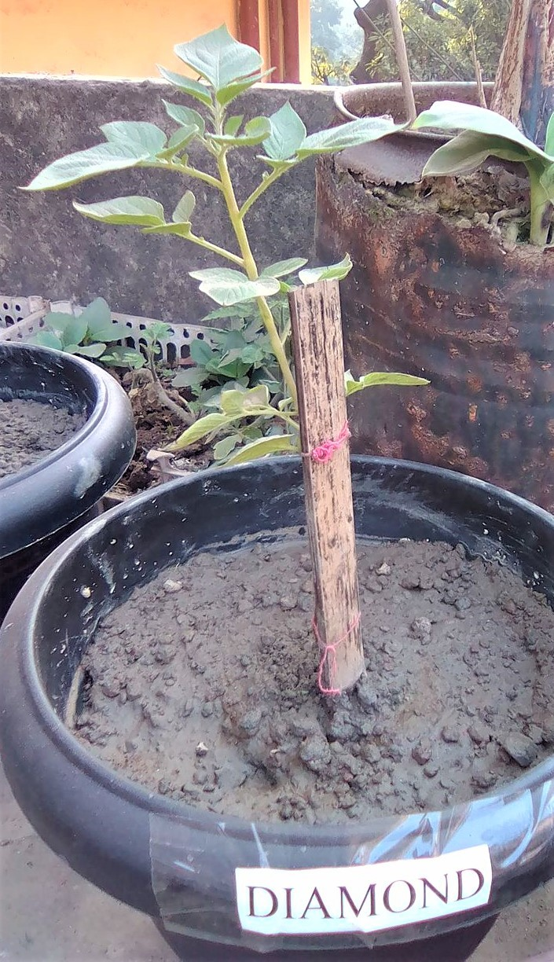
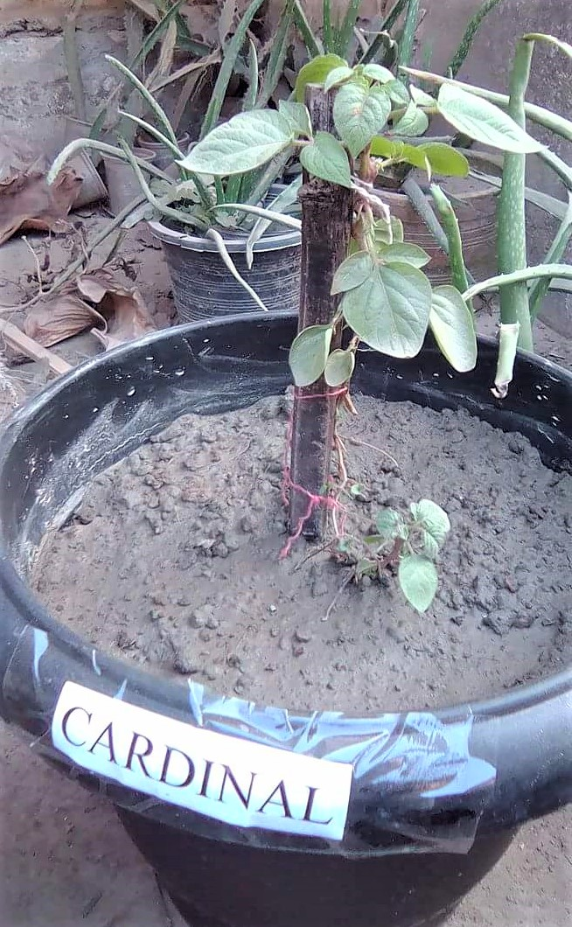
Figure 19. Acclimatization of Diamant and Cardinal variety plantlets
in pots,transplantation of healthy plantlets to the pots
under net house.

Slide 46
Table 9: Yield performance of different potato varieties
Sl. No. | Variety | Yield Parameters
 |  | Total no. of minitubers/plants | Wt. of minitubers (gm) | Max. no. of minitubers | Average wt. of minitubers (gm)
1 | Granola | 15 | 20 | 12 | 20.67
2 | Diamant | 10 | 22 | 9 | 21.84
3 | Cardinal | 13 | 18 | 10 | 18.33

Slide 47
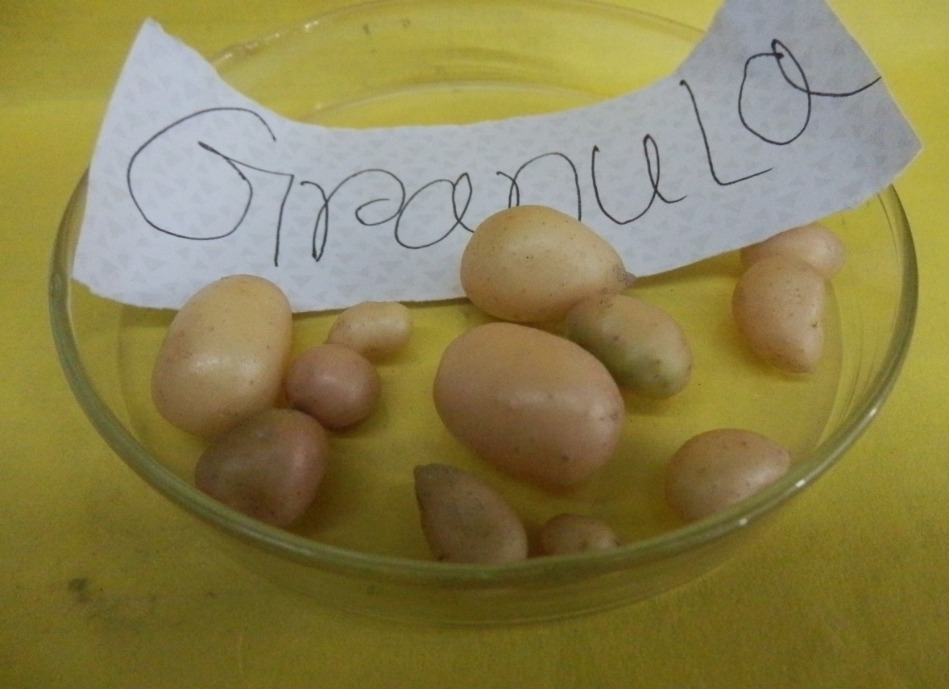
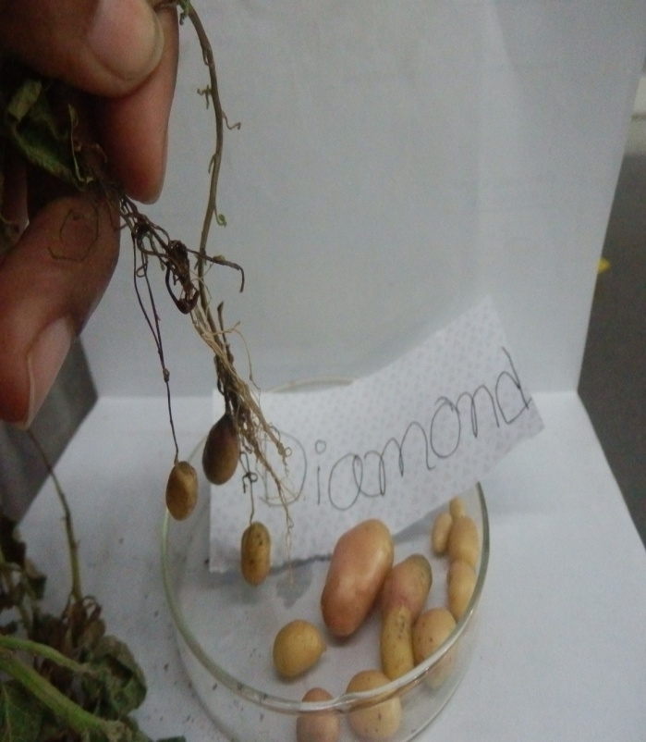
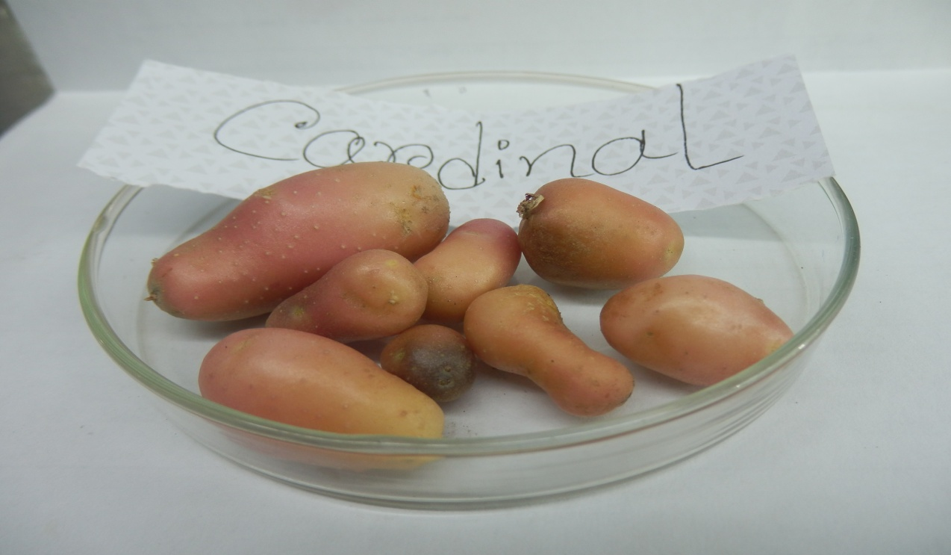
Harvested potato mini tubers
Granola
Diamant
Cardinal
Figure 20. Harvested Granola, Diamant and Cardinal potato mini
tubers

Slide 48

CONCLUSION

Slide 49
Conclusion
Considering the performance of selected potato varieties it may be concluded that
Granola revealed the best performance in case of days to shoot and root initiation, and shoot height as compared to other two varieties at a combination of T3 (0.25 mg/L IBA+0.25 mg/L BAP) within a comparatively short period of time.
However, maximum number of leaves and roots were also obtained from Granola variety.

Slide 50
DAS-ELISA was done, and maximum plantlets of the selected three varieties were gave the negative result against potato viruses.

Slide 51


Slide 52
Recommendations
Further more screening program can be carry out for large scale production of healthy and virus free planting materials of potato.
More potato varieties can be studied for in vitro regeneration following the present research method.

Slide 53

Acknowledgement
Supervisor
Co-Supervisor
All of the Teachers from Plant Pathology
Department
All the Stuffs from Plant Pathology and
Biotechnology Department
Dr. Md. Salim Khan, PSO, BCSIR, Dhaka

Slide 54


Slide 55

?

