Slide 1
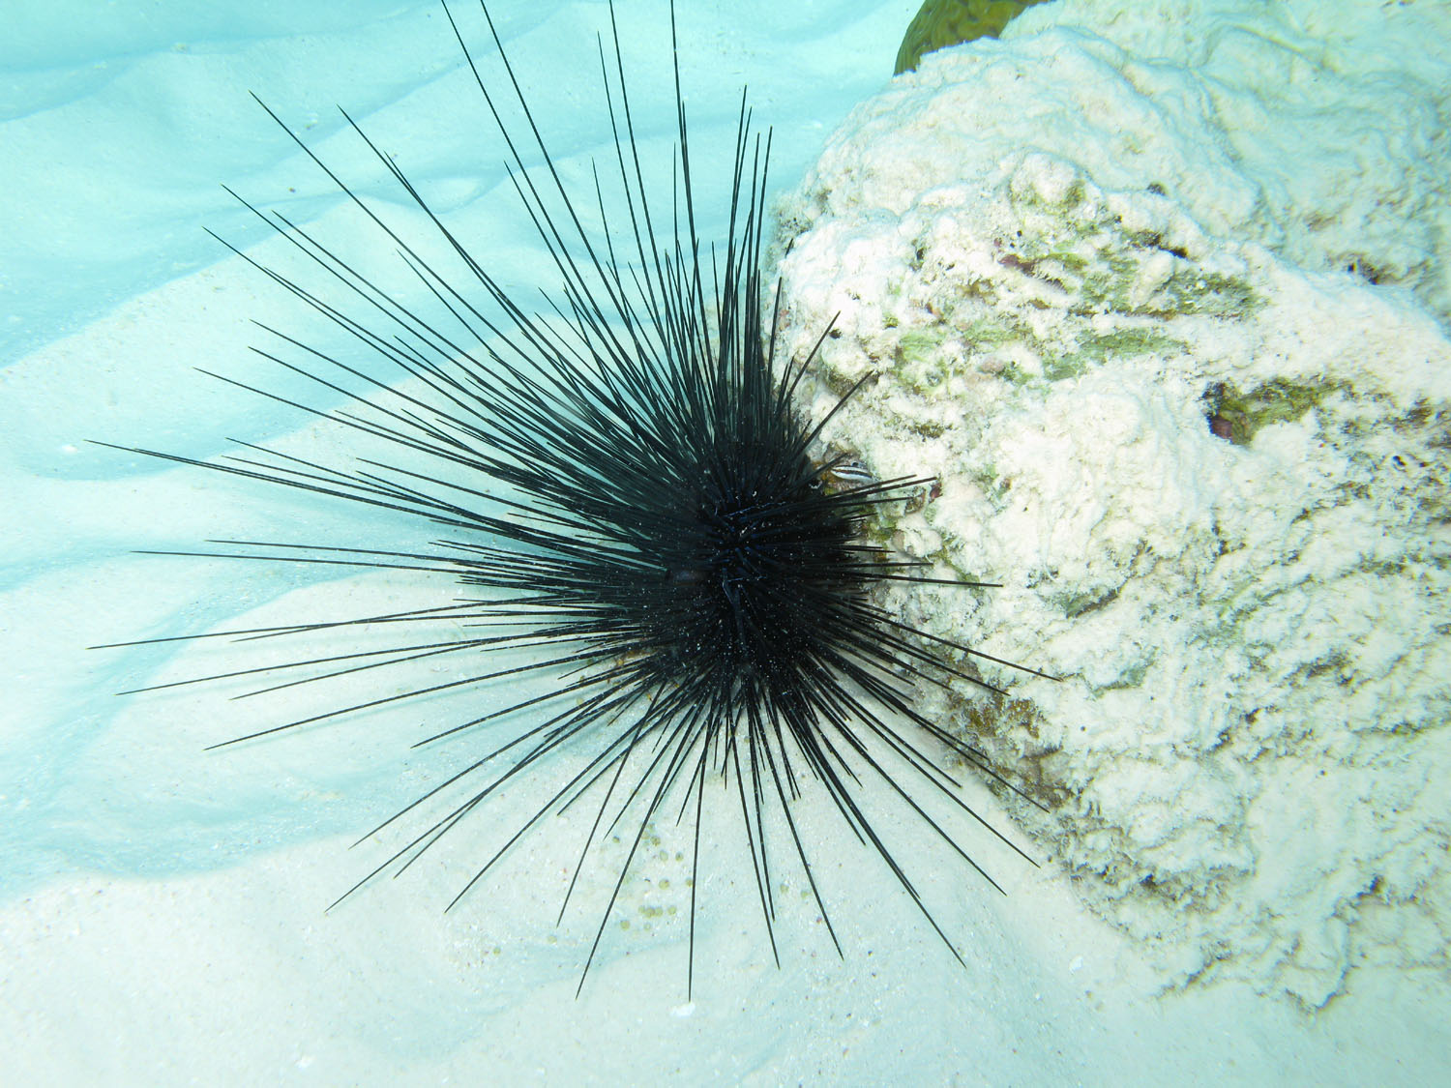
Diadema savignyi, a key prospect in pharmaceutics
AH SHEE TEE Lisa
Faculty of Agriculture
University of Mauritius

Slide 2
Presentation Overview
Introduction
Methodology
Results
Discussion
Conclusion & Recommendation
References

Slide 3
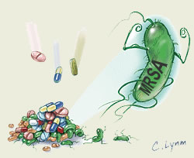
Introduction
Antimicrobial resistance is present in every country (WHO., 2017).
Drug misuse and abuse triggers the increase built-up of reactive oxygen species (ROS).
Sea urchins, commonly known as “sea hedgehogs” belong to the phylum Echinodermata.
Previous studies have reported:
  The antimicrobial potency (Shankarlal et al., 2011)
  The scavenging capability of sea urchins (Pozharitskaya et al., 2013)
Figure 1: MRSA

Slide 4
Aim and Objectives
Morphologically characterise sample and confirm results using molecular tools
Extract bioactives compound using 2 solvents and 2 drying methods
Chemical test
Antibacterial assay
Antioxidant assay
The aim was to study the bioactive potential of sea urchin.
Figure 2: Objectives

Slide 5
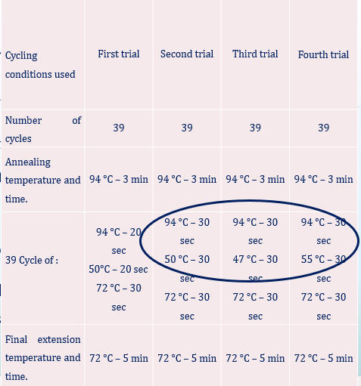
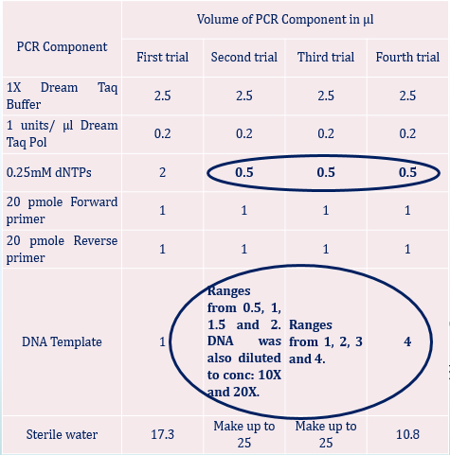
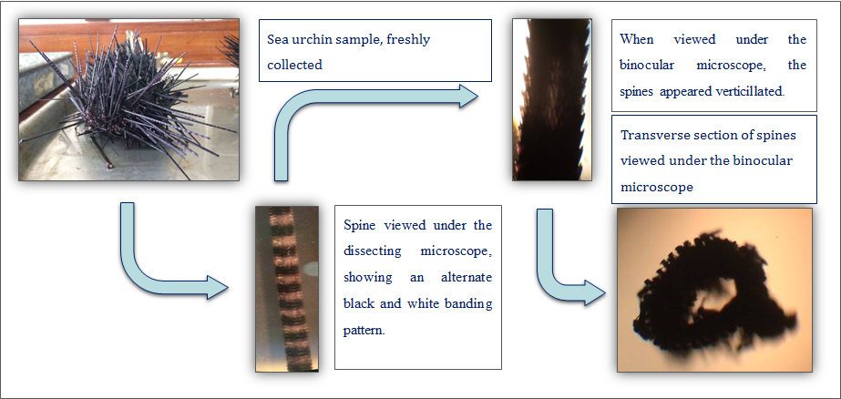
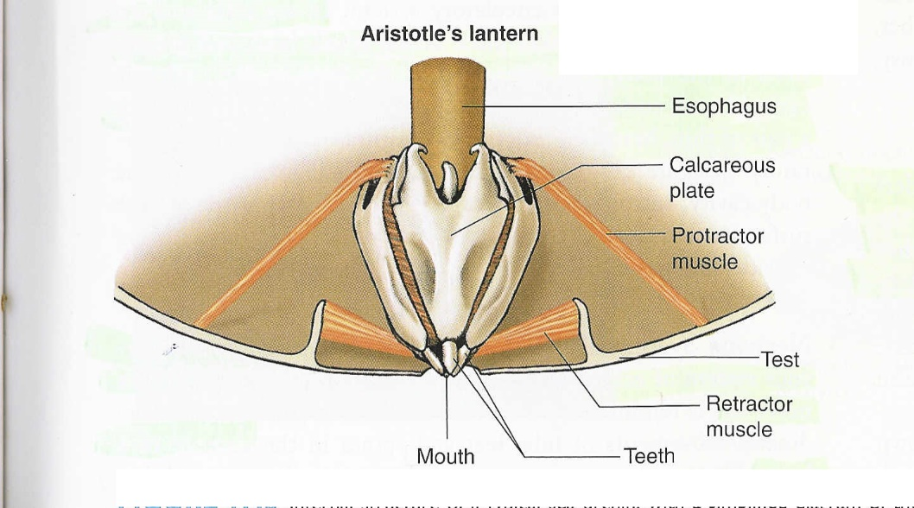
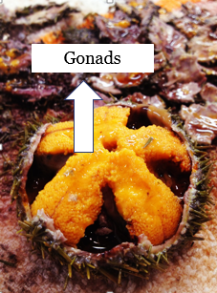
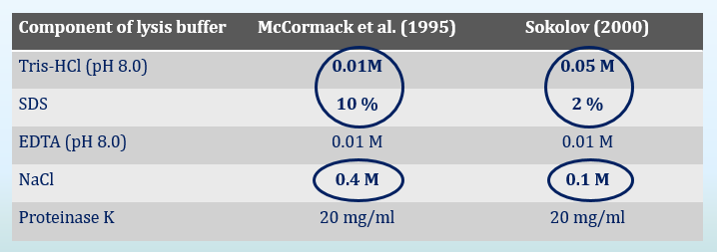
Methodology
Sea urchins
Shells
Extract preparation
Gonads
Biological assay
DNA extraction
Extract preparation
PCR
Sequencing
Biological assay
Antimicrobial
Antioxidant
Chemical analysis
Chemical analysis
Antimicrobial
Antioxidant
Qualitative test
Saponins
Phenols
Flavonoids
Carotenoids
0.5 ml sample in 5 ml water
2 ml sample mixed with drops of 1% ferric chloride
2 ml extract mixed with 5 ml diluted ammonia
Extract sample with chloroform. Add drops of 85% sulphuric acid
Persistent froth
A blue, violet, green, purple or red-brown color observed
Disappearance of yellow color on addition of conc. sulphuric acid
Presence of blue color at interface
Figure 3: Overview of methodology

Slide 6
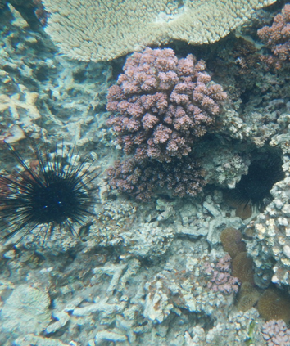
Results – Morphological identification
Sea urchin hiding in crevices
Sea urchin had long black and slender-like spines.
White dots on the interambulacral area is evident
Absence of orange ring indicated the sample cannot be D. setosum.
Figure 4: Sea urchin found in small crevices

Slide 7
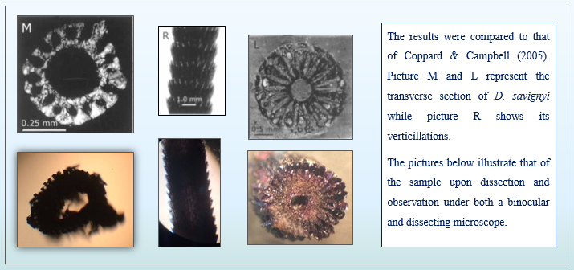
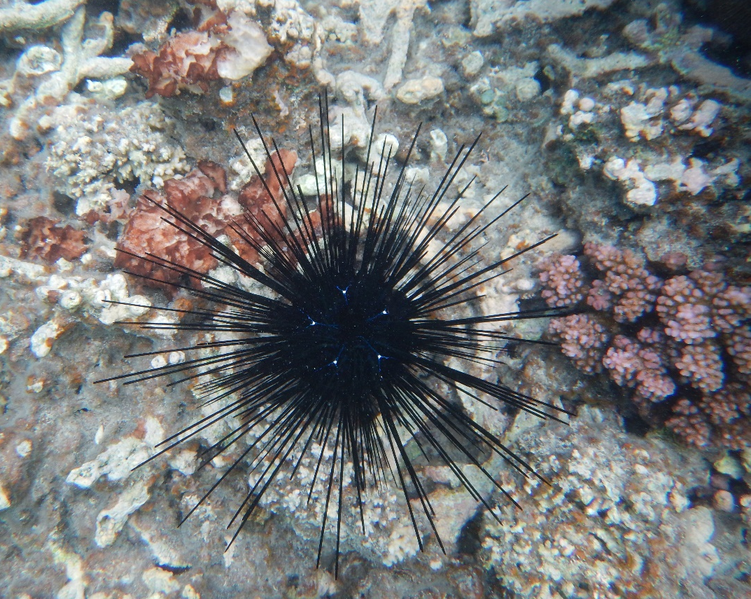
Results – Morphological identification
A
B
C
A: Long slender and black spines
Length: 100.9 ± 5.99 mm
B: Y-shaped blue lines iridophores
C: White spots on central axis of Y- shaped structure
Figure 5: Underwater view of sample

Slide 8
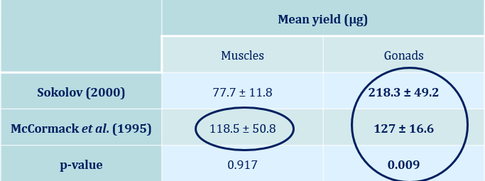
Results – DNA extraction
Results - PCR
Trial | DNA Sample used | Primer used | Results
1 | Muscles and Gonadal tissue from Sokolov protocol | Folmer | Primer Dimer
2 | Gonadal tissue with a good purity from McCormack protocol | Folmer | Primer Dimer
3 | Gonadal tissue from Sokolov protocol | Folmer | Primer Dimer
4 | Gonadal tissue from McCormack protocol | COIF & COIR COII 8068F & COII8235R | No visible bands

Slide 9
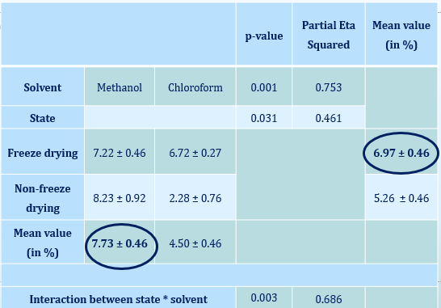
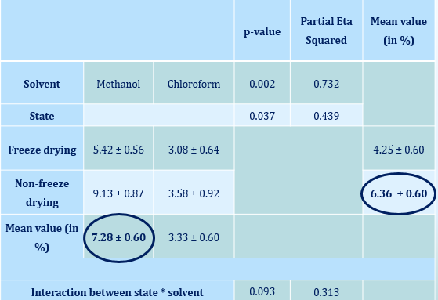
Results – Sample extraction (Gonads)
Results – Sample extraction (shells)

Slide 10
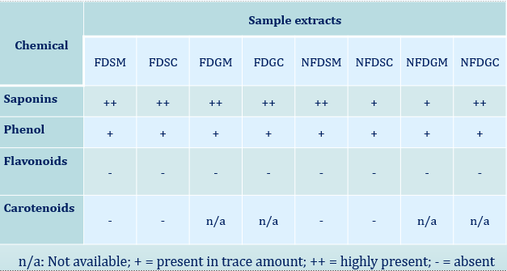
Results – Chemical test
Results – Total phenolic content

Slide 11
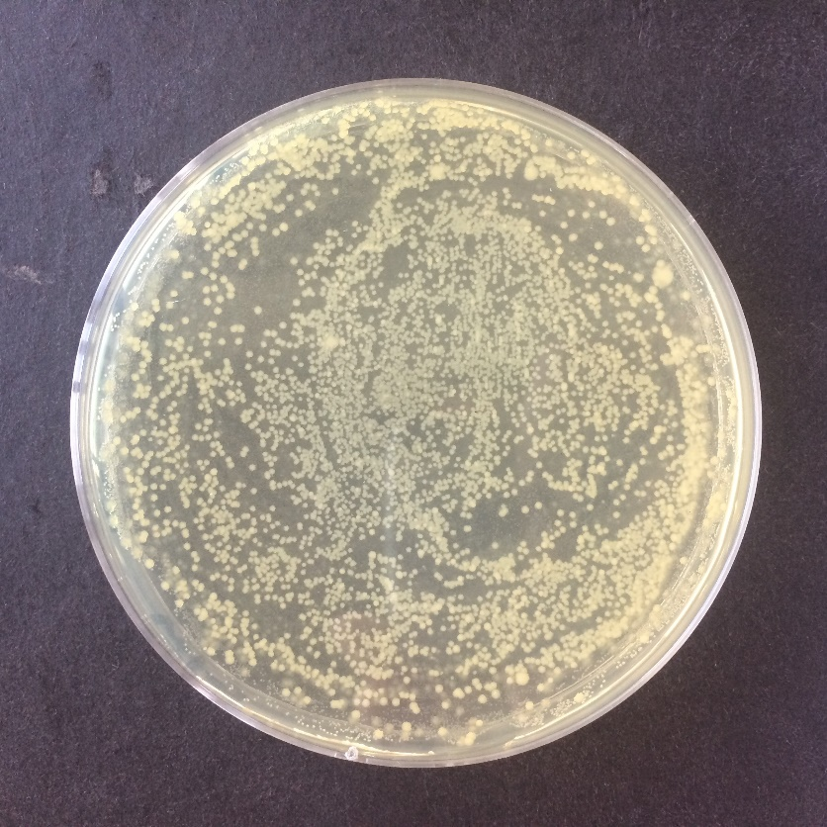
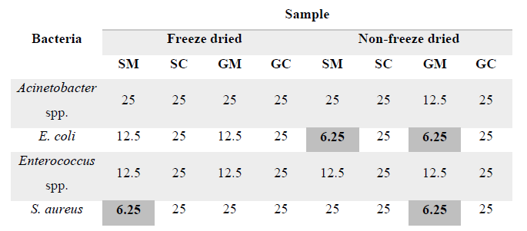
Results – MIC & MBC
Results – Antimicrobial assay
Bacteria | Extract | Inhibition zone (mm)
Escherichia coli | Non-freeze dried methanolic shell | 16.3 ± 1.37
Acinetobacter spp. |  | 11.1 ± 1.29
Enterococcus spp. |  | 12.6 ± 0.59
Staphylococcus aureus | Freeze dried methanolic gonads | 17.1 ± 0.23

Slide 12
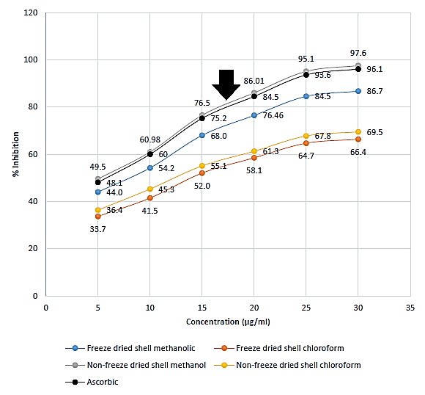
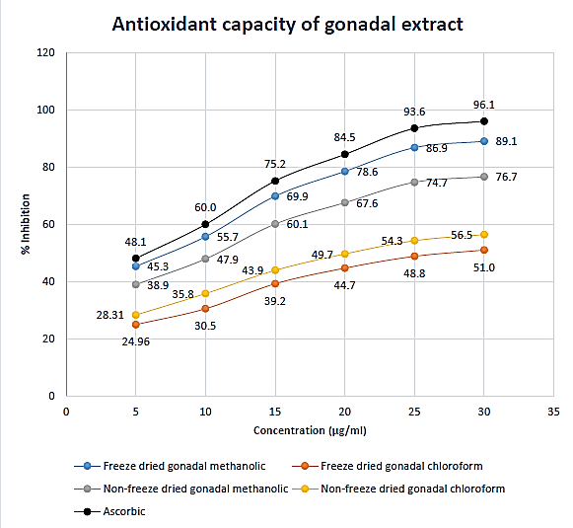
Results – Antioxidant (gonads)
Results – Antioxidant (shells)

Slide 13
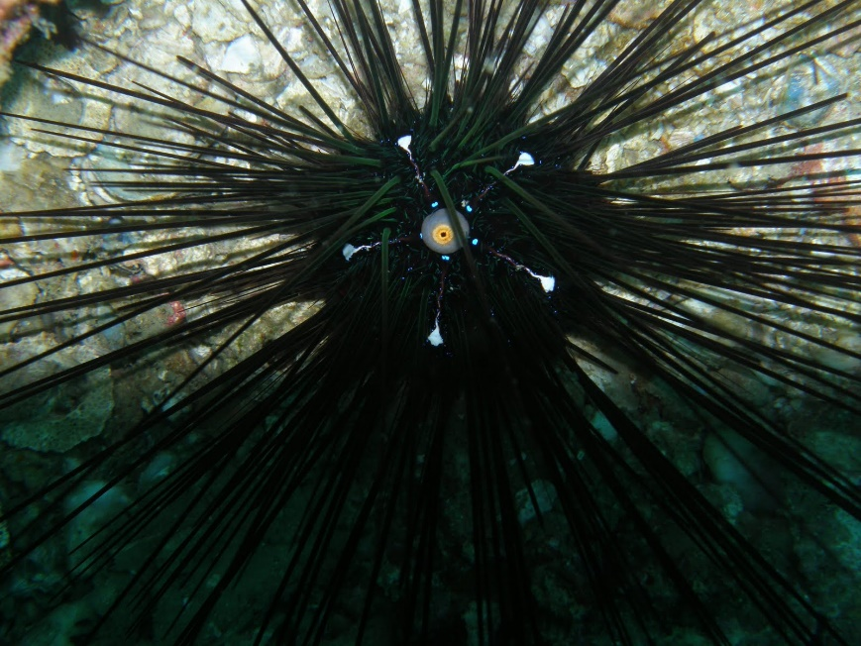
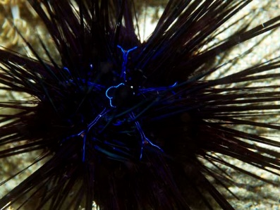

Discussion– Morphological identification
These results rule out the possibility of the sample being D. setosum.
Hence, D. savignyi was the scientific name proposed to sample.
Figure 5: (i) D. setosum (ii) D. savignyi (iii) Sample

Slide 14
Discussion – DNA extraction
Methods used had an impact on the DNA yield.
Muscles had a low yield → highly fibrous nature (Ziegler et al., 2012).
Gonads higher yield → mature urchin tend to have more nucleic acid.
Fire-bands obtained is an indication of contamination.

Slide 15
Discussion - PCR
Low annealing temperature → formation of non-specific product.
High annealing temperature → too stringent condition yielded low PCR product.
Volume of dNTP was decreased and DNA was diluted to lower polysaccharide content → still primer dimer.
According to Hoareau & Boissin (2010), amplifying COI regions of echinoderms is challenging.
Designing new phylum-specific primers is a solution to this problem

Slide 16
Discussion – Sample extraction
Freeze drying have different impact on different components (Oikawa et al., 2011)
High yield implies:
  Freeze drying have protected secondary metabolites
  Components must had had a polarity index close to that of extraction solvent.
Significant synergistic interaction (between drying method and solvent used) was observed for the gonads (p<0.05).
Low yield may means vacuum applied during freeze drying might have destroyed secondary metabolites.

Slide 17
Discussion – Chemical test
Qualitative test
No carotenoids was found in the shell which can be explained by the influence of solvent used.
Quantitative test
Higher phenolic yield (NFD) can be explained by the absence of vacuum or components had had a polarity index close to extraction solvent.
Phenolic content in gonads are influenced by the urchin’s diet (Archana & Babu, 2016) ➔ gonads had high TPC (688.1 mg GAE/g DW)

Slide 18
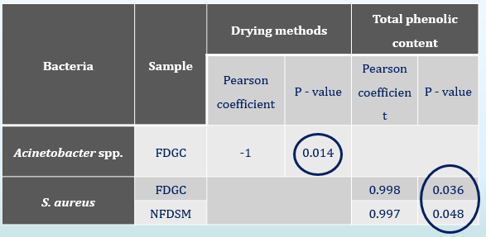
Discussion – Antibacterial assay
Shells showed higher inhibitory activity due to a high level of PHNQs (echinochrome A)
Chloroform have a low polarity index (4.1) and was not able to remove maximum compounds.
Gram positive bacteria have increased permeability to lipophilic solution.
Presence of saponins might also explain the extract’s inhibitory activity.

Slide 19
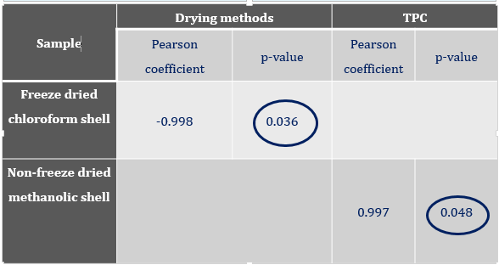
Discussion – Antioxidant assay
Results coincide to Kuwahara et al. (2010) → Shell had higher antioxidant capacity.
Shell has high level of PHNQ that resembles polyphenolic components.
Echinochrome A is highly soluble in polar solvent and presence of OH group increases its scavenging capacity (Popov & Krivoshapko, 2013)
Chloroform might extract volatile component which is affected by the vacuum applied during freeze drying (Cronin et al., 1995).
Correlation suggest phenolic content is responsible for antioxidant activity.

Slide 20
Conclusion
Molecular characterisation was not possible.
Methanol is the best solvent to remove maximum bioactives.
Freeze drying is best suited for gonads and non-freeze drying for shells.
Results demonstrate both shell and gonads as potential source of novel antimicrobial drugs.
Pigment in shells had better antioxidant activity than ascorbic acid.

Slide 21
Recommendation
Tissue must be preserved in either 70% alcohol or liquid nitrogen to lessen DNA degradation.
Use phylum specific primer to amplify COI region of echinoderms.
Use a mixture of ethyl acetate and hexane to extract carotenoids.
Pigments are responsible for antioxidant capacity and should be identified using GC-MS.

Slide 22
References
Archana, A. & Babu, R. K., 2016. Nutrient composition and antioxidant activity of gonads of sea urchin Stomopneustes variolaris. Food Chemistry, Volume 197, pp. 597-602.
Coppard, S. E. & Campbell, A. C. 2005. Taxonomic significance of spine morphology in the echinoid genera Diadema and Echinothrix. Invertebrate Biology, 123(4), pp. 357-371.
Cronin, G., Lindquist, N., Hay, M. E. & Fenical, W., 1995. Effects of storage and extraction procedures on yields of lipophilic metabolites from the brown seaweeds Dictyota ciliolata and D. menstrualis. Marine Ecology Progress Series, Volume 119, pp. 265-273.
Hoareau, T. B. & Boissin, E., 2010. Design of phylum-specific hybrid primers for DNA barcoding: addressing the need for efficient COI amplification in the Echinodermata. Molecular Ecology Resources, Volume 10, pp. 960-967.

Slide 23
References
Kuwahara, R., Hatate, H., Yuki, T., Murata, H., Tanaka, R. & Hama, Y., 2009. Antioxidant property of polyhydroxylated naphthoquinone pigments from shells of purple sea urchin Anthocidaris crassispina. LWT- Food Science and Technology, 42(7), pp. 1296-1300.
McCormack, G., Keegan, B., McInerney, J. & Powell, R., 1995. Comparison of DNA extraction techniques from amphiurid species (Ophiuroidea: Echinodermata) suitable for polymerase chain reaction. In: R. Emson, A. Smith & A. Campbell, eds. Echinoderm Research 1995. Rotterdam, Netherlands: A. A. Balkema, pp. 43-49.
Oikawa, A., Otsuka, T., Jikumaru, Y., Matsuda, F., Nakabayashi, R., Takashina, T., Isuzugawa, K., Saito, K. & Shiratake, K., 2011. Effects of freeze-drying of samples on metabolite levels in metabolome analyses. J. Sep. Sci., Volume 34, pp. 3561-3567.

Slide 24
References
Popov, A. M. & Krivoshapko, O. N., 2013. Protective effects of polar lipids and redox-active compounds from marine organisms at modeling of hyperlipidemia and diabetes. J. Biomedical Science and Engineering , Volume 6, pp. 543-550.
Pozharitskaya, O. N., Ivanova, S. A., Shikov, A. N. & Makarov, V. G., 2013. Evaluation of Free Radical-Scavenging Activity of Sea Urchin Pigments Using HPTLC with Post-Chromatographic Derivatization. Chromatographia, Volume 76, pp. 19-20.
Shankarlal, S., Prabu, K. & Natarajan, E., 2011. Antimicrobial and Antioxidant Activity of Purple Sea Urchin Shell (Salmacis virgulata L. Agassiz and Desor 1846). American-Eurasian Journal of Scientific Research, 6(3), pp. 178-181.

Slide 25
References
Sokolov, E. P., 2000. An improved method for DNA isolation from mucopolysaccharide-rich molluscan tissues. Journal of Molluscan Studies, 66(4), pp. 573-575.
World Health Organization (2017). Antimicrobial resistance. [online] WHO. Available at: http://www.who.int/mediacentre/factsheets/fs194/en/ [Accessed 25th October 2017].
Ziegler, A., Schroder, L., Ogurreck, M., Faber, C. & Stach, T., 2012. Evolution of a Novel Muscle Design in Sea Urchins (Echinodermata: Echinoidea). PLoS ONE, 7(5).

Slide 26
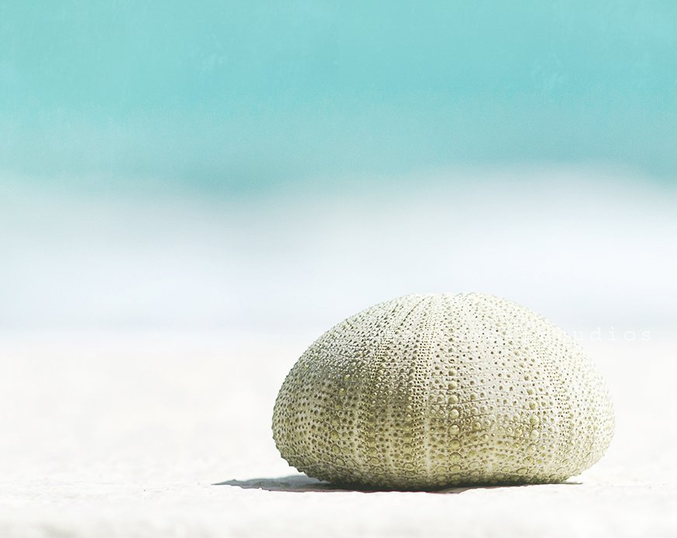
Thank You !

