Slide 1

WORKSHOP ON ABANDONED MINES: Moulay Ismail University of Meknes, Morocco and the Institute for Research and Development (IRD), France. .
CHARACTERIZATION AND ENVIRONMENTAL RISK ASSESSEMENT OF ABANDONED MINES IN PARTS OF NIGERIA
PRESENTED
BY
Therese Nganje
UNIVERSITY OF CALABAR,NIGERIA
SEPTEMBER 2019

Slide 2
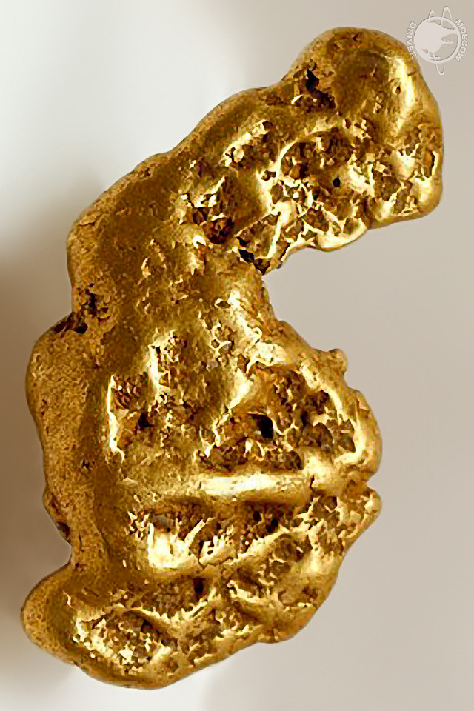
OUTLINE
Introduction
Nigeria’s mineral endowment and
potentials.
Brief history of mining in Nigeria.
Characteristics and management of
of the abandoned mines.
Environmental investigation, degree
of contamination and risk assessment
Conclusion/management strategies

Slide 3
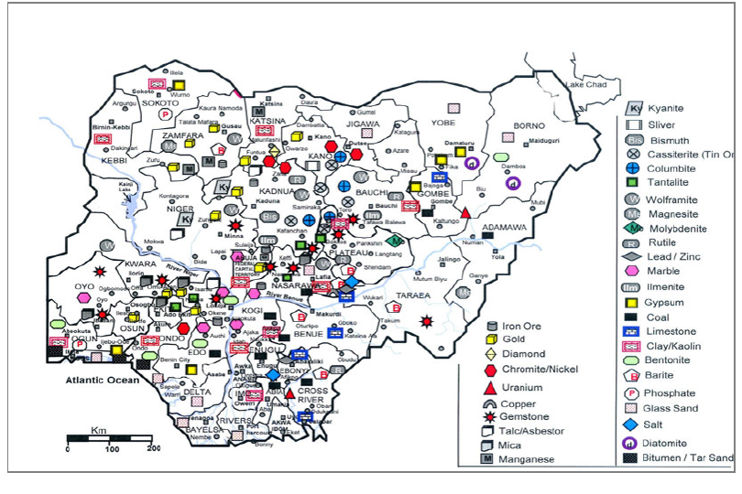
NIGERIA’S MINERAL ENDOWMENT AND POTENTIALS
Fig 1: NIGERIA’S Ministry of Mines and steel development (2011)

Slide 4
Fig 2: Location map of some abandoned mines in Nigeria

Slide 5
BRIEF HISTORY OF MINING IN NIGERIA
History of mining in Nigeria
Before 1960 Tin and Columbite contributed >30% to Nigeria’s GDP.
In 2007 <0.16%
2019 <1%
Attributable to the discovery of Oil and Gas in 1963

Slide 6
Table 1: Brief history of mining in Nigeria
S/N | Mineral type | Associated ore/mineral | Year of discovery | Year mining started/mining method | Production history | Production in Tons | Source/Reference
1 | Coal Coal | Sub-bituminous, Anthracite, Bituminous, Lignite | 1909 | 1916 Underground/open cast | 1950 -1959 1966-1970 1971- 1972 1973-1981 1982 2001 | 583,487 -905,397 No production 126,830 - 282,290 282,290 – 144,779 83,936 2,712 | Idris et al 2016, NGSAMMSD(2008), Ministry of mines and power, Lagos () Amoniyi 1977, Akande et 1992 1992
2 | Iron ore |  |  |  |  |  | MMSD 2008
3 | Gold |  |  | 1912 - 1914 | 1933 -1943 1945 1966 -1970 | 1.4t Production declined No production | NGSA 2008, MMSD 2011, Dept. of Geology UNICAL 1989, Waziri 2014
4 | Lead-Zinc | Galena, Sphalerite, siderite, Fluorite, Baryte, quartz, calcite | Mid 19^{t} ^{h}century | 1885 1925 | 1924 -1932 1947 1966 -1970 | 1,000 Commercial production No production | Kogbe 1989, Dept. of Geology. UNICAL 1989 Umeji 2000, MMSD 2011
5 | Tin | Niobium, Tantalum, Colunbite |  | 1904 | 1904 -1914 1900 1925 1943 1926 1950 1966 1970 1971 -1983 | 1.36 - 5573 2.6% of world’s production 15,842 5.5 % of world’s total. No production 7,326 – 1,366 | Dept. of Geology, UNICAL 1989 IMM Transactions, Maleri Smelting company Nzallo 2012
6 | Barite |  | 1952 | Open pit and cast | 1996- 2008 | 17928 - 1494 | Dept. of Geology, UNICAL 1989, Adamu et al 2015

Slide 7
CHARACTERISTICS OF ABANDONED MINES IN NIGERIA
REASONS FOR ABANDONING THE MINES;
Lack of funds
Exhaustion of reserves
Flooding
War
Economic problem
Decline in production
CHARACTERISTICS OF ABANDONED MINES IN NIGERIA
positive and negative impacts on the environment
Positive Impacts:
Artificial lakes used for fishing and recreation
Used for irrigation,sand mining, domestic source of water

Slide 8
CHARACTERISTICS OF ABANDONED MINES IN NIGERIA (Cont’d)
Fig 4: Rayfield tin mine pond used as a resort in Jos for boat cruising

Slide 9
Table 2: Characteristics of the abandoned mines in southeastern Nigeria
Name/mine type | Basin/Mine | Formation | Site lithology | Current status | Reason for abandonment | Main feature | Environmental Impact | Source/Reference
Coal | Anambra Basin | Mamu | shale | abandoned | War and conflict, Lack of funds and reserves | Water from tunnel are used for domestic purposes, Mine spoil/waste, mine tunnel still visible | Acid Mine Drainage, Soil, sediment, Surface and underground water contamination | Omotehinse &Ako 2019, Nganje et al 2014, 2011 &2010, Ezeigbo and Ezeanyim 1993,
Gold | Oban massif |  |  | Abandoned | World war 11 and civil war | Mine pits within farmlands/grazing land. | Soil, stream sediment | Dept of Geology, UNICAL 1989
Lead - Zinc | Enyinba Pb-Zn district, Gabu & Alifokpa | Asu River Eze-Aku | Shale Shale | Dormant/ abandoned Abandoned | Flooding of mine pits, war and conflict | Located with residential area, pond is deep and constitute hazard risk in the area. Children swim in ponds, scavenge for ore from the abundant tailings, mine dumps, dangerous for humans and animals | Acid Mine Drainage, Groundwater and surface water soil, food crops | Obiora et al 2019 2018 & 2016, Nnabo &Ajadi 2017 Nnabo 2015 a, b, c,d,e. f, Department of Geology, UniCAL 1989
Tin | Oban massif |  | Pegmatite | Abandoned |  | Steam engine crusher, Mine shaft, still visible |  | Dept of Geology, UNICAL 1989
Barite | Oban massif and Mamfe embayment. | Mamfe Eze-Aku Basemet | Sandstone Shale Schist/Gneiss | Abandoned | Exhaustion of deposit, Flooding of mine pits | Abandoned mine spoils and pits | Acid Mine Drainage, surface water, soil and sediment contamination | Adamu et al 2015

Slide 10
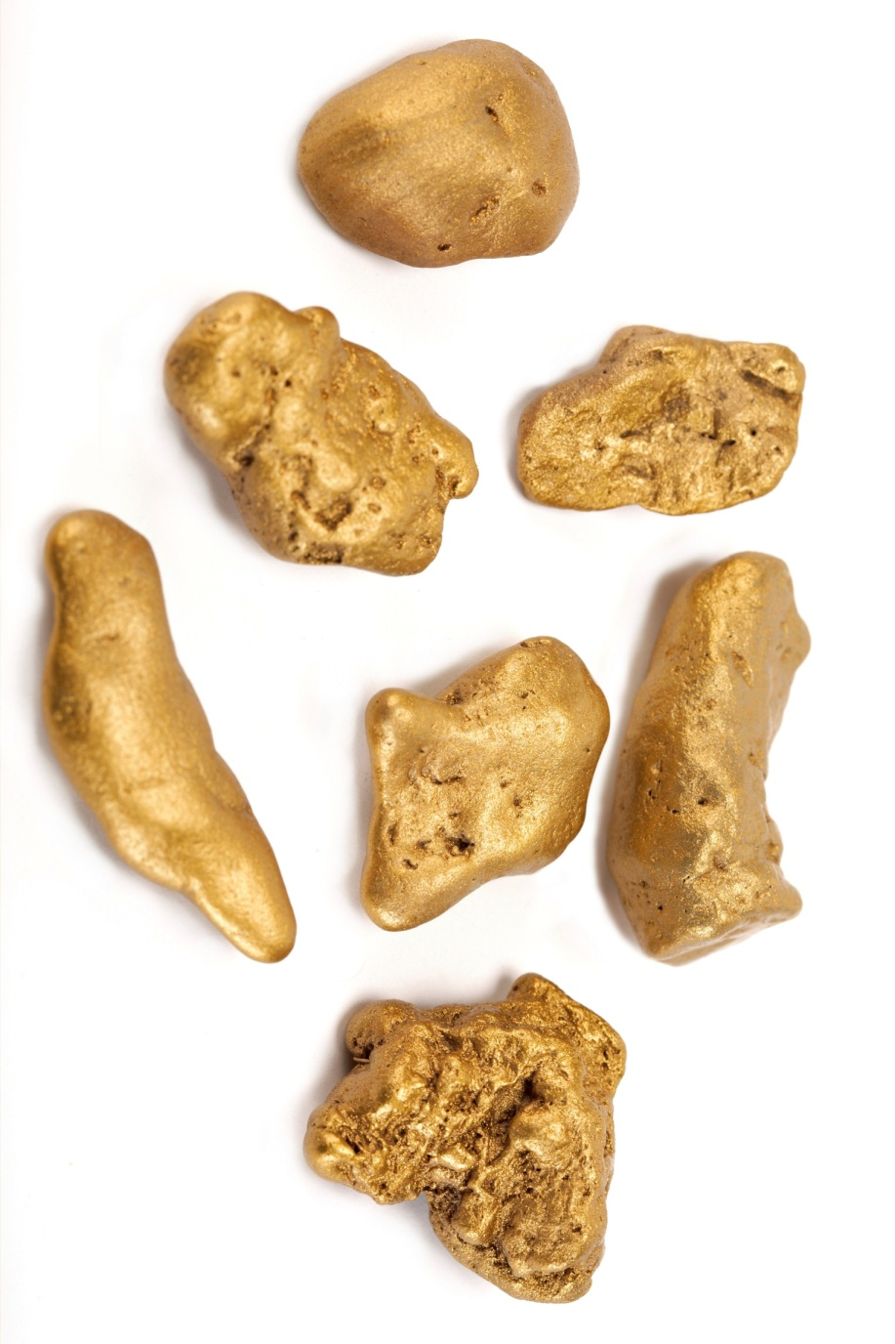
CHARACTERISTICS OF ABANDONED MINES(Cont’d)
Negative impacts:
Toxic elements in soil,surface and groundwater.
Uptake of toxic element by plants
Death traps

Slide 11
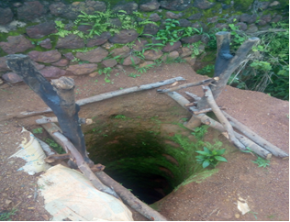
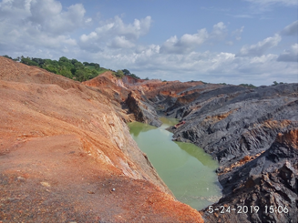
A
B
Fig 5:(a) Exposed abandoned Tin mine pit, Jos (b) Flooded Galena pit at Ameka, Ebonyi State

Slide 12
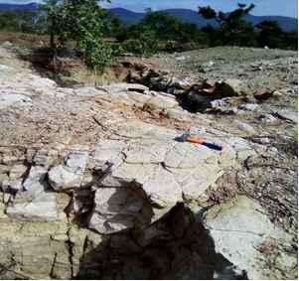
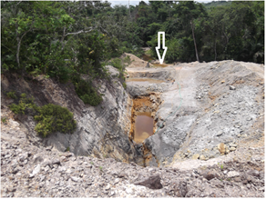
B
A
Fig. 6: (a) Abandoned Pb-Zn mine near Ruga village, Taraba state (b) Flooded Barite/galena pit at Nde,Ikom discharging mine water into adjacent stream through the vein (indicated with an arrow)

Slide 13
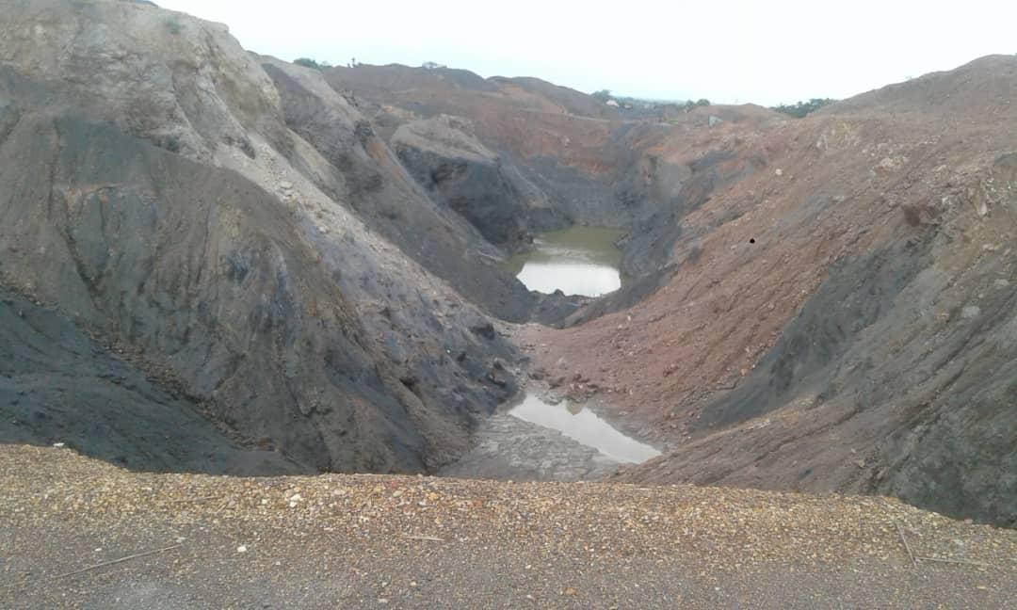
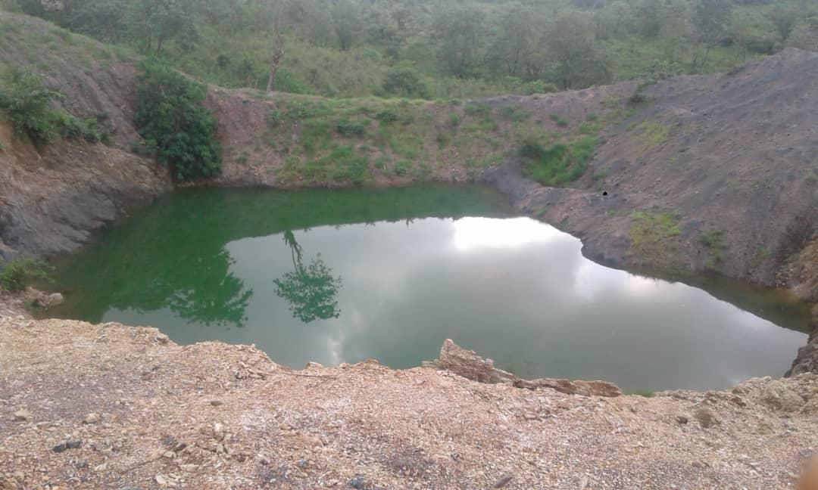
A
B
Fig 7: (a) Abandoned Pb-Zn mines in Ameka and (b) in Ohaukwu,Abakaliki, Ebonyi State

Slide 14
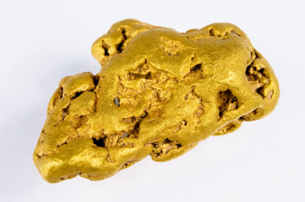
CASE EXAMPLES: CONTAMINATION AND RISK ASSESSMENT
Table 3: Mean values of trace element (mg/l) for pond and stream water for various barite mine site in Cross river state.
Location | As | Ba | Fe | Hg | Mn | Ni | Pb | Zn
Nde | 0.14 | 1.03 | 0.02 | 0.363 | 0.18 | 0.02 | 1.03 | 0.60
Alese | 0.18 | 0.01 | 0.05 | 0.138 | 0.18 | 0.02 | 0.14 | 0.05
Okumeritet | 0.17 | 0.00 | 0.14 | 0.069 | 0.06 | 0.00 | 0.08 | 0.07
Iyametet | 0.35 | 0.01 | 0.29 | 0.035 | 0.35 | 0.01 | 0.04 | 0.04
Akpet | 0.00 | 0.43 | 1.31 | 0.013 | 0.09 | 0.00 | 0.01 | 0.25
Ibogo | 0.12 | 0.09 | 0.02 | 0.266 | 0.10 | 0.00 | 0.01 | 0.28
SON 2007 | 0.01 | 0.7 | 0.3 | 0.001 | 0.4 | 0.02 | 0.01 | 3
Source: Adamu et al .,(2013)

Slide 15
Degree of contamination, ecological and human health risk assessment
C_{d} = ∑ Ci surface/ Ci reference
Where:Ci surface is concentration of metals in soil
Ci Reference background conc. of metals in study area
C_{d} < 05 Low contamination
05 > C_{d} < 10 Moderate contamination
10 > C_{d} < 20 Considerable contamination
C_{d} > 20 High contamination

Slide 16
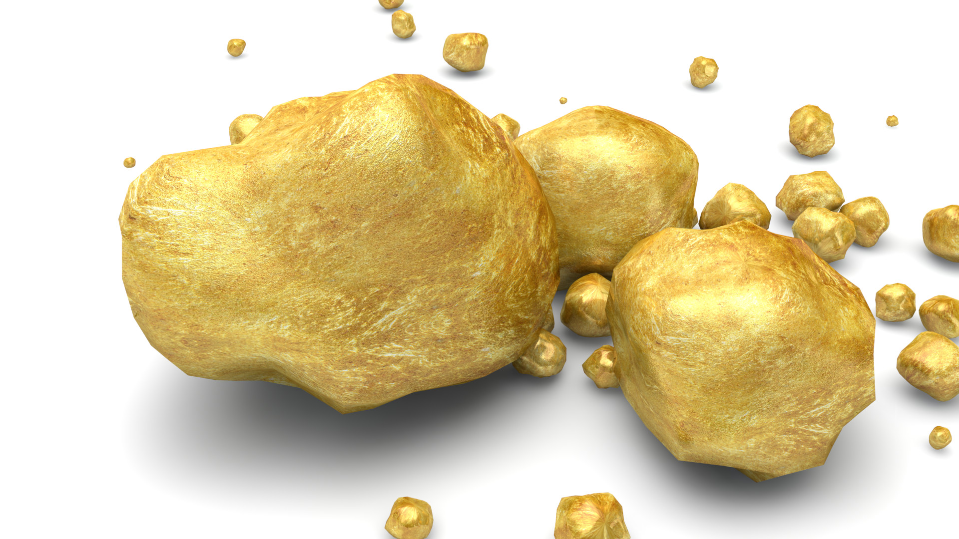
Table 4: Mean concentration (mg/kg) of trace metal in agricultural soils within the vicinity of the Barite and Pb-Zn mine sites in cross river state
Location | As | Cd | Cr | Cu | Ni | Pb | Zn
Nde | 204 | 0.00125 | 60 | 134 | 94 | 577 | 387
Alese | 327 | 0 | 98 | 183 | 41 | 394 | 341
Okumeretet | 199 | 0.0125 | 69 | 271 | 57 | 408 | 302
Iyametet | 176 | 0.005 | 75 | 281 | 55 | 473 | 305
Ekukunela | 137 | 0.0005 | 64 | 151 | 50 | 201 | 282
Akpet 1 | 206 | 0.005 | 74 | 231 | 63 | 287 | 419
Ibogo | 145 | 0.00125 | 69 | 173 | 79 | 334 | 458
control | 20 | 0.005 | 85 | 26 | 40 | 50 | 79
Ameka (Pb-Zn) | 14 | 1.85 | 51 | 120 | 16 | 812 | 283
Value considered toxic | 20 | 0 - 8 | 75 - 100 | 60 - 125 | 100 | 100 - 400 | 70 - 400
Adamu et al.,2013

Slide 17
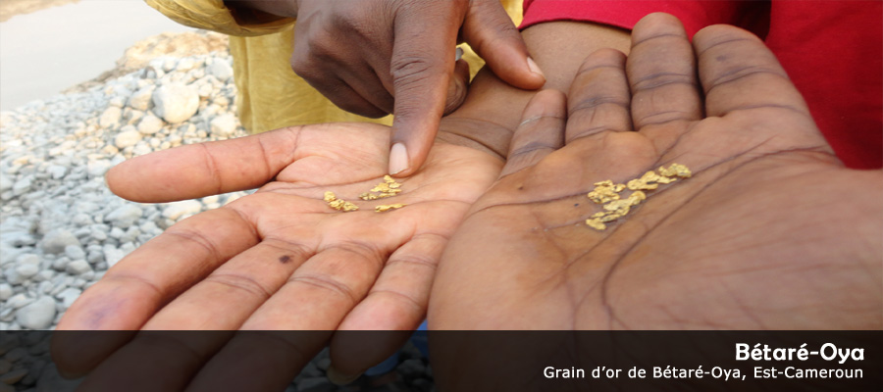
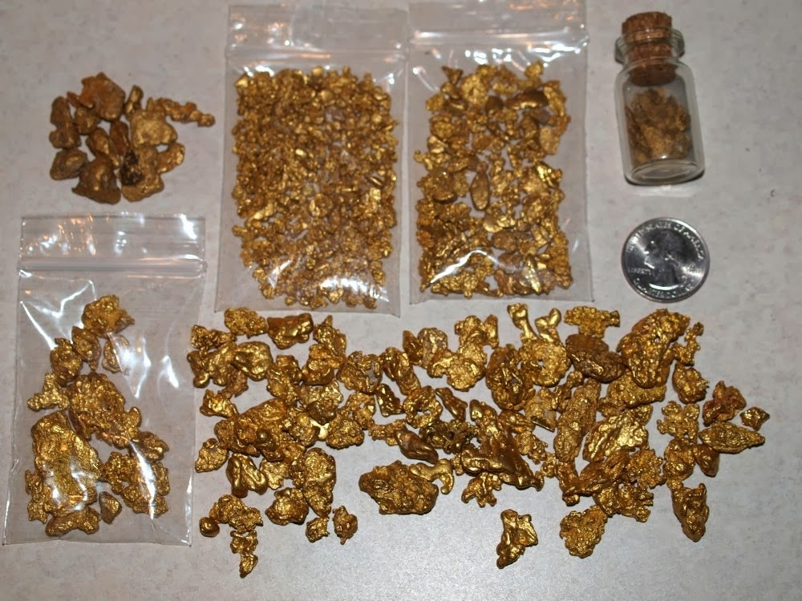
Table 5: Mean concentration (mg/kg) of trace elements in some edible crop plants
Element |  | As | Cr | Cu | Ni | Pb | Zn
Tuber | Mean | 0.37 | 3.24 | 6.28 | 0.98 | 1.47 | 28.69
 | SD | 0.29 | 5.00 | 5.78 | 0.91 | 1.61 | 11.93
Stem | Mean | 0.68 | 0.09 | 16.58 | 0.85 | 0.79 | 14.01
 | SD | 0.06 | 1.24 | 0.35 | 0.05 | 0.10 | 11.85
Fruit | Mean | 0.85 | 2.58 | 24.64 | 2.60 | 11.69 | 111.70
 | SD | 0.31 | 2.57 | 8.26 | 0.48 | 0.76 | 1.23
Leafy vegetable | Mean | 1.30 | 4.07 | 30.20 | 1.81 | 7.77 | 91.78
 | SD | 1.73 | 8.90 | 38.24 | 1.57 | 10.68 | 58.58
Tolerable level | A | 0.00 - 1.5 |  | 5.0 - 300 | 0.1 - 37 | 5.0 - 100 | 27 - 150
 | B |  |  | 10 | 02* | 2 | 50*
Source: Ikpi et al.,(In press)

Slide 18
Table 6:Degree(C_{d}) of contamination on case areas
Mine | Location | Depth (cm) |  |  | Remarks
 |  | 0-15 | 15-30 | Average
Barite | Nde | 33.1 | 32.6 | 32.8 | High contamination
 | Alese | 30.3 | 47.5 | 38.9 | High contamination
 | Okumeretet | 41.1 | 29.9 | 35.5 | High contamination
 | Iyametet | 32.7 | 31.7 | 32.2 | High contamination
 | Ekukunela | 25.9 | 21.2 | 23.5 | High contamination
 | Akpet 1 | 40.9 | 27.2 | 34.1 | High contamination
 | Ibogo | 33.6 | 24.6 | 29.1 | High contamination
Pb-Zn | Ameka | 41.7 | 21.5 | 31.6 | High contamination
 | Ohawuku | 27.1 | 7.4 | 17.3 | Considerable contamination
Source: Nganje et al.,in Press

Slide 19
Table 7: Ecological Risk Index (RI) and class of individual trace metals on case areas
Metal | Barite mines |  |  |  | Pb-Zn mine
 | 0-15cm | 15-30cm | Average | Class | Ameka | Ohawuku | Average | Class
As | 603.7 | 761.4 | 682.5 | Very high risk | 30.9 | 39.6 | 35.3 | Low risk
Cd | 220.5 | 0.0 | 110.3 | Low risk | 5.6 | 47.0 | 26.3 | Low risk
Cr | 10.3 | 14.3 | 12.3 | Low risk | 2.3 | 3.6 | 2.9 | Low risk
Cu | 288.0 | 259.8 | 273.9 | Moderate risk | 4.5 | 14.8 | 9.6 | Low risk
Ni | 95.8 | 57.5 | 76.6 | Low risk | 7.4 | 10.8 | 9.1 | Low risk
Pb | 312.0 | 196.4 | 254.2 | Moderate risk | 47.8 | 132.2 | 90.0 | Low risk
Zn | 34.1 | 28.9 | 31.5 | Low risk | 10.8 | 29.9 | 20.3 | Low risk
Source: Nganje et al., in press

Slide 20
Table 8: Non-carcinogenic risk (hazard quotient, HQ), overall toxic risk (hazard index, HI) and carcinogenic risk (ADDlife x SF)
Source | Location | HQ |  |  |  |  | HI = ΣHQ | ADDI_{Life} X SF
 |  | As | Hg | Ni | Pb | Zn
Pond | Nde | 0.108 | 1.129 | 0.027 | 18.210 | 0.108 | 19.582 | 0.072
 | Alese | 0.376 | 0.592 | 0.031 | 0.277 | 0.022 | 1.297 | 0.251
 | Okumeritet |  | 0.323 | 0.592 | 0.004 | 1.153 | 0.010 | 2.081
 | Iyametet | 0.054 | 5.916 | 0.040 | 5.025 | 0.005 | 11.039 | 0.036
 | Akpet | 1.000 | 0.645 | 2.205 | 0.006 | 0.138 | 0.051 | 3.046
 | Ibogo | 0.000 | 1.076 | 0.004 | 0.277 | 0.047 | 1.404 | 0.000
Stream | Nde | 0.766 | 3.698 | 0.004 | 0.184 | 0.020 | 4.673 | 0.511
 | Alese | 0.134 | 0.229 | 0.003 | 0.726 | 0.008 | 1.101 | 0.090
 | Okumeritet |  | 0.188 | 0.229 | 0.005 | 1.337 | 0.005 | 1.763
 | Iyametet | 0.175 | 0.215 | 0.003 | 0.277 | 0.003 | 0.673 | 0.117
 | Akpet | 1.000 | 0.094 | 0.403 | 0.002 | 0.067 | 0.003 | 0.569
 | Ibogo |  | 0.134 | 8.202 | 0.002 | 0.066 | 0.004 | 8.409
Statistics | Max | 1.000 | 5.916 | 8.202 | 18.210 | 1.337 | 19.582 | 8.409
 | Min | 0.000 | 0.094 | 0.003 | 0.002 | 0.003 | 0.003 | 0.000
 | Mean | 0.401 | 1.187 | 0.979 | 2.083 | 0.248 | 3.320 | 1.412
 | SD | 0.409 | 1.790 | 2.359 | 5.271 | 0.469 | 6.032 | 2.415
Source:Adamu et al.,2013

Slide 21
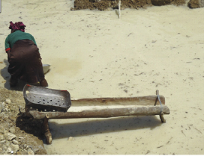
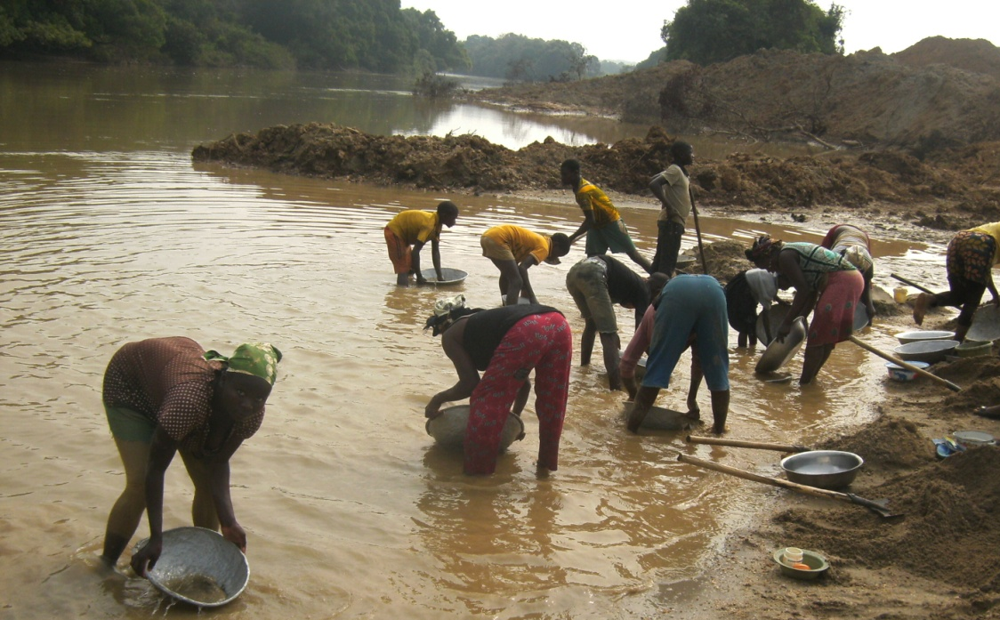
CONCLUSION:
Mines are abandoned
Environmental degradation
Negative effects on plants,
animals and humans
Need for treatment and reclamation

Slide 22
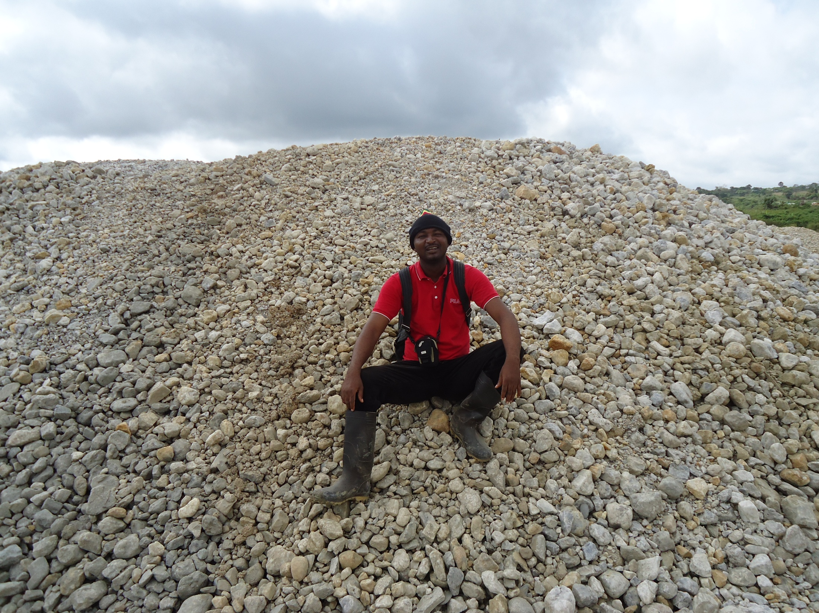
THANK YOU

