Slide 2
Contents
Aim
Introduction
Methodology
Results and Discussion
Conclusion
Acknowledgements

Slide 3
Aim
Production of value added products from sugarcane bagasse(SCB)
Glucose is a green precursor for chemicals and fuels.
Acid and alkali Pre-treatment (Extraction of cellulose from SCB)
Optimization of enzyme dose, surfactant concentration and substrate consistency
Characterisation of raw bagasse and acid/alkali pre-treated bagasse
Objectives

Slide 4
Introduction
Lignocellulosic materials are renewable feedstock comprising of a wide variety of agricultural residues, forest products and dedicated crops etc. Amongst all sugarcane bagasse, an agriculture residue, possesses a high potential for the conversion to biofuels and is one of the most important agro-industrial crops produced abundantly in South Africa.
Sugarcane is mainly used for sugar and alcohol production, sugarcane stems are milled to obtain the cane juice, which is used for sugar production.
The residual fraction that is left after the extraction of juice is called sugarcane bagasse (SCB). The SCB consists of components such as: cellulose, lignin, hemicellulose, ash, etc.
The sugarcane bagasse in which the pith is removed is called depithed bagasse

Slide 5
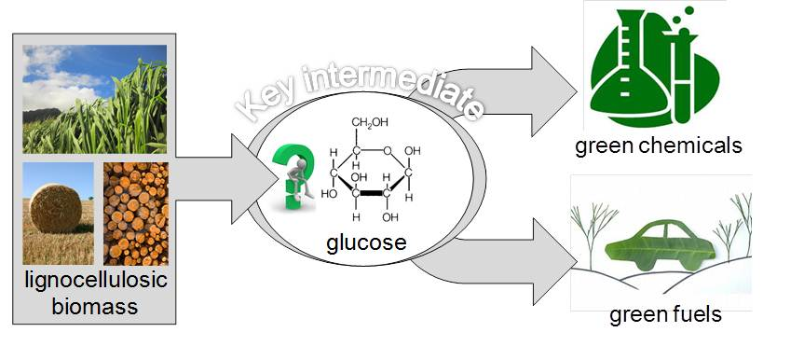
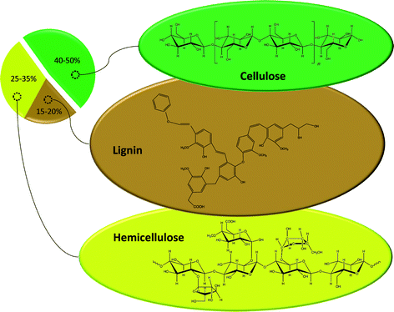
Sugarcane bagasse (SB)
[1] Joseph Zakzeski, Ruud J. H. Grisel, Arjan T. Smit, and Bert M. Weckhuysen, Solid acid-catalyzed cellulose hydrolysis as monitored by in-situ ATR-IR spectroscopy, ChemSusChem, 5, 430-437, 2012
[2] David Martin Alonso , Jesse Q. Bond and James A. Dumesic. Catalytic conversion of biomass to biofuels, 12, 1493-1513, 2010

Slide 6
Introduction
These components of lignocellulosic biomass forms a very complex structure to provide it resistance from chemical and/or microbial degradation. By virtue of this strong packaging of the biomass structural polymers, an effective pre-treatment method is required to break the lignin and hemicellulose seal and to expose the cellulose for hydrolysis [3]
Pre-treatments methods can be classified into different categories namely physical, physiochemical, chemical, biological and electrical and they differ in their mechanism of action [4]
[3] Manzoor, A., Khokhar, Z., Hussain, A., Uzma, Ahmad, A., Syed, Q., and Baig, S. Dilute sulphuric acid: a cheap acid for optimization of bagasse pre-treatment Sci.Int. (Lahore), 24, 41-45, 2012.
[4] Kumar, P.; Barrett, D.M. Delwiche, M.J., & Stroeve, P. Methods for Pre-treatment of Lignocellulosic Biomass for Efficient Hydrolysis and Biofuel Production, Industrial & Engineering Chemistry Research, 48 , 3713-3729, 2009.

Slide 7
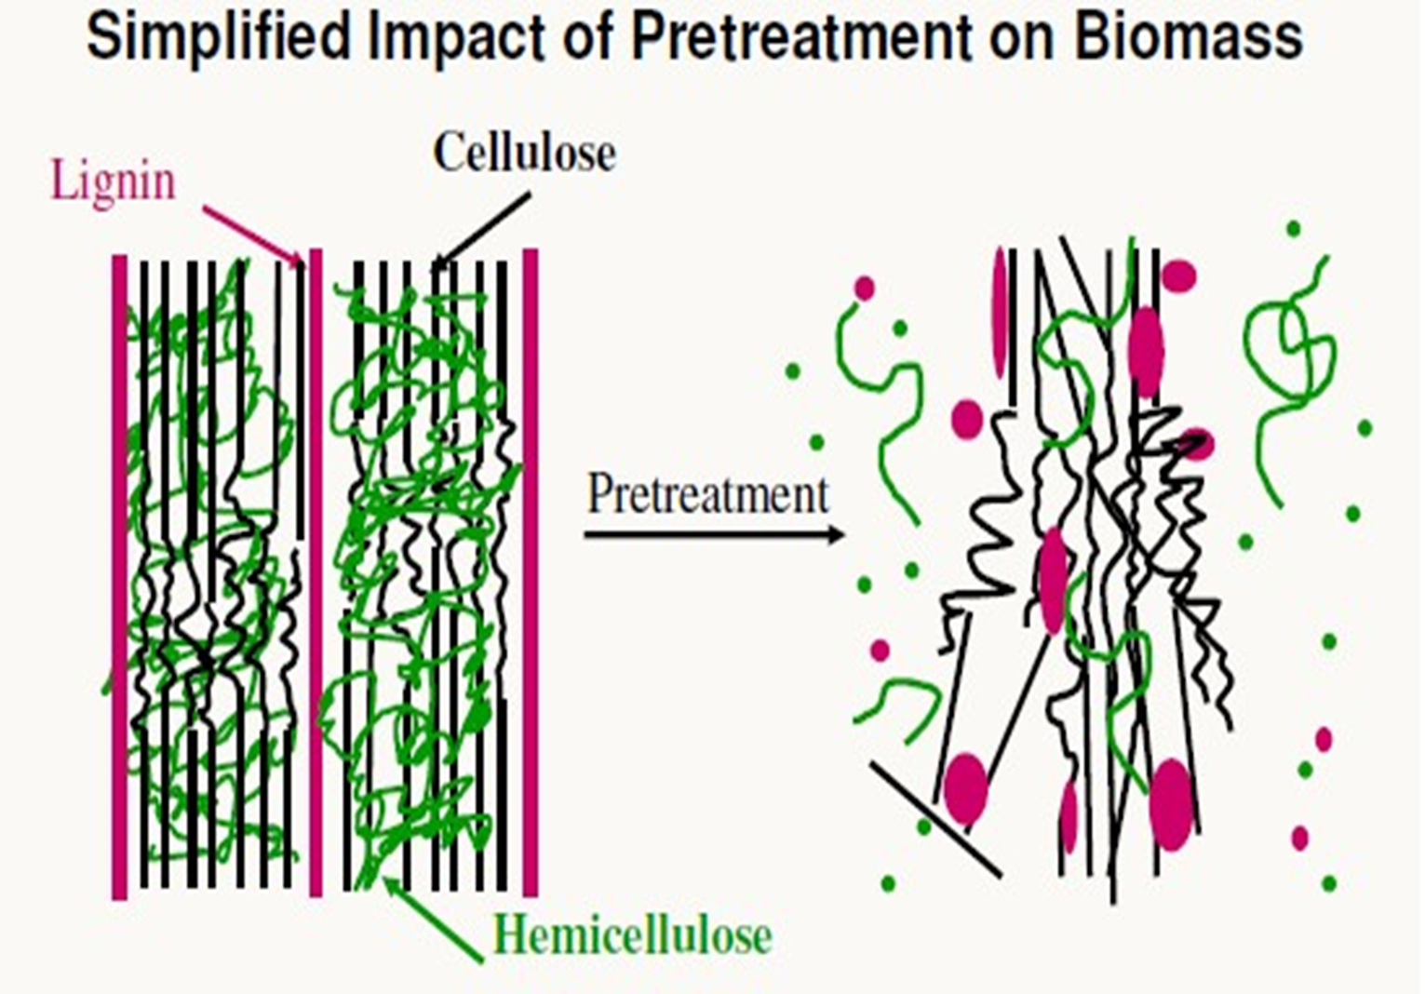
Acid/Alkali pre-treatment
Acid pre-treatment
Cellulignin ( solid residue) + Hemicellulose (liquid fraction)
SB
Alkali pre-treatment
Cellulose (solid residue) + Lignin ( liquid fraction)
Cellulignin

Slide 8
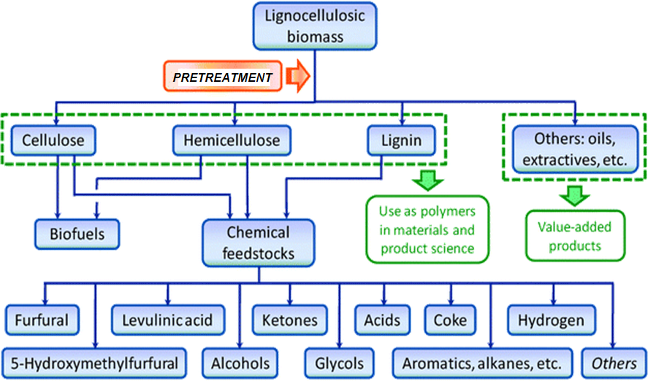
Possible products from lignocellulosic biomass
Source: Chem. Commun., 2011,47, 1405-1421

Slide 9
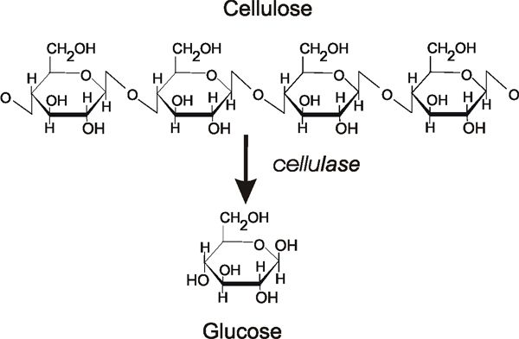
Enzymatic saccharification

Slide 10
Methodology
Chemicals
Sulphuric acid (98%)
Sodium hydroxide
Tween 80
3.5-Dinitrosalicylic acid (DNSA)
Citric acid buffer were purchased from Titan Biotech, India.
Cellulase was synthesized in-house using RCKC65 at University of Delhi, South Campus.
Preparation and compositional analysis of SCB
SCB was obtained from a local mill in Kwa-Zulu Natal, South Africa.
It was dried, ground and sieved to 40 mesh particle size.
The cellulose, hemicellulose, lignin, moisture, and ash contents of raw and pre-treated biomass were determined according to the method described by TAPPI (1992).
[5] TAPPI, “Technical association of pulp and paper industry,” Atlanta, Georgia, 1992.

Slide 11
Pre-treatment Method
Acid
3 % (v/v) sulphuric acid
30 minutes in an autoclave
121 °C
Alkali
4 % (w/v) sodium hydroxide
15 minutes in an autoclave
121 °C
Removal of Hemicellulose
Removal of Lignin

Slide 12
Optimization of conditions for enzymatic saccharification of SCB
Depith Sugarcane Bagasse
Enzyme dose (Cellulase)
10, 20, 30 and 40 fpu
(1g of SCB+ buffer + enzyme
Substrate consistency 10, 12, 14 and 16%
Cellulose SCB was saccharified using crude enzyme extract produced by fungal RBT strain (8 FPU/mL)
1g SCB+ 50 mM citrate buffer, pre-incubate at 50 ͦͦͦC, 150 rpm for 1 hr
Surfactant dose (Tween 80)
0.3, 0.4, 0.5, and 0.6 %
1g of SCB+ buffer + enzyme
Reaction time : 24 hrs
Sampling intervals: 8, 12, 16, 20 hrs
Samples withdrawn at 8 h, centrifuged at 12000 rpm for 10 min
Total reducing sugars was analysed in the hydrolysate by DNS method

Slide 13
Analysis of the reducing sugars
The DNS-reagent is used for the photometric measurement of reducing sugar concentration under alkaline conditions. The functional group, aldehyde in reducing sugars like glucose is oxidized to a carboxylic group. In parallel, 3,5-dinitrosalicylic acid is reduced to 3-amino-5-nitrosalicylic acid, which strongly absorbs light at 540 nm [6].
The DNS method detects the whole range of reducing sugars. The method consists of reading the absorption at 540 nm in a solution composed of the sample containing reducing sugars and DNS reagent. The intensity of the colour is transformed in mg of sugars using a standard curve.
At first, the hydrolysate samples are centrifuged at approximately 10000 rpm for 5 minutes. The supernatant is diluted in order to match the valid absorbance range of the applied UV-photometer.
[6] Miller G. L. Use of dinitrosalicylic acid reagent for determination of reducing sugar. Analytical Chemistry, 31, 426–428, 1959.

Slide 14
Results and Discussion
Table 1. Compositional analysis of raw and Pre-treated sugarcane bagasse
Bagasse Sample |  | Components (wt. %)
 |  | Cellulose | Hemicellulose | Lignin | Moisture | Ash
Depith | Raw | 55.0 | 10.2 | 31.0 | 6.3 | 6.1
 | Acid Pre-treated | 74.1 | 13.1 | 57.5 | 16.3 | 5.2
 | Acid/Alkali Pre-treated | 89.1 | 1.7 | 32.7 | 12.0 | 5.7

Slide 15
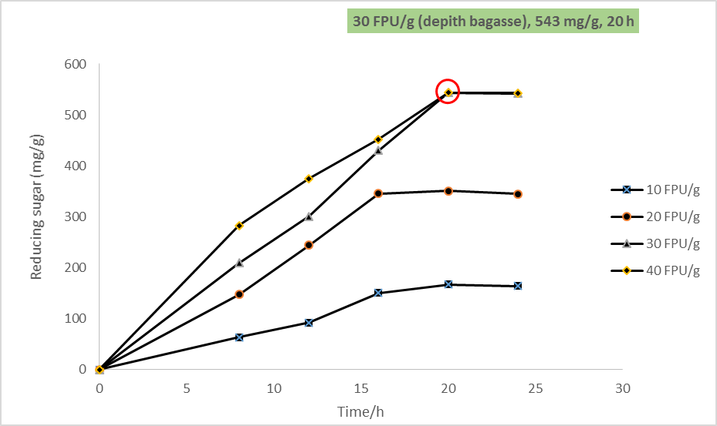
Optimization of enzyme dose and time for saccharification of pre-treated sugarcane bagasse

Slide 16
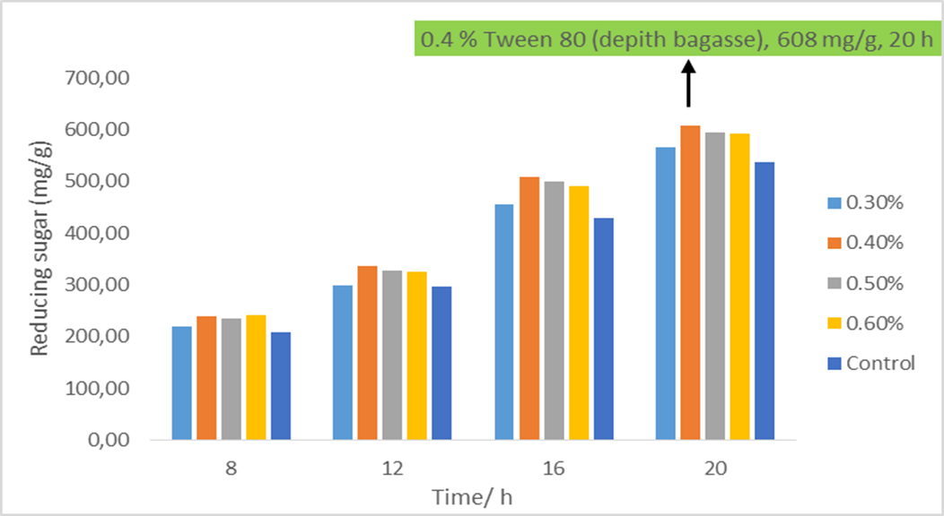
Optimization of surfactant dose and time for the saccharification of pre-treated sugarcane bagasse

Slide 17
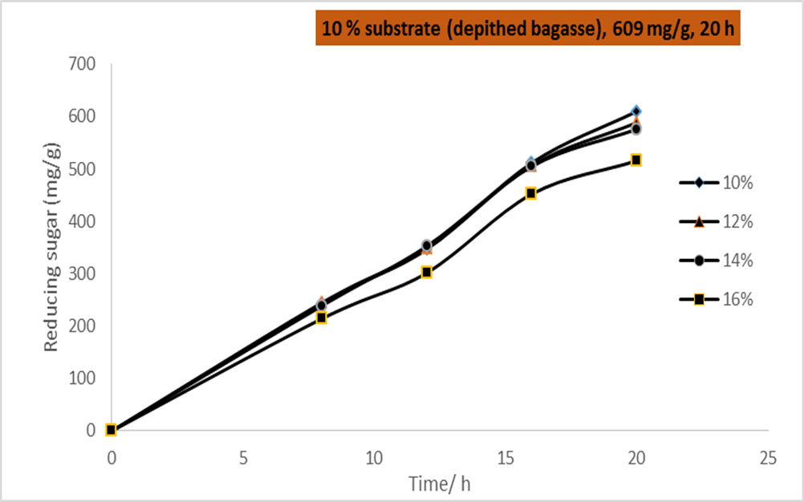
Optimization of substrate consistency

Slide 18
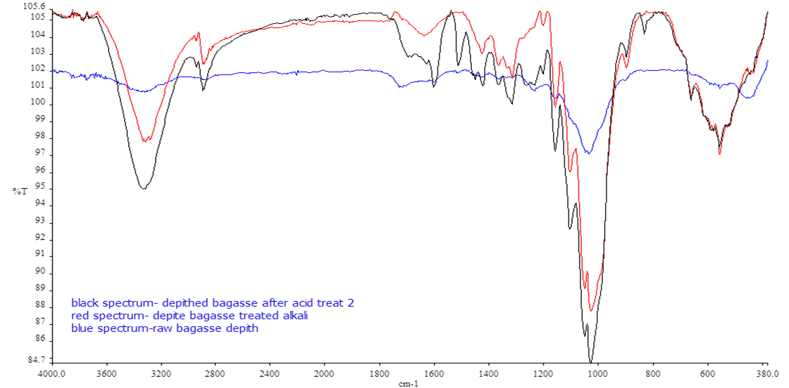
FTIR Analysis
C-C
C=O
O-H
C-O-C
C=O

Slide 19
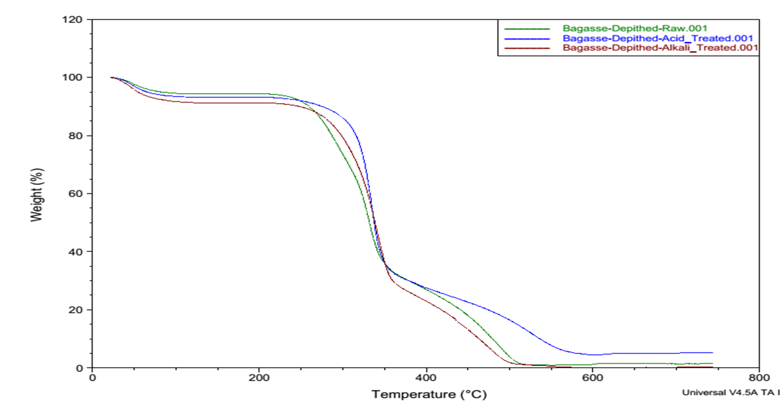
TGA Analysis
30 and 100 ͦC Weight loss due to evaporation of residual water
150-350 ͦC Weight loss due to decomposition of holocellulose
350-520 ͦC degradation of lignin

Slide 20
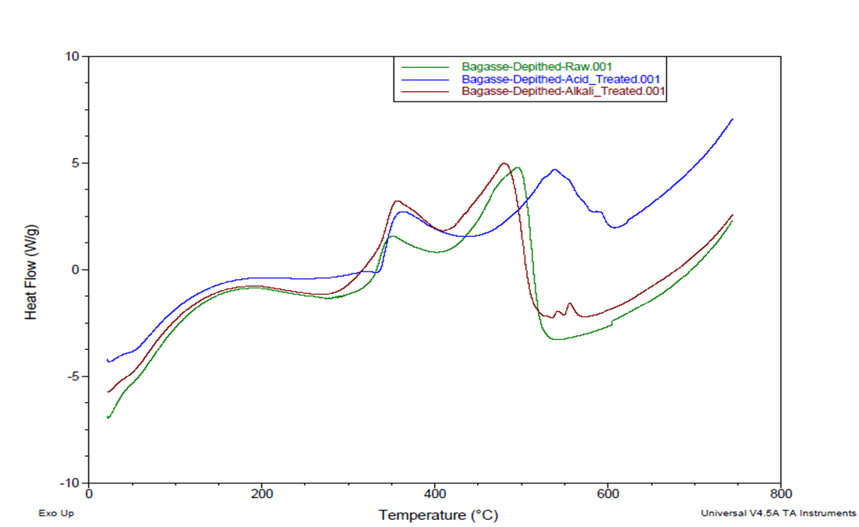
DSC Analysis
Exothermic peak at 100 ͦC is due to the removal of moisture when the sample was heated.
The exothermic peaks that appear at 350 and 400 ͦC are attributed to charring [7].
[7] Yang, H. P., Yan, R., Chen, H. P., Lee, D. H. and Zheng, C. G. (2007). Characteristics of hemicellulose, cellulose and lignin pyrolysis. Fuel, 86 (12), 1781 -1788

Slide 21
SEM ANALYSIS
Raw bagasse is compact, rough and it has a thick-walled fiber cells
Acid pre-treatment remove hemicellulose thus it separates the fibers disrupting the cell wall
Alkali pre-treatment remove lignin from cellulignin leaving cellulose and the surface of the substrate is smooth with the appearance of parallel sheaths
A
B
C
SEM scan for A) raw, B) acid treated and C) acid/alkali treated bagasse

Slide 22
Conclusion
The pre-treatment of the substrates with acid followed by alkali proved to be successful since the pore size increased as it can be seen in the SEM images. This led to the accessibility of the substrate to cellulase enzyme for hydrolysis.
The pre-treated substrate (10% w/v) when hydrolysed using 20 FPU/g with 0.4% Tween 80 for 20h resulted in 609 mg/g (depithed bagasse) sugars, being the best condition to use when compared with the other conditions.

Slide 23
Acknowledgements
I would like to thank the following people:
My supervisor, Prof N. Deenadayalu and Co-supervisor, Dr P. Reddy.
Amandeep Kaur and Prof R.C. Kuhad from the University of Delhi, India.
Thandeka Mkhize
Alpha and Omega
My Family
And NRF for funding this project.

Slide 24

Thank you for listening, Ngiyabonga

