Slide 1

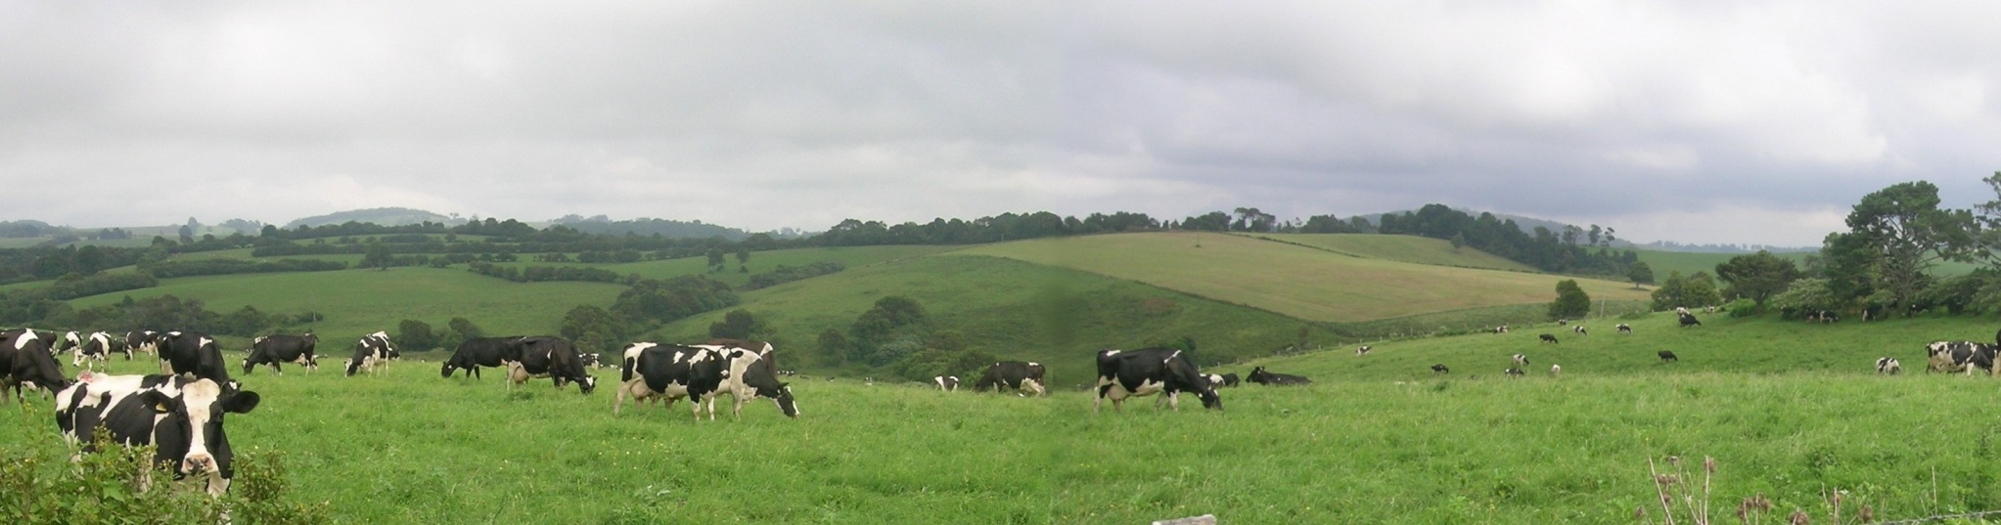
OVERVIEW ON Milking Hygiene and milk Quality IN EGYPT
By
Dr. Sherin kamal Genina
Researcher at Animal Production Research Institute
Egypt - 2013

Slide 2
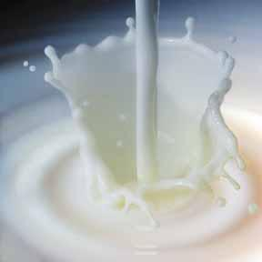
PHYSICAL DESCRIPTION
Animal production represent 33 % of the total agricultural products in Egypt.
Total livestock dairy animals is 8.5 million ( 4.7 cattle & 3.8 buffaloes, 2010).
Buffalo is the main dairy animal in Egypt and after that cattle.
Milk production per year is 5.6 million tons.
The contribution of buffalo to total milk production in Egypt is around 70 per cent

Slide 3
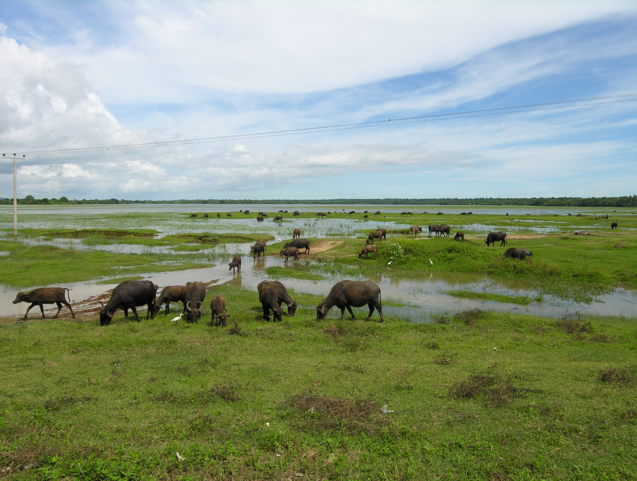

Slide 4
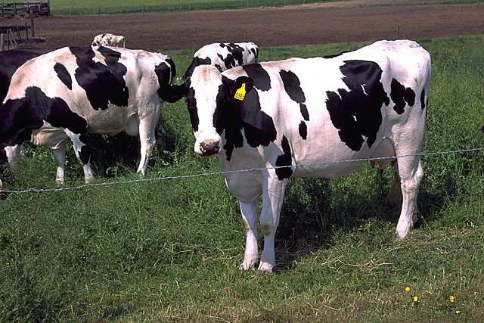
Holstein,Friesian and its crossbreds

Slide 5
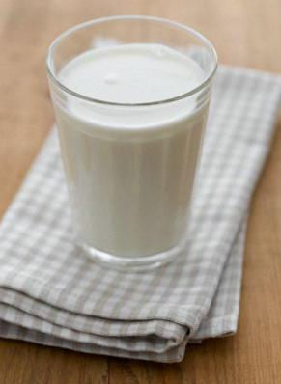
The definition of liquid milk:
Milk is a normal secretion of the mammary glands resulting from the milking due to a good feeding which does not increase the acidity of 0.16 - 0.17
From the above it is clear that the milk of the cow and buffalo are the major exporters of milk

Slide 6
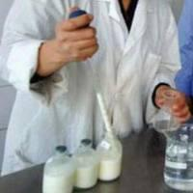
Tests performed on Raw Milk
Appearance : colour, smell,taste, temperature and dirty
Test density ,
The chemical tests conducted
Estimate the fat %,SNF% test
Acidity: alcohol test ,the clotting by boiling)
Cheats detection tests
Tests specific weight and % of fat and solids to detect cheating with water
Cheating filler substances and, Formalin, Boric acid (borax)
Adding substances antacid formula such as(carbonate and bicarbonate)
Cheating detection natural colored substances as Alanato

Slide 7
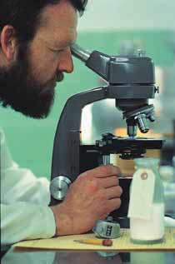
Microbiological tests on milk and milk products
Total bacterial count of milk
Total SCC in milk
The detection of coliform bacteria
Ecoli -Staphylococcus Aures
Detection of yeasts and fungi

Slide 8
Suggestions to eliminate the situation of cheating
Canceling the system of street vendors (small distributors) and not allowed to carry milk in tanks or distribution of milk
Continued expansion in the create of points and collection centers and the use of private cars equipped for cooling
Reconsider the traditional methods for estimating the price of milk, and not just on the basis of the % of fat only, but must be in addition to the assessment protein milk where the properties of milk bacteriological into account when estimating the price.
Expansion of control Labs for milk, and providing them with all the possibilities and applying modern methods of examination
Reconsider the laws and regulations of milk as appropriate types of milks.
Publicity work that explain to consumers the importance of getting non-cheating milk and the need to get milk from guaranteed sources licensed

Slide 9
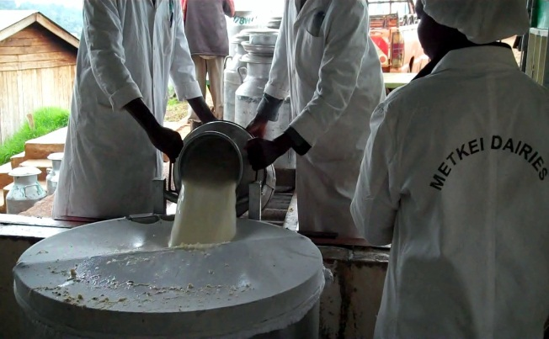
Milk Collection, Cooling
Filter milk
Fill in cans from stainless steel
Packing in milk tankers and fitted with large amounts coating heat-insulating
Milk Cooling:
Cooling in the production of small farms:
- Cover immediate cloth or wet canvas
- Put the tanks of milk in running water (possible, especially in the winter)
Putting pieces of ice in a metal box inside the sterile milk tank.
Non Mechanical refrigeration(Method of cement pools- the cooled surface ).
Cooling in the production of commercial farms Mechanical refrigeration
Cooled immediately to a temperature of 4 C has been stored on this class even manufacturing

Slide 10
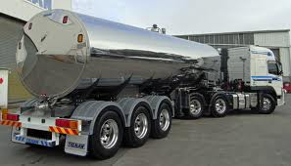
Milk Transfer
Transferred milk often in tanks or in tank cars Precautions 1-Cleaner transport containers - milk cooling at 40 F 2-Filling the tanks to the end to prevent appearance of butter pellets. 3-Test a quick way to save and prevent spoiling milk 4-Not be exposed transport containers to the sun and not opening.

Slide 11
Collection centers and cooling milk
Places that use to collect milk from small producers to facilitate the marketing of a good economic way
Stages of the work in the collection centers:
Collects the milk needed to run these centers:
The top producers supplied directly their milk for assembly center.
- The middlemen milk collection and also
, the cooperatives producers
Final preparation for milk

Slide 12
Work Steps collection centers
Arrival of milk ↓ Examination tanks ↓ Initial detection on the milk to a report accepted or rejected ↓ Sampling of milk to estimate the degree of quality and value ↓ Weight of milk ↓ Milk collection at the Reception tub ↓ Filter milk ↓ Cooling ↓ filling
↓ (In the transport Tanks ---- in Tanks --- the closet conservation) (Store keeping cool) ↓ To the factory

Slide 13
MILK MARKETING
From the producer directly to the consumer or to the factory or the middleman or collection point (wholesaler) and may transferred the milk directly to the reseller
Transportation from the middleman to wholesaler or consumer or factory or reseller
From the factory to the reseller
From the reseller to the consumer
from the wholesaler to the factory or reseller

Slide 14
MILK MARKETING
Producer Middleman
Consumer
Reseller Wholesaler
Factory

Slide 15
MILK Evaluation and PRICES
Selling on the basis of weight and volume and disadvantages of this method not to give importance to the milk and clean and its components and facilitates cheating
Selling on the basis of the amount of cream in milk
Selling on the basis of estimate the ratio of fat in milk in every 100 units in milk
Selling on the basis of the fat ratio and solid not fat in milk which are important for cheese processing

Slide 16
Quality Standard
The number of bacteria
The number of SCC
The presence of Antibiotics
The presence of dirt and smell
The presence of remains of Cleaners and any additions by seller
Acidity

Slide 17
Recommendations
Follow the hygiene used in the production of milk and get to know the different aspects of the default speed of treatment.
Select different levels of quality of milk on the basis of which is the price of milk
Tracking the health status of the herd animals and detect any cases of sick and isolated to protect the rest of the herd
Speed ​​detect any changes in the economic components of milk represented in the proportion of fat and solids not fat and knowledge of the reasons for it.
According to quality tests and accurately estimate the proportion of fat in diets accounts for feed herd animals.
Placed the results of the tests potential infection of some animal diseases and thus the marketing process must be stopped even be sure of that it free from infection.

Slide 18
Cont.
Making sure to provide a rapid means for cooling milk after milking during storage and transportation .
Permanent examination for the all parts of milking machines as (milk unit, linear rubber, milk tube, rubber joined stainless steel tank) with renew every 6 months and the other parts every year .
Daily cleaning and disinfection for all the parts of milking machines.
Making sure about modifying the pulsation level of the cups during milking.

Slide 19
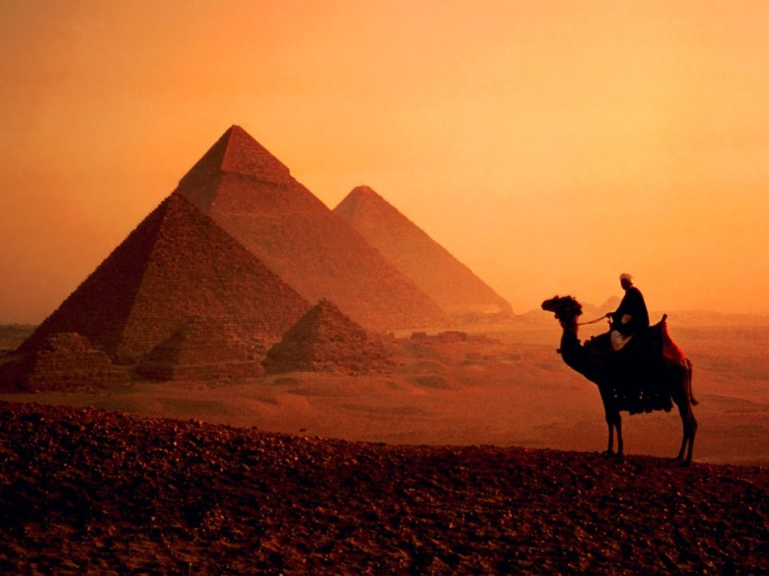

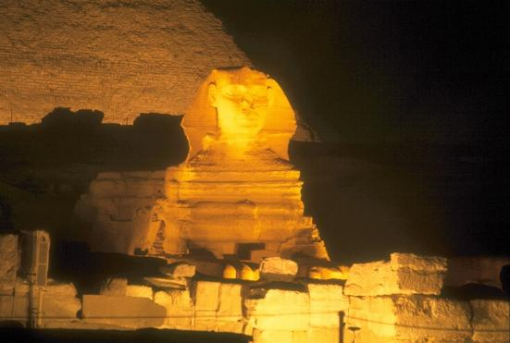
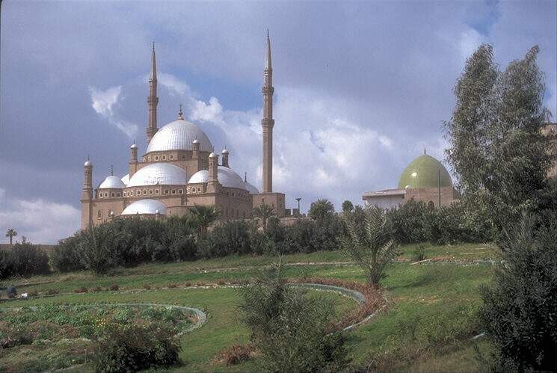
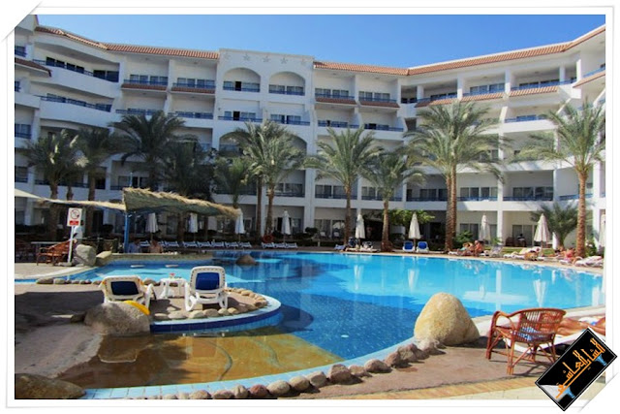
THANK YOU
Welcome to Egypt

