Slide 1
Production of Mushroom Based Food Condiment (Pleurotus Ostreatus)
BY
OKAFOR DAMARIS C
DEPARTMENT OF FOOD SCIENCE AND TECHNOLOGY
FEDERAL UNIVERSITY OF TECHNOLOGY OWERRI

Slide 2
MUSHROOM
Mushroom is a micro fungus with a distinctive fruiting body which can be either epigenous (appearing above the earth surface) or hypogenous (occurring below the surface) and large enough to be seen with the naked eyes and to be picked by the hand.

Slide 3
They are fungi that produce conspicuous fruit bodies.
The distinctiveness of mushroom steps in part, from the fact that it is not truly a vegetable, but a fungus- a plant that has neither roots nor leaves, that does not flower or bear seeds and that does not need light to grow (although some do need light to fruit). Instead, it proliferates in the dark and reproduces by releasing billions of spores.

Slide 4
  PREPARATION OF THE MUSHROOM BASED FOOD CONDIMENT
The mushrooms were dried at 80oc for 3 hours, ground, weighed and kept in an air tight container.
Onions were dried using an oven at 80oc for 3 hours to remove moisture and then ground using a manual blender.
The crayfish was also dried at 60oc for 1 hour and ground also using a manual blender.

Slide 5
The pepper was dried also at 70oc for 2 hours and then ground using a manual blender.
Salt and sugar were also weighed into another container.
Each ingredient except the mushroom were weighed accurately and mixed properly to form the base ingredients.

Slide 6
Then the base ingredients were divided into three different batches with three samples in each of the batches making it nine samples and weighed in different proportions (0%, 5%, 10%, 15%, 20%, 25%,30%, 35%, 40%,) to which mushrooms of different proportions (100%, 95%, 90%, 85%, 80%,75%, 70%, 65%, 60%) were also weighed and added to the nine different base ingredients and mixed properly.
They are coded as MW, MW1, MW2, MW3, MW4, MW5, MW6, MW7 and MW8.

Slide 7
Formulations of Mushroom based Food Condiment

Slide 8

Then from each of the nine mushroom condiments 2g is obtained and used in the preparation of pepper soup.

Slide 9
The ground dried mushroom and the spice ingredients were weighed and mixed at different ratios to obtain a mushroom based food condiment.
Composites of ground mushroom sample (P. ostreatus) and spice condiment was formulated. 100% of the mushroom sample was used as control. The ratios of the ground mushroom to the spice ingredients.

Slide 10
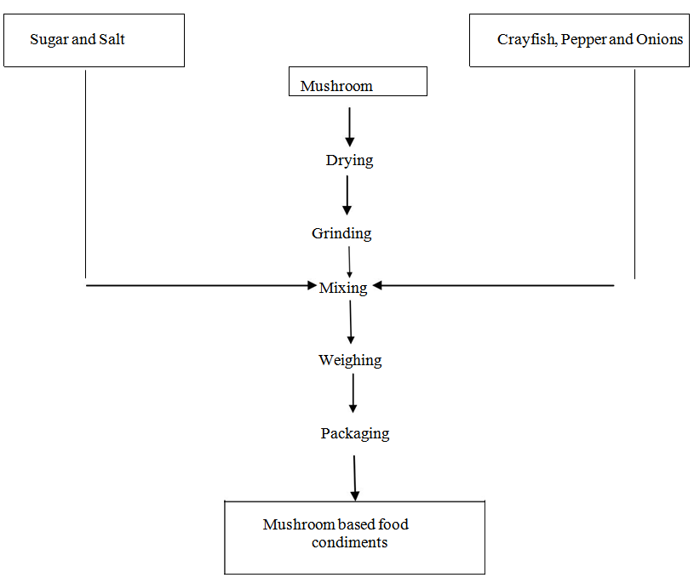
Flow chart for the production of mushroom based food condiment is shown above.

Slide 11
.
Sensory evaluation of the various mushroom based food condiment samples was done by a 15-man panelist.
The analysis carried out by the panelist scores for taste of the mushroom based food condiment samples showed a significant difference (p≤0.05).

Slide 12
The taste score of the different mushroom based food condiment samples ranged from 8.80 to 5.20 with MW (100% mushroom and 0% spice) having the lowest score of 5.20.
MW8 (60% mushroom and 40% spice) having the highest score of 8.80 indicating that the panelists liked the taste of the product very much.

Slide 13
This might be due to high spice content of 40% and low mushroom content of 60% in MW8. MW having the least score of 5.20 indicates that the panelist liked the score least.
This might be attributed to the fact that only coarse ground mushroom was used in the preparation of the mushroom based food condiment.

Slide 14
MW8 (60% mushroom and 40% spice) , MW7 (65% mushroom and 35% spice) and MW6 (70% mushroom and 30%) were not significant different (p≤0.05).
MW2 (90% mushroom and 10% spice) was significantly different (p>0.05) from other samples.

Slide 15
The scores for aroma ranged from 8.467 to 4.800. MW had the highest score of 8.467 and it was significantly different (p>0.05) from the rest of the samples.
MW7 had the least score of 4.800 and was not significantly different from MW5 (75% mushroom and 25% spice), MW6 and MW8

Slide 16
MW had the highest score for aroma and this is due to the flavor impacted by the mushroom since MW which was the control had 100% mushroom.
MW7 and MW8 had the least mushroom composition of 60%.

Slide 17
For mouthfeel analysis, MW5 had the highest score of 8.400 while MW had the least score of 5.067. This signifies that MW5 was best accepted by the panelists and MW was least liked among the samples.
The low ratings for MW may also be due to the coarse ground mushroom sample (larger particle size).

Slide 18
MW5, MW6, MW7, MW8 were not significantly different (p≤0.05) in the scores of the mouth feel.
For overall acceptability, MW4 (80% mushroom and 20% spice) was the most preferred among the panelist with a score rating of 8.267, while MW had the least score rating of 5.533 and was the least preferred.

Slide 19
All the samples however scored above 5.0 in all parameters assessed except samples MW7 and MW8 that scored 4.800 and 4.867 respectively in aroma. The high scores of the samples showed that all the samples had a good acceptance by the panelist.

Slide 20
Conclusion and Recommendation
The different mushroom samples were generally accepted among the panelists but the most preferred is the 80% mushroom and 20% base ingredient aka spice.
I recommend that more research work be carried out on the nutritional, medicinal and anti-nutritional properties of not just Pleurotus ostreatus but on other mushroom species.

Slide 21
People should also be more enlightened on the numerous nutritional benefits as well as the medicinal properties of Pleurotus ostreatus as well as other mushroom species.
This would help low income families which could make use of the mushroom as meat substitutes. Also, proper packaging and storage conditions should be developed so as to prevent the rapid deterioration of Pleurotus ostreatus due to its high moisture content

Slide 22
THANK
YOU
FOR
LISTENING

