Slide 1



Production of levulinic acid from sugarcane bagasse
L.D. Mthembu, L. M. Schmidt, P. Reddy, I. Smirnova and N. Deenadayalu

Slide 2
Outline
Aim
Objectives of the study
Introduction
Methodology
Results and Discussion
Conclusion
Acknowledgements

Slide 3
Aim
The main purpose of this work was to produce levulinic acid from sugarcane bagasse using an experimental design that complies with the principles of Green Chemistry.
Green chemistry, which is also known as sustainable chemistry, is the design of chemical products and processes that reduce or eliminate the use or generation of hazardous substances. Green chemistry applies across the life cycle of a chemical product, including its design, manufacture, and use.
Prevention
Use of Renewable Feedstocks
Less Hazardous Chemical Syntheses

Slide 4
Objectives of the Study
Sugarcane bagasse pretreatment:
Liquid Hot Water pretreatment
Enzymatic hydrolysis
Acid hydrolysis of glucose solution:
Comparing sulphuric acid and methanesulfonic acid (MSA)
Optimisation of levulinic acid production:
Comparing parameters such as temperature, time and acid concentration

Slide 5
Introduction
When the sugarcane stems are milled to obtain the cane juice, which is used for sugar production, the residual fraction that is left after the extraction of juice is called sugarcane bagasse (SB).
Sugarcane is mainly used for sugar and alcohol production.
Sugarcane bagasse is used as a fuel to power the sugar mill, when burnt. It produces sufficient heat energy to supply all the needs of a typical sugar mill. What is good about the SB used for sugar mill electricity production is that the resulting CO₂ emissions are equal to the amount of CO₂ that the sugarcane plant absorbed from the atmosphere during its growing phase, which makes the process of cogeneration a greenhouse gas neutral technology(Rainey 2009).

Slide 6
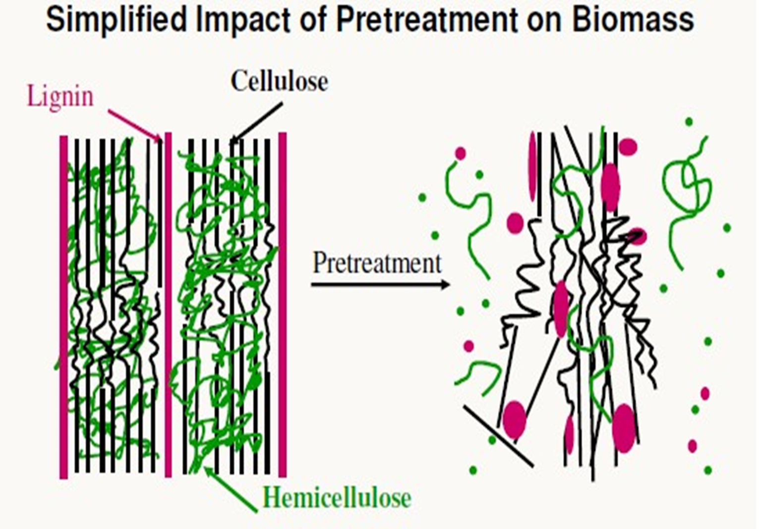
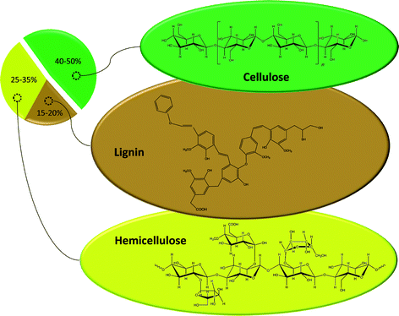
Sugarcane Bagasse (SB)
Effect of pretreatment on SB
Composition analysis of SB
Source: Kumar et al. 2009
Source: Alonso et al. 2010

Slide 7

Levulinic Acid
Levulinic acid (LA) (4-oxopentanoic acid) also known as 3-acetypropionic acid, is a linear C5-alkyl carbon chain containing one carboxylic acid group in position 1 and one carbonyl group in position 4. The structure of LA is given in Fig. 1.
Figure 1. Molecular structure of levulinic acid

Slide 8
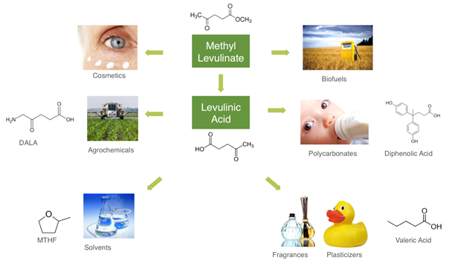
Levulinic Acid Applications
Source: Avantium.com

Slide 9
LA market volume share by applications
Source: Grandviewresearch.com

Slide 10
Methodology
LHW Pretreatment
Enzymatic hydrolysis
3 L reactor
1 kg of pelletized bagasse
Temp.: 200 °C
Time: 30 min
Volume flow: 250 ml/min
10 L glass reactor
Bagasse/water: 1:10
Temp.: 50 °C
Time: 72 hr.
pH: 4.8
Enzyme activity: 15 FPU (Cellic Ctech 2)

Slide 11
Levulinic Acid Production
Glucose solution
Cellulignin
30 ml reactor
Substrate: 0,24 M (glucose solution, pure glucose, glucose/xylose, fructose)
Temp.: 180 °C
Time: 45 min.
Catalyst: 0,5 M (H₂SO₄, MSA)
30 ml reactor
Substrate: 1,7 wt% (Cellulignin, pure Cellulose)
Temp.: 150 °C
Time: 120 min.
Catalyst: 1 M (MSA)

Slide 12
Results and Discussion

Slide 13
LHW pretreatment for sugarcane bagasse

Slide 14
Hydrolysate from LHW
Table 1: Hydrolysate composition from LHW
 | Monomer (mg/L) | Oligomers (mg\L)
Cellobiose | <50 | 460
Glucose | 115 | 1200
Xylose | 1400 | 21300
Arabinose | 1100 | 2300
Formic acid | <50 | <100
Acetic acid | 1100 | 3700
Levulinic acid | <50 | <100
HMF | <50 | <100
Furfural | 370 | 570
Hydrolysate
pH value: 3.83
Density: 1.012 g.cm⁻³ at 20 °C

Slide 15
Enzymatic hydrolysis

Slide 16
Glucose solution
Table 2: Compositional analysis of the liquid fraction obtained after enzymatic hydrolysis
Test for glucose solution
DNS for reducing sugars: 52.2 g/L
Glucose kit : 42.7 g/L
Xylose kit : 9.03 g/L
 | Monomers (mg/L) | Oligomers (mg\L)
Cellobiose | 1500 | 730
Glucose | 42800 | 44000
Xylose | 9600 | 11700
Arabinose | 500 | 600
Formic acid | 500 | 0.0
Acetic acid | 2600 | 0.0
Levulinic acid | <50 | 0.0
HMF | 60 | 160
Furfural | 400 | 550

Slide 17
Table 3: Glucose solution and other substrate hydrolysed with H₂SO₄ to produce LA
No. | Sample | Cellobiose | Glucose | Xylose | Arabinose | Formic Acid | Acetic Acid | Levulinic acid | HMF | Furfural
 |  | mg/l | mg/l | mg/l | mg/l | mg/l | mg/l | mg/l | mg/l | mg/l
1 | Fructose | < 50 | < 50 | < 50 | < 50 | 8100 | 340 | 17700 | < 50 | < 50
2 | Glucose | < 50 | < 50 | < 50 | < 50 | 6875 | 265 | 14450 | < 50 | < 50
3 | Glucose and xylose | < 50 | 185 | 75 | < 50 | 7600 | 305 | 15000 | < 50 | 235
4 | Glucose Solution | < 50 | 240 | 180 | 65 | 8550 | 2825 | 15900 | < 50 | 290

Slide 18
Acid hydrolysis (sulphuric acid) of the glucose solution

Slide 19
Table 4: Glucose solution and other substrate hydrolysed with MSA to produce LA
No. | Sample | Cellobiose | Glucose | Xylose | Arabinose | Formic Acid | Acetic Acid | Levulinic acid | HMF | Furfural
 |  | mg/l | mg/l | mg/l | mg/l | mg/l | mg/l | mg/l | mg/l | mg/l
1 | Fructose | < 50 | < 50 | 70 | < 50 | 8025 | 355 | 17450 | < 50 | < 50
2 | Glucose | < 50 | 725 | 65 | < 50 | 6725 | 230 | 13800 | <50 | < 50
3 | Glucose and xylose | < 50 | 160 | 105 | < 50 | 7050 | 295 | 13650 | < 50 | 260
4 | Glucose Solution | < 50 | 275 | 225 | < 50 | 8175 | 2775 | 14900 | < 50 | 290

Slide 20
Acid hydrolysis (MSA) of the glucose solution

Slide 21
Design of Experiments (DoE)
Stat-Ease Design-Expert 8.0.7.1 was used for the experimental design and analysis. Set-up and analysis of the designs were conducted according to the standard procedure implemented in the software. DoE provides a set of powerful tools for the effective planning and evaluation of experimental designs by minimizing the number of required experiments
Table 5: Parameters used for optimization LA production
Parameter | Minimum | Maximum
Temperature | 160 °C | 200 °C
Reaction time | 30 min | 90 min
Acid | 0.25 M | 1.0 M

Slide 22
Table 6 (a) : Optimization of LA production
Run | Temperature [ ºC] | Time [min] | Acid [M] | Levulinic acid (mg/L)
1 | 180 | 60 | 0.131 | 11000
2 | 180 | 60 | 0.625 | 16000
3 | 160 | 90 | 0.250 | 11000
4 | 153.7 | 60 | 0.625 | 12000
5 | 160 | 90 | 1.000 | 17000
6 | 200 | 30 | 1.000 | 16000
7 | 180 | 60 | 0.625 | 16000
8 | 180 | 99.5 | 0.625 | 18000
9 | 180 | 60 | 0.625 | 17000
10 | 200 | 30 | 0.250 | 16000
11 | 180 | 60 | 0.625 | 16000
12 | 206.3 | 60 | 0.625 | 16000
13 | 180 | 20.5 | 0.625 | 16000
14 | 160 | 30 | 1.000 | 12000
15 | 180 | 60 | 0.625 | 19000
16 | 200 | 90 | 0.250 | 15000
17 | 160 | 30 | 0.250 | 3000
18 | 180 | 60 | 1.119 | 16000
19 | 200 | 90 | 1.000 | 17000
20 | 180 | 60 | 0.625 | 17000

Slide 23
Table 6 (b): Optimization of LA production
Sample | Cellobiose | Glucose | Xylose | Arabinose | Formic acid | Acetic acid | Levulinic acid | HMF | Furfural
 | mg/l | mg/l | mg/l | mg/l | mg/l | mg/l | mg/l | mg/l | mg/l
431 | 170 | 14500 | 930 | < 50 | 5900 | 290 | 11000 | 810 | 2300
432 | < 50 | < 50 | 210 | < 50 | 7400 | 290 | 16000 | < 50 | < 50
433 | 140 | 16500 | 930 | < 50 | 6000 | 290 | 11000 | 560 | 1800
434 | 220 | 15000 | 800 | < 50 | 5700 | 260 | 12000 | 410 | 1300
435 | < 50 | 370 | 190 | < 50 | 7900 | 280 | 17000 | < 50 | < 50
436 | < 50 | < 50 | 160 | < 50 | 6400 | 300 | 16000 | < 50 | < 50
437 | < 50 | < 50 | 250 | < 50 | 7400 | 280 | 16000 | < 50 | < 50
438 | < 50 | < 50 | 230 | < 50 | 7600 | 300 | 18000 | < 50 | < 50
439 | < 50 | < 50 | 230 | < 50 | 7800 | 290 | 17000 | < 50 | < 50
440 | 95 | 260 | 260 | < 50 | 7800 | 300 | 16000 | < 50 | 860
441 | < 50 | < 50 | 210 | < 50 | 7900 | 300 | 16000 | < 50 | < 50
442 | < 50 | < 50 | 190 | < 50 | 4700 | 320 | 16000 | < 50 | < 50
443 | < 50 | < 50 | 160 | < 50 | 7800 | 290 | 16000 | < 50 | < 50
444 | < 50 | 13000 | 670 | < 50 | 5600 | 270 | 12000 | 360 | 1400
445 | < 50 | < 50 | 180 | < 50 | 8500 | 300 | 19000 | < 50 | 130
446 | < 50 | < 50 | 220 | < 50 | 6500 | 310 | 15000 | < 50 | < 50
447 | 575 | 33500 | 5160 | 529 | 2300 | 270 | 3000 | 920 | 2400
448 | < 50 | < 50 | 170 | < 50 | 7100 | 300 | 16000 | < 50 | < 50
449 | < 50 | < 50 | 130 | < 50 | 3700 | 310 | 17000 | < 50 | < 50
450 | < 50 | < 50 | 170 | < 50 | 7800 | 300 | 17000 | < 50 | < 50

Slide 24
Production of LA from cellulignin
Table 7: Production of LA from cellulignin and pure cellulose using MSA
No. | Sample | Cellobiose | Glucose | Xylose | Arabinose | Formic Acid | Acetic Acid | Levulinic acid | HMF | Furfural
 |  | mg/l | mg/l | mg/l | mg/l | mg/l | mg/l | mg/l | mg/l | mg/l
1 | Cellulignin (LHW) | < 50 | 1075 | < 50 | < 50 | 940 | 215 | 1875 | < 50 | < 50
2 | Cellulose (pure) | < 50 | 2400 | <50 | < 50 | 1625 | 65 | 3250 | < 50 | < 50

Slide 25
Conclusion
LHW dissolved hemicellulose although 11 % of hemicellulose remained in cellulignin, this method is more preferred because it only uses water and the reaction time of 1 hr.
Enzymatic hydrolysis converted cellulose into glucose solution with a concentration of 42.7 g/L.
In comparing sulphuric acid and MSA, a slightly difference of 2.3 % was observed, therefore MSA can be used for the production of LA because it is more environmentally friendly, less toxic and less corrosive compared to H₂SO_{4.}
When LA was produced from glucose solution at 180 ºC, with 0.625 M of MSA for 60 min, gave the highest yield of 19000 mg\L compared with other parameters that were used for the optimisation of LA production.

Slide 26
Acknowledgements
I would like to thank the following for assisting me in this work:
My supervisor, Prof Nirmala Deenadayalu and Co-supervisor, Dr Prashant Reddy
Lisa Schmidt , Dr Carsten Zetzl and Prof Irina Smirnova from TUHH
Alpha and Omega
My family
Technische Universität Hamburg-Harburg (TUHH) , Institute of Thermal Separation Processes for providing the facilities to carry out the present work
And NRF for funding this project
DUT for providing me with the opportunity to pursue my studies

Slide 27

Thank you for listening Ngiyabonga

